Slide 1
Loan Prediction
Presented by,
ANDREWS HIMAKIRAN P

Slide 2
Loan prediction case study
Business Objective:
To predict/AnalyzeWhether the customer will fall under default or not.
In this project basing on various attributes which is given to us we have to say whether the customer is able to pay the loan which he/she takes from the respective bank.

Slide 3
Various attributes in the given dataset are
Name
City
State
Zip
Bank
BankState
CCSC
ApprovalDate
ApprovalFY
Term
NoEmp
NewExist
CreateJob
RetainedJob
FranchiseCode
UrbanRural
RevLineCr
LowDoc
ChgOffDate
DisbursementDate
DisbursementGross
BalanceGross
MIS_Status
ChgOffPrinGr
GrAppv
SBA_Appv

Slide 4
Number of columns and number of rows in the dataset:
Rows – 1,50,000
Columns – 26 ( A – Z )

Slide 5
Number of numerical, categorical, currency and date columns
Categorical Columns – 14
Numerical Columns – 4
Date columns – 3
Currency columns - 3

Slide 6
Various categorical columns
Name
City
State
Zip
Bank
Bank State
CCSC
Approval FY
New Exist
Franchise Code
Urban Rural
RevLineCr
Low Doc
MIS_Status

Slide 7
Various Numerical columns
Term
No Emp
Create Job
Retained Job
VARIOUS CURRENCY COLUMNS
Disbursement Gross
Balance Gross
VARIOUS DATE COLUMNS
Approval Date
ChgOff Date
Disbursement Date

Slide 8
Total number of distinct organization names
select distinct Name from loansprediction;;
139558
Total number of distict city names
select distinct City from loansprediction;
14808
Total number of distinct state
select distinct State from loansprediction;
7472
Number of Unique Zip
select distinct Zip from loansprediction;
17212
Number of Unique Bank
select distinct Bank from loansprediction;
15178
Number of unique BankState
select distinct BankState from loansprediction;
2883
Number of unique CCSC
select distinct CCSC from loansprediction;
1189
Number of unique ApprovalDate
select distinct ApprovalDate from loansprediction;
3480
Number of unique ApprovalFY
select distinct ApprovalFY from loansprediction;
690

Slide 9
Total amount of loan amount disbursed for all the employees
select sum(DisbursementGross) from loansprediction;
1672085
Total loan amount which has to be collected from all the employees
select sum(BalanceGross) from loansprediction;
15624858
Total count of high risk customers who are considered to be as loan defaulters
=COUNTIF(W2:W150000,"CHGOFF")
39008
Total count of customers who are considered to be as loan payees
=COUNTIF(W2:W150000,"P I F")
110123
Total guaranteed amount of loan approval
select sum(SBA_Appv) from loansprediction;
10654333
Total Charged-off Amount
select sum(ChgOffPrinGr) from loansprediction;
1168988

Slide 10
Total number of all employees
select sum(NoEmp) from loansprediction;
21440296
Total count of existing business customers
=COUNTIF(L2:L150000,"1")
101813
Total count of new business customers
=COUNTIF(L2:L150000,"2")
48058
Total number of all created jobs
select sum(CreateJob) from loansprediction;
275592
Total number of all retained jobs
select sum(RetainedJob) from loansprediction;
368558
Total count of undefined employees neither rural nor urban
=COUNTIF(P2:P150000,"0")
51507
Total count of urban employees
=COUNTIF(P2:P150000,"1")
81799
Total count of rural employees
=COUNTIF(P2:P150000,"2")
16693

Slide 11
Number of null values in each column
loans.isnull().sum()
Name 8
City 1
State 2
Zip 0
Bank 147
BankState 148
CCSC 0
ApprovalDate 0
ApprovalFY 0
Term 0
NoEmp 0
NewExist 0
CreateJob 0
RetainedJob 0
FranchiseCode 0
UrbanRural 0
RevLineCr 23
LowDoc 0
ChgOffDate 109533
DisbursementDate 225
DisbursementGross 0
BalanceGross 0
MIS_Status 868
ChgOffPrinGr 0
GrAppv 0
SBA_Appv 0

Slide 12
In NAME column these rows consists of missing values
loans[loans.Name.isnull()]
272, 409, 465, 466, 51439, 82751, 103696, 143179
In CITY column these rows consists of missing values
loans[loans.City.isnull()]
42535
In STATE column these rows consists of missing values
loans[loans.State.isnull()]
35517, 49244
In BANK column number of rows consists of missing values
loans[loans.Bank.isnull()]
147
In BANKSTATE column number of rows consists of missing values
loans[loans.BankState.isnull()]
148
In RevLineCr column number of rows consists of missing values
loans[loans.RevLineCr.isnull()]
23
In ChgOffDate column number of rows consists of missing values
loans[loans.ChgOffDate.isnull()]
109533
In DisbursementDate column number of rows consists of missing values
loans[loans.DisbursementDate.isnull()]
255
In MIS_Status column number of rows consists of missing values
loans[loans.MIS_Status.isnull()]
868

Slide 13
Python command to find value counts of each column
loans['City'].value_counts()
loans['State'].value_counts()
loans['Name'].value_counts()
loans['Zip'].value_counts()
loans['Bank'].value_counts()
loans['BankState'].value_counts()
loans['CCSC'].value_counts()
loans['ApprovalDate'].value_counts()
loans['ApprovalFY'].value_counts()
loans['Term'].value_counts()
loans['NoEmp'].value_counts()
loans['NewExist'].value_counts()
loans['CreateJob'].value_counts()
loans['RetainedJob'].value_counts()
loans['FranchiseCode'].value_counts()
loans['UrbanRural'].value_counts()
loans['RevLineCr'].value_counts()
loans['LowDoc'].value_counts()
loans['ChgOffDate'].value_counts()
loans['DisbursementDate'].value_counts()
loans['DisbursementGross'].value_counts()
loans['BalanceGross'].value_counts()
loans['MIS_Status'].value_counts()
loans['ChgOffPrinGr'].value_counts()
loans['GrAppv'].value_counts()
loans['SBA_Appv'].value_counts()

Slide 14
Python command to find value counts of all columns together using for loop
for col in loans.columns:
display(loans[col].value_counts())
If we drop the rows which consists of missing values in any of the column then the shape is like this
loannew.dropna(how='any').shape
(40224, 26)

Slide 15
Describing each column
loannew.Name.describe()
count 149991
unique 140883
top SUBWAY
freq 78
Name: Name, dtype: object
loannew.City.describe()
Count 149998
Unique 15792
top LOS ANGELES
freq 1902
Name: City, dtype: object
loannew.State.describe()
count 149997
Unique 51
top CA
Freq 19314
Name: State, dtype: object

Slide 16
loannew.Zip.describe()
count 149999.000000
mean 49849.046527
std 31159.635854
Min 0.000000
25% 20854.000000
50% 48053.000000
75% 80003.000000
max 99999.000000
Name: Zip, dtype: float64
loannew.Bank.describe()
count 149852
unique 2932
top BANK OF AMERICA NATL ASSOC
freq 28023
Name: Bank, dtype: object
loannew.BankState.describe()
count 149851
unique 52
top NC
freq 26847
Name: BankState, dtype: object

Slide 17
loannew.CCSC.describe()
count 149999.000000
mean 401567.535270
std 256946.069805
min 0.000000
25% 236118.000000
50% 447110.000000
75% 561612.000000
max 928120.000000
Name: CCSC, dtype: float64
loannew.ApprovalDate.describe()
count 149999
unique 2548
top 1997-09-30 00:00:00
freq 466
first 1961-07-12 00:00:00
last 2006-12-10 00:00:00
Name: ApprovalDate, dtype: object
loannew.ApprovalFY.describe()
count 149999.000000
mean 2002.302889
std 5.212507
min 1962.000000
25% 1998.000000
50% 2005.000000
75% 2006.000000
max 2007.000000 Name: ApprovalFY, dtype: float64

Slide 18
loannew.Term.describe()
count 149999.000000
mean 93.010887
std 69.306154
min 0.000000
25% 57.000000
50% 84.000000
75% 84.000000
max 480.000000
Name: Term, dtype: float64
loannew.NoEmp.describe()
count 149999.000000
mean 9.313749
std 78.956632
min 0.000000
25% 2.000000
50% 4.000000
75% 8.000000
Max 9999.000000
Name: NoEmp, dtype: float64
loannew.NewExist.describe()
count 149999.000000
mean 1.319535
std 0.468125
Min 0.000000
25% 1.000000
50% 1.000000
75% 2.000000
max 2.000000
Name: NewExist, dtype: float64

Slide 19
loannew.CreateJob.describe()
count 149999.000000
mean 1.278455
std 10.958749
Min 0.000000
25% 0.000000
50% 0.000000
75% 0.000000
max 3000.000000
Name: CreateJob, dtype: float64
loannew.RetainedJob.describe()
count 149999.000000
mean 3.685918
std 27.679464
min 0.000000
25% 0.000000
50% 1.000000
75% 4.000000
max 9500.000000
Name: RetainedJob, dtype: float64
loannew.FranchiseCode.describe()
count 149999.000000
mean 1655.999787
std 9956.791183
Min 0.000000
25% 0.000000
50% 1.000000
75% 1.000000
max 91999.000000
Name: FranchiseCode, dtype: float64

Slide 20
loannew.UrbanRural.describe()
count 149999.000000
mean 0.767905
std 0.633091
min 0.000000
25% 0.000000
50% 1.000000
75% 1.000000
max 2.000000
Name: UrbanRural, dtype: float64
loannew.RevLineCr.describe()
count 149976
unique 7
top N
freq 71611
Name: RevLineCr, dtype: object
loannew.LowDoc.describe()
count 149999
unique 4
Top N
freq 137871
Name: LowDoc, dtype: object
loannew.ChgOffDate.describe()
count 40466
unique 4234
top 2010-03-13 00:00:00
freq 201
first 1988-01-11 00:00:00
last 2014-12-08 00:00:00
Name: ChgOffDate, dtype: object

Slide 21
loannew.DisbursementDate.describe()
count 149774
unique 1962
top 2006-05-31 00:00:00
freq 6220
first 1948-09-17 00:00:00
last 2013-01-06 00:00:00
Name: DisbursementDate, dtype: object
loannew.DisbursementGross.describe()
count 149999
unique 38747
top $50,000.00
freq 10214
Name: DisbursementGross, dtype: object
loannew.BalanceGross.describe()
count 149999
unique 3
top $0.00
freq 149997
Name: BalanceGross, dtype: object
loannew.MIS_Status.describe()
count 149131
unique 2
top P I F
freq 110123
Name: MIS_Status, dtype: object

Slide 22
loannew.ChgOffPrinGr.describe()
count 149999
unique 28116
top $0.00
freq 109702
Name: ChgOffPrinGr, dtype: object
loannew.GrAppv.describe()
count 149999
unique 5986
top $50,000.00
freq 17500
Name: GrAppv, dtype: object
loannew.SBA_Appv.describe()
count 149999
unique 8220
top $25,000.00
freq 15063
Name: SBA_Appv, dtype: object

Slide 23
loannew.skew()
Zip 0.043240
CCSC -0.294294
ApprovalFY -1.820957
Term 1.635568
NoEmp 85.345185
NewExist 0.749068
CreateJob 153.805054
RetainedJob 280.376475
FranchiseCode 6.564306
UrbanRural 0.234411
dtype: float64
loannew.var()
Zip 9.709229e+08
CCSC 6.602128e+10
ApprovalFY 2.717023e+01
Term 4.803343e+03
NoEmp 6.234150e+03
NewExist 2.191407e-01
CreateJob 1.200942e+02
RetainedJob 7.661527e+02
FranchiseCode 9.913769e+07
UrbanRural 4.008043e-01
dtype: float64

Slide 24
loannew.kurtosis()
Zip -1.359245
CCSC -0.941827
ApprovalFY 4.043594
Term 2.105555
NoEmp 8392.107414
NewExist -1.368378
CreateJob 38317.941544
RetainedJob 93595.388301
FranchiseCode 43.797513
UrbanRural -0.650376
dtype: float64

Slide 25
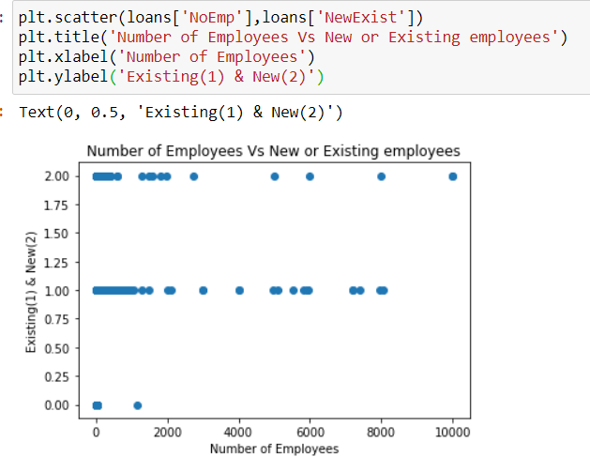
Various plottings using python

Slide 26
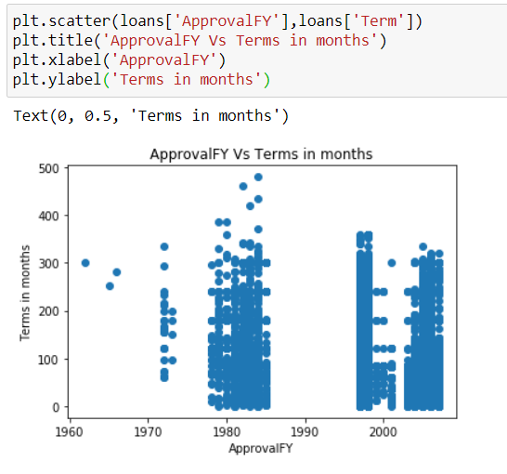

Slide 27
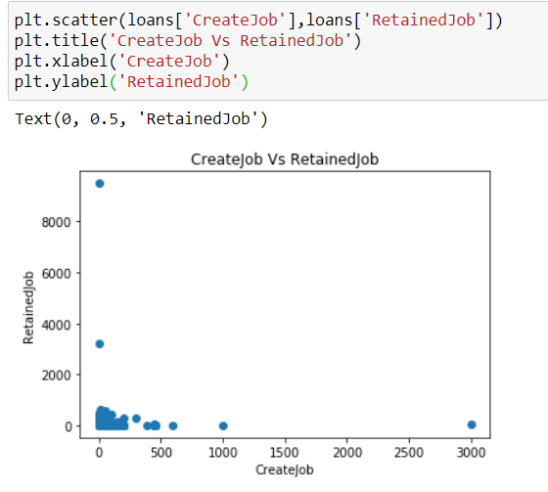

Slide 28
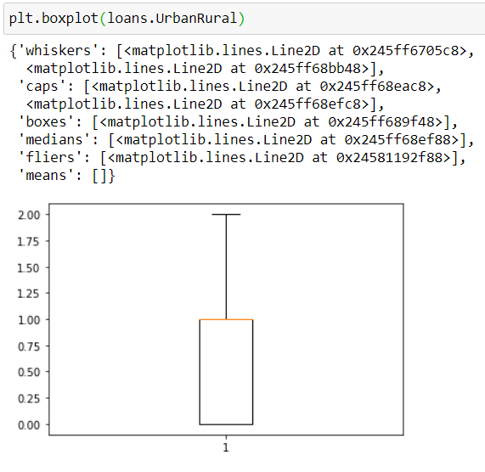

Slide 29
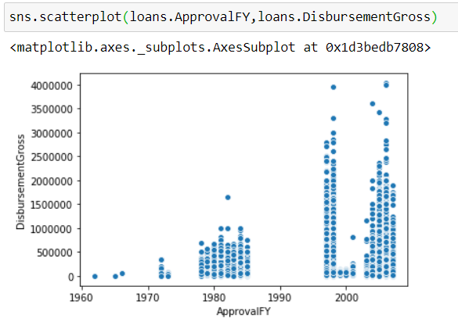
Scatterplot between approval Year and amount disbursed

Slide 30
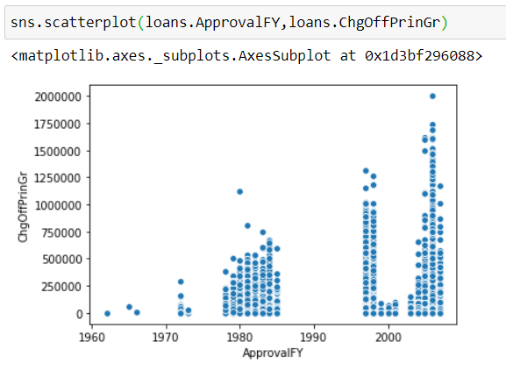
Scatterplot between approval year and chargedoff amount

Slide 31
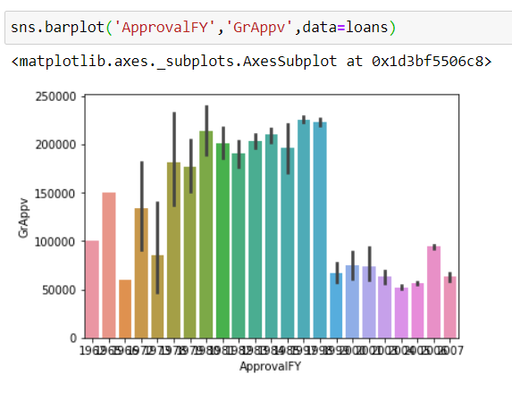
Barplot between approval Year and gross amount of loan approved by bank

Slide 32
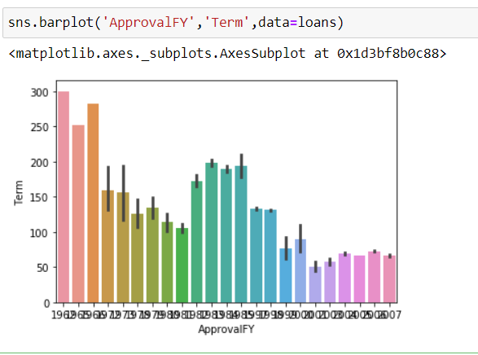
Barplot between approval year and loan term in months

Slide 33
TABLEAU VISUALIZATIONS

Slide 34
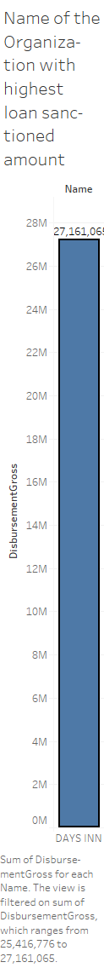
Name of the organization with highest loan amount

Slide 35
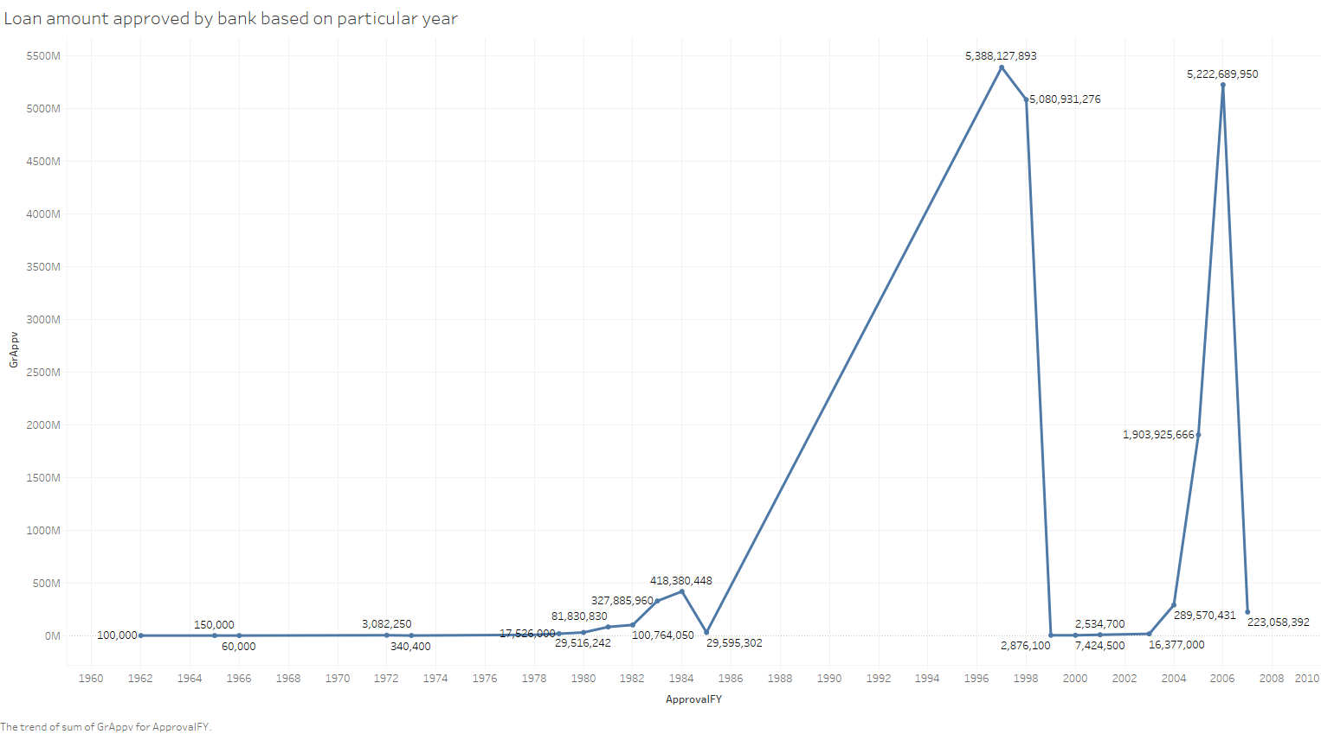

Slide 36
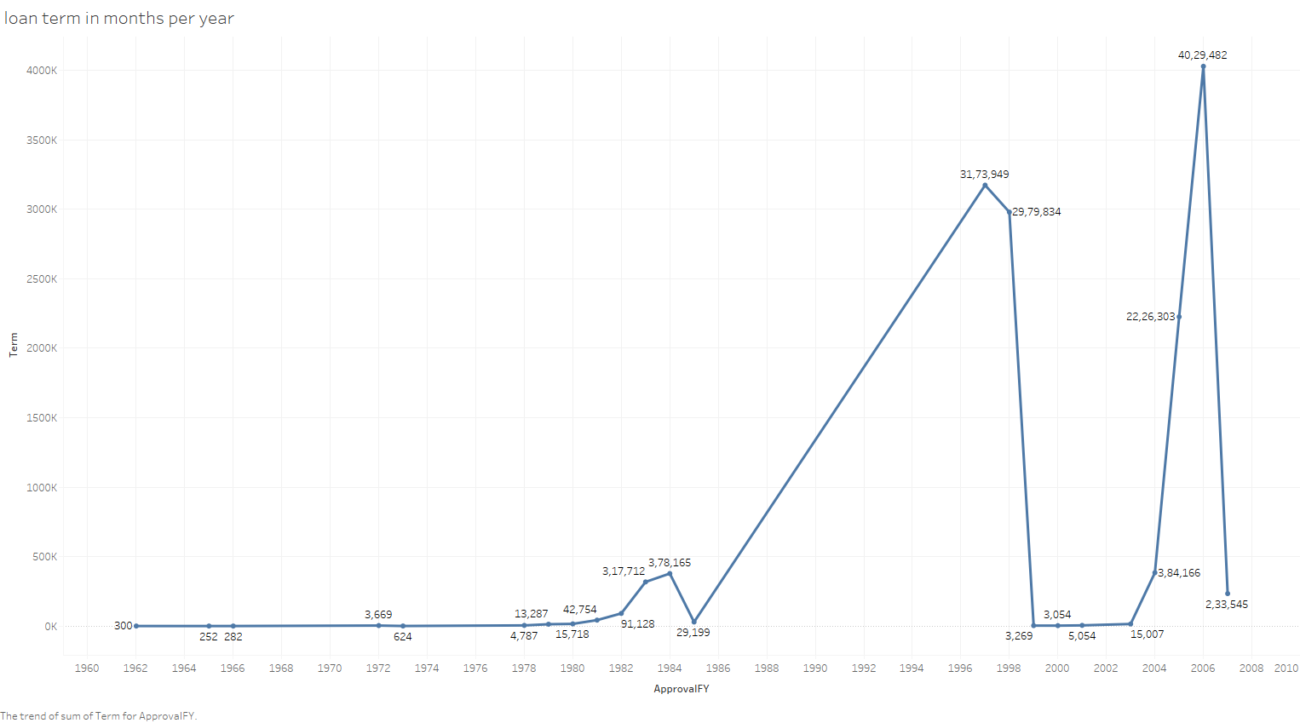

Slide 37
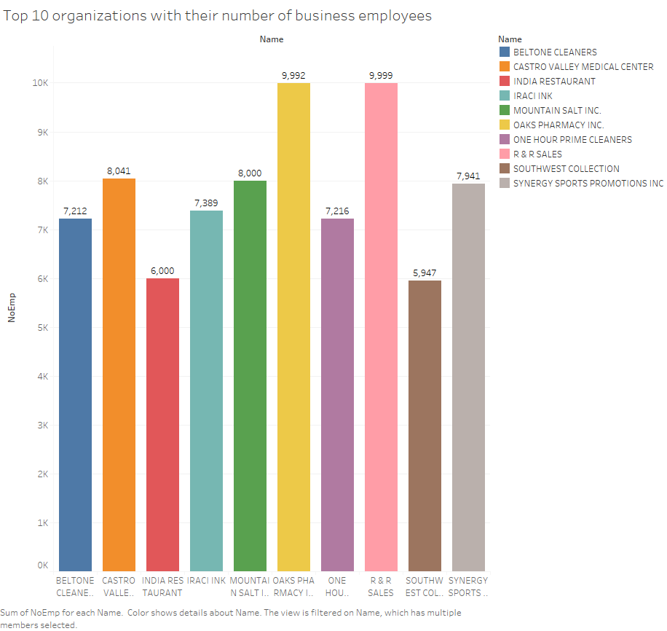

Slide 38
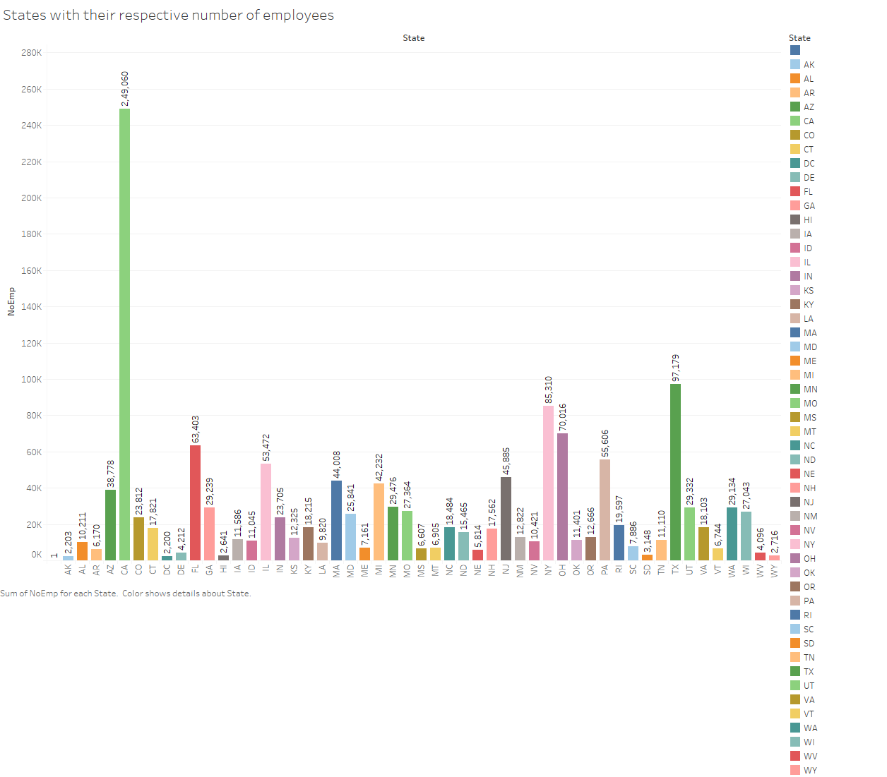

Slide 39
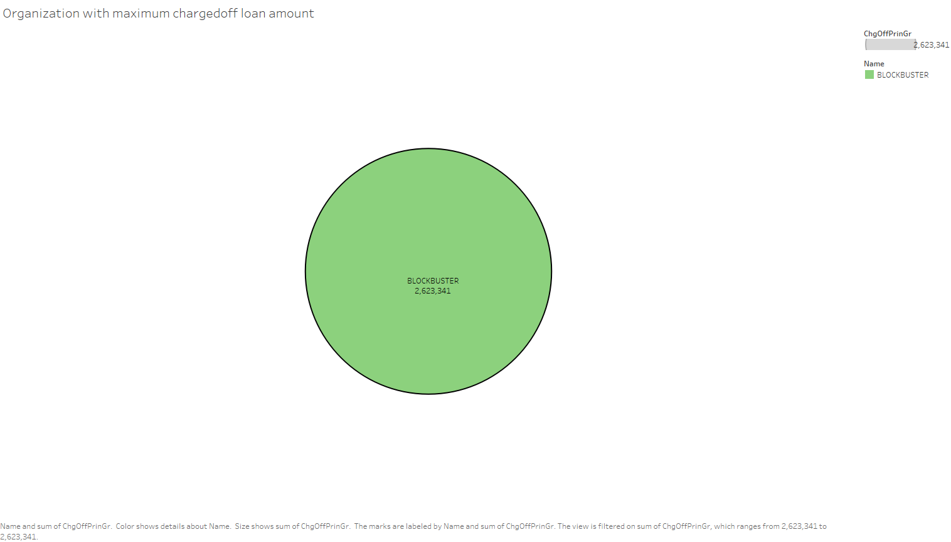

Slide 40
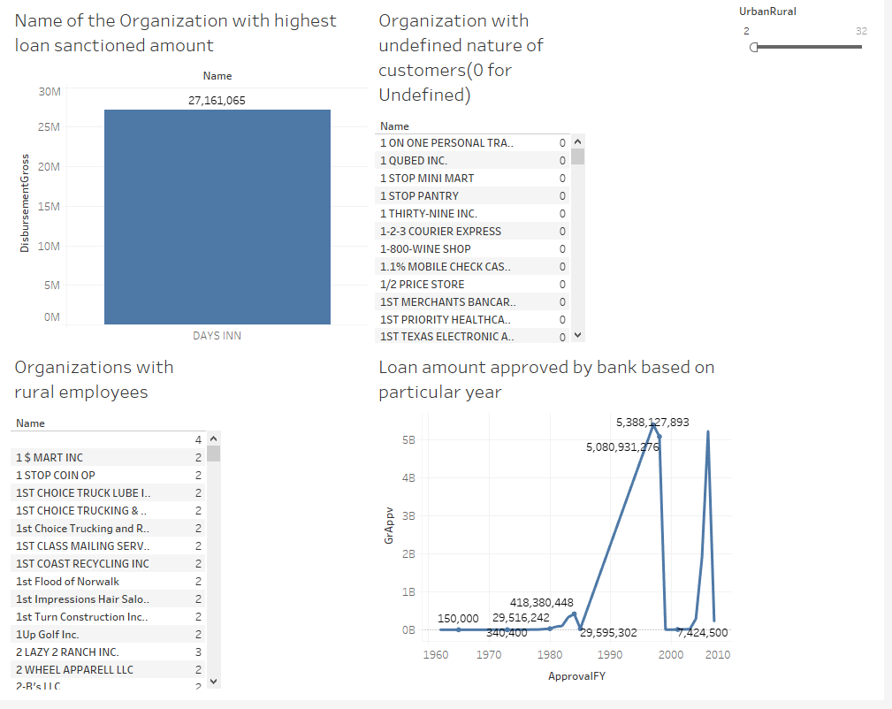

Slide 41
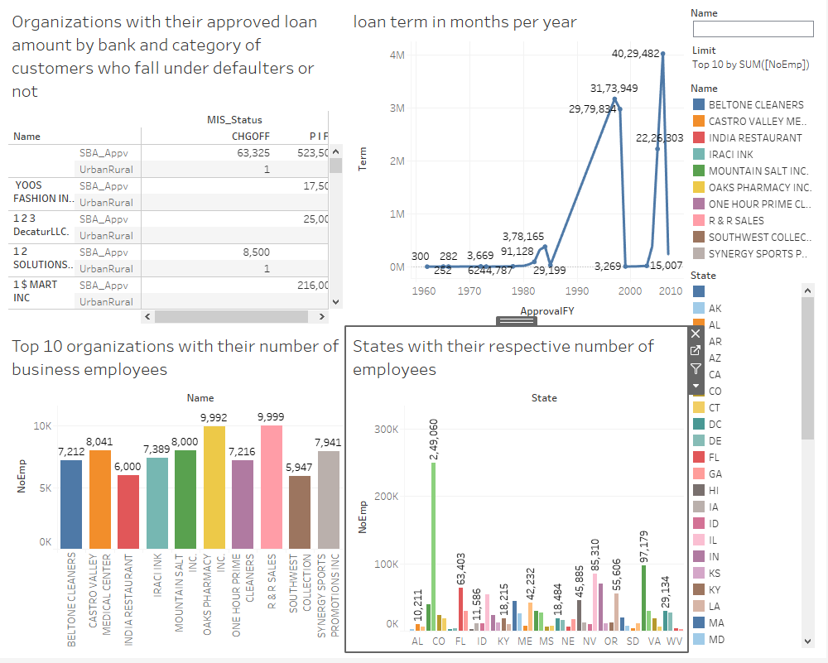

Slide 42
