Slide 1
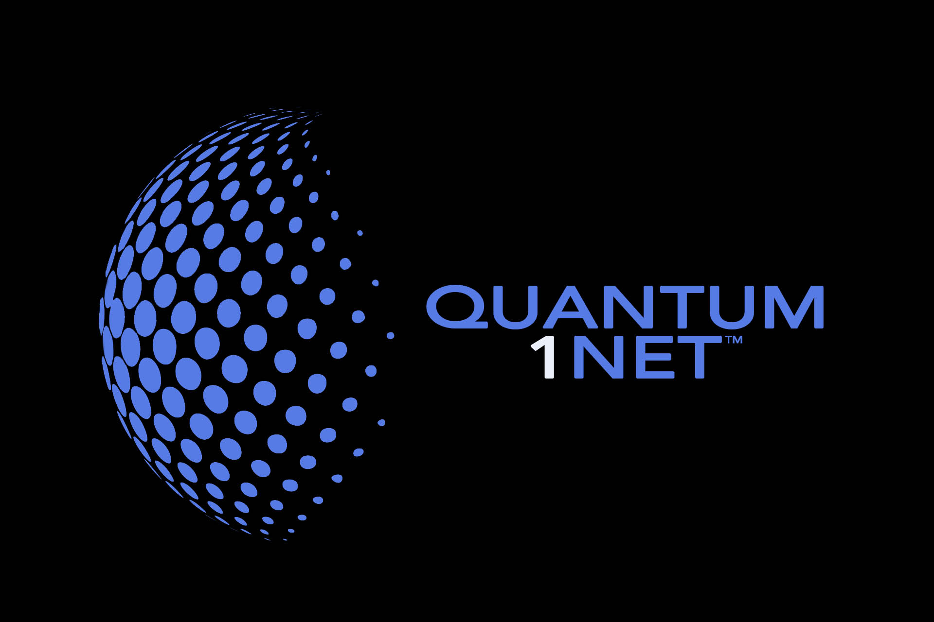

Slide 2
SUMMARY
The Problem
RSA is 40 years old, and made for a time where traditional computers struggled to do complex mathematical calculations quickly, and could only do one at a time.
Quantum computing poses the single greatest threat to RSA thanks to its capability to multiple calculations at the same time.
The Solution
Quantum1Net is leveraging quantum computing to develop an encryption platform that is impervious to attack.
The Quantum Encryption Key Generator produces truly random computationally irreducible keys that are impossible for even other quantum computers to crack through pattern recognition techniques.
The ICO
Our ICO is a three phase effort, with our Silver Token initially aimed at funding development and the initial build-out of the network.
Our Gold Token release will include the QEK as proof of concept of Quantum1Net’s technology, and fund the company for the long term.

Slide 3
WHY RSA HASN’T BEEN CRACKED
Factoring large numbers is a difficult process, and that’s the basis of RSA encryption keys
Large amount of computing power is needed to do so, and it takes a lot of time: hundreds of machines and two years just to crack a 768-bit (232 digit) number
Hackers don’t have patience or resources to crack RSA, and there’s easier targets
The limitations of traditional computing

Slide 4
QUANTUM COMPUTING CHANGES EVERYTHING
Traditional computers work by storing bits with a value of either 0 or 1, and only one calculation can be done at a time
Quantum computers work on the premise of subatomic particles being able to exist in superposition of states and share information via quantum entanglement
This allows quantum bits (qubits) to store massive amounts of data at the same time, and calculations are significantly quicker

Slide 5
RSA AND QUANTUM COMPUTING
Quantum computers should and will be able to factor complex numbers quickly
At current pace, a quantum computer capable of breaking RSA-2048 in minutes is likely by 2030 at a cost of $1 billion USD
Quantum computers capable of cracking RSA in days or weeks is much closer
It’s an expensive process, but priceless to whomever does it first

Slide 6

INTRODUCING QUANTUM1NET
Cryptography for the Post-Quantum World

Slide 7
THE PROBLEM WITH RSA KEYS
RSA generates a key using what is called a pseudo random number generator (PRNG)
As the name suggests, it’s not truly random: our own testing found a pattern can be deduced after ~10,000 runs
This pattern can then be used to predict future behavior, which quantum computers can use to crack a PRNG

Slide 8
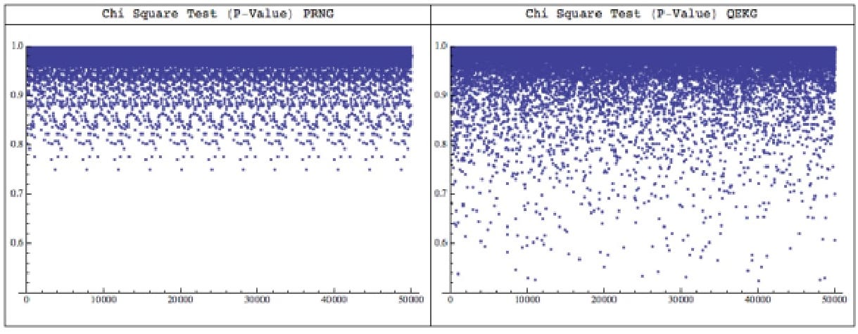
LAB TEST EXAMPLE
The image above illustrates the difference between PRNG (left) and Quantum random number generator (right). It shows 50,000 runs of 20,000 random bits each. The repetitive pattern of PRNG is obvious, while no pattern emerges when using QRNG.

Slide 9
THE QUANTUM ENCRYPTION KEY
The properties of quantum computers allow for more truly random number selection
QRNGs use properties of quantum entanglement process to produce a number
Quantum1Net’s QRNG produces QEKs with just a single qubit quantum computer
QEKs can also protect other public-key encryption platforms (Diffie-Hellman, elliptic curve) from quantum attacks

Slide 10
QUANTUM1NET: ROADMAP AND ICO

Slide 11
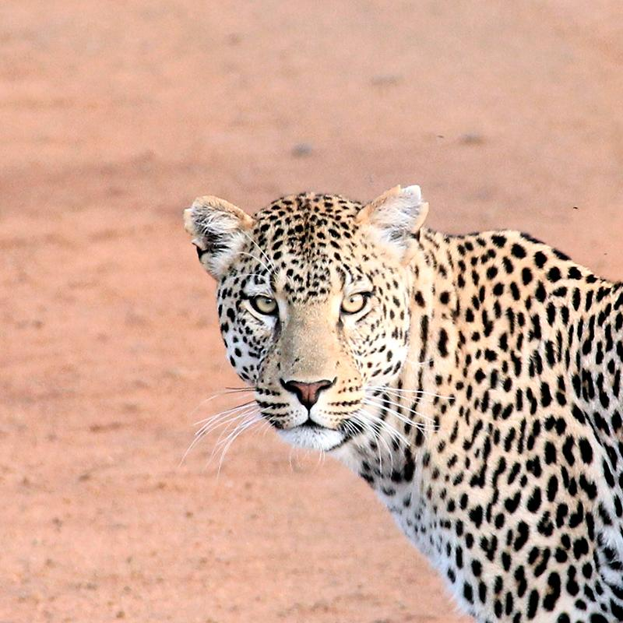
QUANTUM1NET LEADERSHIP TEAM
Mattias Bergstrom
CEO
Patent holder
Stan Miasnikov
CTO
Patent holder
Mats Jagmalm
Crypto Currency
Expert
Thomas Olofsson
Security
lead
Joseph Fernandez
Physics
guy
Andreas Tibblin
Creative
Marketing
Michael Johnson
Strategic
Marketing

Slide 12
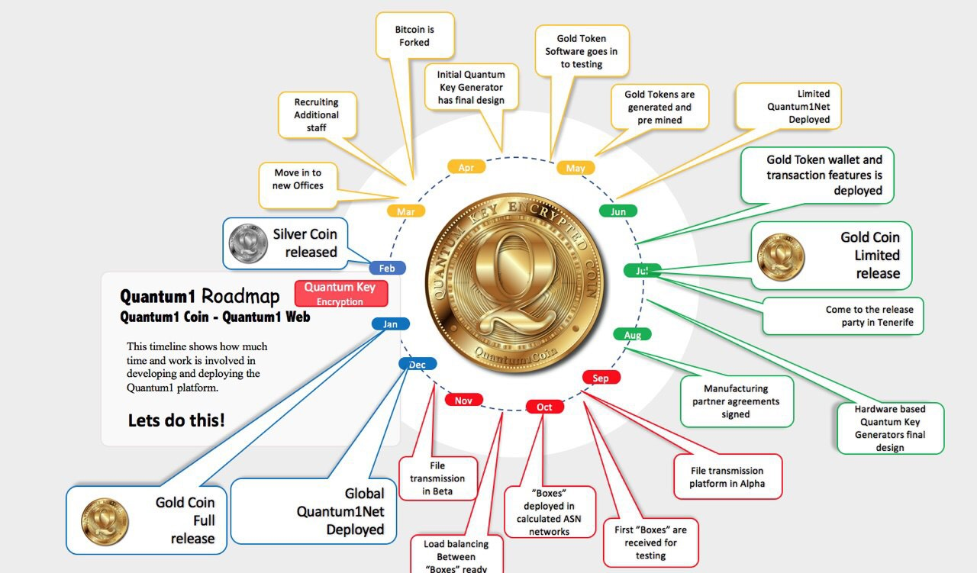
QUANTUM1NET ROADMAP

Slide 13
ICO TIMELINE
First Token Sale: Silver Convertible Token
February 2018
Ethereum-based
Convertible to Gold Token at 20% discount
Sale capped at €15 million
Goals
Supports move to new office to centralize development
Hiring new developers to meet May 2018 limited Quantum1Net release

Slide 14
ICO TIMELINE
Second Token Sale: Gold Token (Restricted)
July 2018
Bitcoin-based, include QEK
Silver Token investors get priority
Sale capped at €18 million
Goals
Offer proof-of-concept of our QEK, this token will include quantum encryption
Supports development of hardware and file transmission platform

Slide 15
ICO TIMELINE
Third Token Sale: Gold Token (Open)
January 2019
Bitcoin-based, QE enabled
Silver Token investors that converted in July 2018 sale can participate at 5% discount
Sale capped at €200 million
Goals
Supports Quantum1Net long term
Supports development and use outside of cryptocurrency

Slide 16
PRIMARY POTENTIAL RISKS
Technological
Quantum computing is a nascent technology, and significant hurdles remain.
Quantum1Net relies on technology, and issues with these technologies may prevent use of tokens.
Quantum1Net is secure by nature, but we cannot assure token users that they may not be affected by third-party attacks.
Regulatory
Cryptocurrency is new and largely unregulated.
Some jurisdictions are already restricting and/or banning the sale and use of ICOs. Buyers must heed all local regulations.
ICOs may be subject to local taxes.
We reserve the right to modify the ICO and/or token to ensure compliance with securities law.
Economic
Success of Quantum1Net and the ICO are subject to economic conditions, just like any other investment.
Participation is seen as acceptance of such risk.
Volatility in the value of Ethereum and Bitcoin also plays a role in the value of Quantum1Net tokens.

Slide 17
WHITE PAPER
For more information, download our white paper
WHITE PAPER COVER IMAGE
HERE

Slide 18
Thanks!
ANY QUESTIONS?
You can find me at
@username
user@mail.me

