Slide 1
Customer Relationship ManageMEnt
VIGNESH V. 312018104071
ANDREWS D EDBERG. 312018104007
ANISUR RAHMAN. 312018104008
JERIS BABIYO. 312018104027

Slide 2
Overview Of The Project
>Abstract
>Introduction
>Existing System
>Limitations of Existing System
>Proposed System
>Advantages of Proposed System
>Modules
>Data Flow ER Diagram
>Use Case diagram
>Output Screenshots
>Conclusions
>References(IEEE Format)

Slide 3
ABSTRACT
>Customer Relationship Manager(CRM) is a combination of people,processes and technology that seeks to understand a company's customers.
>It is an integrated approach to managing relationship's by focusing on customer retention and relationship development.CRM has evolved from advances in information technology and organizational changes in customer-centric processes
>Companies that successfully implement CRM will reap the rewards in customer loyality and long run profitablity.However,successful implementation is elusive to many companies,mostly because they do not understand that CRM requires company-wide,cross-functional,customer-focused business process re-engineering.
>Although a large portion of CRM is technology,viewing CRM as a technology-only solution is likely to fail.
>Managing a successful CRM implementation requires an integrated and balanced approach to technology,process and people.

Slide 4
Introduction
CRM(Customer Relationship Management)is a company wide business strategy designed to reduce costs and increase profitability by solidifying customer loyalty.
True CRM brings together information from all data sources within an organization(and where appropriate,from outside the organization)to give one,holistic view of each customer in real time

Slide 5
EXISTING SYSTEM
>It is built in JSP servlet
Customer Relationship Management(CRM)can help you gain an insight into the behaviour of your customers and modify your business operations to ensure that customers are served in the best possible way.CRM can help you recognise the value of your customers and to capitalise on improved customer relations
CRM is about making each and every customer have one to one relationship with you.Effective CRM gives you the opportunity to show your customers that:* you know and recognize them.*you understand them.*you care about their needs and concerns.*you appreciate their business. *you want to deliver services and the product they need the most.

Slide 6
LIMITATIONS OF EXISTING SYSTEM
>It cannot handle heavy load
>It is comparatively slow
>Low level API handling
Customer Relationship Management are strategies that companies employ when dealing with customers.Many kimitations with CRM solutions exist and overcoming these challenges has become has become a point of interest in business

Slide 7
PROPOSED SYSTEM
>Spring boot with Hibernate
Customer Relationship Management (CRM) is a process that can cover every mode of customer interaction. This concept has been widely used in business language, enabling companies to gain more knowledge about their customers which can be used to improve marketing and sales targeting, improving their results.
CRM solution helps you focus on your organisation's relationships with individual people — including customers, service users, colleagues, or suppliers — throughout your lifecycle with them, including finding new customers, winning their business, and providing support and additional services throughout the ...

Slide 8
ADVANTAGES OF PROPOSED SYSTEM
>High level API handling
>Flexibility of configuring spring(xml based and annotation based)
>Use of modularity
>Well designed web framework
Accessibility across devices for users
Customisation for different devices
Integration with other systems.

Slide 9
MODULES
>Create and maven project using spring MBC
>Creating front end with HTML and CSS
>Design a database for customers
>Implement DAO pattern to execute thread operation
>Build the front end using HTML and CSS
>Integrate the database with DAO controller

Slide 10
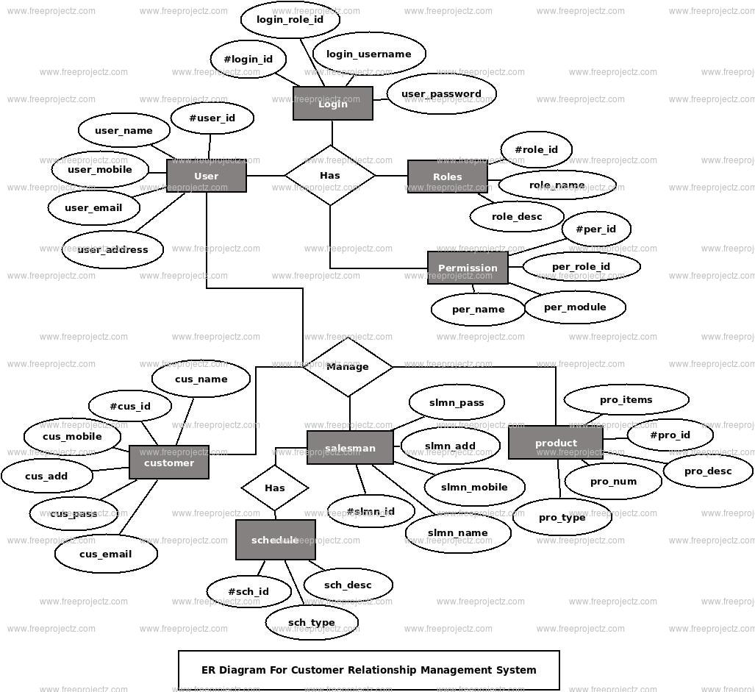
Data Flow ER Diagram

Slide 11
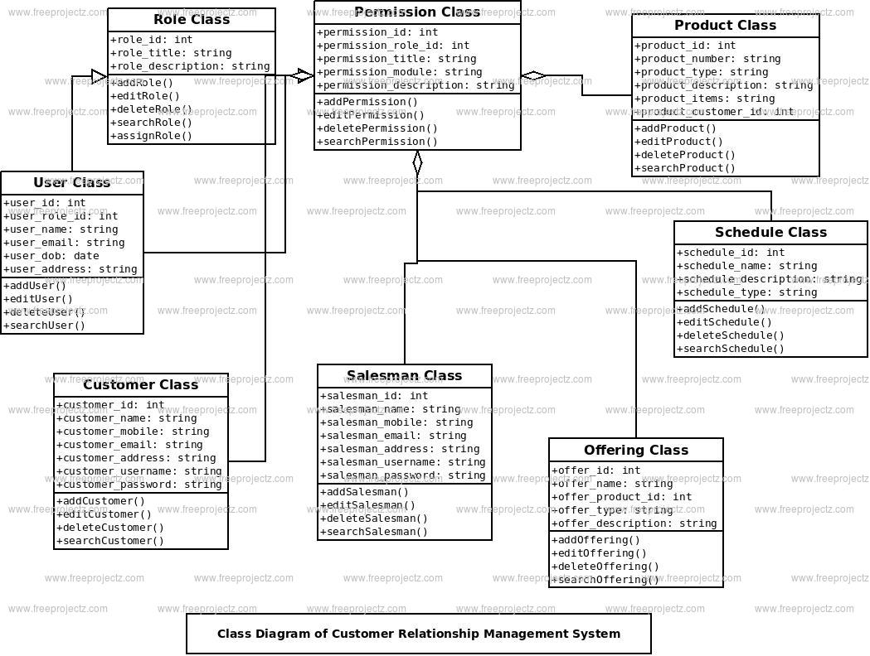
Class Diagram

Slide 12
REFERENCE
Customer Relationship Management casts and cases by RAI
Buttle F.(2009)CRM concepts and Technologies.2nd Ed. USA: Elsevier Ltd
HILBERT M.(2007)Digital process and democratic Theory . Nurenberg.

Slide 13
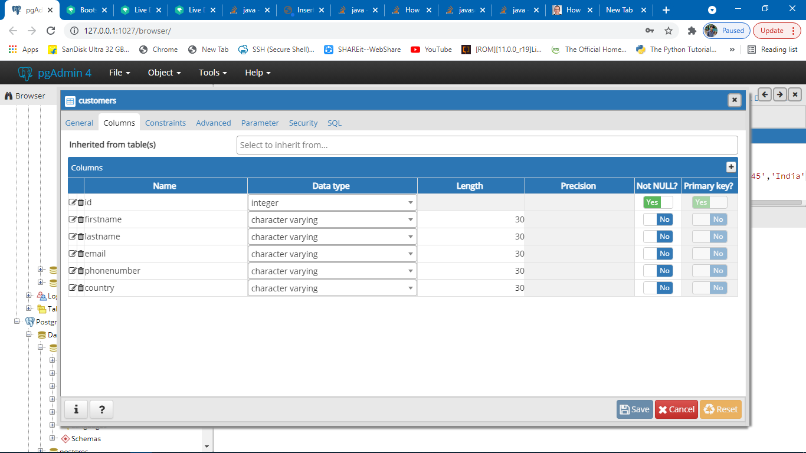

Slide 14
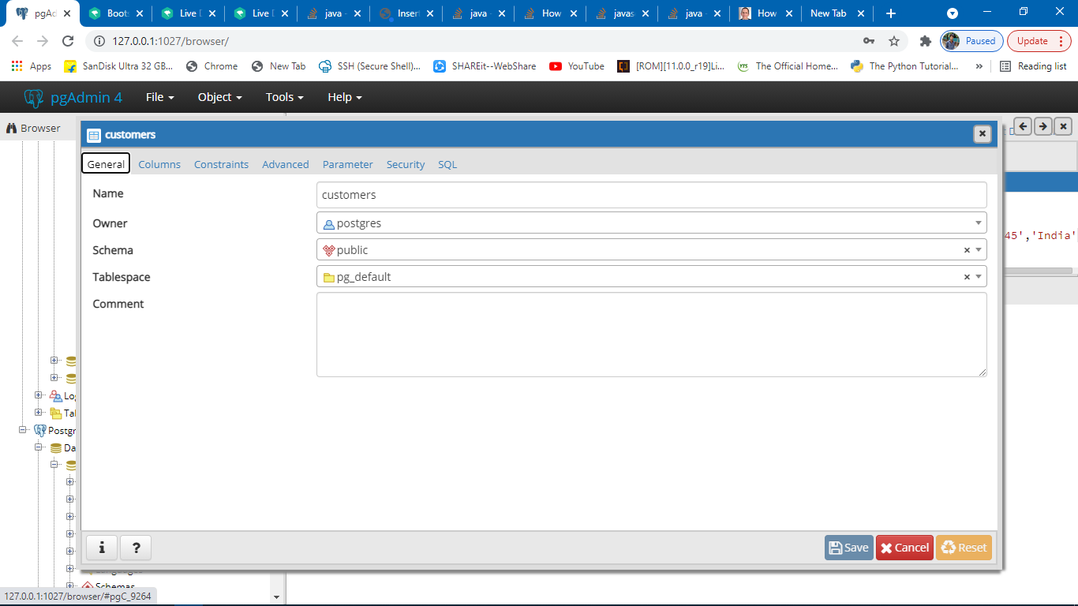

Slide 15
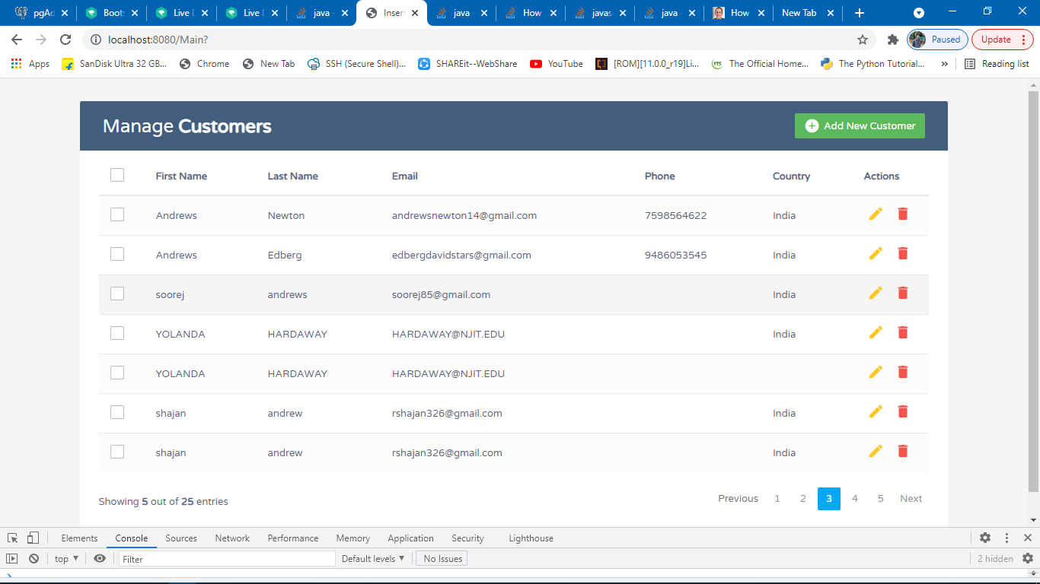

Slide 16
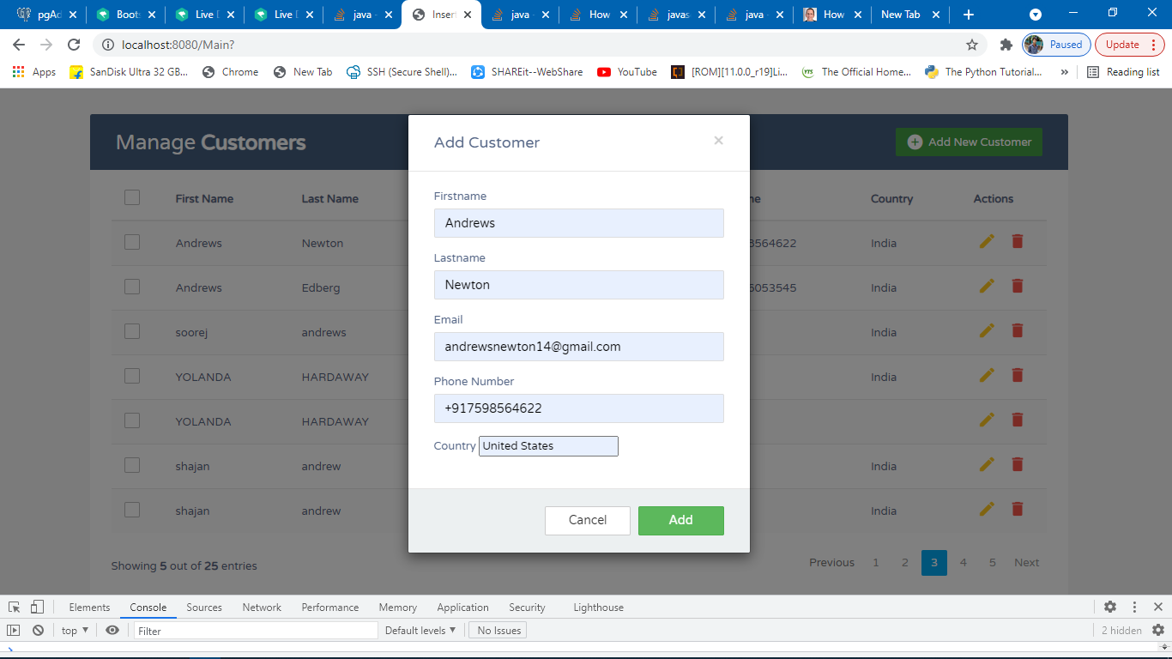

Slide 17
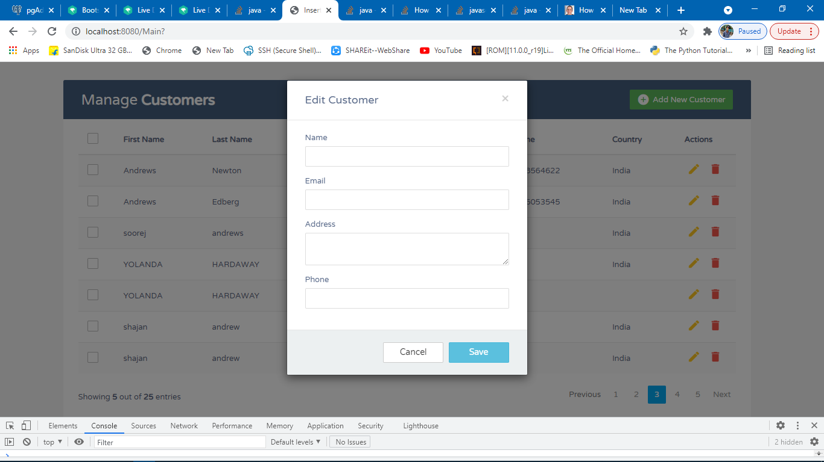

Slide 18
CONCLUSION
>CRM enables a company to align its strategy with the needs of the customer in order to meet those needs and thus ensure long-term customer loyalty. It is faster and more secured

Slide 19
THANK YOU

