Slide 1
CS410 Final Presentation
By Andrew Son and Sujay Nanjannavar

Slide 2
Installation Guide
Python 3.8
Selenium
BeautifulSoup4
Gensim 3.8.3
Flask
Numpy
Scipy
These packages can all be installed via “pip install –r requirements.txt” from the root directory

Slide 3
Selenium Specific Installation
Selenium requires specific drivers to be installed
For our project, we used Chrome and installed Chrome drivers
Chrome version specific
https://chromedriver.chromium.org/downloads
Place in drivers/

Slide 4
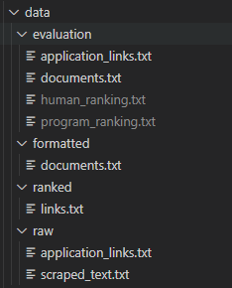
Understanding the codebase
All important scripts are in src/
scraper.py
application_links.txt
scraped_text.txt
data/raw/
formatter.py
documents.txt
data/formatted/
ranker.py
links.txt
data/ranked/

Slide 5
Running the program
Run order of scripts:
scraper.py {LINK_URL}
formatter.py
ranker.py {“Experience with SQL is required”}
The {} indicate required command line arguments.

Slide 6
Running the frontend
The frontend is an additional component that is not required
Navigate to frontend_flask/
Flask run
Does not require command line arguments
Frontend handles inputs and outputs

Slide 7
Demo

