Slide 1
UPHILL RACER GAME
By – andrew steev jacob Sap - 590028964
U S I N G R AY L I B

Slide 2

W H A T I S R A Y L I B ?
Raylib is a simple, beginner-friendly game development library written in C.
It helps you create 2D and 3D games easily without needing complicated engines.
Created by Ramon Santmorie( RAY)
No Engine, Just a Library Raylib is NOT Unity or Unreal.
It does NOT:
Give you an editor
Handle physics automatically Give you a scene system
You code everything manually — which is why it's great for learning.

Slide 3
G O A L S F O R T H I S P R O J E C T
Simulate gravity on 2d objects
Simulate friction on 2d objects
Simulate terrain collision on 2d objects
Simulate car suspension
Generate a randomly generated terrain
3
1 2 / 3 / 2 0 2 5

Slide 4
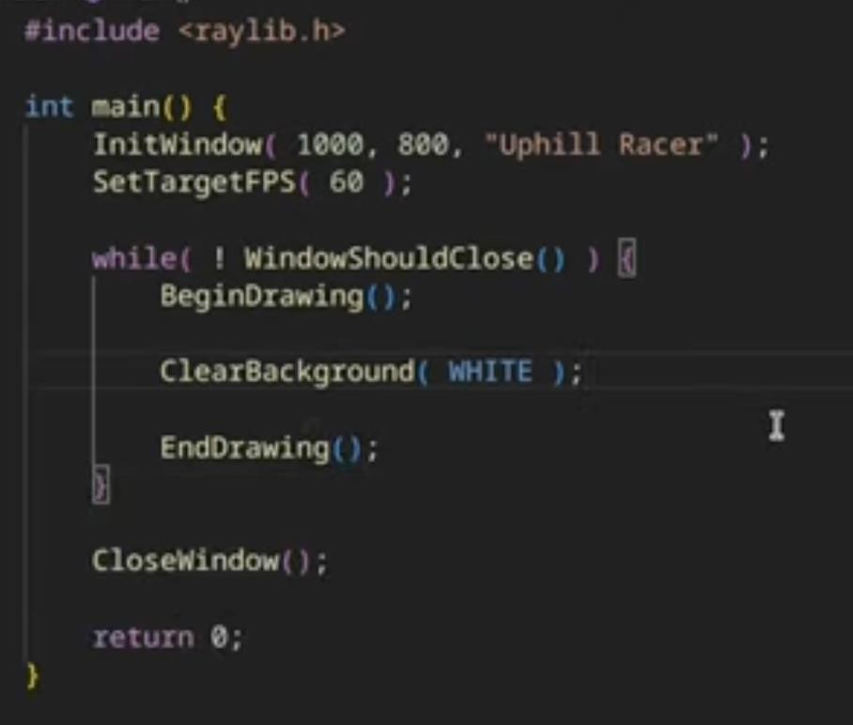
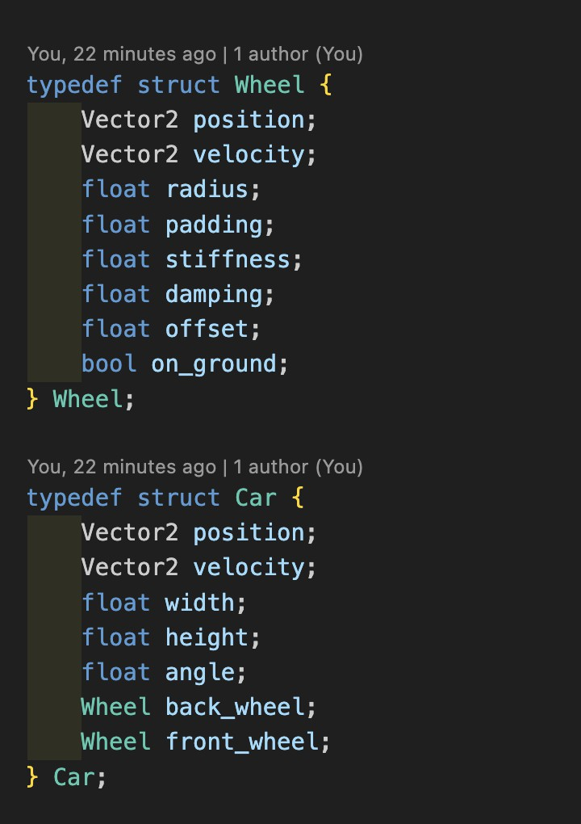
P A R T 1 ( B A S I C B O I L E R P L A T E A N D D R A W I N G
)
First we create a basic window
This creates a blank window and now we add the main car
NOW TO ADD THE CAR
4
1 2 / 3 / 2 0 2 5

Slide 5
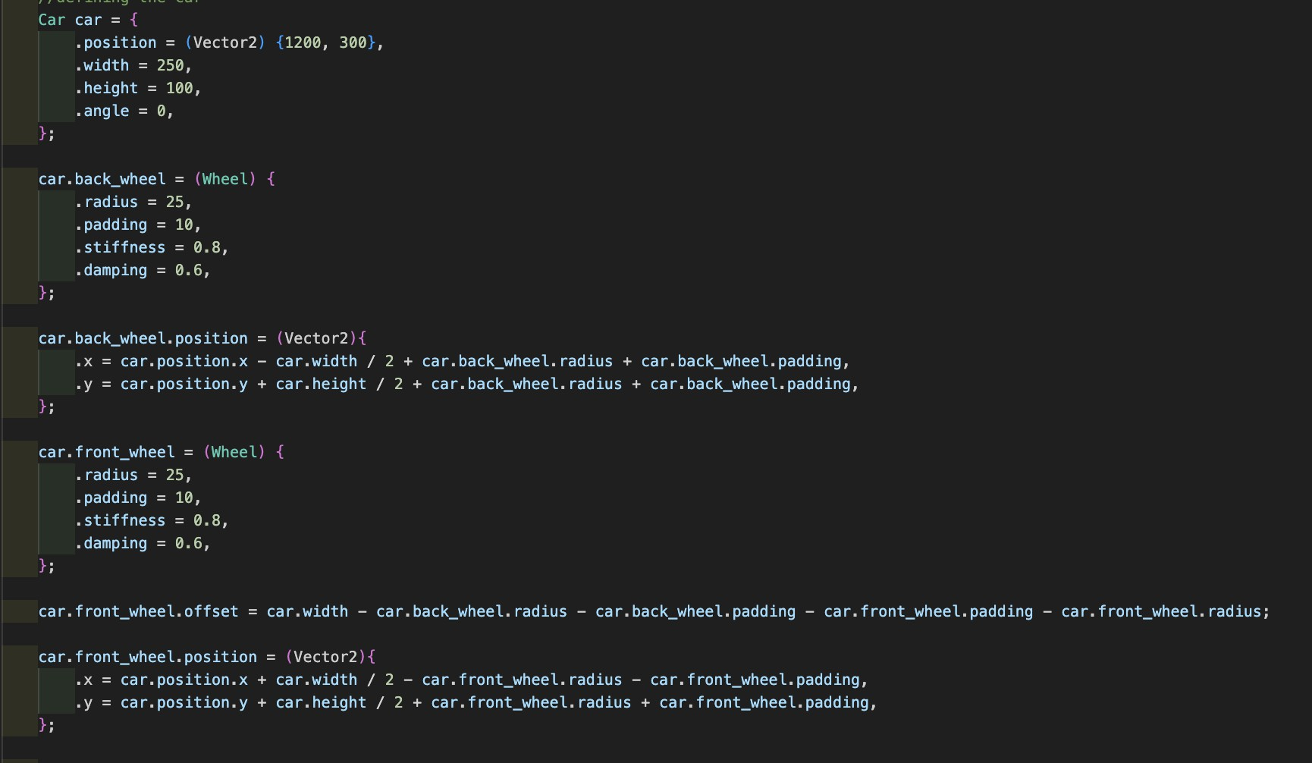
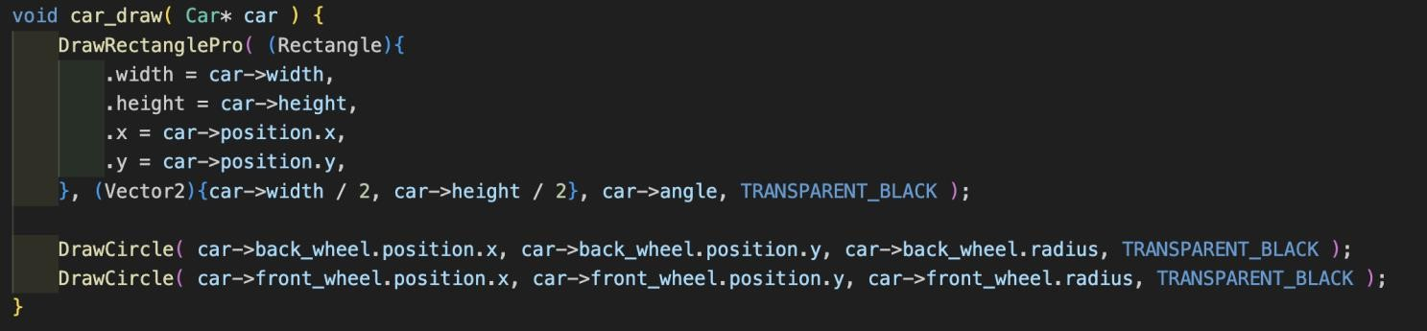
D R A W I N G T H E C A R
Using struct we were able to assign values to the car for example the values of HEIGHT,WIDTH and everything else that we might need in the code in future
Using a basic formula I was able to assign values of both the front and back wheel with respect to the car , we need to write the coordinate of wheels with respect to car both in x and y axis
backwheel for example x coordinate is written as
.x = car position – car width /2 + car backwheel radius + backwheel padding
Padding is the extra space in between the wheels
5
1 2 / 3 / 2 0 2 5

Slide 6
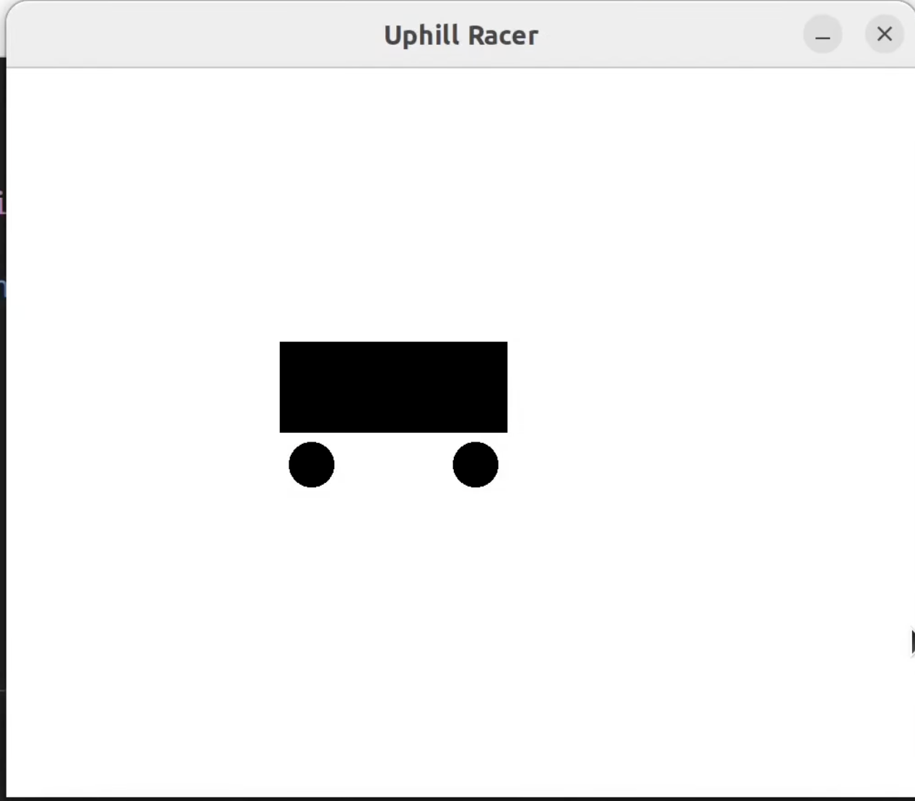
F I N A L O U T P U T
6
1 2 / 3 / 2 0 2 5

Slide 7
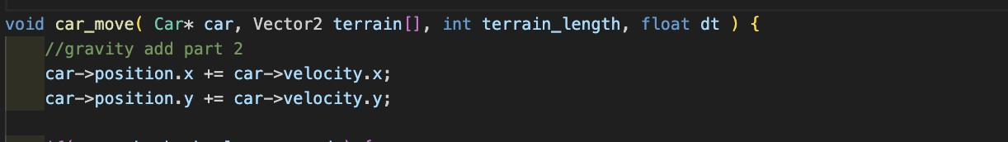
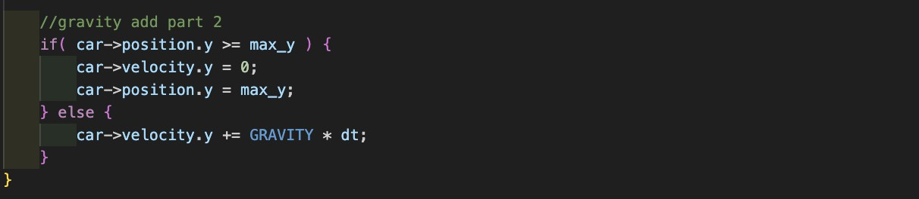
P A R T 2 – G R A V I T Y
Using a basic GetFrametime() function that is inbuild in raylib we are able to get per second rate of movement on screen
Defining gravity at start in terms of pixels
By defining a dt = GetFrametime()
we can just multiply the dt with the GRAVITY and add it to the position of the car , moslty acts in y axis but for future changes added changes in x axis also .
Used the if statement so that when the car reaches the bottom on the defined screen , it stops moving
7
1 2 / 3 / 2 0 2 5

Slide 8
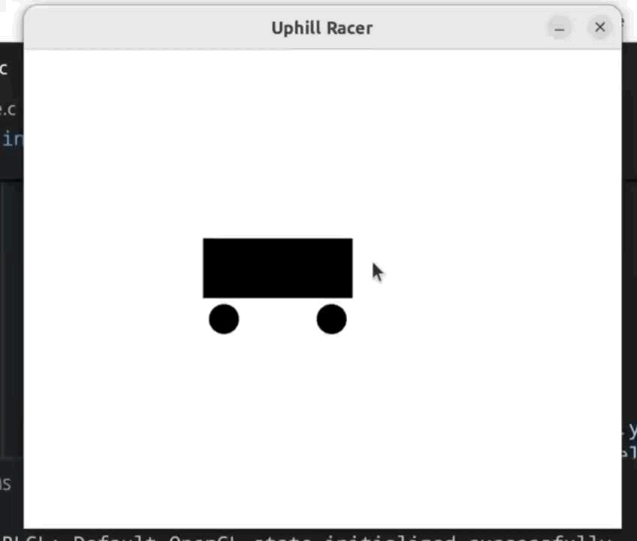
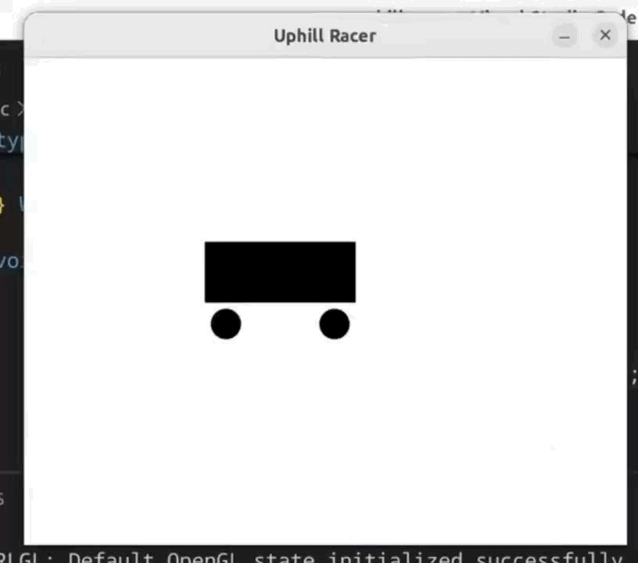
W I T H N O I F C O N D I T I O N .
W I T H I F C O N D I T I O N .
8
1 2 / 3 / 2 0 2 5

Slide 9
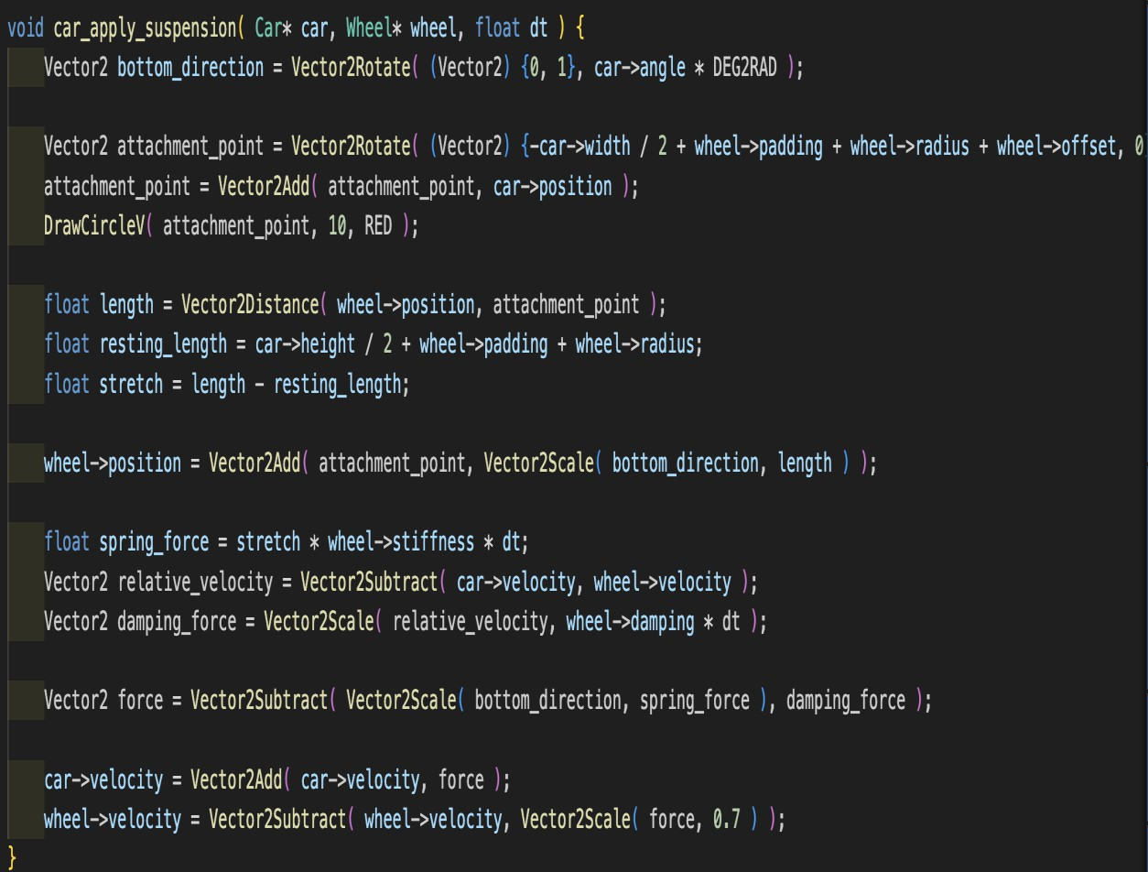
P A R T 3 – C A R S U S P E N S I O N
Car supsension work on the basic idea of hooke's law , finding out the attachment point the resting lenth and the actual length
Calculating stretch = length – resting length
Calclulating the spring force = stretch * wheel stifness ( more the stiffness more the continous bounce )
WRITING THE CODE JUST TILL HERE MAKES AN INFINITE LOOP
To slow down the total bouce of car we introduce DAMPING that decreases the bounce with gradual bounces
9
Updating the velocity and position of wheels according to the calculated values
1 2 / 3 / 2 0 2 5

Slide 10
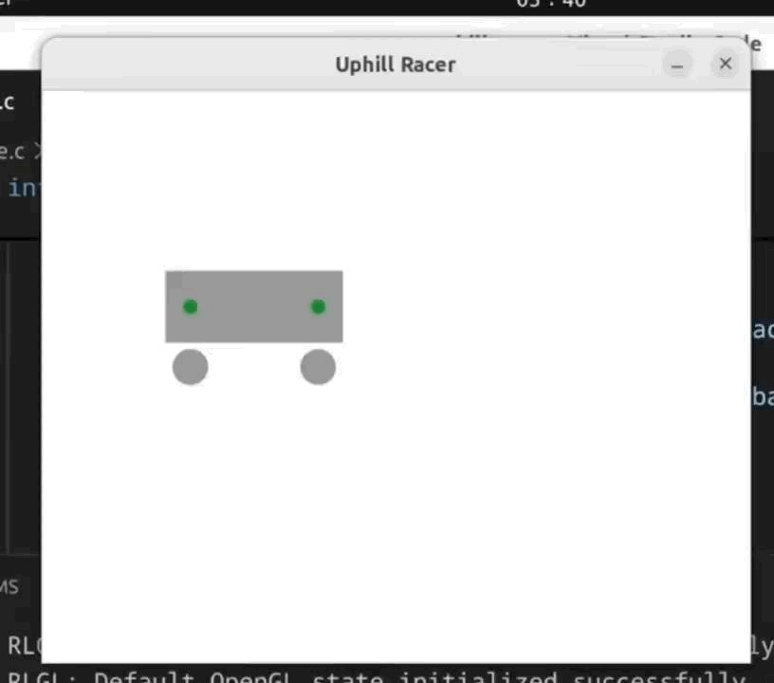
E N O U G H O F T H E O R Y - S U S P E N S I O N )
F I N A L O U T P U T ( C A R
10
1 2 / 3 / 2 0 2 5

Slide 11
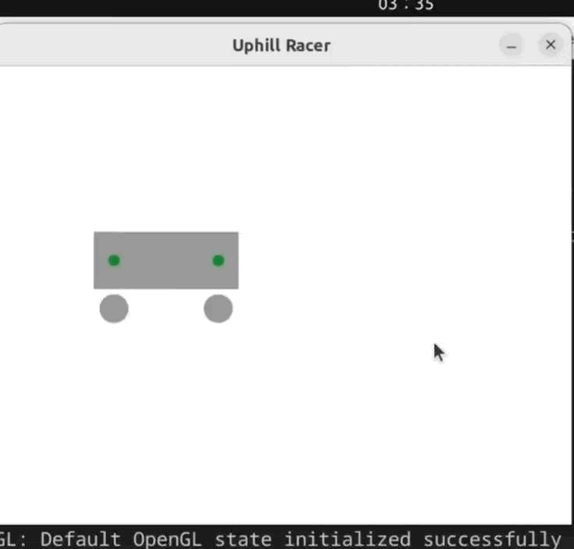
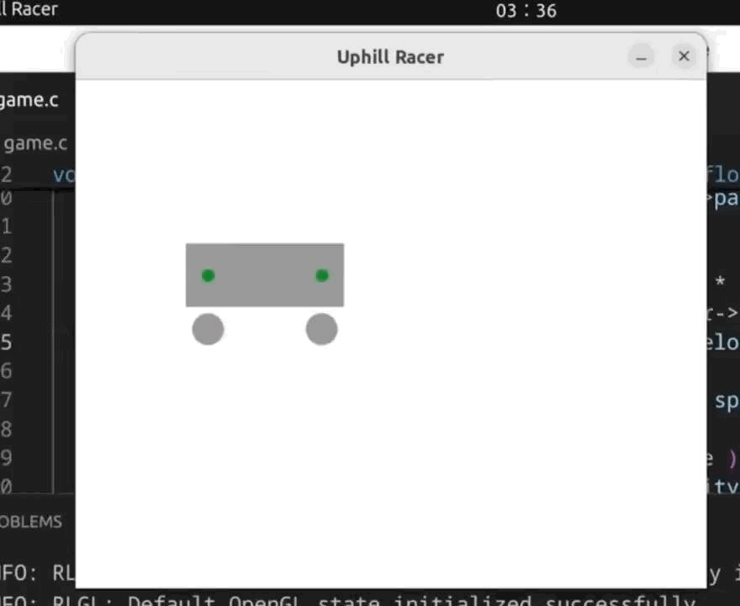
S O M E | F A I L S | I N F I N I T E | B O U N C E
W E I R D | W O B B L E
11
1 2 / 3 / 2 0 2 5

Slide 12
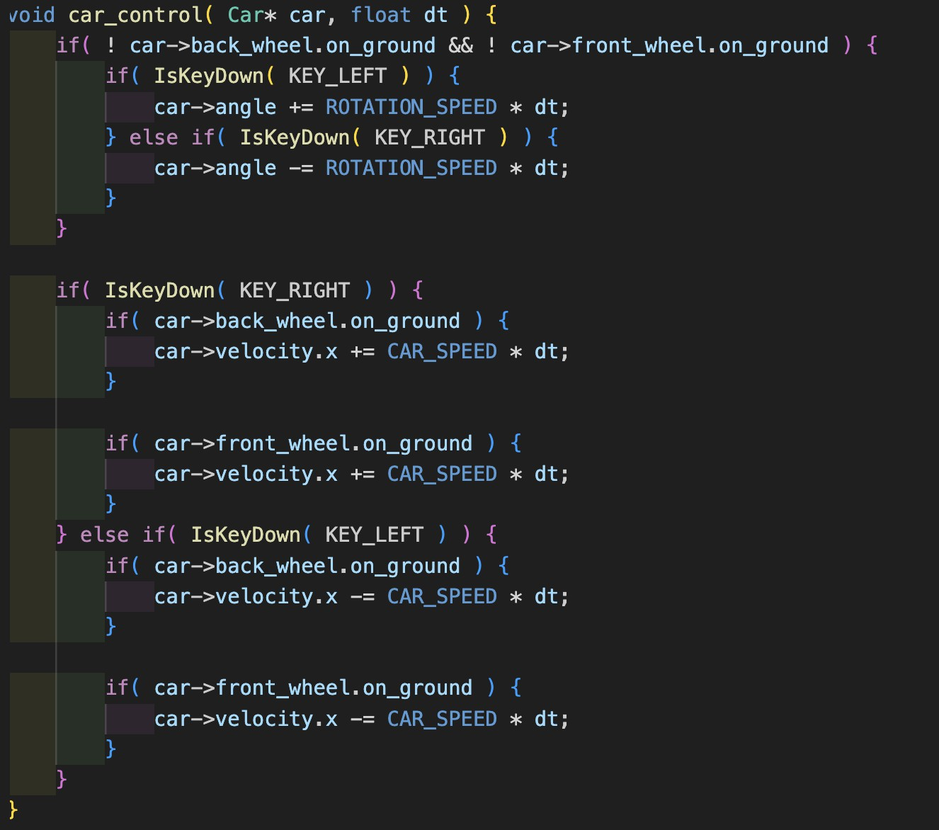
A S S I G N I N G B U T T O N S F O R C A R T O M O V E
12
1 2 / 3 / 2 0 2 5

Slide 13
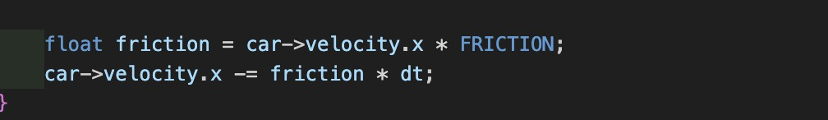
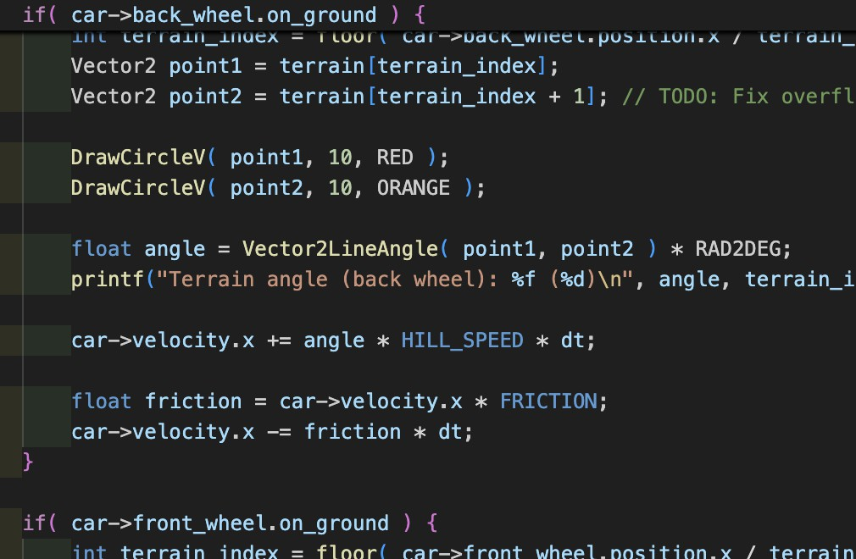
Used If - condition for both front and back wheel . So that friction only acts when the wheels of the car on the ground or detect a collision
A D D I N G F R I C T I O N
Friction only works in x axis so , code to change the velocity in x axis with respect to friction
13
1 2 / 3 / 2 0 2 5

Slide 14
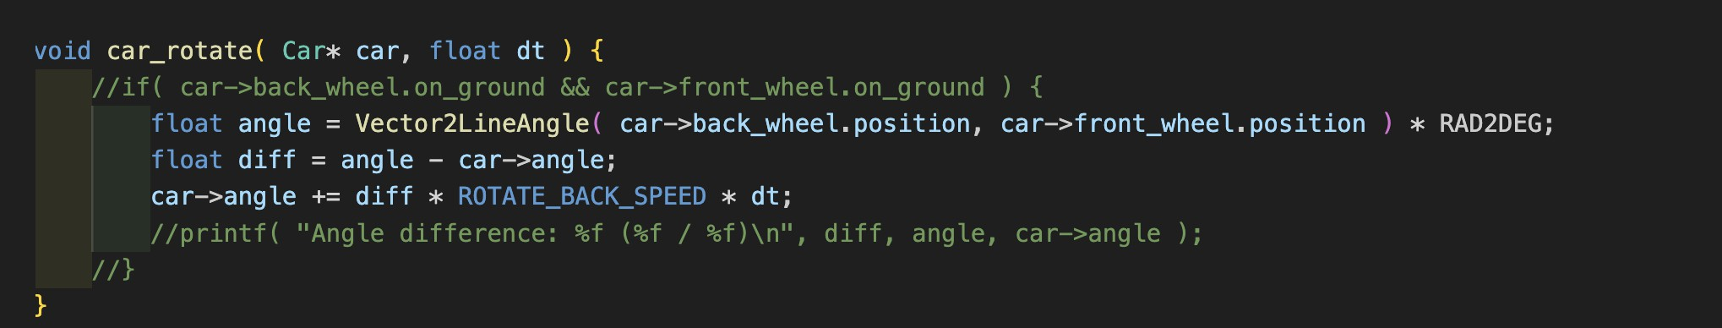
P A R T 4 – R O T A T I N G T H E C A R
14
Defining the car angle in car struct and assigning it initial value 0 that is in degree we can use this basic Vectro2LIneAngle() function and since the position of back and front wheel have coordinate (x,y) we can change the new ANGLE in degree by (RAD2DEG)
And can change the rotation angle of the car , by press of some buttons
1 2 / 3 / 2 0 2 5

Slide 15
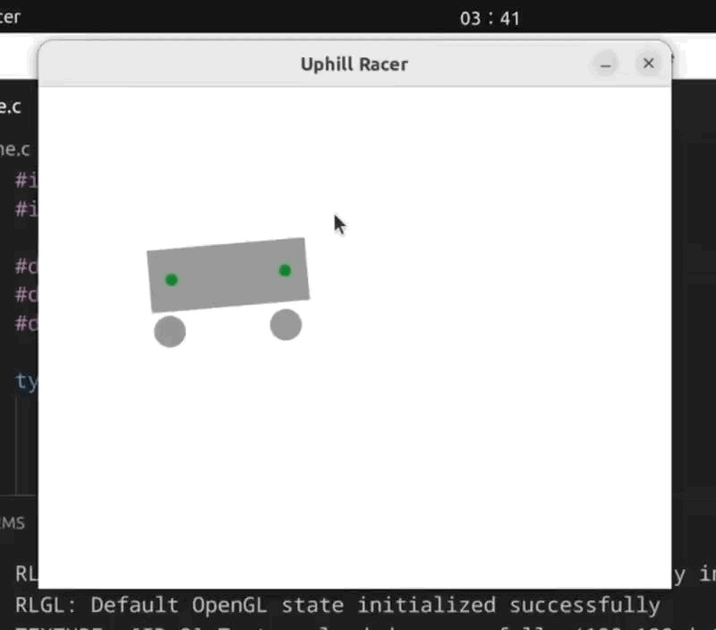
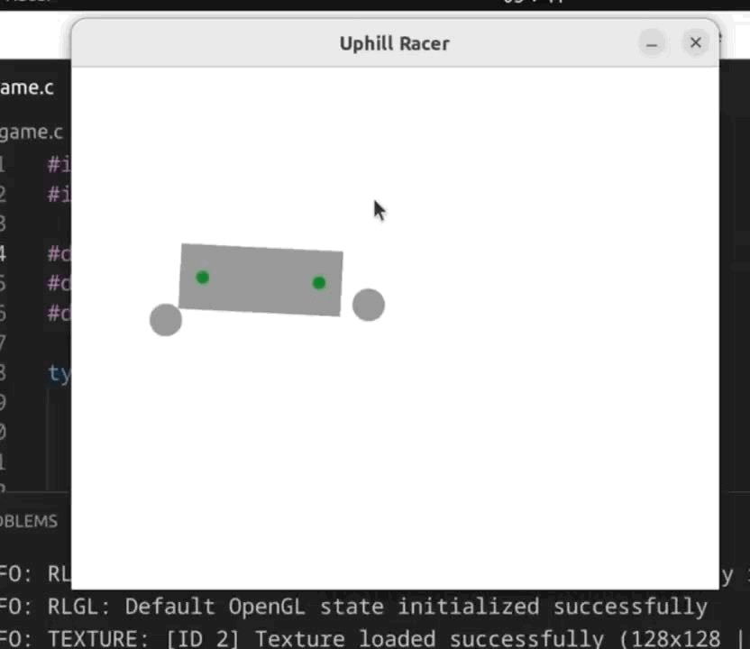
H O W I T L O O K S
What I got
FAILS
15
1 2 / 3 / 2 0 2 5

Slide 16
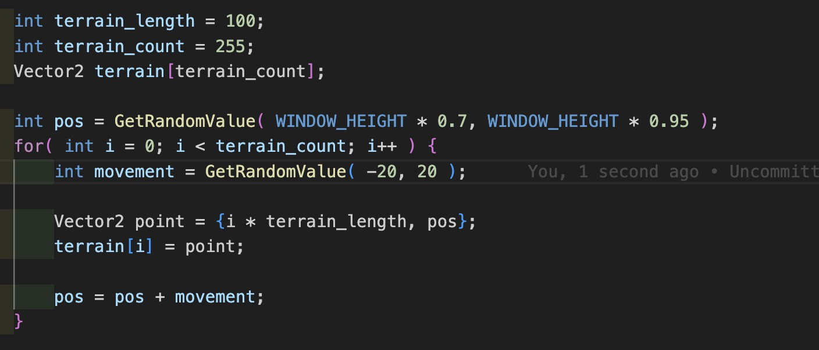
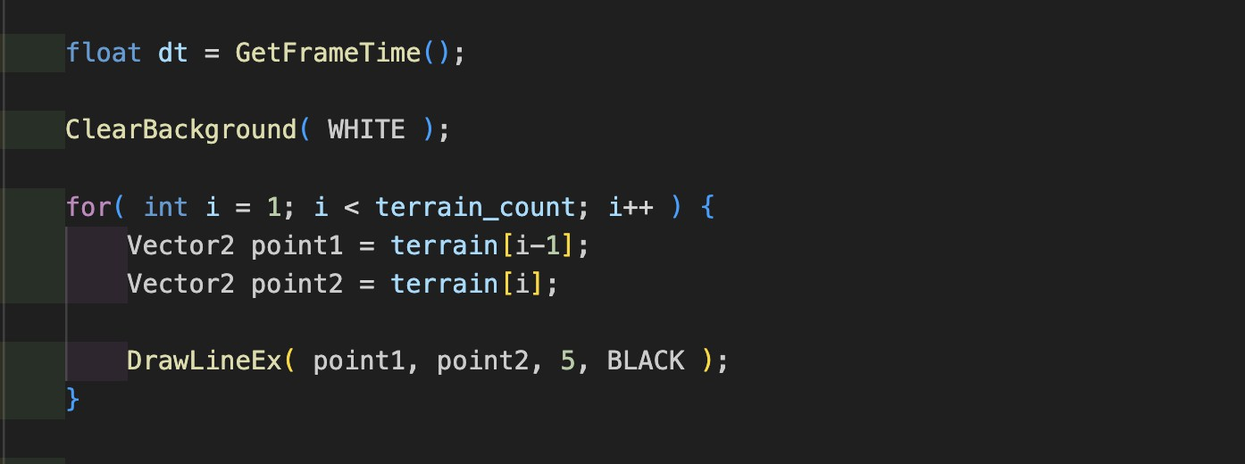
M A K I N G R A N D O M L Y G E N E R A T E D T E R R A I N
16
1 2 / 3 / 2 0 2 5

Slide 17
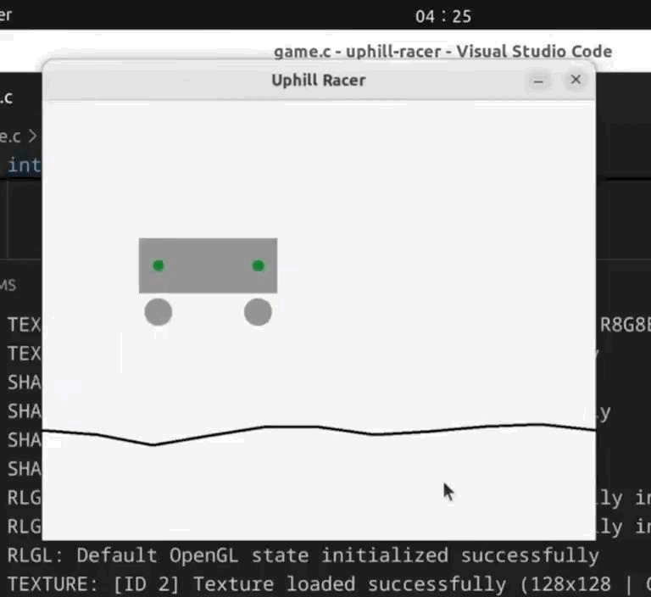
H O W I T L O O K S L I K E
17
1 2 / 3 / 2 0 2 5

Slide 18
W A S N ’ T A B L E T O S I M U L A T E C O L L I S I O N O N
R A N D O M L Y G E N E R A T E D T E R R A I N
Used gpt and was able to fingure some things out
Just to figure out what is happening , I plotted points on the terrain
18
1 2 / 3 / 2 0 2 5

Slide 19
FINAL OUTPUT
19
Let u9999s also play around with some values
1 2 / 3 / 2 0 2 5

Slide 20





W H A T I W A S A B L E T O D O
Simulate gravity on 2d objects
Simulate friction on 2d objects
Simulate terrain collision on 2d objects
Simulate car suspension
Generate a randomly generated terrain
Make good game graphics
20
1 2 / 3 / 2 0 2 5

Slide 21
C H A L L E N G E S I F A C E D
Car suspension – not even chatgpt could help me with this
Collision detection - didn’t understand what to do , found a code online ( pasted it )
Making the wheels move with the car while rotating
21
1 2 / 3 / 2 0 2 5

Slide 22
T H A N K Y O U ! !
Just the basic prototype
you can check more of the coming update on my git - andrewsteevjacob
22
1 2 / 3 / 2 0 2 5

