Slide 1
History of Frontend Frameworks

Slide 2
Merriam-Webster definition for history:
a chronological record of significant events (such as those affecting a nation or institution) often including an explanation of their causes

Slide 3

1980 - Tim Berners-Lee works at CERN and develops ENQUIRE, the HTML predecessor
1990 - he specified HTML and wrote browser and server software
1991- HTML becomes publicaly available

Slide 4

1994 - Håkon Wium Lie proposes CSS
1996 - W3C CSS Recommendation (CSS1) released.
1996 - Space Jam Website is released

Slide 5
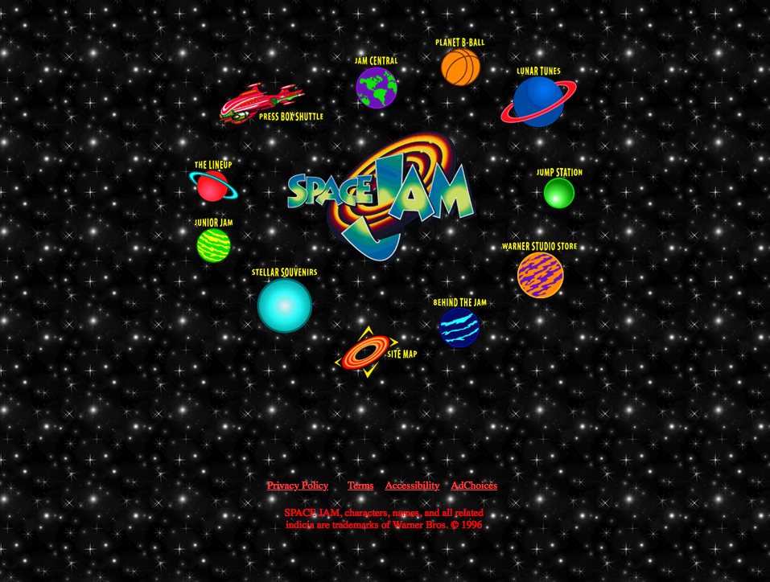

Slide 6
We are javascript developers first. Framework developers second.

