Slide 1
History of Frontend Frameworks

Slide 2
Merriam-Webster definition for history:
a chronological record of significant events (such as those affecting a nation or institution) often including an explanation of their causes

Slide 3


Winners
Losers

Slide 4

Winners
Losers

Slide 5
Winners
Losers
?

Slide 6
We are front end developers first. Framework developers second.

Slide 7

1980 - Tim Berners-Lee works at CERN and develops ENQUIRE, the HTML predecessor
1990 - he specified HTML and wrote browser and server software
1991- HTML becomes publicly available

Slide 8
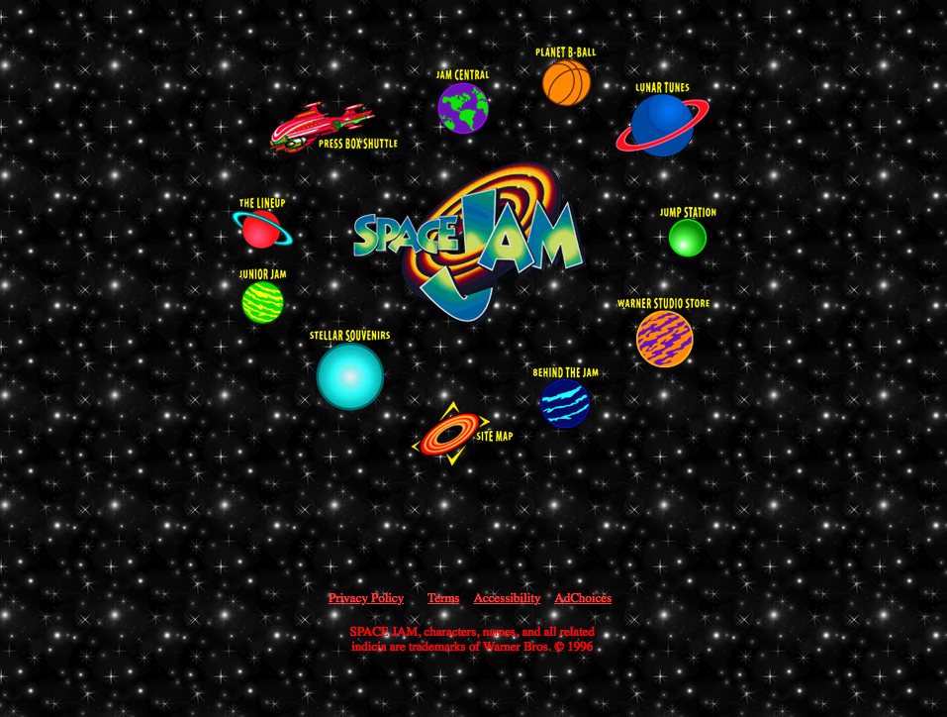

1994 - Håkon Wium Lie proposes CSS
1996 - W3C CSS Recommendation (CSS1) released.
1996 - Space Jam Website is released

Slide 9

1995 (sometime before may) - Brendan Eich gets recruited by Netscape Communications to embed a programming language into Netscape Navigator
1995 (may) - Brendan Eich is tasked to create a prototype for a browser scripting language
10 days later – Javascript was born

Slide 10
With the introduction of JS, developers could start adding behaviors to our website.
Now we can do cool things like ….

Slide 11
A Click event in React

