Slide 1
History of Frontend Frameworks

Slide 2
Merriam-Webster definition for history:
a chronological record of significant events (such as those affecting a nation or institution) often including an explanation of their causes

Slide 3


Winners
Losers

Slide 4

Winners
Losers

Slide 5

Winners
Losers
Browser
Compatibility?

Slide 6
Winners
Losers
?

Slide 7
We are front end developers first. Framework developers second.

Slide 8

1980 - Tim Berners-Lee works at CERN and develops ENQUIRE, the HTML predecessor
1990 - he specified HTML and wrote browser and server software
1991- HTML becomes publicly available

Slide 9
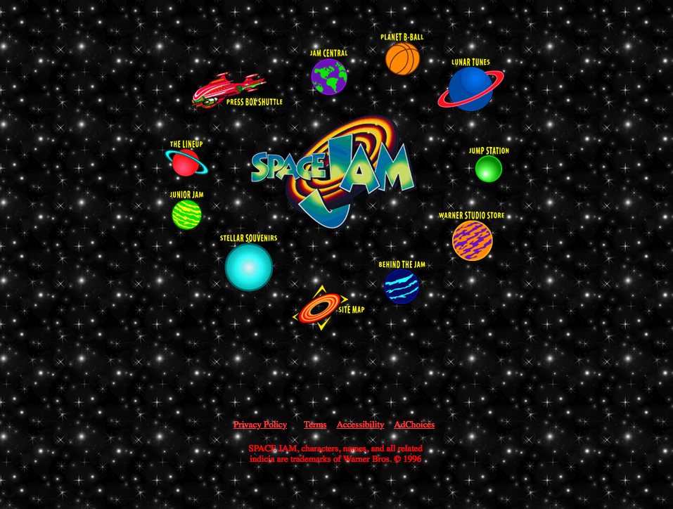

1994 - Håkon Wium Lie proposes CSS
1996 - W3C CSS Recommendation (CSS1) released.
1996 - Space Jam Website is released

Slide 10
1995 (sometime before may) - Brendan Eich gets recruited by Netscape Communications to embed a programming language into Netscape Navigator
1995 (may) - Brendan Eich is tasked to create a prototype for a browser scripting language
10 days later – Javascript was born

Slide 11
With the introduction of JS, developers could start adding behaviors to our website.
Now we can do cool things like ….

Slide 12
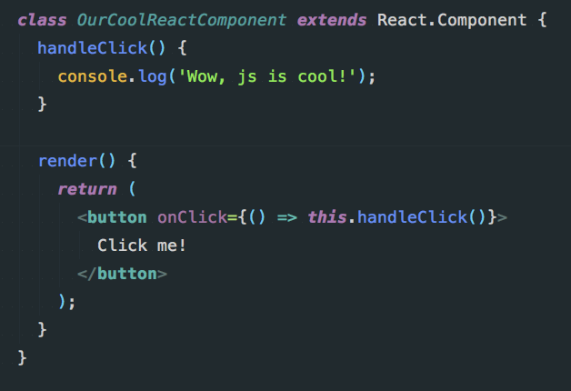
A click event in React

Slide 13
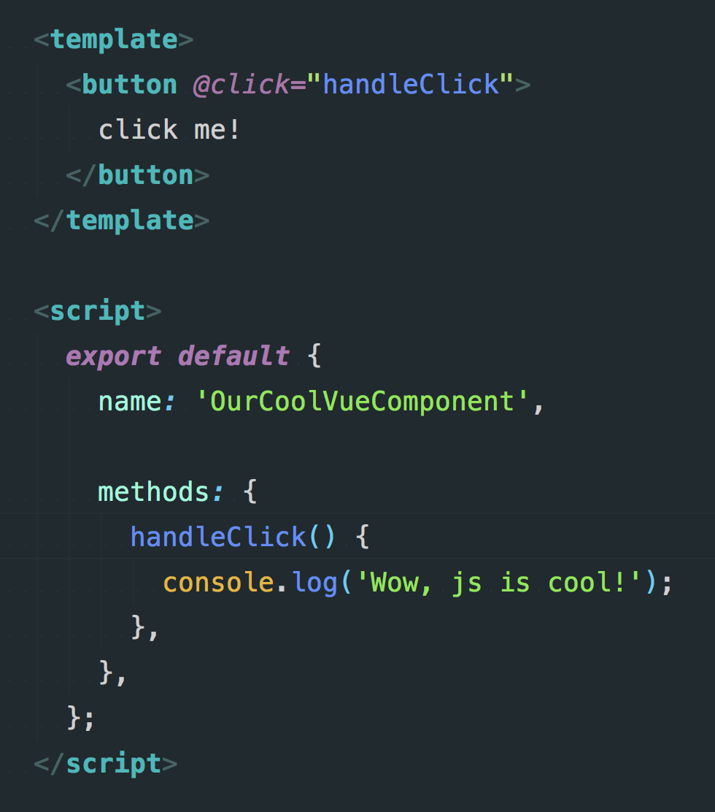
A click event in Vue

Slide 14
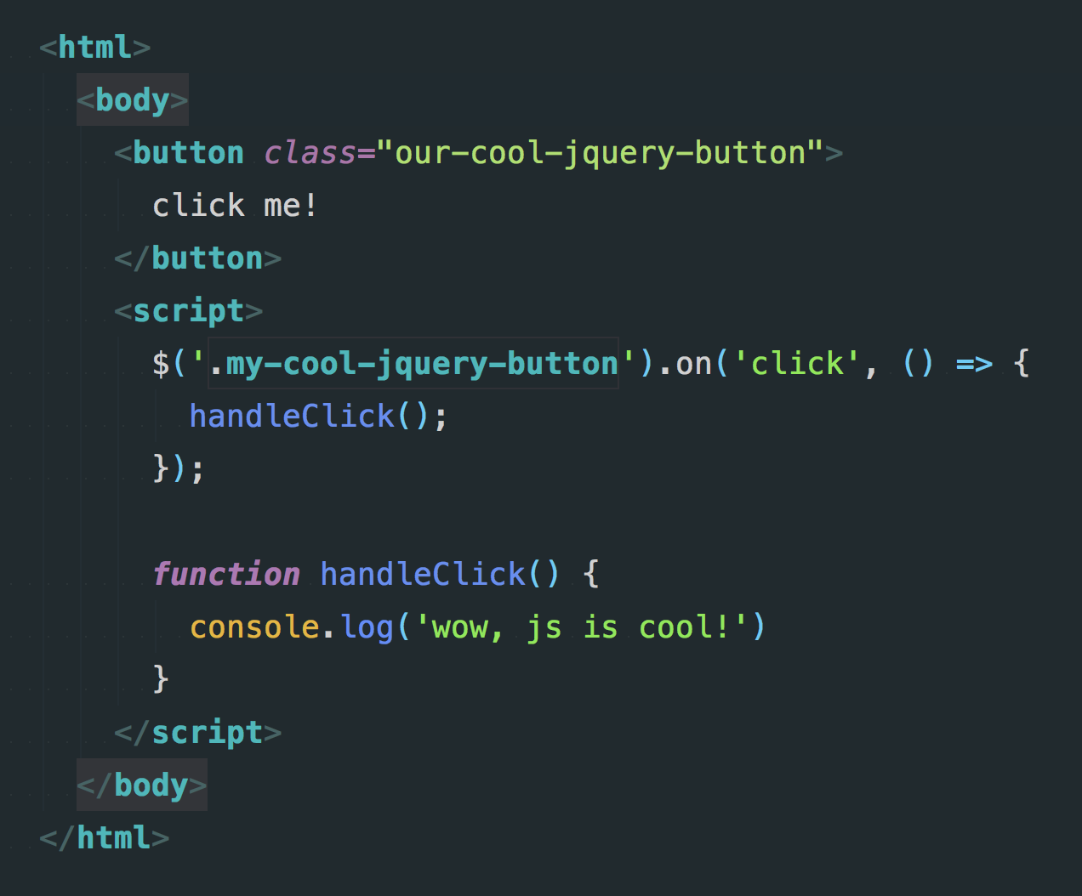
A click event in jQuery

Slide 15
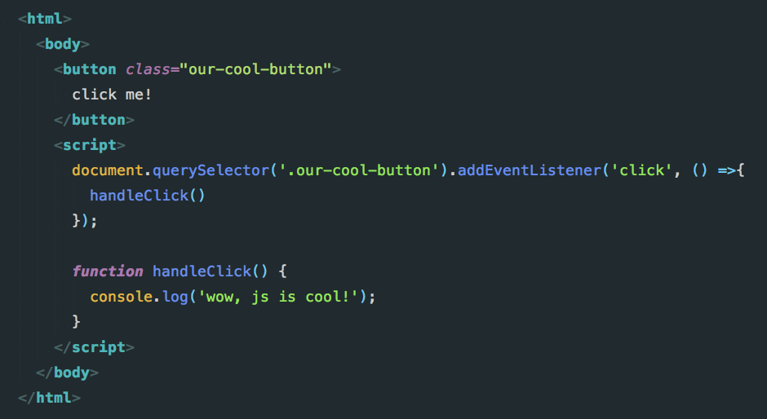
A click event in vanilla JS

Slide 16
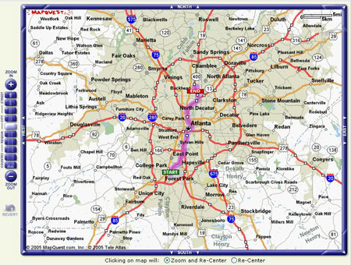
MAPQUEST!

Slide 17
XMLHttpRequest object
In 1998, the Microsoft Outlook web access team created the core competencies that surround the XMLHttpRequest object

Slide 18
XMLHttpRequest object
By 2004 and 2005, google released their gmail and google maps clients using this technology.
By April of 2006, the w3c released the first specification for the XMLHttpRequest object.

