Slide 1
Creating decision-making tools for selecting Opportunity Zones
in Chicago
Team 2
Lydia Stump, Erika Haren, Wuyan Xu, Anthony Elkadi, & Andy Swellie

Slide 2
What is an Opportunity Zone?
The Opportunity Zones incentive is a new community investment program established by Congress in the Tax Cuts and Jobs Act of 2017 to encourage long-term investments in low-income urban and rural communities nationwide by providing tax benefits to investors.
Notes:
Anthony
Opportunity Zones are designed to spur economic development by providing tax benefits to investors. First, investors can defer tax on any prior gains invested in a Qualified Opportunity Fund (QOF) until the earlier of the date on which the investment in a QOF is sold or exchanged, or December 31, 2026. If the QOF investment is held for longer than 5 years, there is a 10% exclusion of the deferred gain. If held for more than 7 years, the 10% becomes 15%. Second, if the investor holds the investment in the Opportunity Fund for at least ten years, the investor is eligible for an increase in basis of the QOF investment equal to its fair market value on the date that the QOF investment is sold or exchanged.

Slide 3
Objectives, Bounds, and Audience
Provide investors with decision-making tools to make informed decisions about what Opportunity Zones to invest in within a given area
Investors could be anyone that wants to buy real estate or invest in local business in these zones
It will also provide local governments and Chambers of Commerce with a tool that is more user-friendly and dynamic, versus requiring investors to sift through pages of information
We chose Cook County in Chicago as a proof of concept
135 qualified Opportunity Zones exist in this County
Notes:
Lydia

Slide 4
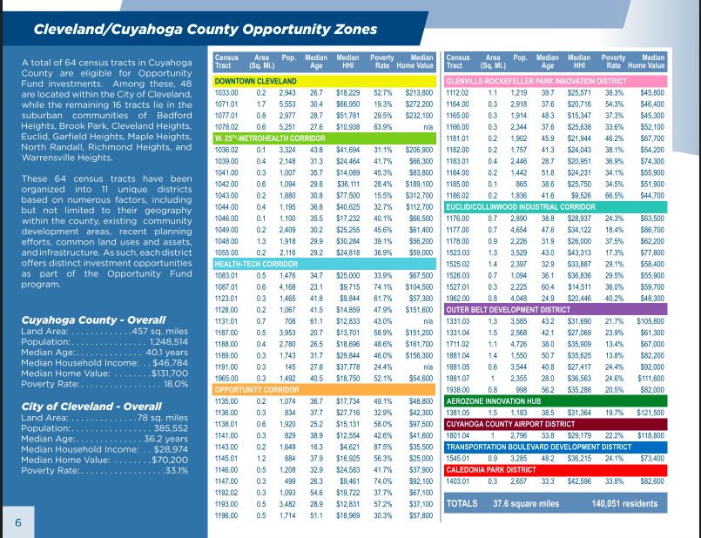
Notes:
Lydia

Slide 5
Key Performance Indicators
Population growth or decline
Annual median income
Percent change in home values
Educational attainment levels
Unemployment rate
Crimes per 1000 people
Notes:
Wuyan

Slide 6
Methodology
This is what we used to build our app:
Server
Python
Flask
SQLalchemy
Numpy
pandas
Database
SQLite
SQLalchemy
Web
HTML/CSS
Bootstrap
Heroku (hosting)
Javascript (all the good stuff)
Leaflet
D3
Plotly
jQuery
Node.js
Notes:
Wuyan

