Slide 1
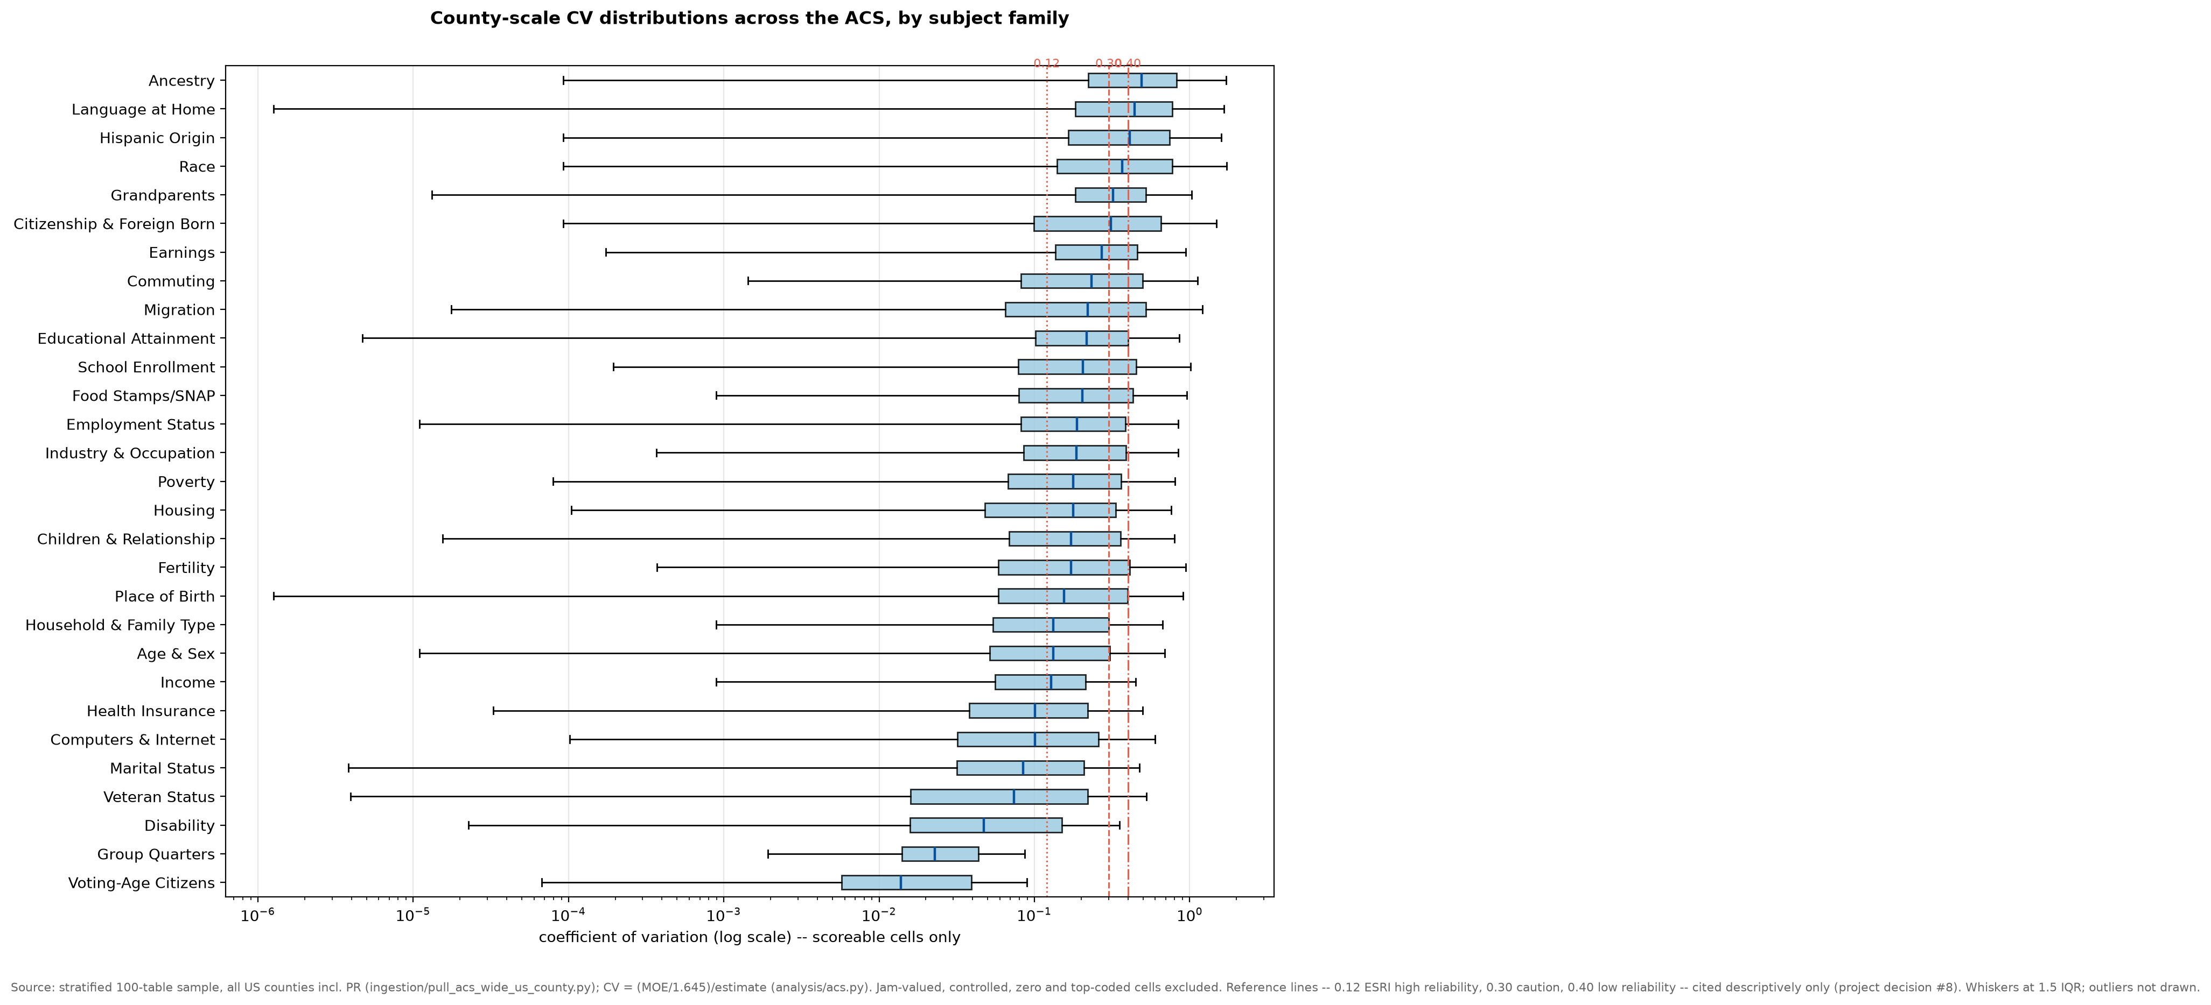
EDA 14 · ERROR BARS ACROSS THE ENTIRE ACS · PROOF OF CONCEPT · AUGUST 2026
72% of the ACS can carry an error bar — the other 28% needs words, not numbers
1
Scoreability is structured, not random
9.6M county × variable cells, each classified: 72% score cleanly. The rest: true zeros (16%), unpublished at county scale (11%), controlled — exact by design (0.6%), not computable (0.5%). Each class needs its own verdict.
2
Reliability spans 36× across subjects
Median county CVs run 0.014 (voting-age citizens) to 0.49 (ancestry), and 36% of scoreable cells exceed the 0.30 caution convention — county scale protects totals, not detail.
3
One law prices most of the noise
Estimate size predicts count CVs across 6.1M cells (slope −0.54, R² 0.78) — our NJ size law at catalog scale. Medians escape it, so per-estimate scoring is both necessary and feasible.
How to read it
Each box is one subject area’s county-level error bars (CV, log scale) across a stratified 100-table sample of the whole dataset. Boxes crossing the dashed 0.30 line sit in caution territory at the Bureau’s most reliable publication scale. Reference lines are shown descriptively — our tier choices remain a mentor decision.
notebook 14 · 100 tables × 3,222 counties (PR included) · sentinel-aware pull, reproduces verified NJ receipts exactly · fully reproducible from the repo Ask for mentors: confirm the ACS-wide scope.
Notes:
TALK TRACK (~90 seconds)
Setup (~15s): Everything we showed you before was income and poverty. The question behind this slide: if the reliability layer is going to cover more of the ACS, what does the error-bar landscape look like across the WHOLE dataset? We classified all 28,472 variables in the 2024 catalog and pulled a stratified 100-table sample at every US county -- 9.6 million cells.
Card 1 (~20s): 72% of cells score cleanly -- real value, real error bar. The point is the other 28%: it isn't missing data, it's STRUCTURED absence. True zeros. Tables that simply don't publish at county scale. Controlled totals that are exact by design but LOOK blank. And 'could not compute' codes. Today, all of those look the same to a user -- a blank. Each needs its own plain-language verdict, which is exactly what our tool adds.
Card 2 + chart (~30s): Point at the chart. Every box is one subject area at county scale -- the Bureau's MOST reliable geography -- and the spread is 36-fold. Citizenship counts are near-exact; the typical ancestry cell's noise is half the size of its estimate. A third of everything scoreable is past the 0.30 caution line. So 'county-level data is safe' is true for totals and false for detail -- reliability has to be judged per estimate.
Card 3 (~15s): The good news: one rule prices most of it. Estimate size predicts count error bars with R-squared 0.78 across six million cells -- the same law we measured in New Jersey, now at catalog scale. Medians break the rule, and we handle them separately.
The ask (~10s): We built this as a proof of concept under our income-and-poverty scope. We're asking you to confirm the widened scope: the same reliability layer, applied ACS-wide, county pilot first.
POCKET ANSWERS
- 'How did you verify the pipeline?' It reproduces our hand-verified NJ income numbers to the dollar, estimate and MOE, all 21 counties; every headline number is assert-locked in the notebook.
- 'Why is the x-axis log scale?' CVs span four orders of magnitude; a linear axis would squash every reliable family onto one line.
- 'Why include Puerto Rico?' 78 municipios, flagged throughout; it runs about 18 points less scoreable but doesn't change any family's ranking.
- 'What's the 0.30 line?' A published convention (ESRI mapping practice, NCHS reporting standard), cited descriptively -- our own tiers are a decision we want to make WITH you.
- 'One oddity we can't explain:' 132 rural-plains counties publish a real population MOE where the other 3,090 are controlled -- the national twin of a New Jersey mystery we logged in July. We'd value a pointer.

