Slide 1
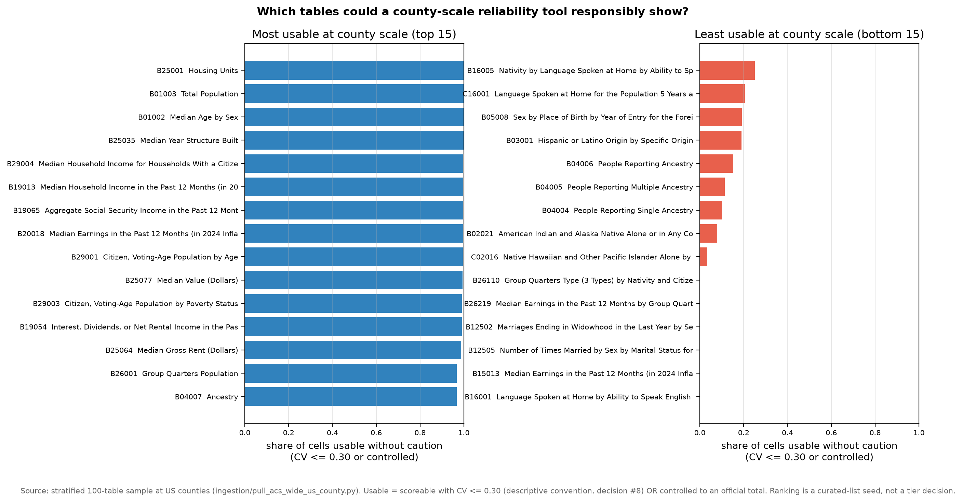
EDA 14 · FROM SURVEY TO PRODUCT · EXPANSION PREVIEW · AUGUST 2026
One county, four verdicts — the reliability layer beyond income & poverty
THE PRODUCT — every estimate answered in plain language (four real cells, Los Angeles County)
THE CURATION — the survey ranking decides which tables earn a slot
Total population
9,808,667
Exact by design — controlled to official population totals; no sampling error.
Median gross rent
$1,954 ± $6
CV 0.002 — the noise is one-fifth of one percent of the estimate.
Ancestry: Senegalese
212 ± 140
CV 0.40 — the error bar is two-thirds the size of the estimate itself.
Language detail (42 languages)
—
Not published at county scale — this table needs a larger geography.
Top-ranked tables (housing units, population, median age, income) enter the expanded tool first. Bottom-ranked tables still get honest treatment — “not published here” or “too noisy at this scale” — instead of silently looking fine.
1
County pilot — underway
The survey + scoring engine behind this slide: all 28,472 variables classified, verified against our NJ receipts.
2
Curated tables + imputation axis
With your sign-off: the ranked shortlist ships, and the composite score (error bar × imputation) extends to it.
3
Tract & block-group scale
Where planners actually work — and where our NJ EDA says error bars grow 3–10×. The design already generalizes.
every value shown is a real cell from the EDA 14 pull (notebook 14, assert-verified) · verdict wording deliberately neutral — final voice to follow sponsor guidance Ask for mentors: confirm the ACS-wide scope.
Notes:
TALK TRACK (~90 seconds)
Setup (~10s): Last time we showed you a reliability layer for income and poverty. This slide is what the same layer looks like when it covers the whole ACS. Everything on here is real data from our dataset-wide survey -- no mock numbers.
The product, left (~35s): Four cells from one county -- Los Angeles, the largest in America -- and they need four different sentences. Population: exact by design, because it's controlled to official totals; today its blank margin of error looks like missing data. Median rent: an error bar of six dollars on 1,954 -- essentially exact. Senegalese ancestry: published, but the error bar is two-thirds of the estimate -- a user should know that before citing it. And detailed language: not published at county scale at all -- the honest answer is 'go up a geography,' not a blank. One vocabulary, every estimate answered. That's the feature.
The curation, right (~20s): We don't hand-pick tables by intuition. The survey ranks all of them by the share of cells a county-scale view can actually support -- housing, population, age and income at the top; detailed race, ancestry and language at the bottom, either unpublished or noise-dominated. The shortlist for the expanded tool falls straight out of this chart, and we'd finalize it with you.
The path, bottom (~15s): Step one is done -- the engine exists and reproduces our verified New Jersey numbers exactly. Step two is the curated shortlist plus our imputation axis, which is where we want your sign-off. Step three takes it to tract and block-group scale, where the planners we're designing for actually work.
The ask (~10s): Confirm the widened scope -- same reliability layer, applied ACS-wide, county pilot first.
POCKET ANSWERS
- 'Are these verdict labels final?' No -- wording is deliberately neutral and descriptive; we understood the guidance to avoid judgment chips, and the final voice is a decision we want to make with you.
- 'Why is population 'controlled'?' County totals are pinned to official population estimates, so they carry no sampling error; the API marks this with a sentinel that most tools -- including the standard Python client -- silently turn into a blank.
- 'How real are these four cells?' Pulled live from the 2024 ACS 5-year API and assert-verified in notebook 14; the pipeline reproduces our hand-verified NJ income numbers to the dollar.
- 'What decides the ranking?' Share of a table's county cells that are either precise (CV at or under 0.30, a published convention we cite descriptively) or controlled; unpublished tables rank at zero.
- 'When do tracts come?' After the shortlist is agreed -- our NJ work already covers tract and block-group scale for income, so the extension is the same machinery pointed at smaller geographies.

