Slide 1
MSBA CAPSTONE × U.S. CENSUS BUREAU
Census Uncertainty Analytics
Setup recap — what's built, what we found, and what comes next
Team sync · July 12, 2026 · Andrew Swiniarski
Notes:
Welcome — quick 10-minute recap of where the project stands before we split up work. Everything I show today is in the GitHub repo, and by the end you'll see how to get the exact same data on your own laptop in about 10 minutes.

Slide 2
WHY THIS PROJECT EXISTS
Every Census number carries hidden noise — we're making it visible
Where the noise comes from
What we're building
1
Sampling
Surveys like the ACS only reach a fraction of households — the rest is statistical estimation.
1
Measure each noise source in real Census data
2
Combine them into one simple reliability score
2
Filled-in answers
When people skip questions, the Bureau fills in values with models (“imputation”).
3
Put the score on a map dashboard anyone can read
3
Privacy noise
Deliberate blurring is added to published counts so no individual can be identified.
The test for everything we make: could a county planner act on it?
Notes:
The Census Bureau's own framing: uncertainty enters at multiple points in the product lifecycle, and today there is no unified way for a non-technical user to judge whether an estimate is reliable enough for their decision. Our three-part job maps to the research questions: decompose the sources (Q1), build a composite score (Q2/Q3), and communicate it visually (Q4). All data is public — no NDA needed.

Slide 3
SCOPE AND SCHEDULE
Three graded deliverables — and we're in week 1 of 14
1
Uncertainty Report
2
Reproducible Codebase
3
Executive Dashboard
Where the noise comes from, our scoring method, and “fit for use” guidance for 3–5 Census products.
Scripts that take anyone from raw Census data to scores and maps — rerunnable end to end.
Linked maps with color-coded reliability tiers and plain-English tooltips.
WE ARE HERE
Wks 1–3
Wks 4–6
Wks 7–10
Wks 11–12
Wks 13–14
Explore data & research
Concept pitch & wireframe
Working prototype
Leadership feedback
Launch tool
First mentor meeting ≈ July 22 — we bring a one-slide status and our first real chart.
Notes:
Ground rule from the sponsor: biweekly mentor meetings, and we bring a one-slide status — what worked, what's blocked, what we need. Nice-to-haves exist (interactive sliders, counterfactual tools) but only after the three must-haves are safe.

Slide 4
SETUP STATUS
The foundation is built — and every step is a rerunnable script
✓
GitHub repo is live
Clean folder structure, README walkthroughs, and secrets (API keys) kept out of git permanently.
Why scripts instead of downloads?
✓
Python environment
Reproducibility is itself a graded deliverable. No file in this project was downloaded by hand — every dataset is rebuilt by a committed script, so anyone (including the Census Bureau) can reproduce our results identically.
One command recreates the exact same toolset on any laptop.
✓
Data script #1 — the numbers
Pulls Census estimates together with their official error margins, then runs automatic sanity checks.
✓
Data script #2 — the maps
Raw data never goes into git — only the scripts that rebuild it.
Pulls the matching geographic boundaries and verifies every row of data joins to exactly one shape.
Notes:
Scripts live in the /ingestion folder; each has a docstring saying what it needs and what it produces. Sanity checks are built in: the pull verifies NJ has exactly 21 counties, checks null rates and value ranges, and prints a per-column report before we trust anything.

Slide 5
PILOT DATASET
Pilot data in hand: New Jersey at three zoom levels
Four variables, chosen to span the uncertainty range
Three zoom levels
Total population — the baseline everyone understands
21
counties
the view most people know
Median household income — a typical “middle difficulty” estimate
↓
2,181
census tracts
People below the poverty line — policy-relevant, moderate noise
roughly neighborhood-sized
↓
One small subgroup (Black residents, 65+) — small groups are where noise explodes — we need one to show it
6,599
block groups
just a few city blocks each
Every estimate ships with a margin of error — the official “how far off could this be?” number. That's the raw material for the whole project.
Notes:
ACS 5-year estimates, 2024 vintage (2020–2024), state = New Jersey. Why NJ: small enough to iterate fast, real enough to learn from. Margin of error definition if asked: the published number could plausibly be off by up to this much, at 90% confidence. The plan is to prove the method on one state, then scale.

Slide 6
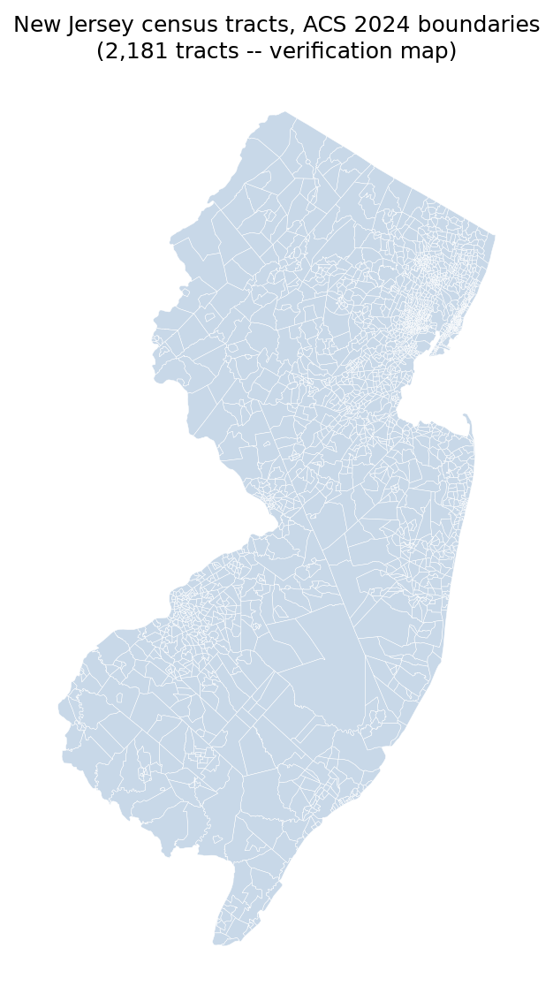
VERIFICATION
Verified: our numbers and our maps snap together 1-to-1
✓
Every row matches exactly one shape
At all three zoom levels, each data row joined to exactly one boundary on the map — no orphans, no duplicates.
✓
The eyeball test
We drew all 2,181 tracts with no styling at all. It looks like New Jersey because it is — the join keys work.
✓
Why this matters
The final dashboard is a map. Getting data-to-map joins verified now means every choropleth we build later is trustworthy.
All 2,181 NJ census tracts, drawn straight from our pulled data
Notes:
Technical detail if anyone asks: boundaries are cartographic boundary files, vintage-matched to the data (2024), saved as GeoParquet. A handful of shapes (6 tracts, 6 block groups) have tiny self-intersection quirks — harmless for maps, and we've documented the fix needed before any area calculations.

Slide 7
EARLY HEADLINE FINDING
Zoom in, and uncertainty explodes
Worst-case margin of error on median household income, same survey, same state:
COUNTY LEVEL
BLOCK GROUP LEVEL
±$3,982
62×
±$247,531
Reliable enough for most planning decisions
noisier
The error is bigger than most incomes being measured
Same data source — the only thing that changed is how far we zoomed in. Knowing when a number is still trustworthy is exactly the question our reliability score will answer.
Notes:
This is the project's central empirical fact and the seed of our first mentor-meeting chart. Intuition, not formula: think of uncertainty as noise as a share of the number itself. At county scale the noise is a rounding error; at block-group scale it can be bigger than the estimate. Small areas = small survey samples = huge error bars. This is why a single reliability score, shown on a map, is genuinely useful.

Slide 8
DATA LANDMINES — FOUND AND DOCUMENTED
Three quirks we caught early, so nobody trips on them
!
!
!
Tiny areas are missing tables
Income tops out at $250,001
Blanks that lie
Poverty and detailed demographic tables simply aren't published below the tract level. We've logged the “is tract an acceptable floor?” question for our Census mentors.
Any area with median income above $250k shows the exact same capped value — several NJ tracts hit it. Wealthy areas need careful handling.
Two special codes with opposite meanings — “officially exact” and “too little data to publish” — both arrive as empty cells in our tools. We know how to recover the difference when it matters.
All three are written up in the repo's handoff notes — future-us will not rediscover them the hard way.
Notes:
Details if asked: (1) the API literally returns 'no content' below tract for poverty (B17001) and race-by-age tables — verified empirically, and a block-group-friendly alternative table is on the mentor-question list. (2) Top-coding at 250,001 is a Census disclosure practice. (3) The special codes are annotation values like -555555555 (controlled, very reliable) and -666666666 (insufficient sample); our data library converts both to blank, but the API offers annotation columns that recover the distinction.

Slide 9
YOUR TURN
Get the exact same data on your laptop — about 10 minutes
1
Clone the GitHub repo
One git command — the README on the repo front page has it ready to copy.
Full walkthrough
README → “Getting Started” on the repo front page. Written for exactly this — ten minutes from clone to working environment.
2
Install the Python environment
One command installs the identical toolset we used.
3
Get your free Census API key
Instant signup; the key arrives by email within minutes. It stays on your machine, never in git.
Because data is rebuilt by scripts, we all stay perfectly in sync — nobody ever emails a CSV.
4
Run the two data scripts
The identical New Jersey dataset appears on your machine, sanity checks and all.
Repo: github.com/andrewswiniarski-hue/Census_Uncertainty_Analysis
Notes:
Encourage everyone to do this before the next work session — it's the fastest way to get familiar with the repo, and it proves our reproducibility claim on four more laptops. If anything in the walkthrough fails on your machine, that's a bug in our deliverable — tell me and we fix the README, not just your laptop.

Slide 10
WHAT'S NEXT
Next analyses are queued — and I need three things from you today
Queued analyses (data is already on disk)
For discussion on this call
1
Chart: how noise grows as areas shrink
our first real finding, and the chart we bring to the July 22 mentor meeting
Your feedback from the repo review — anything unclear or missing?
Who wants which workstream — analysis, dashboard, methodology write-up, data hunting?
Confirm our recurring biweekly slot with the mentors.
2
Map: where uncertainty concentrates in NJ
a crude preview of the final dashboard
3
Find the privacy-noise demo dataset
the one setup item still open — needed to study the Decennial Census side
Notes:
The analyses are intentionally paused until the team has reviewed the repo — that's this call. Once we agree, analysis #1 starts immediately; everything it needs is already on disk. Workstreams are a starting point, not silos — everyone should touch the data at least once via the 10-minute setup.

Slide 11
APPENDIX — CURRENT SETUP
The pipeline today: one API, two scripts, identical data for everyone
1
2
3
4
Census Bureau API
Script #1 — the numbers
Script #2 — the maps
Analysis-ready files
→
→
→
The Bureau's free public data service. We ask for exactly the tables, places, and error margins we want — a personal key (kept out of git) unlocks it.
Pulls estimates plus their margins of error at all three zoom levels, then sanity-checks itself: 21 counties, value ranges, blank rates.
Pulls the matching boundary shapes and proves every data row joins to exactly one shape — then draws a test map as visual proof.
Six checked data files plus the verification map land on disk — byte-identical on any laptop that runs the scripts.
api.census.gov
ingestion/pull_acs_nj.py
ingestion/pull_nj_geometry.py
data/raw/ (never committed)
What stacks on top of this next:
Measure the error (noise vs. estimate)
→
Build the reliability score
→
Put it on the dashboard
Raw data never goes into git — the scripts are the source of truth. Run them, and you rebuild the exact same files.
Notes:
Read left to right: data comes in through the Census Bureau's public API (each of us uses our own free key, stored locally, never committed), script #1 fetches the estimates with their margins of error and validates itself, script #2 fetches the matching geography and proves the 1-to-1 join, and the result is analysis-ready files on disk. The dashed boxes are the layers we build next — each one reads from the files this pipeline produces, so if the pipeline is trustworthy, everything downstream inherits that.

