Slide 1
MSBA CAPSTONE × U.S. CENSUS BUREAU
Census Uncertainty Analytics
Biweekly check-in #1 — Phase 1 exploration complete:
all three sources of uncertainty measured empirically
July 22, 2026 · Andrew Swiniarski · New Jersey testbed
Notes:
Frame the meeting: two-week update, three things to show, three questions to ask. Since kickoff we finished the entire Phase 1 exploration checklist: five analysis notebooks, eight charts, every data pull scripted and rerunnable by anyone with a free API key. One slide of status, then questions — the rest of the deck is backup material if discussion goes deep.

Slide 2
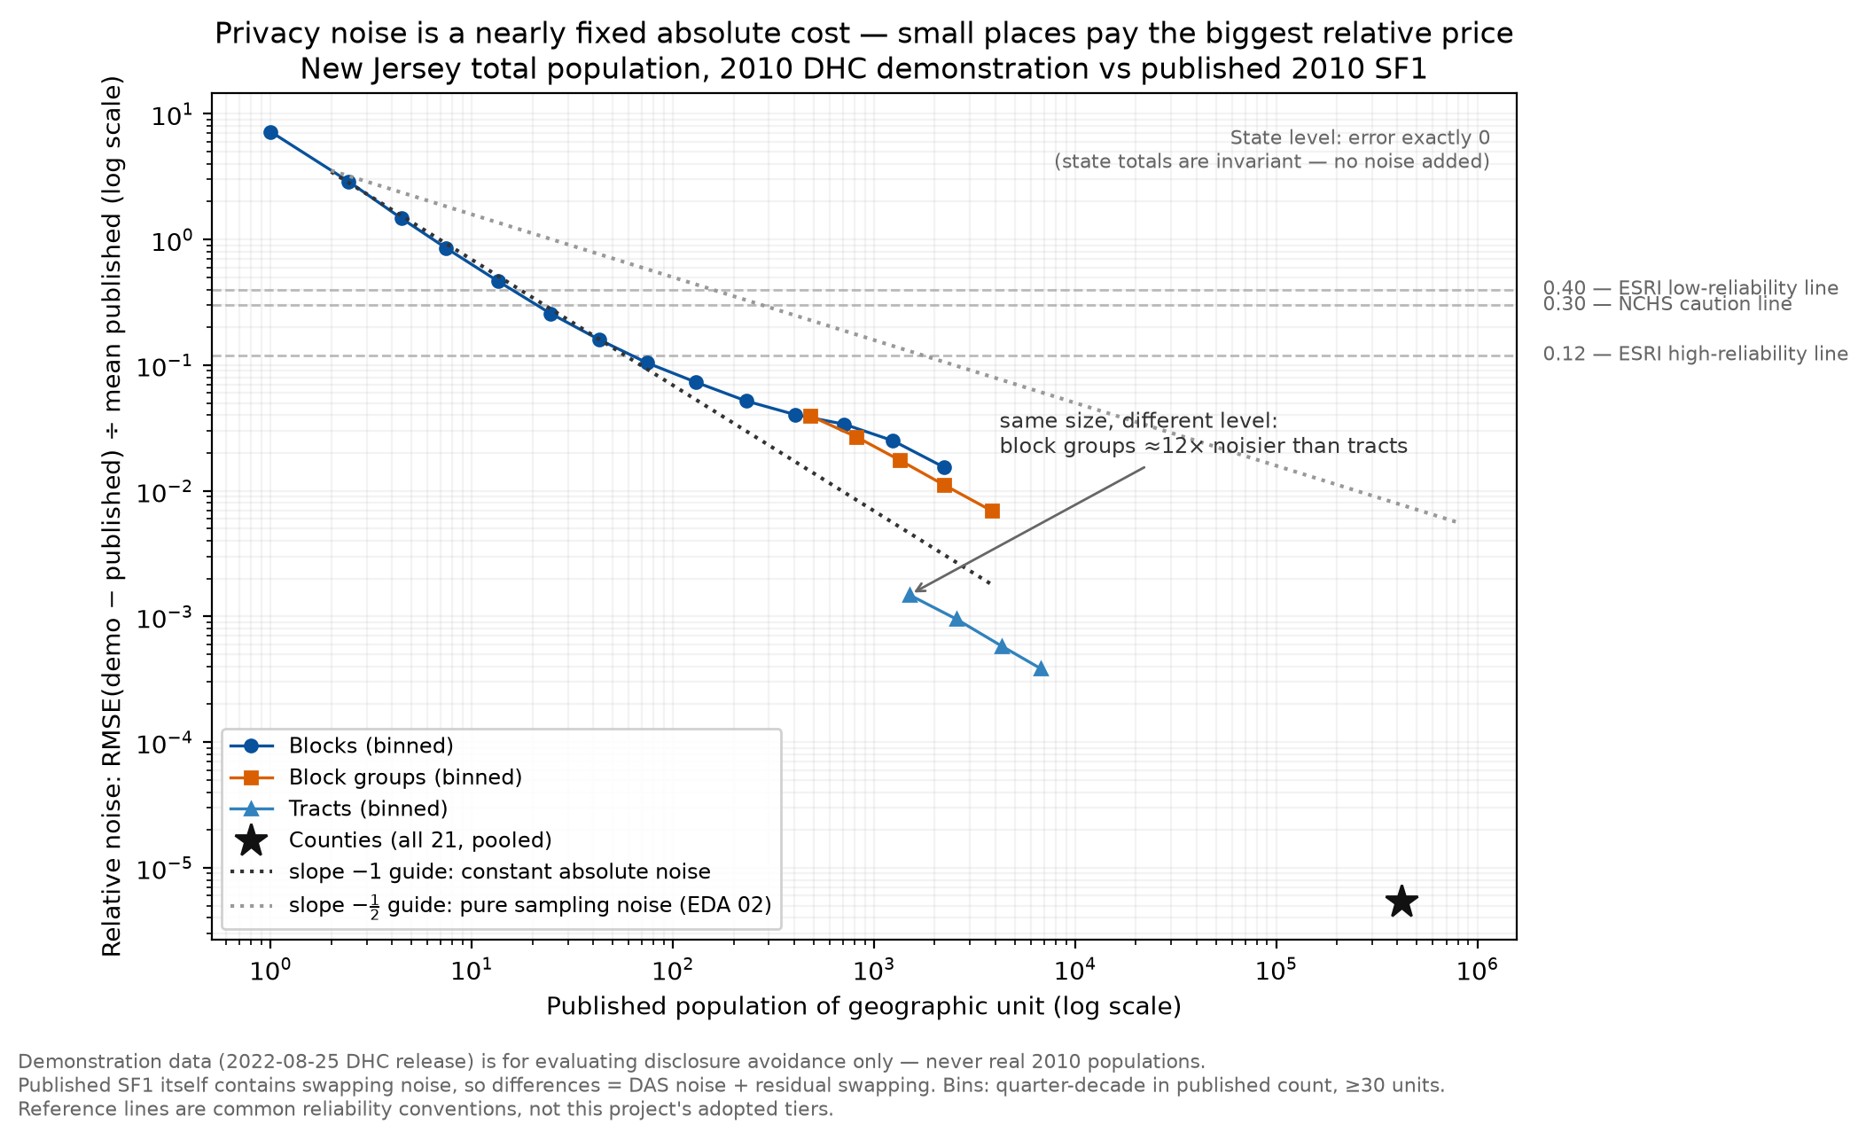
STATUS · PHASE 1 COMPLETE · JULY 22, 2026
All three sources of noise are now measured — and they follow different laws
1
Sampling noise obeys a size law
ACS relative noise grows predictably as places shrink (log-log slope −½, confirmed across 8,800 NJ geographies). Lawful noise is scoreable noise.
2
Privacy noise is a fixed absolute cost
The 2020 privacy system adds roughly constant noise per place (slope ≈ −1): invisible at county scale (±2–5 people), dominant below ~60-person blocks. A different law than sampling — see chart.
3
Imputation is the axis error bars can't see
At the median tract, ~39% of households had income imputed — yet allocation rates are statistically independent of margins of error. A multi-component reliability score isn't a preference; the data requires it.
5 notebooks · 8 charts · fully reproducible — github.com/andrewswiniarski-hue/Census_Uncertainty_Analysis
Notes:
The chart is the story: relative noise vs. place size, on log scales. Blue/orange series are privacy noise measured from the Bureau's own 2010 demonstration data vs. published 2010 counts. The two dotted guides are the two laws — sampling noise falls like 1/√N (shallow), privacy noise like ~1/N (steep, a fixed absolute cost). Our measured series track the steep guide. Practical reading: for total population, privacy noise matters only below ~60-person blocks; at tract/county scale it is negligible. Caveats we always state: demonstration data is evaluation-only, and the 2010 published baseline contains swapping noise, so differences are DAS + residual swapping. Also visible: same-size block groups sit ~12× above tracts — that's question 2.

Slide 3
WHAT WE NEED FROM YOU TODAY
Three questions only the Bureau can answer
1
Confirm scope: products and privacy-noise vintage
Is the 3–5 product shortlist right (ACS 5-year, Decennial DHC, …)? And is the 2022-08-25 DHC demonstration release the right basis for privacy-noise analysis, or should we move to the 2023 production-settings microdata?
2
The block-group anomaly — is our reading right?
In the demonstration data, NJ block groups carry ~9× the absolute total-population noise of tracts (a same-size block group is ~12× noisier). We suspect privacy-budget allocation along the geographic spine, with tabulation block groups assembled off-spine. Is that correct — and will production 2020 DHC behave the same way?
3
What should the reliability score consume?
For the privacy component: the published ε allocations, or the noise we measured empirically? For imputation: is the one nonzero signal we found (income allocation vs. income CV, ρ ≈ +0.19 after size control) a known mechanism, or small enough to ignore?
Full open-questions list (seven items) in the backup slides.
Notes:
Question 1 gates everything downstream — we need the shortlist and vintage locked to start the scoring phase. Question 2 is our genuine discovery: noise depends on WHERE the privacy budget is spent, not just place size; if confirmed, geography level becomes its own component in the score. Question 3 shapes the score's design inputs. If time is short, get answers to 1 and 2 and take 3 offline.

Slide 4
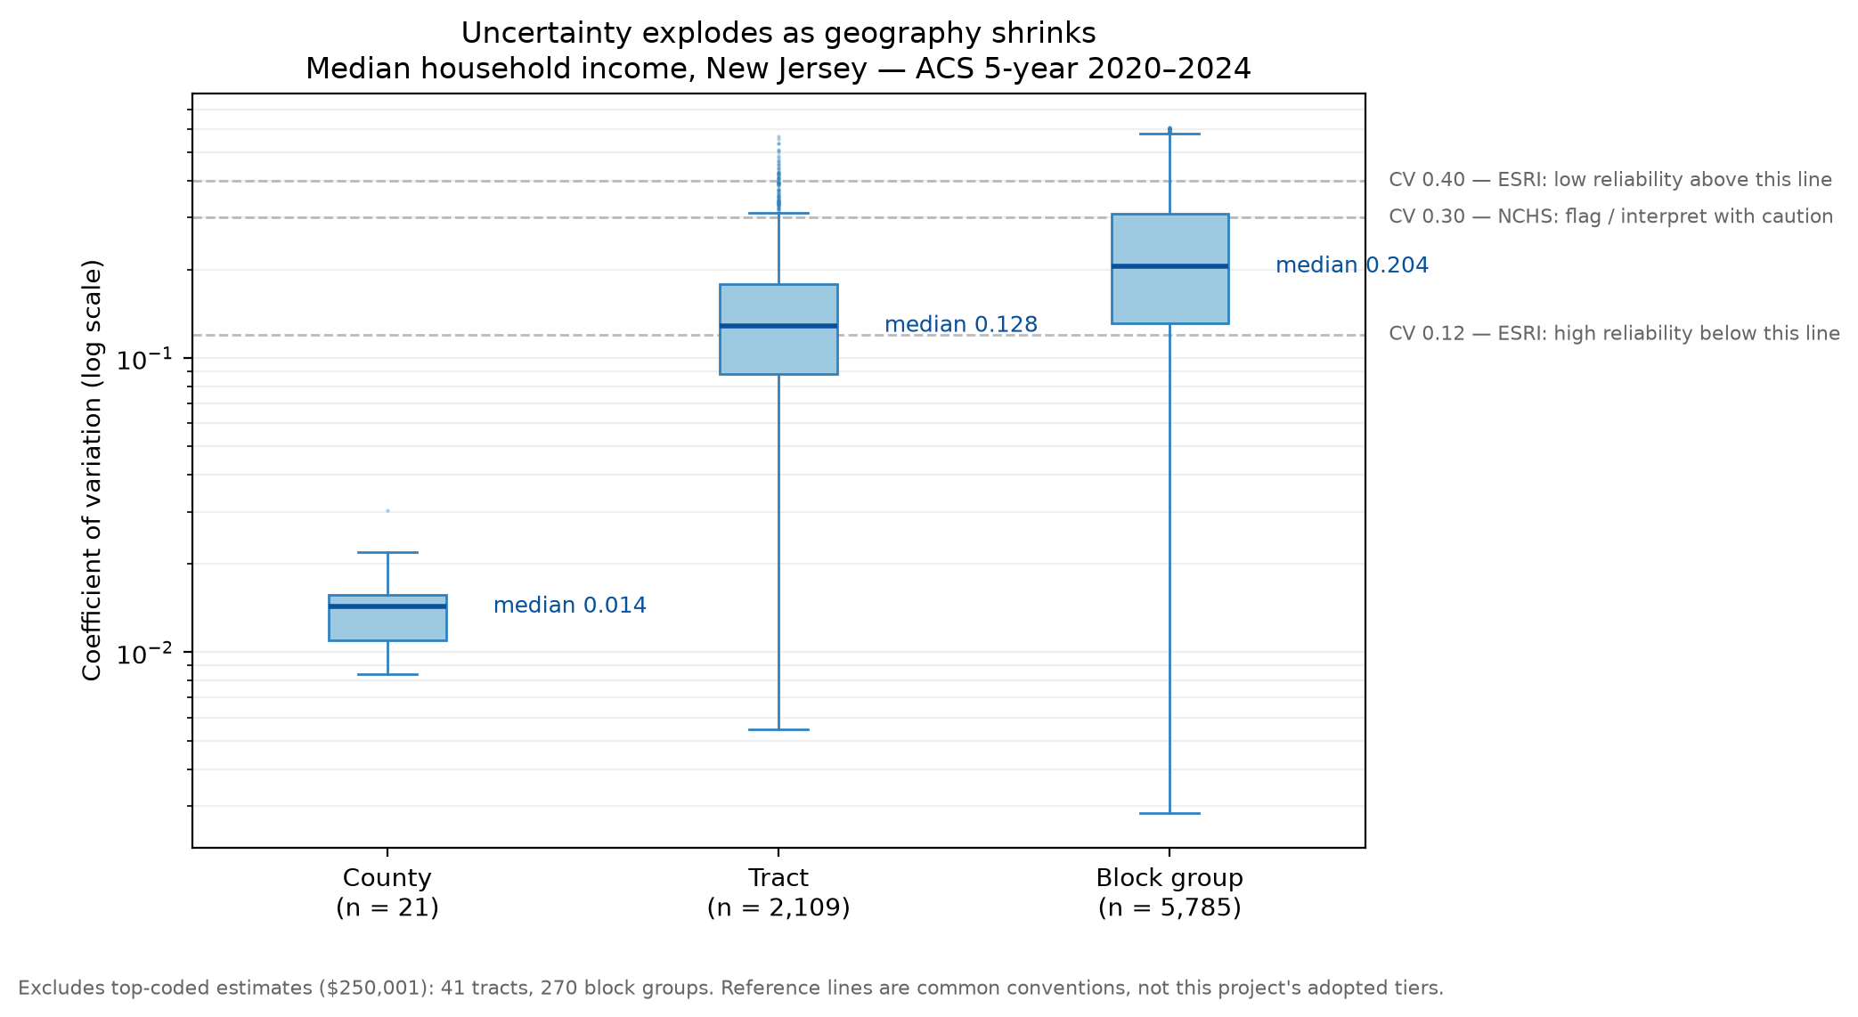
BACKUP — SAMPLING NOISE (EDA 01)
Zoom in, and reliability collapses — predictably
How to read it
Same survey, same state — only the zoom level changes. County income estimates: ~2% noise. Block groups: noise can exceed the income being measured.
The collapse is lawful, not random — which is exactly what makes reliability scoreable.
Reference lines (0.12 / 0.30 / 0.40) are common agency conventions, not our adopted tiers — tier design is a mentor decision for the scoring phase.
Notes:
The distribution of relative noise (CV) for median household income at three geography levels. Emphasize: the whole project premise in one chart — uncertainty is invisible in the published tables but large and systematic. If asked about the gray exclusions: top-coded incomes ($250,001) are censored values and excluded, documented in the notebook.

Slide 5
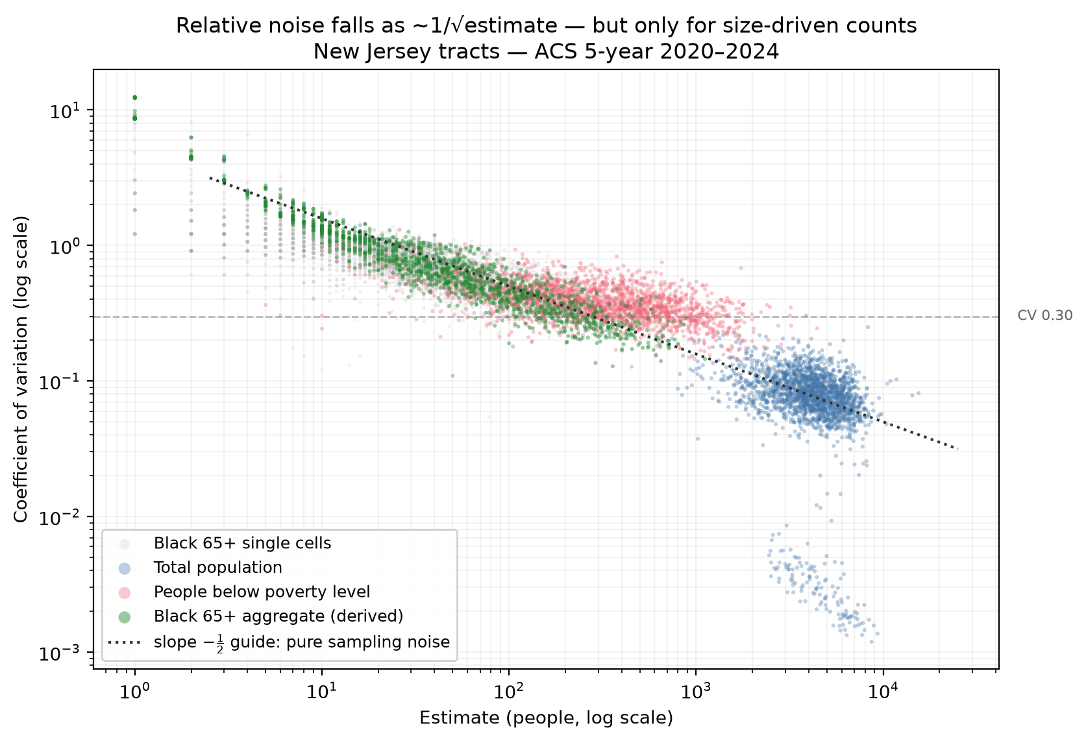
BACKUP — THE MECHANISM (EDA 02)
The number of people behind an estimate sets its reliability
How to read it
Every point is one tract-level estimate; noise falls along the dotted −½ guide — the pure sampling law.
Size-driven counts (population, subgroup counts) obey the law; prevalence-driven estimates (poverty) run shallower.
This fitted size law is also the backbone of our independence test in EDA 05 — we residualize against it before correlating anything with CVs.
Notes:
The mechanism slide: CV vs estimate size on log axes, slope −½ confirmed (population −0.47, Black 65+ aggregate −0.51). This established the sampling law that the privacy-noise law is contrasted against on the status slide.

Slide 6
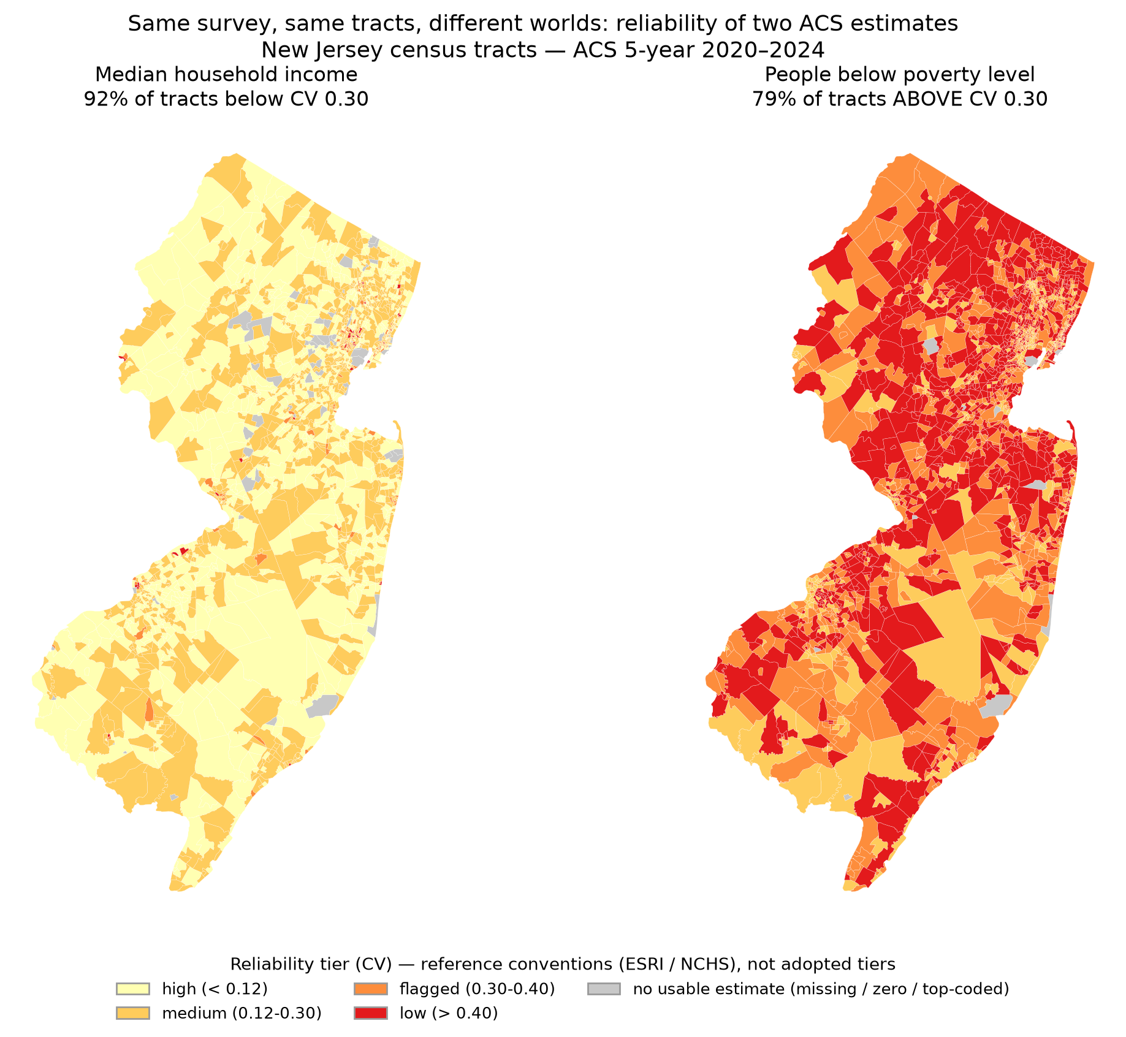
BACKUP — WHERE IT CONCENTRATES (EDA 03)
The county-planner view — reliability as a map
How to read it
Tract-level reliability tiers for income (left) and poverty (right) — a crude preview of the dashboard deliverable.
Poverty is systematically less reliable than income at the same geography — variable type matters as much as size.
Gray tracts = CV undefined (zero estimates). Our standing rule: report as their own class, never “infinitely unreliable.”
Notes:
Dashboard-direction evidence: this is what a non-technical decision-maker would consume. Spatial pattern: unreliable tracts cluster in low-population and high-variance areas. The choropleth uses classed tiers (not continuous ramps) deliberately — tier boundaries will be a mentor-reviewed decision.

Slide 7
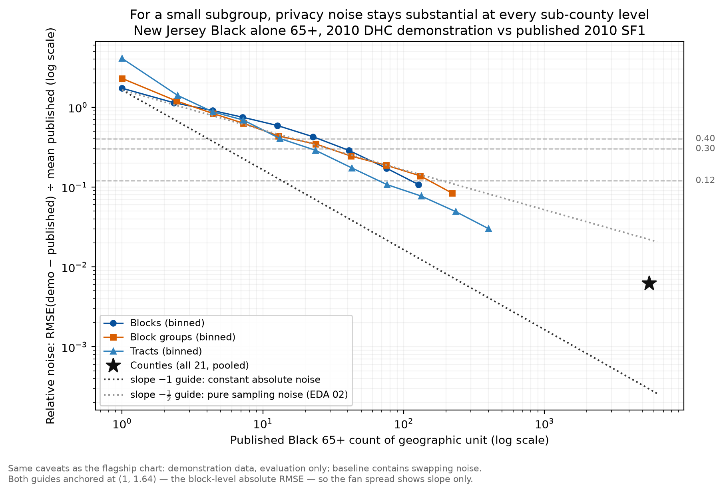
BACKUP — PRIVACY NOISE, SMALL SUBGROUP (EDA 04)
Privacy noise hits small subgroups everywhere below county scale
How to read it
Same analysis as the flagship chart, for Black residents 65+ — the small-subgroup stress test.
At the median tract (18 people in the subgroup), privacy noise is ~30–40% relative — at or above common caution thresholds.
Context: the ACS sampling noise for the same subgroup at tract level is ~2–3× larger (median CV 0.886). At block level only the privacy mechanism exists — surveys don't publish there.
Notes:
If mentors ask about equity implications: privacy noise is proportionally hardest on small subgroups in small places, and the ghost/vanished-block artifact (807 blocks gain phantom residents, 427 lose all) matters for block-level uses like redistricting. All caveats as before: demonstration data, evaluation only, baseline includes swapping.

Slide 8
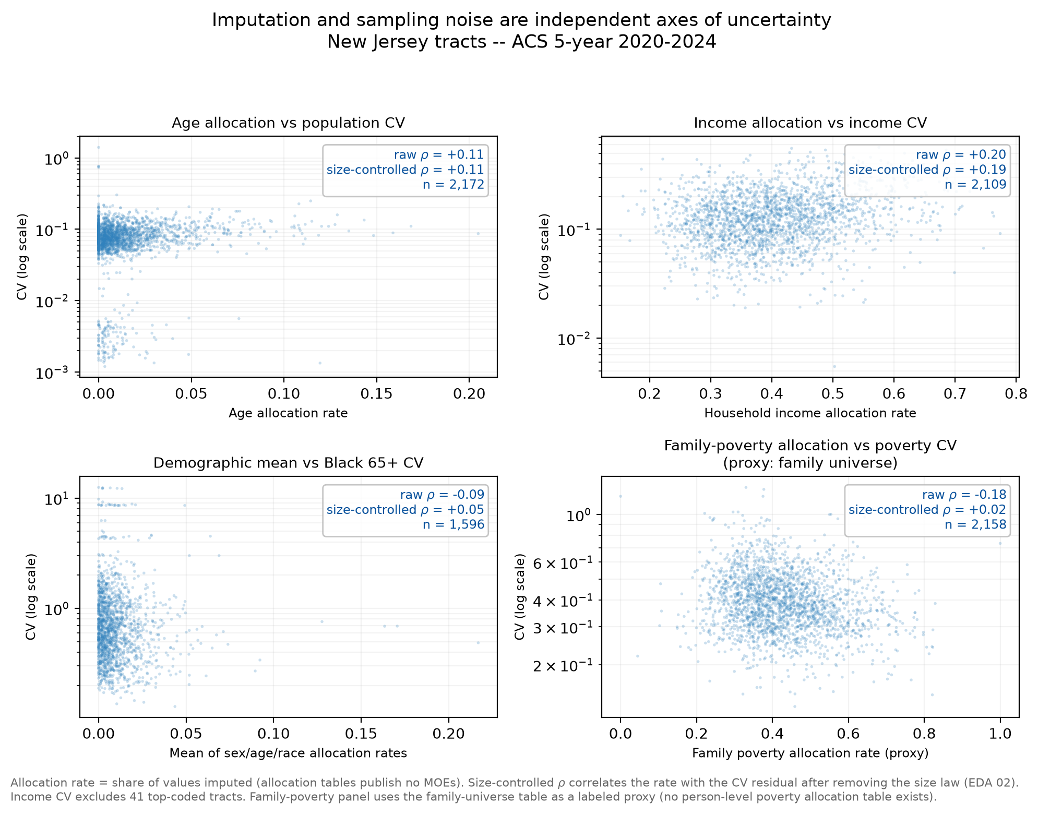
BACKUP — IMPUTATION INDEPENDENCE (EDA 05)
Imputation is invisible to error bars — and independent of them
How to read it
Four pairings of imputation rate vs. sampling reliability across NJ tracts — four structureless clouds.
After controlling for place size, every correlation sits between −0.00 and +0.19: knowing one tells you nothing about the other.
Why the control matters: the poverty panel's raw −0.18 collapses to +0.02 once size is removed — the raw association was pure size confound.
Consequence: a score built on error margins alone systematically overstates certainty for high-imputation places.
Notes:
This is the empirical justification for the multi-component score design (research question 2). Prevalence headline: ~39% of households at the median tract had some income imputed, vs under 1% for age/race. The family-poverty panel is a labeled proxy — no person-level poverty allocation table exists (poverty is derived from income).

Slide 9
BACKUP — FULL OPEN-QUESTIONS LIST
Everything we've queued for the mentors
!
Product shortlist
Confirm the 3–5 Census products the report and dashboard should cover.
!
DAS demonstration vintage
Is the 2022-08-25 tabulated DHC release the right privacy-noise basis (vs. the 2023-04-03 production-settings microdata)?
!
Block-group anomaly
~9× tract-level absolute noise at block groups; county noisiest for the P12B subgroup table. Is the off-spine allocation reading right? Persist in production?
!
Score input for privacy
Published ε allocations vs. empirically measured noise (our per-level RMSE)?
!
131-tract MOE mystery
6% of NJ tracts publish near-controlled population MOEs (±14–143 vs. median ±546). What mechanism? Own class in the score?
!
Tract floor
Poverty and race×age tables stop at tract level — acceptable floor for the dashboard?
!
Income-allocation signal
Weak positive association between income imputation and income CV after size control (ρ ≈ +0.19). Known mechanism or ignorable?
Notes:
The canonical list lives in the repo README under 'Open Questions for Mentors' with dates and notebook references. Items 1–4 are the priority; 5–7 as time allows.

Slide 10
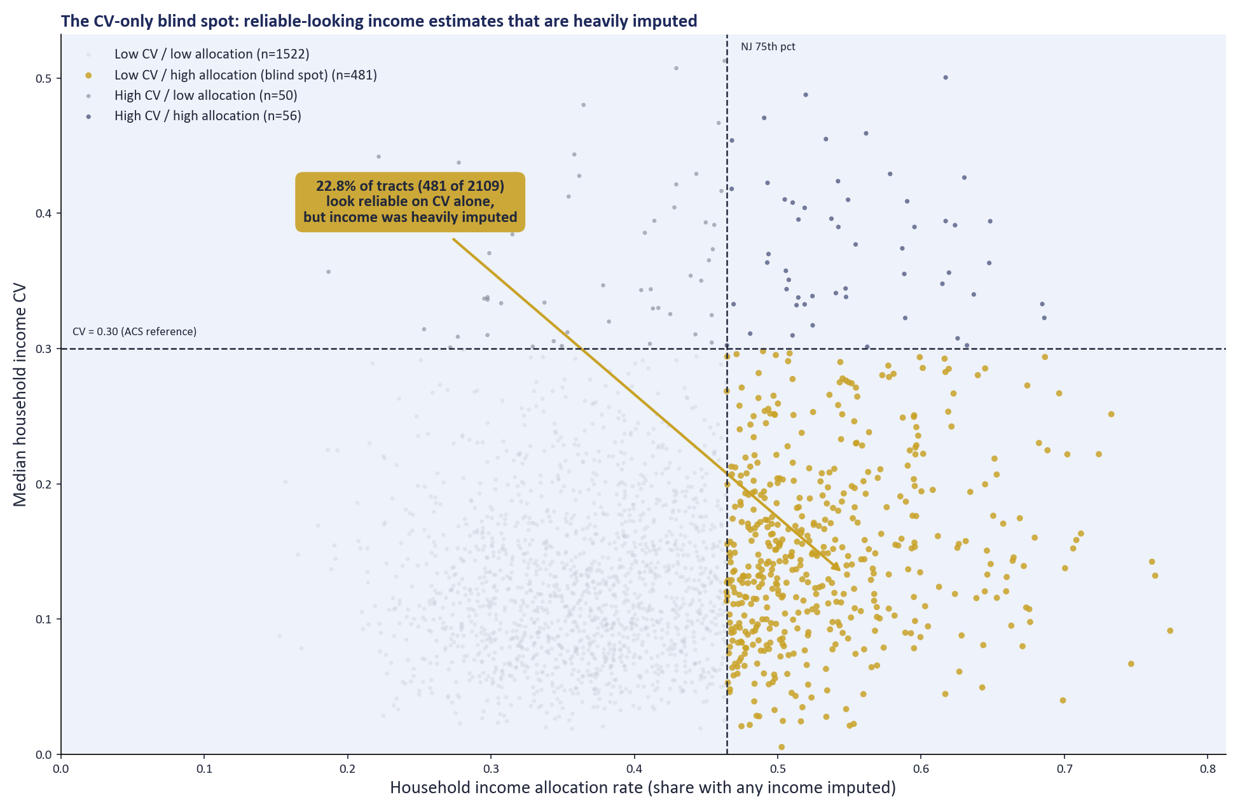

BACKUP · COMPOSITE PROTOTYPE (EDA 06)
The CV-only blind spot: ~23% of tracts
How to read it
Each point is one NJ tract. Dashed lines mark CV = 0.30 (ACS reference) and the NJ 75th percentile of income allocation (~0.46).
Gold = low CV / high allocation (n=481, 22.8% of classified tracts). That's the blind spot: published error bars look fine, but imputation does not.
Why it matters: a score built on MOEs alone would call these tracts reliable. Matrix stays the headline; weights not locked (equal-weight vs worst-component agree on ~85% of top-risk-quartile membership).
Notes:
EDA 06 blind-spot matrix. Blind spot = 481/2,109 classified tracts (22.8%), the visually dominant gold quadrant with an on-chart callout. Equal-weight vs worst-component agree on only 84.6% of top-risk-quartile membership, so combination rules matter: do not claim locked tiers. Poverty/Black 65+ are labeled robustness cases only. No DHC privacy join into ACS rows.

Slide 11
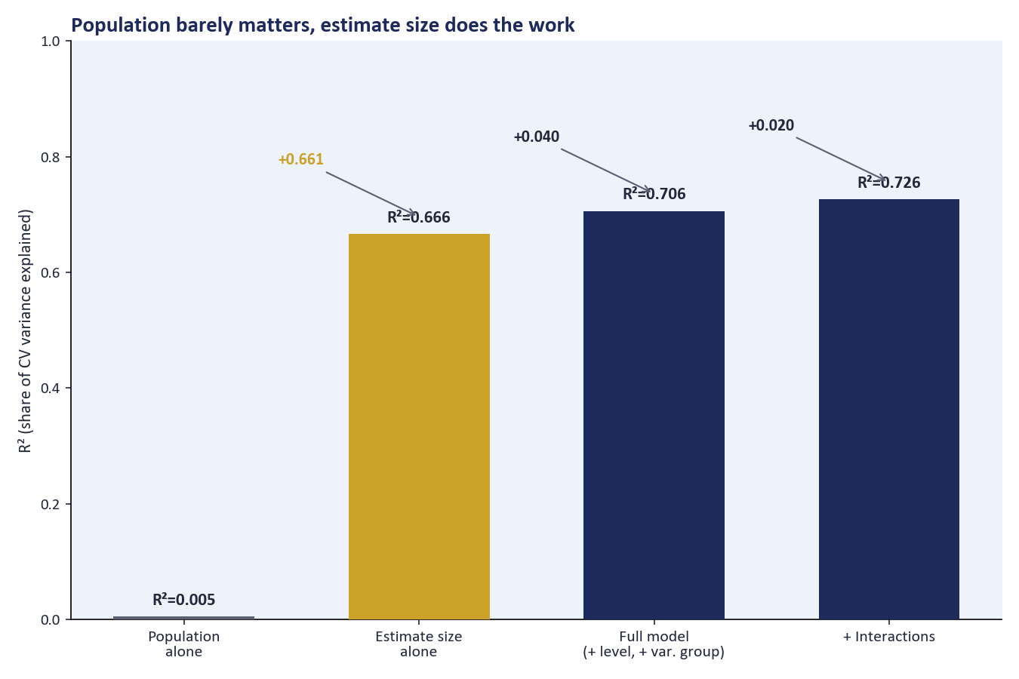
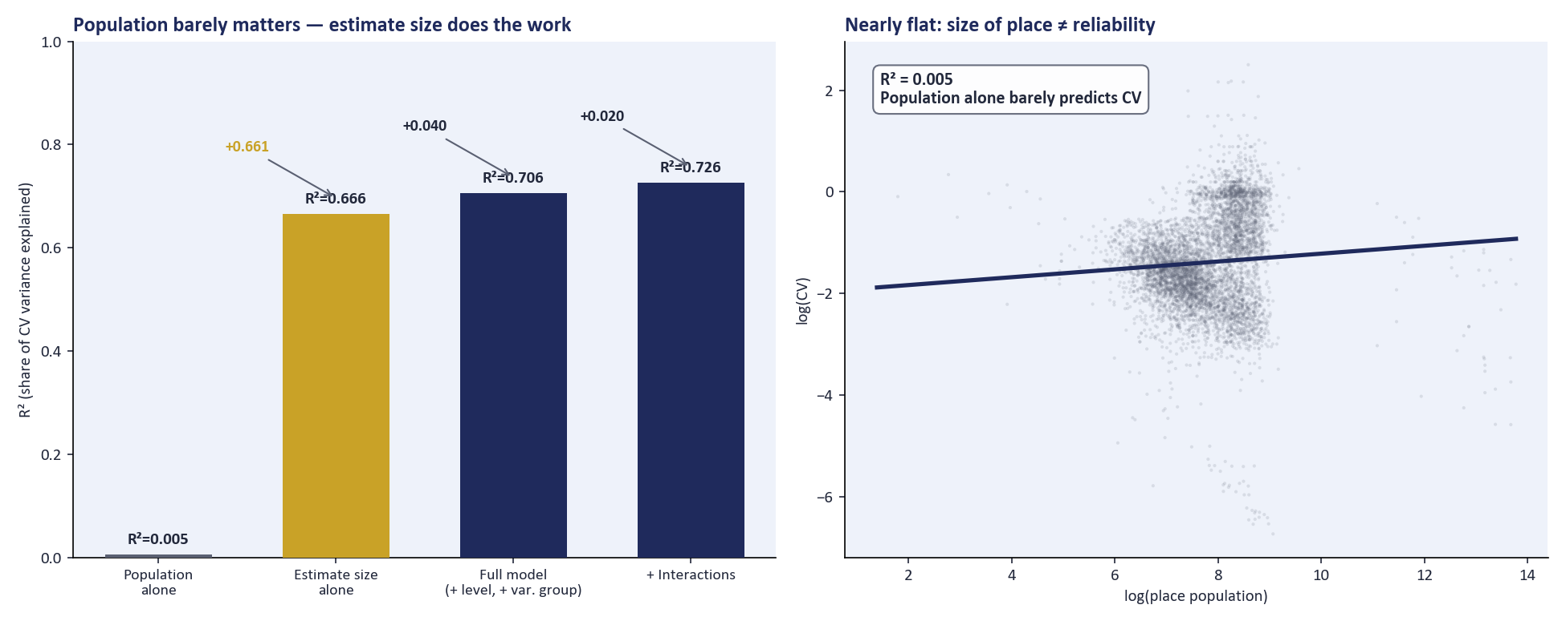
BACKUP · CV DRIVER MODEL (EDA 07)
Score the estimate, not the place
How to read it
Each bar is one model's R² (the share of CV variance it explains), run in sequence on n≈24,947 rows.
Population alone explains almost nothing (R²≈0.005). Swapping in estimate size jumps to R²≈0.666, by far the biggest gain.
Adding geography level and variable group reaches R²≈0.706. Adding interactions reaches R²≈0.726.
Caveat: income medians are weakly size-explained (R²≈0.01), so residual flags work better for count variables than for income.
Notes:
EDA 07 resolves the JL Final Takeaway: place pop is not the CV driver, estimate size is. Chart is now a single R2 waterfall labeled by variable added; dropped the population-vs-CV scatter panel per lead feedback since it wasn't adding insight beyond the waterfall. Matched-size panel (if asked): Black 65+ is still noisier than population at similar counts (about 0.28 vs 0.17 median CV). Composite V2's optional cv_residual_high flag is a seed for counts, not a locked score component.

