Slide 1
Appendix M
Historical Perspectives and
References

Slide 2
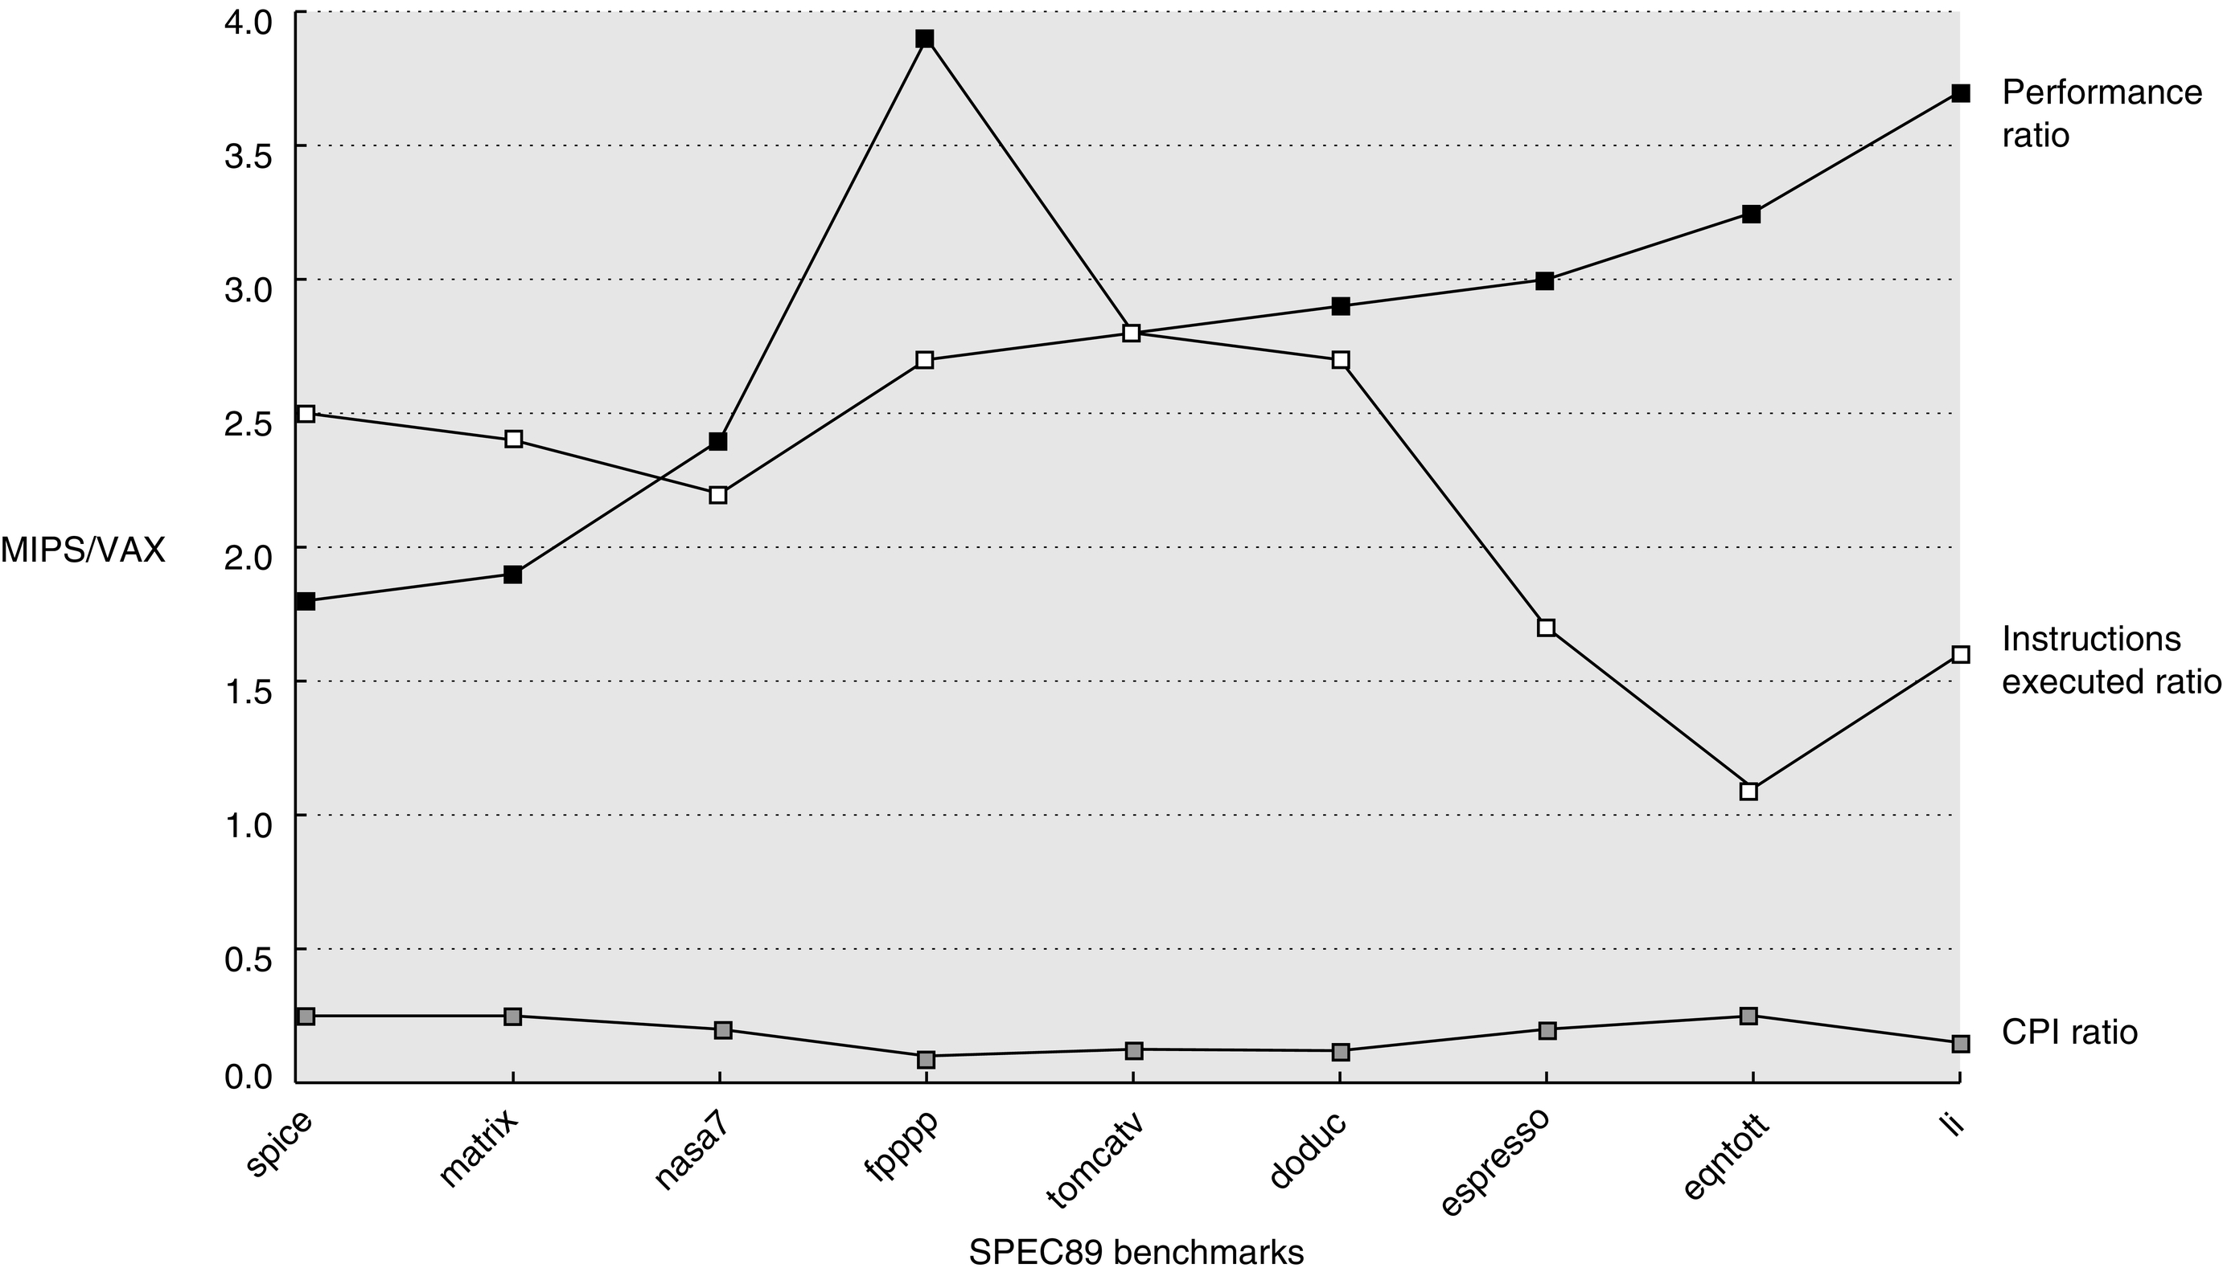
Figure M.1 Ratio of MIPS M2000 to VAX 8700 in instructions executed and performance in clock cycles using SPEC89 programs. On average, MIPS executes a little over twice as many instructions as the VAX, but the CPI for the VAX is almost six times the MIPS CPI, yielding almost a threefold performance advantage. (Based on data from Bhandarkar and Clark [1991].)

Slide 3
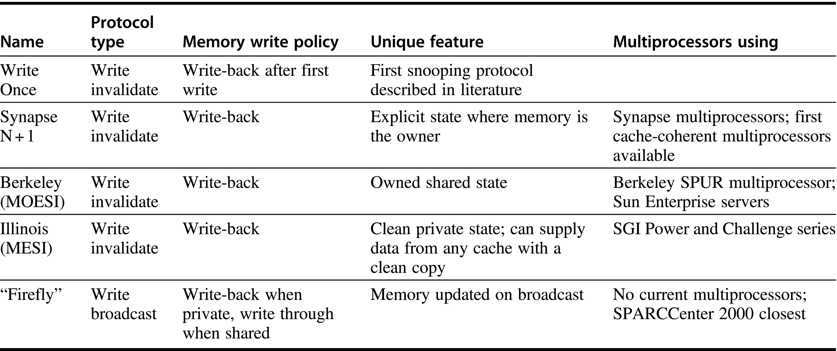
Figure M.2 Five snooping protocols summarized. Archibald and Baer [1986] use these names to describe the five protocols, and Eggers [1989] summarizes the similarities and differences as shown in this figure. The Firefly protocol was named for the experimental DEC Firefly multiprocessor, in which it appeared. The alternative names for protocols are based on the states they support: M = Modified, E = Exclusive (private clean), S = Shared, I = Invalid, O = Owner (shared dirty).

