Slide 1
Static Program Analysis Lecture 1: Introduction. Static Analysis. Software Metrics.
Andrei Tatarnikov
atatarnikov@hse.ru
@andrewt0301

Slide 2
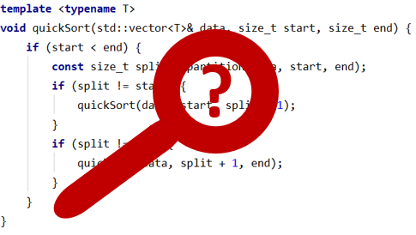
Course Resources
Wiki
http://wiki.cs.hse.ru/SPA_2022
Web site
https://andrewt0301.github.io/static-analysis-course/
Telegram channel
https://t.me/+gazeL_TRsRYyMWYy
Telegram chat
https://t.me/+d33WiFnng905Mjdi

Slide 3







Course Staff
Andrei Tatarnikov
HSE page: https://www.hse.ru/org/persons/36585966
Email: atatarnikov@hse.ru
Telegram: @andrewt0301
LinkedIn: https://www.linkedin.com/in/andreitatarnikov/
GitHub: https://github.com/andrewt0301

Slide 4
Course Outline
Course Contents
https://andrewt0301.github.io/static-analysis-course/
15 Lectures and 15 Workshops
Spoken Exam: 0-10 Points
Bonus Points for Presentation at Workshop: +1 Point Each

Slide 5
Course Motivation
Increase your computer literacy
Improve understanding of languages and compilers
Understand modern static analysis problems and techniques
Be able to use static analysis tools in your projects
Learn how to create static analysis tools

Slide 6
What is Static Program Analysis
Static Program Analysis is a method that allows developers to ensure code quality without running it. Modern software companies use a variety of static program analysis tools and even create their solutions to cover specific requirements.
Program properties to be analyzed:
Structure (easy)
Behavior (more complicated)

Slide 7
Compiling and Interpreting
Source Code
Input Data
Input Data
Source Code
Program
Compiler
Interpreter
Output Data
Executable Program
Output Data

Slide 8
Program Analysis
Internal Representation
Source
Code
Tokens
Parse Tree / AST
CFG / DFG
SSA
Executable Program

Slide 9
Types of Analysis
Software metrics
Lexical and syntax analysis
Semantic analysis
Control and data-flow analysis
Inter-procedural analysis
Symbolic execution and abstract interpretation
Deductive verification
Mining-based analysis

Slide 10
Any Questions?
.text
__start: addi t1, zero, 0x18
addi t2, zero, 0x21
cycle: beq t1, t2, done
slt t0, t1, t2
bne t0, zero, if_less
nop
sub t1, t1, t2
j cycle
nop
if_less: sub t2, t2, t1
j cycle
done: add t3, t1, zero

