Slide 1
Digital Repository System in Kilgore College
Presented by
Andy Tang
Notes:
Click to add notes

Slide 2
Agenda
Background
Why do we digitize them?
Project Schedule
Stakeholders’ interaction
System selection
4 steps to complete project
Final product
Successive Training

Slide 3
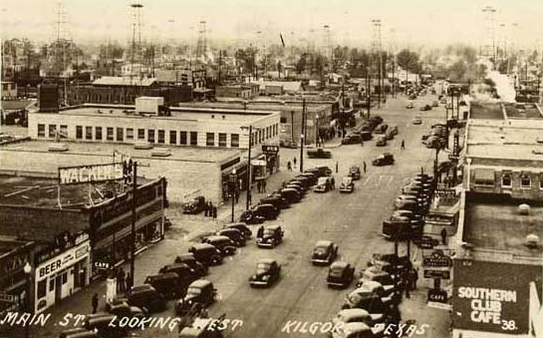
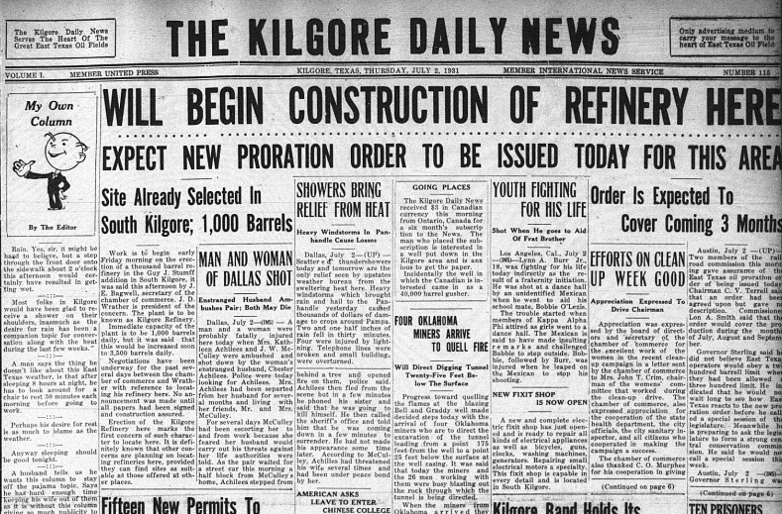
Background
Oil booming -> Newspaper (1931)
Notes:
How presentation will benefit audience: Adult learners are more interested in a subject if they know how or why it is important to them.
Presenter’s level of expertise in the subject: Briefly state your credentials in this area, or explain why participants should listen to you.

Slide 4
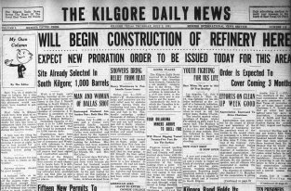
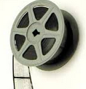
Local newspaper preservation and usage in Kilgore College
Kilgore News Herald – Newspaper
Microfilm
  For the purpose of preservation, Kilgore city issued a fund to convert newspaper from paper to microfilm.
  All of the microfilms are preserved in Kilgore College
Daily usage
  Patrons from local and nearer cities, government, the public.
Notes:
Lesson descriptions should be brief.

Slide 5
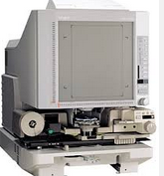

Why do we digitize them
Microfilm reader usage is not convenient
Library director and circulation staff have the motivation to digitize them- why, reduce workload, easy to search
We have to face the problems of how to manage these PDF format newspapers
Notes:
Microfilm reader using is not convenient
1.Sometimes, the patron has to load and unload many microfilms to reader until they find what they want.
2. It is painful to browse the microfilm page by page.
3. There is no way to use metadata and information retrieval efficiency is low.

Slide 6
Project schedule
 | Time | Person in charge | Notes
Systems selection | 3 months | Library director and systems librarian (Andy Tang) | Hardware and software
Microfilm digitizing/metadata creation | 1st phase: 1.5 year | Archival assistant (Jacklyn) | [1931 : 1935]
Submission Information Package tools creation | 1 week | Andy Tang
Metadata processing and SIP preparation/importing | 2 days | Andy Tang
Web Interface customization | 1 week | Andy Tang

Slide 7





Stakeholder interaction
Local government
The public
Library staff
IT
College Administration Level

Slide 8
System selection
DSpace – Digital Repository system
Pros | Cons
Institutional Repository System Encompass lots of digital formats Allow creation, indexing, and searching of metadata Distribute digital microfilm to web Free | Installation is complicated SIP preparation is not very easy.
Notes:
SIP - Submission Information Packages
Advantages:
GUI
Workflow – rold definition
OAI- open archives initiative
Persistent identifiers
Access control
Dupline core metadata schema

Slide 9
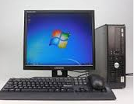
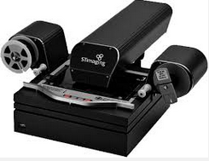

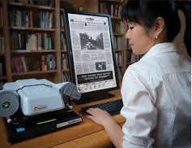
1st step: Digitization
Hardware
Software
Training

Slide 10
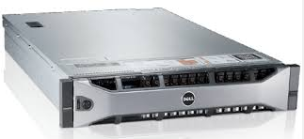





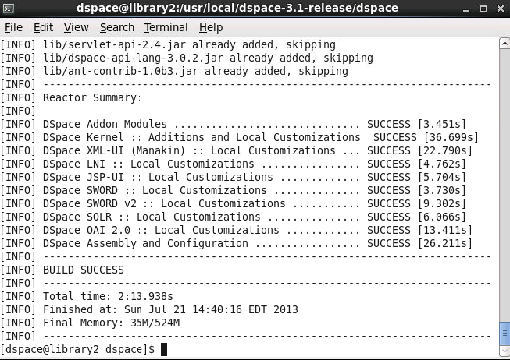
2nd step: Server purchasing and DSpace installation
Hardware: Dell server PowerEdge R720
Software:
  Platform – Redhat linux 6.4
  Javaserver - Tomcat
  Database – PostGreSQL
  Packaging - Maven
  Building - Ant
Installation process see appendix II
Notes:
Apache Tomcat is an open source software implementation of the Java Servlet and JavaServer Pages technologies.
Apache Maven is a software project management and comprehension tool. Based on the concept of a project object model (POM), Maven can manage a project's build, reporting and documentation from a central piece of information.
Apache Ant is a Java library and command-line tool whose mission is to drive processes described in build files as targets and extension points dependent upon each other. The main known usage of Ant is the build of Java applications.

Slide 11
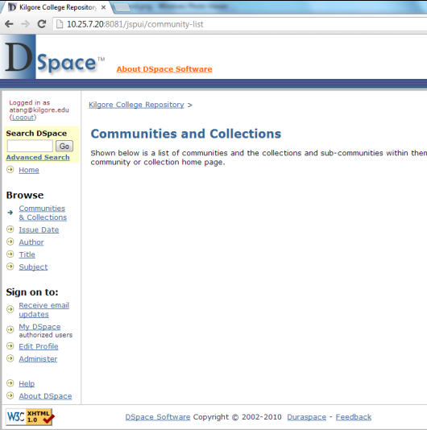
DSpace interface

Slide 12

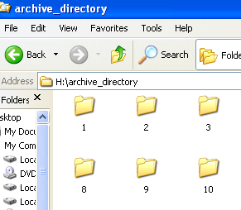
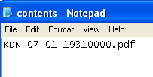

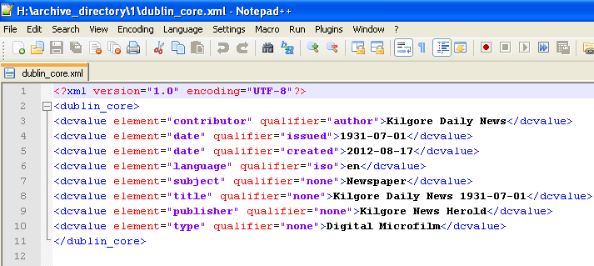
3rd step: Prepare SIP for the preparation to inject data into DSpace
SIP
Notes:
SIP: Submission Information Packages (SIPs).

Slide 13
Key technical issue in step 3
Issues | Solution
How to improve the efficiency of record injection. | Create some Applications
How to design some friendly tools to help library staff create SIP | GUI interfaces
Notes:
SIP: Submission Information Packages (SIPs).

Slide 14
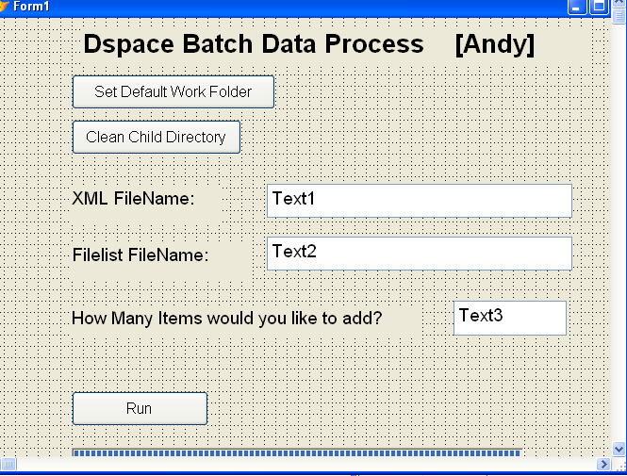
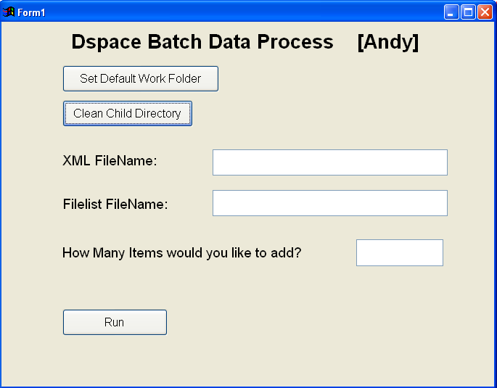
SIP visual tools
Visual tools is created to help library staff to do batch importing.
Codes see appendix I
Notes:
************************************************************
*the beginning to process the xml folder and xml file
*copyright: Andy Tang
*****************************************************************
Form1.Command1.click
stringa=FILETOSTR( Form1.Text1.value)
&&?stringa
&&? LEN(stringa)
&&MESSAGEBOX(Form1.Text3.value)
arrayvalue=Form1.Text3.value
&&arrayvalue
arrayvalue=VAL(ALLTRIM(Form1.Text3.value))
&&MESSAGEBOX(arrayvalue)
DIMENSION arrayt(arrayvalue)
isolator=LEN("</dublin_core>")
jj=1
FOR jj=1 TO arrayvalue
&&arrayt(jj)=STR(jj)+" "+"victory"
&&? arrayt(jj)
IF jj=1
arrayt(jj)=SUBSTR(stringa,1, ATc("</dublin_core>", stringa,1)+isolator)
ELSE
arrayt(jj)=SUBSTR(stringa, ATc("</dublin_core>", stringa,jj-1)+isolator+2,ATc("</dublin_core>", stringa,jj)+isolator-(ATc("</dublin_core>", stringa,jj-1)+isolator))
&&? jj
&&? ATc("</dublin_core>", stringa,jj-1)
&&? ATc("</dublin_core>", stringa,jj)
&&wait
ENDIF
&&
&&? CHR(10)+CHR(13)
&&? arrayt(jj)
&&? CHR(10)+CHR(13)
&&wait
ENDFOR
mm=1
FOR jj=1 TO arrayvalue
MKDIR ALLTRIM(STR(jj))
CD ALLTRIM(STR(jj))
IF FILE('dublin_core.xml')
ELSE
filehandle=fcreate('dublin_core.xml')
=FWRITE(filehandle,arrayt(jj))
=FCLOSE(filehandle)
ENDIF
cd..
endfor
************************************************************
* the beginning to process the filename list
*****************************************************************
stringb=FILETOSTR(Form1.Text2.value)
filebar=FCREATE('test1.txt')
? stringb
=FWRITE(filebar,stringb)
&&=FCLOSE(filebar)
DIMENSION arrays(arrayvalue)
isolator2=4 &&the length of .pdf string
jj=1
FOR jj=1 TO arrayvalue
IF jj=1
arrays(jj)=SUBSTR(stringb,1, ATc(".pdf", stringb,1)+isolator2-1)
ELSE
arrays(jj)=SUBSTR(stringb, ATc(".pdf", stringb,jj-1)+isolator2,ATc(".pdf", stringb,jj)+isolator2-(ATc(".pdf", stringb,jj-1)+isolator2))
ENDIF
arrays(jj)=STRTRAN(arrays(jj),CHR(13),"")
arrays(jj)=STRTRAN(arrays(jj),CHR(10),"")
=Fputs(filebar,'exllent')
&&=FWRITE(filebar, arrays(jj))
? arrays(jj)
&&? arrays(jj)
ENDFOR
=FCLOSE(filebar)
jj=1
ThisForm.OleControl1.Max = arrayvalue
ThisForm.OleControl1.visible=.t.
FOR jj=1 TO arrayvalue
&& MKDIR ALLTRIM(STR(jj))
directorya=STR(jj)
filenamea=arrays(jj)
copy FILE arrays(jj) TO &directorya\&filenamea
CD ALLTRIM(STR(jj))
IF FILE('contents')
ELSE
filehandlebb=fcreate('contents')
=FWRITE(filehandlebb,arrays(jj))
=FCLOSE(filehandlebb)
ENDIF
ThisForm.OleControl1.Value = jj
cd..
ENDFOR
MESSAGEBOX("Process is completed!")
ThisForm.OleControl1.visible=.f.

Slide 15
4th step: Batch import
Batch importing has high efficiency

Slide 16
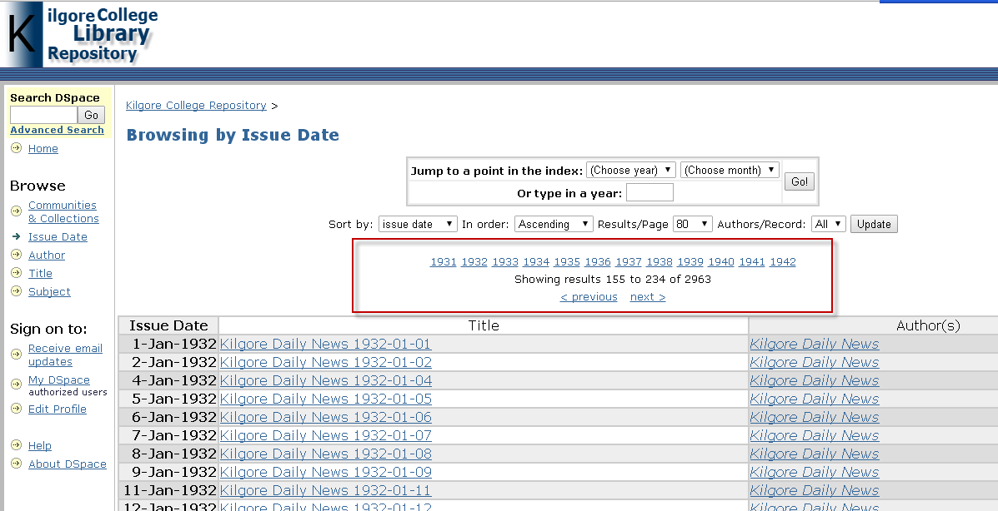

The final product
Customization on toolbar see appendix III
Notes:
Through modification of /usr/local/dspace/webapps/jspui/browse/full.jsp, and adding some customized the code,
A top navigational bar year by year is created.

Slide 17
Project results
Patrons’ satisfaction - Patrons reflects that the information retrieving efficiency is improved.
Reduce abrasion – microfilm preservation
Reduce workload - Library staff don’t have to teach patron on how to use microfilm reader.
Improve efficiency- Library staff feel easy to teach patron how to search and locate digital microfilm.
Improve reputation - College vice president likes it.

Slide 18
Successive Training
Manual
  Teach archive management staff
Training Video
  For Archive management staff
  For reference staff

Slide 19
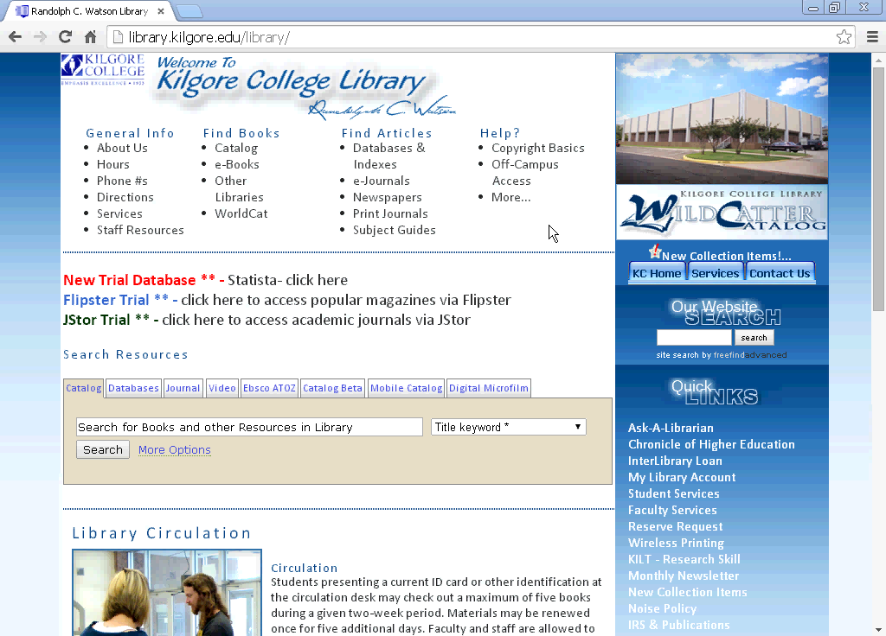
Training Video

Slide 20

Q&A
?

Slide 21
Appendix I
The code to create and process SIP (submission information packages)
Notes:
SIP: Submission Information Packages (SIPs).

Slide 22
Appendix II
How do I install DSpace in Redhat linux 6.4 step by step?

Slide 23
Appendix III
Customization on Years navigational bar in DSpace

