Slide 1

Phil Shirley
Cuyahoga Falls Library

Slide 2

Overview
Word (2 Examples)
Excel (8 Examples)
Global Update (1 Example)
Getting item barcodes into a review file
(5 ways)
Word & Excel 2007

Slide 3

Word

Slide 4
Word: Replace
Home tab, editing group
CTRL+H (for cHange)
Replace All (or ALT+A)

Slide 5
Word: Replace
Paragraph break: ^p
Tab: ^t
Manual Line Break: ^l

Slide 6
Word: Replace: Example 1
Clean Up a List
Create Lists
  List
  Blank lines between records: 1
  Print to email
Copy from email, paste into Word

Slide 7
Word: Replace: Example 1
Clean Up a List
Put CAT DATE on its own line.
  CAT DATE to ^pCAT DATE
Change field labels to something else.
  Click “More”: “Match Case”
Remove periods at end of lines (some have spaces after them)
  . ^p to ^p
  .^p to ^p

Slide 8
Word: Replace: Example 1
Clean Up a List
Remove paragraph breaks within titles.
  Change other paragraph breaks to line breaks:
    ^p^pTITLE to ^l^lTITLE
    ^pBIB LOC to ^lBIB LOC
    ^pCAT DATE to ^lCAT DATE
  Change remaining paragraph marks to spaces

Slide 9
Word: Replace: Example 2
Magazine list for web site
Click a title to go to the catalog record
Construct URLs from the bib number and title
When creating code in Word, beware of
  smart quotes
  extra spaces
  other things
  Set in Word options: advanced

Slide 10
Word: Replace: Example 2
Magazine list for web site
URL that links to the full display for a bib record:
http://catalog.cuyahogafallslibrary.org/record=b1236742

Slide 11
Word: Replace: Example 2
Magazine list for web site
Start with:
b1236742 AARP the Magazine
With URL, HTML & title:
<a href="
http://catalog.cuyahogafallslibrary.org/record=b1236742
">AARP the Magazine</a><br />

Slide 12
Word: Replace: Example 2
Magazine list for web site
Create Lists: Export (to get columns)
  Field delimiter: tab (control character 9)
  Text qualifier: none

Slide 13
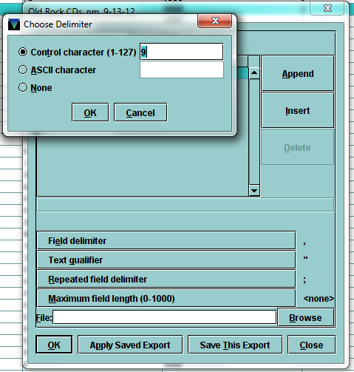
Word: Replace: Example 2
Magazine list for web site

Slide 14
Word: Replace: Example 2
Magazine list for web site
Beginning of line:
  Replace ^p with
  ^p<a href="http://catalog.cuyahogafallslibrary.org/record=
Between bib # & title:
  Replace ^t with ">
End of line:
  Replace ^p with </a><br />^p

Slide 15
Word: Replace: Example 2
Magazine list for web site
b1236742 AARP the Magazine
<a href="
http://catalog.cuyahogafallslibrary.org/record=b1236742
">AARP the Magazine</a><br />

Slide 16

Excel

Slide 17
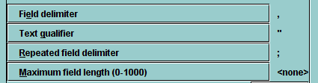
Export, Open in Excel
Create Lists: Export (use defaults)

Slide 18
Export, Open in Excel
Excel: Open (show all file types)
  Delimited (accept default)
  Delimiter: change to comma
  Text qualifier (accept default)
  Data format for each column (accept default)

Slide 19
Excel Example 1
Patrons with multiple barcodes
Create a list of patrons.
Export to Excel with patron number and barcode, with repeated field delimiter same as field delimiter.

Slide 20
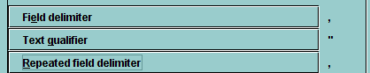
Excel Example 1
Patrons with multiple barcodes

Slide 21
Excel Example 1
Patrons with multiple barcodes
Excel:
  Sort by column C (data tab, sort).
Also works for multiple attached records.

Slide 22
Excel Example 2
Finding Duplicate Records
How do I find records with the same value in some field?
Like bibs with the same OCLC #
Or patrons with the same phone #
  Create a list of all patrons
  Export phone number field

Slide 23
Excel Example 2
Finding Duplicate Records
Step 1: Conditional Formatting
  Select the column
  Home tab
  Styles group
  Conditional formatting
  Highlight cells rules
  Duplicate values

Slide 24
Excel Example 2
Finding Duplicate Records
Step 2: Sort by cell color
  Data tab
  Sort by cell color; no color: on bottom
  Excel freezes with large sets
  (For me, it freezes with 50,000 rows,
  but works with 200 rows)

Slide 25
Excel Example 2
Finding Duplicate Records
Step 2 alternative: Filter by cell color
  Data tab
  Filter
  Filter by cell color
  Slow, but it works for me with 50,000 rows

Slide 26
Excel Example 3:
Subtotal Circ by Location
Create Lists
  Item records sorted by item location
  Export item location, TOT CHKOUT

Slide 27
Excel Example 3:
Subtotal Circ by Location
Excel
  Data tab, Outline group, Subtotal
  At change in location, sum checkouts
  Display only subtotals: Click “2” on left

Slide 28
Excel Example 4:
Number of items by location
Create Lists
  Item records sorted by item location
  Export item location

Slide 29
Excel Example 4:
Number of items by location
Excel
  Insert QTY column, “1” in each row
    1<Enter>, copy, select, paste
    Ctrl+Shift+End to select everything to the end
  Data tab, Outline group, Subtotal
  At change in location, sum QTY
  Display only subtotals: Click “2” on left

Slide 30
Excel Example 5:
Bibs by number of items
Which “new fiction” titles have the most copies?
Create Lists
  Create a list of items in location “new fiction”.
  Sort by title.
  Export title.

Slide 31
Excel Example 5:
Bibs by number of items
Excel
  Add QTY column.
  Subtotal QTY.
  Collapse to level 2.
  Sort by QTY, descending.

Slide 32
Excel Example 6:
Look up groups in other file
How do you group similar location codes?
  DVDs: dvda, dvde, dvdn, dvdp
Create a spreadsheet with codes & categories
In another spreassheet, add a “Category” column with VLOOKUP function

Slide 33
Excel Example 6:
Look up groups in other file
=VLOOKUP(A2,'c:\[Locations lookup table.xlsx]Sheet1'!$A:$B,2,0)
  A2: Cell with value to search for
  'c:\[Locations lookup table.xlsx]Sheet1': file
  !$A:$B: columns A and B in that file
  2: Bring back the value that’s in 2nd column
  0: If no exact match, say “#N/A”

Slide 34
Excel Example 6:
Look up groups in other file
This example is simplified from an Export from Millennium Web Management Reports (/manage)
Circ activity, all activity, last month, by item location
I go on to sort by category, then subtotal, & display only the subtotals

Slide 35
Excel Example 6:
Look up groups in other file
You could also use VLOOKUP to simply translate itype or ptype codes to text labels.

Slide 36
Excel Example 7:
Analyzing billed items
For items that are currently billed, what type of patron has how many of what type of item, and what are the total costs, and how does this vary by branch?

Slide 37

Excel Example 7:
Analyzing billed items

Slide 38
Excel Example 7:
Analyzing billed items
For items that are currently billed, what type of patron has how many of what type of item, and what are the total costs, and how does this vary by branch?

Slide 39
Excel Example 7:
Analyzing billed items
Create a list of items with status “billed”.
Export barcode, itype, ptype, price, branch.
Open in Excel.
Add QTY column.

Slide 40
Excel Example 7:
Analyzing billed items
Select any cell; “Insert” tab: Pivot Table
Accept defaults.
Drag itype to Row Labels
Drag ptype to Column Labels
Drag QTY to Values

Slide 41
Excel Example 7:
Analyzing billed items
Value: Drag QTY out, drag Price in.
Drag Branch to Report Filter

Slide 42
Excel Example 8:
Analyzing item statuses
How many items have what status, by bib location, subdivided by item location?
Create a list of items.
Export item status, item loc, bib loc.
Open in Excel.
Add QTY column.

Slide 43
Excel Example 8:
Analyzing item statuses
Insert pivot table
Rows: bib loc, then item loc
Columns: status
Value: QTY

Slide 44
Global Update
Unsuppressed Bibs with all items suppressed
Find:
  Bibs that are not suppressed …
  Where all the attached items are suppressed
It’s easy to find bibs where at least one item is suppressed.

Slide 45
Global Update
Unsuppressed Bibs with all items suppressed
A: Create a list of bibs with bib suppression code “unsuppressed” & icode2 “suppressed”.
  You get bibs where at least one item is suppressed.
  Includes bibs where all items are suppressed, and bibs where some items are not suppressed.

Slide 46
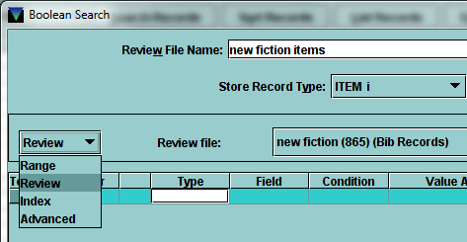
Global Update
Unsuppressed Bibs with all items suppressed

Slide 47
Global Update
Unsuppressed Bibs with all items suppressed
B: Create another list of bibs
  Limited to list A
  With icode2 not “suppressed”
  These are the bibs in list A that you don’t want.
  Update these bibs with something unique that you can search for, so you can exclude them.

Slide 48
Global Update
Unsuppressed Bibs with all items suppressed
Global Update list B to change bib suppression to “suppressed” (or some other field to a temporary code you can find)
C: Create a list of bibs
  Limited to list A
  With bib suppression code not “suppressed”

Slide 49
Global Update
Unsuppressed Bibs with all items suppressed
Rapid Update list B again to change bib suppression back to “unsuppressed”
You could use some unused field instead, perhaps with a special value called “marker”, instead of messing with an important field like suppression.

Slide 50
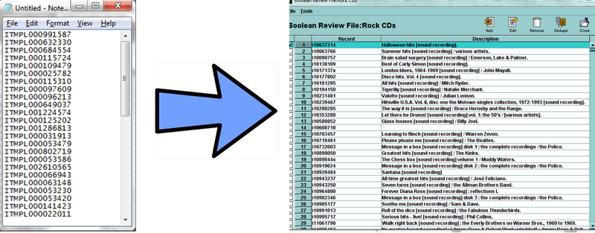
Getting Item Barcodes into a Review File

Slide 51
Barcodes into a Review File 1:
“Add” to Existing List
Millennium Create Lists: Existing List: Add
Scan in barcodes
Once you get started it's space bar, scan, alt-s
Could paste instead of scan
Cumbersome, but requires nothing extra

Slide 52
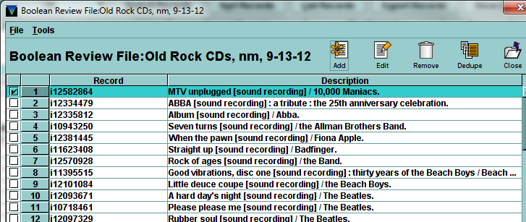
Barcodes into a Review File 1:
“Add” to Existing List

Slide 53
Barcodes into a Review File 2:
Character-based Rapid Update
D > Catalog DATABASE maintenance
R > RAPID updating
  Choose “Items”, “not in a review file”
Make a change that’s unique & reversible
(After you get started, it's scan, enter...)
Create lists: Search for them

Slide 54
Barcodes into a Review File 2:
Character-based Rapid Update
Requires scanning each barcode
Use Millennium Rapid Update to change them back when you’re done

Slide 55
Barcodes into a Review File 3:
Upload to inventory via FTS
Start with text file of barcodes
Put n: before each barcode, like
n:ITMPL000991587 (replace based on prefix)
Put the file on an FTP server

Slide 56
Barcodes into a Review File 3:
Upload to inventory via FTS
C > CIRCULATION subsystem
A > ADDITIONAL circulation functions
P > PROCESS PC transactions
F > FTS Transfer…
C > COMPARE inventory to shelf list
T > TRANSFER file of barcodes to a Review File

Slide 57
Barcodes into a Review File 4:
Offline Circ
Start with text file of barcodes
Put n: before each barcode, like
n:ITMPL000991587 (replace based on prefix)
Make the file: Millennium\Offline\circ.dat
Upload using Offline Circ product

Slide 58
Barcodes into a Review File 4:
Offline Circ
C > CIRCULATION subsystem
A > ADDITIONAL circulation functions
P > PROCESS PC transactions
C > COMPARE inventory to shelf list
T > TRANSFER file of barcodes to a Review File

Slide 59
Barcodes into a Review File 5:
Count Use, Portable Reader
You don’t actually use a portable reader
Does your library use “copy use” field?
  Create lists: items with copy use > 0
Start with text file of barcodes
Put n: before each barcode, like
b:ITMPL000991587 (replace based on prefix)

Slide 60
Barcodes into a Review File 5:
Count Use, Portable Reader
Millennium Circulation
Count Use mode
Choose “Portable Reader”
Process File: Choose a file to upload.

Slide 61
Barcodes into a Review File 5:
Count Use, Portable Reader
Adds to item records’ “copy use” field
Search for copy use < 0 in Create Lists
  Could add “date updated” criteria
Rapid update “copy use” to zero when done

Slide 62


Slide 63

pshirley@CuyahogaFallsLibrary.org

