Slide 1
Streamlining a Focused Collection: I-Types, Loan Rules, ICODE1 Fields and Much More
Ben Kline
Assistant Department Head
University of Cincinnati Libraries – Circulation & Multimedia Services

Slide 2
Streamlining a Focused Collection
In 2008, UCL moved our circulating multimedia equipment collection from our Student Technology Resource Center to our then Circulation Services Department.
After two years of data collection and analysis of usage trends, the Dean and University Librarian charged a working group to assess, streamline and revise the collection, the lending policies and all procedures and documentation relating to equipment. The Dean’s stated goal was to have the library more in line with ITIE (Information Technology and Instructional Equipment ) guidelines and curricular support.

Slide 3
Streamlining a Focused Collection
Initial discussion points:
Casual observations of usage
Historical circulation data
Equipment viability
Student expectations – expressed and otherwise
ITIE guidelines
Library leadership expectations
The working group included management from Circulation & Multimedia Services, members of library administration, Library IT and the library business office.
The working group first studied equipment lending at other institutions, both peer and those with unique/interesting equipment lending situations. (Webpac booking, funding, staffing, etc.)

Slide 4
Streamlining a Focused Collection
After research and analysis, the group addressed the collection itself and focused on streamlining. Many miscellaneous pieces were decommissioned. Other parts were expanded. For example, large speaker systems were removed and the amount of data projectors was increased.
Also, the intended user groups were identified and addressed. Staff and summer program students were removed from the pool of borrowers. Departments across campus were informed of the changes. Promotional materials were created to notify the student population.
The group also addressed the equipment borrowing contract and the policies/procedures for outstanding overdue materials. The result was clear procedures for lost/billed/long overdue items. (UC Asset Management.)

Slide 5
Streamlining a Focused Collection
Next were the necessary technical changes.
Cleaning up itypes.
Cleaning up the loan rules and the loan determiner table.
Employing ICODE1 field for statistics.

Slide 6
Streamlining a Focused Collection
Went from forty plus itypes to three:
5day bookable equipment
4hr equipment
5day limit one equipment
This changed improved the functionality of the 5 day loan rule in the determiner table and facilitated use of the MaxItem fields for the patron type. The MaxItem fields enable ptype specific circ limitations or specifications.
MaxItemA
ulabk
LIMIT OF 6 PER PATRON
MaxItemB
itype 152
Limit one per patron

Slide 7
Streamlining a Focused Collection
Changes to the loan rule determiner table.
rule | location | ptype | itype | loan rule | active |  | NOTES
448 | ulabk | 0-7,27,28 | 100,101,103-141 | 68 | Y |  | 5 day renew
449 | ulabk | 0-7,27,28 | 55 | 70 | Y
450 | ????? | 0-7,27,28 | 102,128 | 54 | Y
451 | ????? | 9 | 999 | 13 | Y
452 | ulabc | 0-7,27,28 | 102 | 71 | Y
453 | ulabk | 0-15,17-23,25-255 | 27 | 44 | Y
454 | ulabk | 0-7,27,28 | 102 | 71 | Y
455 | ulabk | 25,26 | 999 | 1 | Y
Old
 | Location | Ptype | Itype |  | Rule Number | Active
462 | ulabk | 0-6 | 150,152 |  | 68 | Y
463 | ulabk | 0-7,27,28 | 55 |  | 70 | N
466 | ulabc | 0-3 | 102 |  | 71 | Y
467 | ulabk | 0-15,17-23,25-255 | 151 |  | 44 | Y
469 | ulabk | 7-8,15,25-28 | 999 |  | 1 | Y
New. Much simplified.

Slide 8
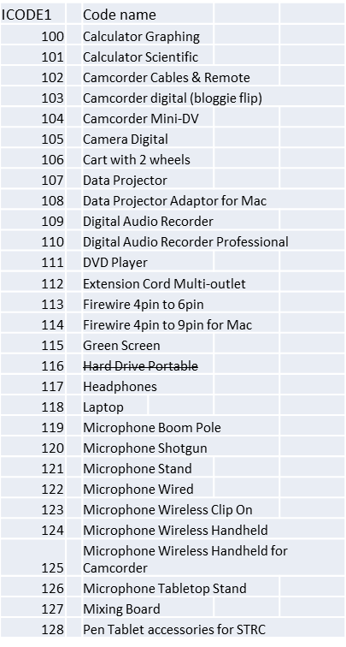
Streamlining a Focused Collection
Use the ICODE1 to track individual item stats.

Slide 9
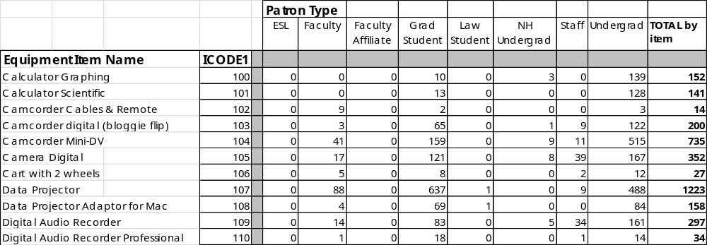
Streamlining a Focused Collection
The ICODE1 field enables us to gather stats on equipment in this fashion without employing numerous itypes and loan rules.

Slide 10
Streamlining a Focused Collection
Outcomes and ongoing efforts.
Questions?
Thank you.
klinedb@ucmail.uc.edu

