Slide 1
Purchase Requests Connecting to OCLC WMS Acquisition
Presented by
Andy Tang
Notes:
Click to add notes

Slide 2
Agenda
Current Procedure
The possible changes
OCLC WMS solutions
My solution
Liaison involvement
Amazon solutions

Slide 3








Current Procedure
Notes:
How to Place an Order for Books or AV Materials
http://trexler.muhlenberg.edu/services/faculty.html#d.en.187679
Requests to purchase materials should be sent to your Departmental Liaison who reviews the requests and forwards those approved to the Librarian Liaison.
Requests can be sent in any of several forms:
on green order cards (available from your Departmental Liaison)
via email to your Departmental Liaison
via the online purchase request form
Any requests of particularly urgent instructional need can be labeled as a “rush” order. Please note if items are for Course Reserves.
Questions about collection development and purchase requests can be directed to your Departmental Liaison, your Librarian Liaison, or the Acquisitions Manager, Karen Gruber (gruber@muhlenberg.edu / 484-664-3570).

Slide 4
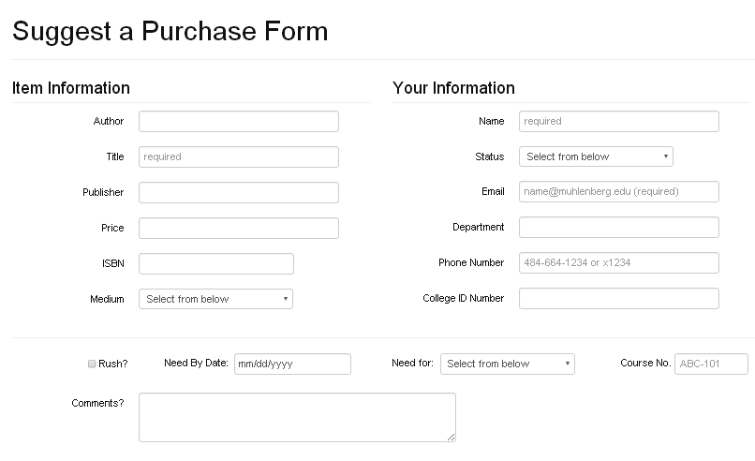
The Current Form

Slide 5


The Possible Changes
Embedded Online Form

Slide 6
OCLC WMS solutions
Admin: enable selector roles for purchase requests
Faculty: double sign in within Worldcat.org
Faculty : search items they want
Faculty : add to list
Faculty : request an item
Acquisition: browse and pick up the order
Acquisition: complete the order

Slide 7
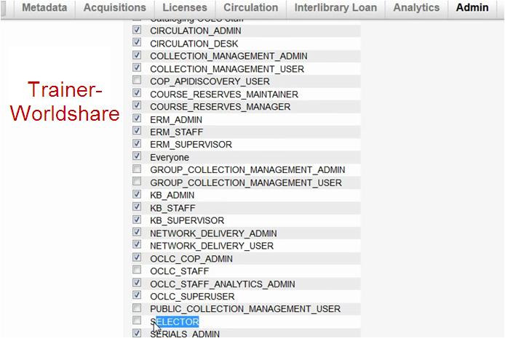
Admin: enable selector roles for purchase requests

Slide 8
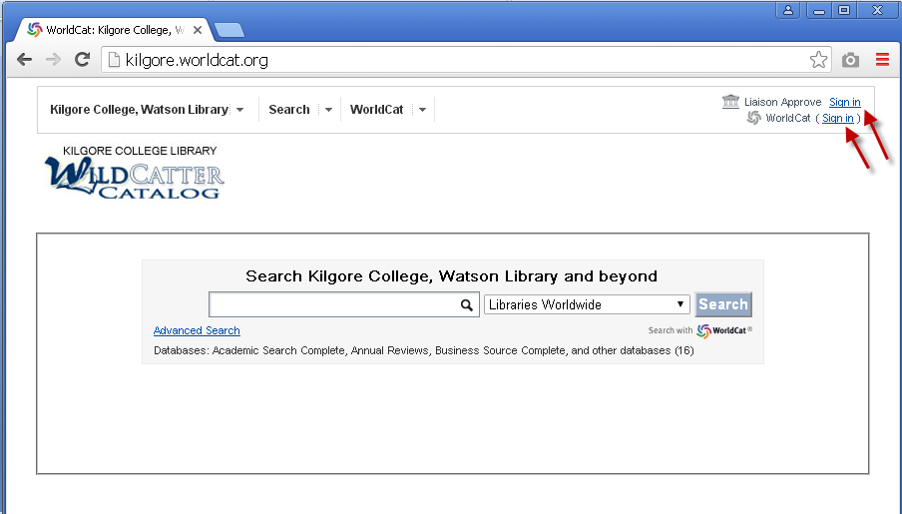
Faculty: sign in at Worldcat.org

Slide 9
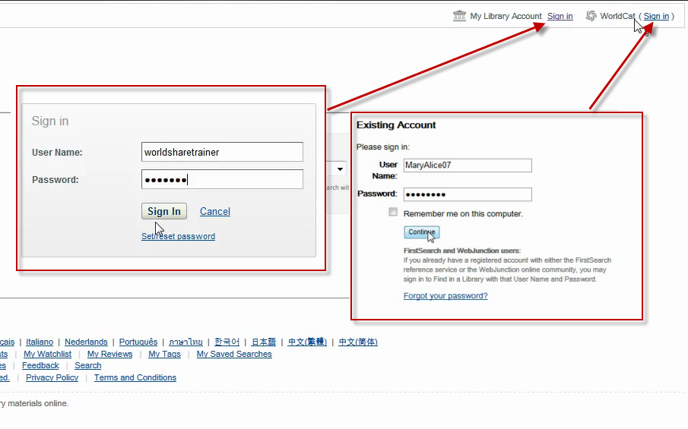
Faculty: double Sign in

Slide 10
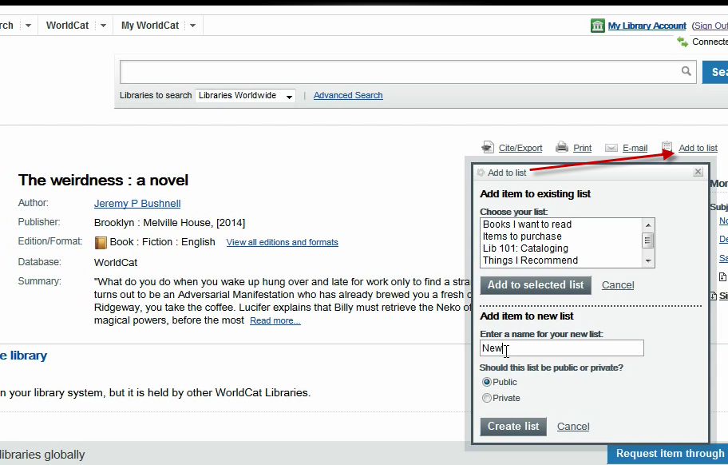
Faculty: add to list

Slide 11
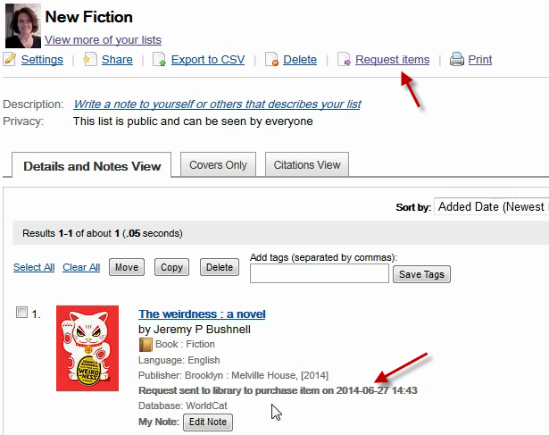
Faculty: request the item

Slide 12
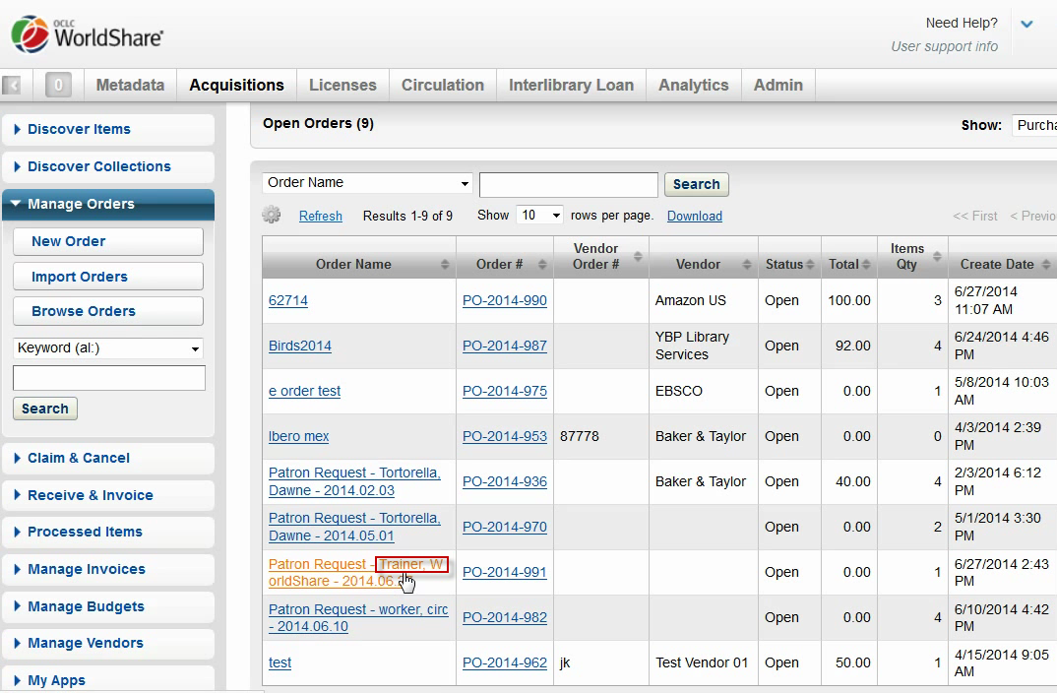
Acquisition: browse and pick up the order

Slide 13
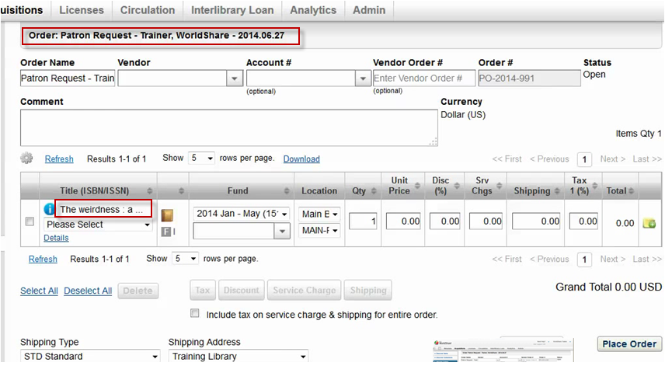
Acquisition: complete the order

Slide 14

The pros and cons of OCLC WMS solutions
Pros
  Streamlined
  One step from item request to orders
  Seamless connection
Cons
  Approval step is lost
  Backup for requests does not exist
  OCLC discovery OCLC WMS
Notes:
Pros
1.Streamlined: from worldcat.org to OCLC WMS
2. Efficiency: We only need one step going from item request to place orders
3. Seamless connection is formed between worldcat.org and OCLC WMS
Cons.
Approval step for liaison is lost in this solutions. This increases the burden of Acquisition librarian.
Requests backup is lost. If some requests are not approved, they will be deleted and fail to leave trace in system.
It is difficult to let patron to send order request from https://muhlenberg.on.worldcat.org/ to OCLC WMS. It just could send order requests from https://muhlenberg.worldcat.org/ to OCLC WMS.

Slide 15
My solution
Designer: design PHP script
Designer: create MySQL database
Designer: use top navigation bar to hold PHP script links
Faculty: start with OCLC Discovery
Faculty : use Record Link function provided by OCLC
Faculty : click PHP script links from top navigation bar
Faculty : inputs and pastes name, email, and item link
Liaison involvement
Designer: transfer the item link in OCLC discovery to the one which can take us to OCLC WMS
Acquisition: Click this link and go into Process order page

Slide 16
Design PHP script
Design Logic
Main.css
Index.php
Insert.php
Display.php
Edit.php
MySQL
Links
Order Request
Order Process
Liaison Approval

Slide 17
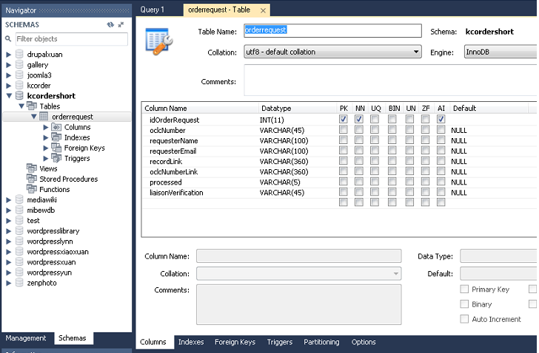
Create MySQL database

Slide 18
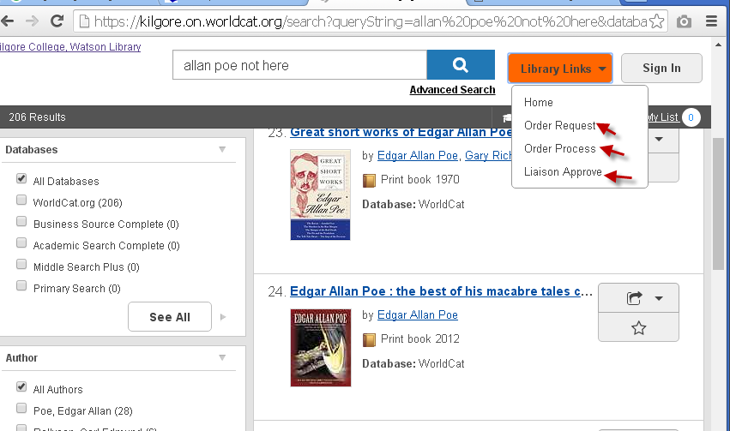
Use top navigation bar to hold PHP script links

Slide 19
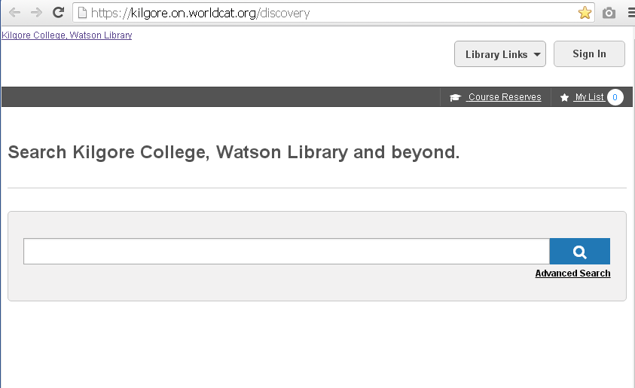
Faculty: start with OCLC Discovery

Slide 20
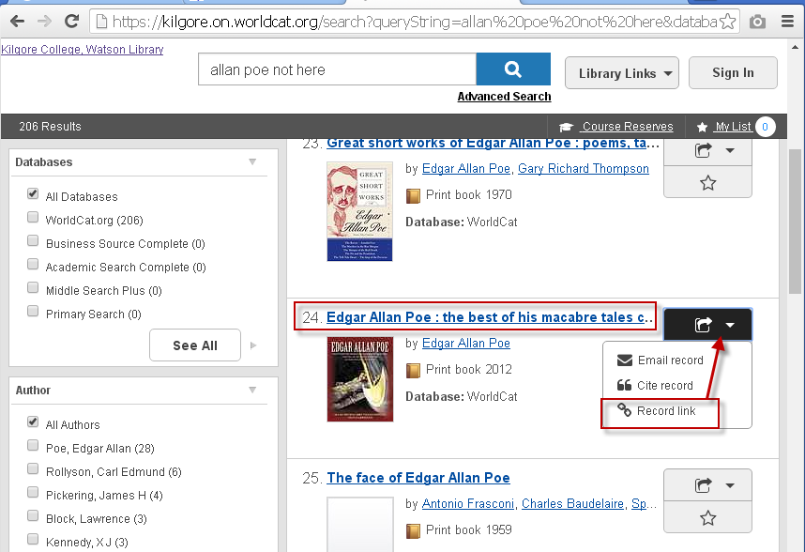
Faculty: use “Record Link” function provided by OCLC
Notes:
The faculty uses “Record Link” function provided by OCLC to copy the link of item they want to purchase.

Slide 21
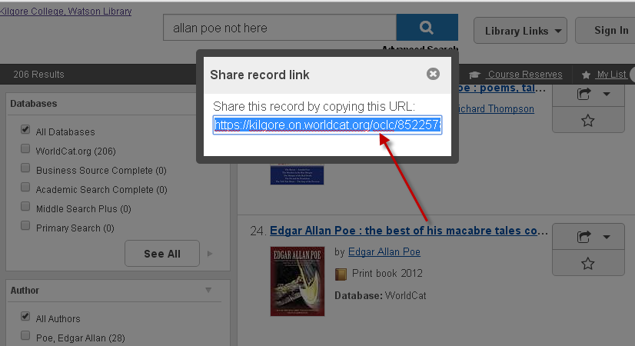
Faculty: copy the URL of the item
Notes:
The faculty uses mouse right key to click the link and copy it.

Slide 22
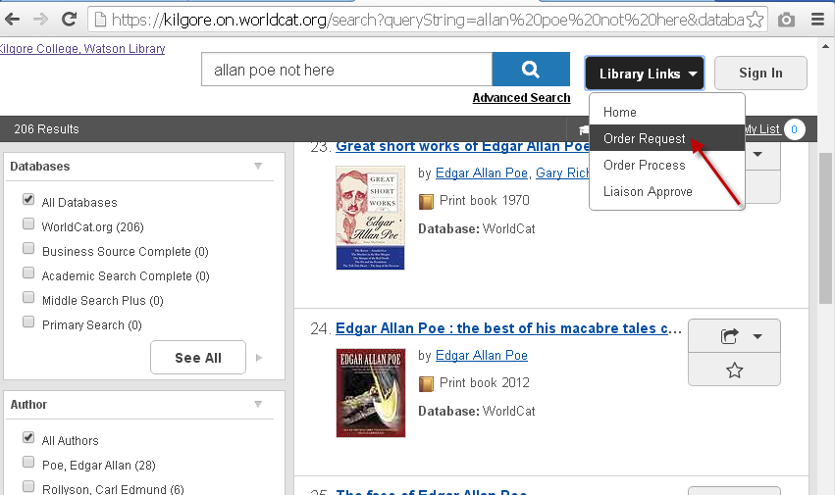
Faculty clicks PHP script link “Order Request” from top navigation bar
Notes:
The faculty clicks PHP script link “Order Request” from top navigation bar.

Slide 23
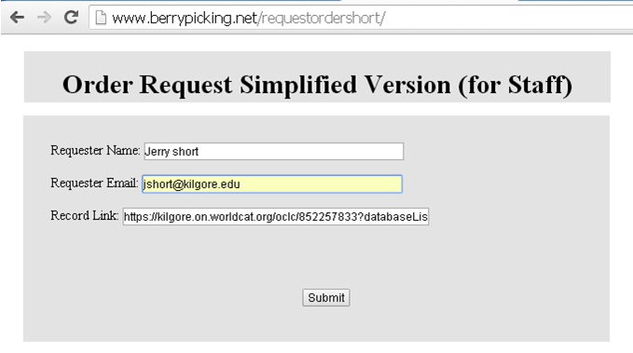
Faculty inputs and pastes the name, email, and item link.
Notes:
Faculty inputs and pastes the name, email, and link which they just copy in previous step. After the faculty clicks submit button, the data is sent to mysql database.

Slide 24
Liaison involvement
Liaison approval required
Which link
How does liaison approve
Liaison approval status

Slide 25
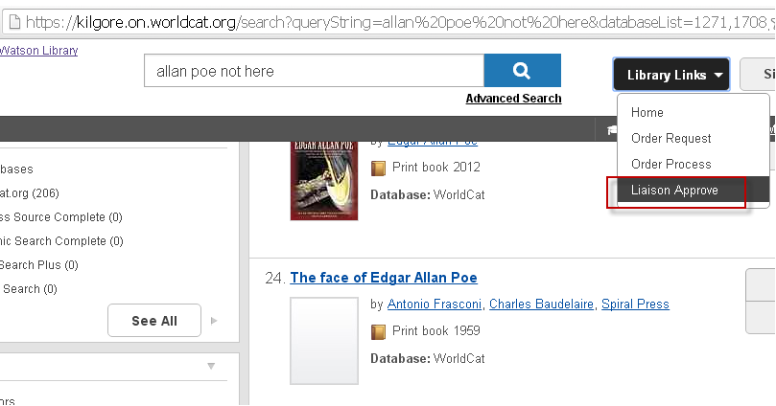
Which link will take liaison to the approval page

Slide 26
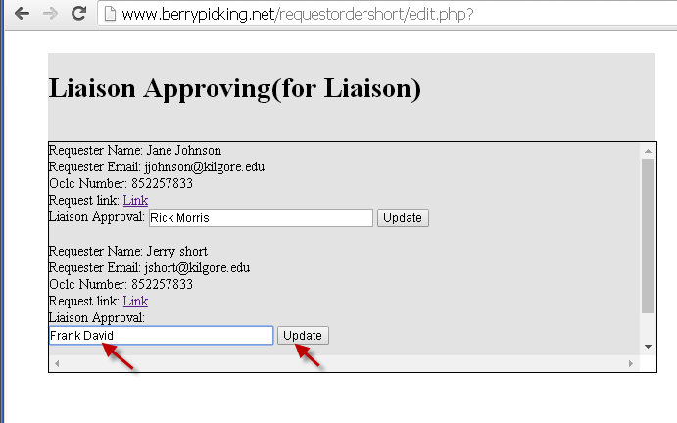
How does liaison approve
Notes:
After the liaison librarian clicks the “Liaison Approve” link, it will go into this page to let he or she to submit their name.

Slide 27
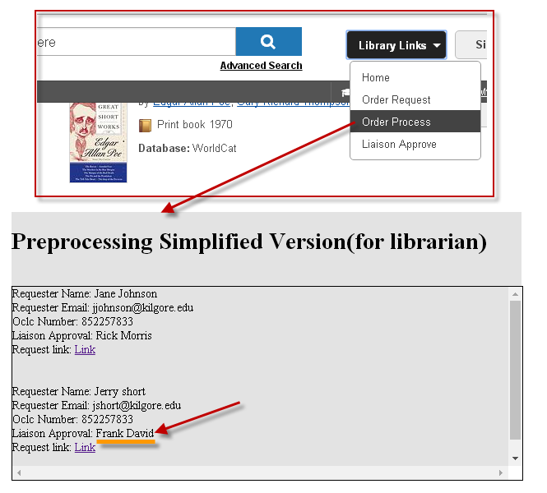
Acquisition: how do we know liaison approved or not
Notes:
Acquisition librarian click “Order Process” to check liaison approval status. If “Liaison” name is the right side of “Liaison Approval”, it means it is approved by liaison.

Slide 28
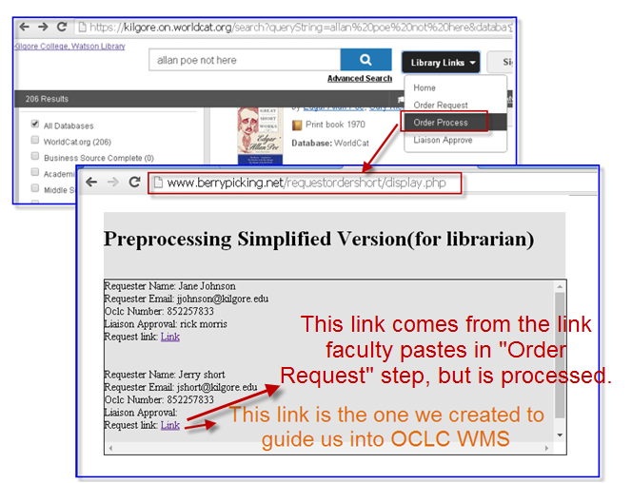
Acquisition : Click “Order process” link, then click “Request Link”.

Slide 29
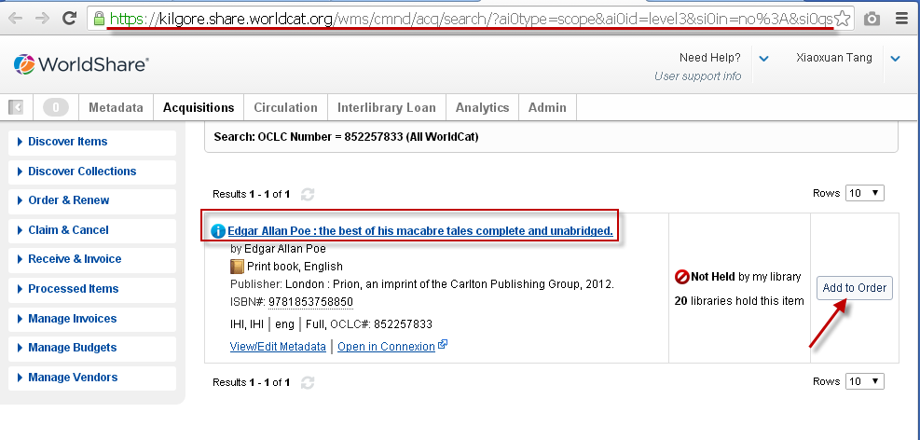
The purchase request is successfully connected to OCLC WMS
Notes:
After we click the button “Add to Order”, it will go into the normal process of OCLC WMS acquisition. See Appendix

Slide 30
The pros and cons of my solution
Cons | Pros
Key in requester’s name and email address | Go from OCLC discovery directly into OLC WMS acquisition module
Filter is not strong (not enough time) | Allow liaison to approve
 | Request history can be preserved.
 | No need to allocate selector rights for everyone in OCLC WMS
Notes:
Sometimes, password protected are advantage and disadvantage.

Slide 31
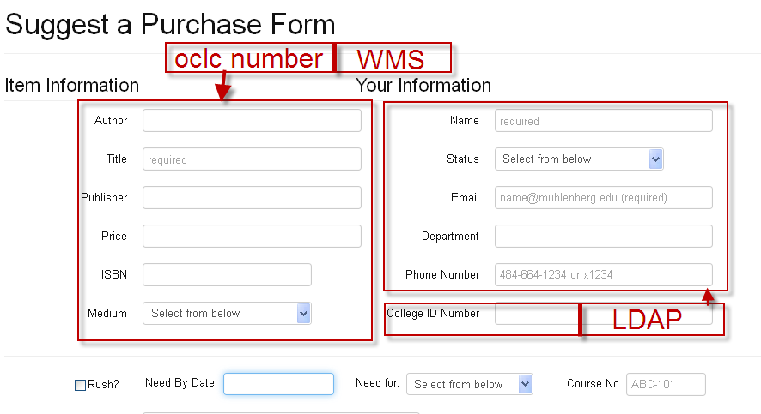
Other Choice

Slide 32
Solutions for Amazon: the possibilities on Amazon
Designer: analyze the link of Amazon books
Designer: add 3 links to Firefox browser
  Order Request (for Faculty)
  Order Process (for Acquisition)
  Liaison Approval (for Liaison Staff)
Patron: click Order Request link
The result of clicking Order Request link

Slide 33
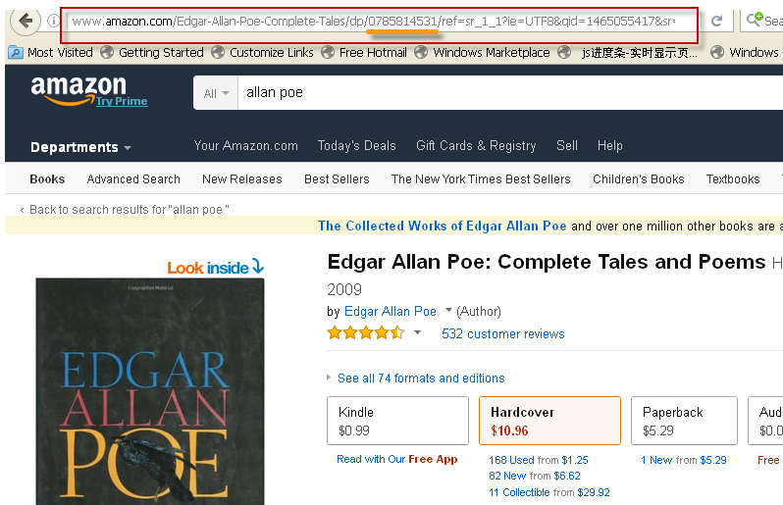
Analyze the link of Amazon book
Notes:
What are UPCs, EANs, ISBNs. and ASINs?
http://www.amazon.com/gp/seller/asin-upc-isbn-info.html

Slide 34
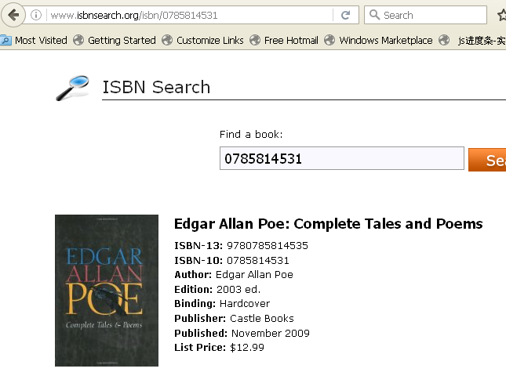
Amazon does use ISBN to organize books

Slide 35
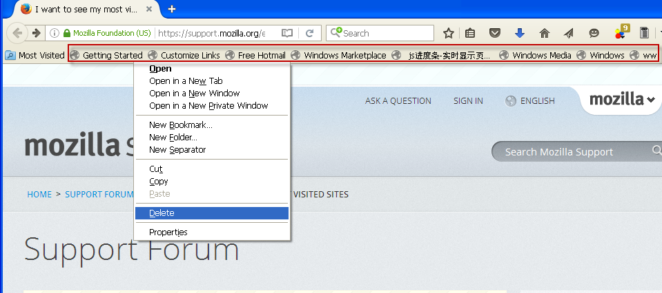
The possibility to use top navigational bar

Slide 36
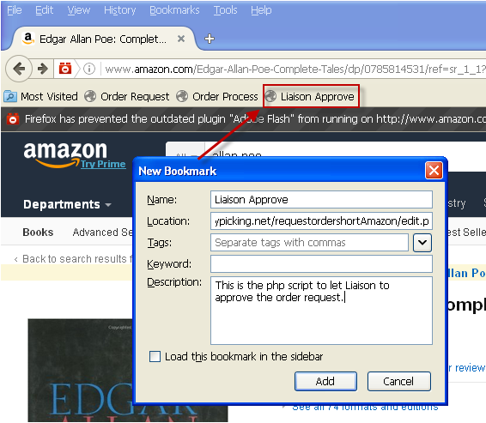
Liaison Approve Bookmark

Slide 37
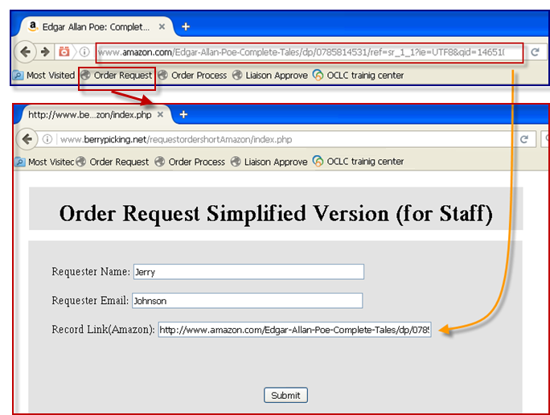
Faculty : click Order Request link

Slide 38
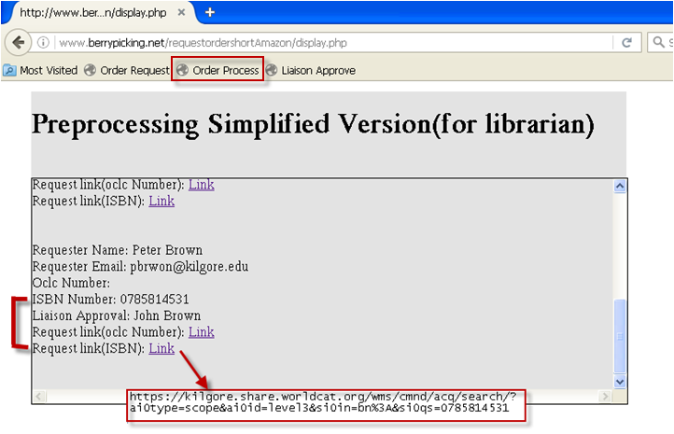
Acquisition: the results of Clicking Order Process Link

Slide 39
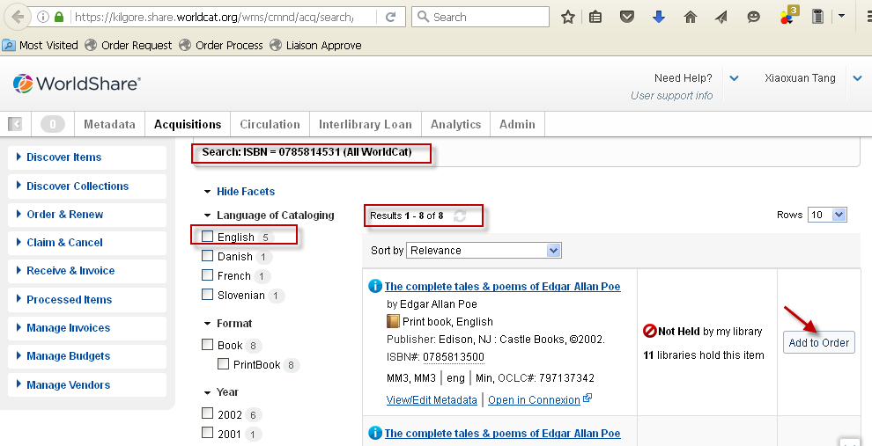
The Request link (ISBN) lead us to OCLC WMS directly

Slide 40

Q&A
?

Slide 41
Appendix I
MySQL database structure

Slide 42
Appendix II
The PHP Script code
index.php
insert.php
display.php
edit.php
Notes:
******************************************
*index.php
********************************************
<html>
<style type="text/css">
<!--
#apDiv1 {
position:absolute;
left:162px;
top:49px;
width:700px;
height:61px;
z-index:1;
background-color: #E3E3E3;
}
#apDiv2 {
position:absolute;
left:33px;
top:33px;
width:644px;
height:200px;
z-index:2;
background-color: #E3E3E3;
}
#apDiv3 {
position:absolute;
left:300px;
top:174px;
width:57px;
height:25px;
z-index:3;
}
#apDiv4 {
position:absolute;
left:161px;
top:125px;
width:700px;
height:270px;
z-index:3;
background-color: #E3E3E3;
}
-->
</style>
<body>
<div id="apDiv1"><h1 align="center">Order Request Simplified Version (for Staff)</h1>
</div>
<div id="apDiv4">
<div id="apDiv2">
<form action="insert.php" method="post">
Requester Name:
<input type="text" name="requestername" size=50 />
<br>
<br>
Requester Email:
<input type="text" name="requesteremail" size=50/>
<br>
<br>
Record Link:
<input type="text" name="recordlink" size=60/>
<br>
<br>
<div id="apDiv3">
<input type="submit" value="Submit" />
</div>
</form>
</div>
</div>
</body>
</html>
******************************************
*insert.php
*copyright Andy Tang
*******************************************
<?php
$servername = "localhost";
$username = "admin_resume";
$password = "";
$dbname = "kcordershort";
// Create connection
$conn = mysqli_connect($servername, $username, $password, $dbname);
// Check connection
if (!$conn) {
die("Connection failed: " . mysqli_connect_error());
}
//$title_post=addslashes($_POST['title']);
//$title_post=mysqli_real_escape_string($_POST[title]); does not work
$recordLink_post=$_POST['recordlink'];
$requesterName_post=$_POST['requestername'];
$requesterEmail_post=$_POST['requesteremail'];
$beginning_position=strpos($recordLink_post,"oclc");
$ending_position=strpos($recordLink_post,"?");
$number_string=$ending_position-($beginning_position+5);
$oclcNumber_processed=substr($recordLink_post,$beginning_position+5,$number_string);
$recordLink_processed="https://kilgore.share.worldcat.org/wms/cmnd/acq/search/?ai0type=scope&ai0id=level3&si0in=no%3A&si0qs=".$oclcNumber_processed;
$sql = "INSERT INTO orderrequest (oclcNumber, requesterName,requesterEmail,recordLink, oclcNumberLink) VALUES ('$oclcNumber_processed','$requesterName_post','$requesterEmail_post','$recordLink_post','$recordLink_processed')";
/*echo $titleLink_cal;
echo "<br>";
echo $isbnLink_cal;
echo "<br>";
echo $oclcNumber_cal;
echo "<br>";*/
if (mysqli_query($conn, $sql)) {
echo "New record created successfully";
?>
<form action="index.php">
<input type="submit" value="Back to previous page">
</form>
<?php
} else {
echo "Error: " . $sql . "<br>" . mysqli_error($conn);
}
mysqli_close($conn);
?>
******************************************
* display.php
*******************************************
<?php
$servername = "localhost";
$username = "admin_resume";
$password = "";
$dbname = "kcordershort";
?>
<style>
<?php include 'main.css'; ?>
</style>
<?php
echo "<br>";
?>
<div id="apDiv1">
<?php
echo "<h1>Preprocessing Simplified Version(for librarian)</h1>";
?>
</div>
<?php
echo "<br>";
// Create connection
$conn = mysqli_connect($servername, $username, $password, $dbname);
// Check connection
if (!$conn) {
die("Connection failed: " . mysqli_connect_error());
}
$sql = "SELECT idOrderRequest, oclcNumber, requesterName,requesterEmail,recordLink, oclcNumberLink,liaisonVerification FROM orderrequest";
$result = $conn->query($sql);
if ($result->num_rows > 0) {
// output data of each row
?>
<div id="apDiv2">
<?php
while($row = $result->fetch_assoc()) {
echo " Requester Name: " . $row["requesterName"]."<br>"." Requester Email: " . $row["requesterEmail"]."<br>"." Oclc Number: " . $row["oclcNumber"]."<br>"." Liaison Approval: " . $row["liaisonVerification"]."<br>"." Request link: " . "<a href='".$row["oclcNumberLink"]." ' target=\"_blank\">Link</a>"."<br>";
?>
<!--<form action="edit.php">
<input type="submit" value="Liaison Approval">
</form>
<form action="edit.php" method="post">
<input type="text" name="idRecord" value="<?php echo $ids;?>" size=5 readonly />
<input type="text" name="liaisonName" size=40/>
<input type="submit" value="Submit" />
</form>-->
<?PHP
echo "<br><br>";
}
?>
</div>
<?php
} else {
echo "0 results";
}
//$conn->close();
mysqli_close($conn);
?>
******************************************
*edit.php
* Copyright: Andy Tang
*******************************************
<html>
<head>
<title>Update a Record in MySQL Database</title>
</head>
<style>
<?php include 'main.css'; ?>
</style>
<body>
<?php
if(isset($_POST['update'])) {
$servername = "localhost";
$username = "admin_resume";
$password = "";
$dbname = "kcordershort";
$conn = mysqli_connect($servername, $username, $password, $dbname);
if (!$conn) {
die("Connection failed: " . mysqli_connect_error());
}
$id_table = $_POST['idRecord'];
$liaison = $_POST['liaisonName'];
$sql = "update orderrequest ". "set liaisonVerification = '$liaison' ". "where idOrderRequest=$id_table";
$result = $conn->query($sql);
if (mysqli_query($conn, $sql)) {
echo "The record modified successfully";
?>
<form action="edit.php">
<input type="submit" value="Back to Liaison Approving page">
</form>
<?php
} else {
echo "Error: " . $sql . "<br>" . mysqli_error($conn);
}
mysqli_close($conn);
// $sql = "UPDATE employee ". "SET emp_salary = $emp_salary ".
// "WHERE emp_id = $emp_id" ;
// mysql_select_db('test_db');
// $retval = mysql_query( $sql, $conn );
//if(! $retval ) {
// die('Could not update data: ' . mysql_error());
// }
// echo "Updated data successfully\n";
}else {
?>
<form method = "post" action = "<?php $_PHP_SELF ?>">
<?php
$servername = "localhost";
$username = "admin_resume";
$password = "Pepsi5567";
$dbname = "kcordershort";
$conn = mysqli_connect($servername, $username, $password, $dbname);
if (!$conn) {
die("Connection failed: " . mysqli_connect_error());
}
$sql = "SELECT idOrderRequest, oclcNumber, requesterName,requesterEmail,recordLink, oclcNumberLink,liaisonVerification FROM orderrequest";
$result = $conn->query($sql);
if ($result->num_rows > 0) {
// output data of each row
?>
<div id="apDiv1">
<?php
echo "<h1>Liaison Approving(for Liaison)</h1>";
?>
</div>
<div id="apDiv2">
<?php
while($row = $result->fetch_assoc()) {
echo " Requester Name: " . $row["requesterName"]."<br>"." Requester Email: " . $row["requesterEmail"]."<br>"." Oclc Number: " . $row["oclcNumber"]."<br>"." Request link: " . "<a href='".$row["oclcNumberLink"]." ' target=\"_blank\">Link</a>"."<br>";
$ids=$row["idOrderRequest"];
$liaisons=$row["liaisonVerification"];
?>
Liaison Approval:
<form action="edit.php" method="post">
<input type="hidden" name="idRecord" value="<?php echo $ids;?>" size=5 readonly />
<input type="text" name="liaisonName" value="<?php echo $liaisons;?>" size=40 />
<input name = "update" type = "submit" id = "update" value = "Update">
</form>
<?PHP
echo "<br><br>";
}
?>
</div>
<?php
} else {
echo "0 results";
}
?>
</form>
<?php
}
?>
</body>
</html>

Slide 43
Appendix III
Exception
Ordering when there is no WorldCat record
  Check https://www.oclc.org/content/dam/training/WMS/acquisitions/order-when-no-record/field-notes-exercises-ordering-when-no-worldcat-record.pdf
OCLC number is in mistake
  a. Find the correct OCLC number
  b. Handle as no Worldcat record

Slide 44
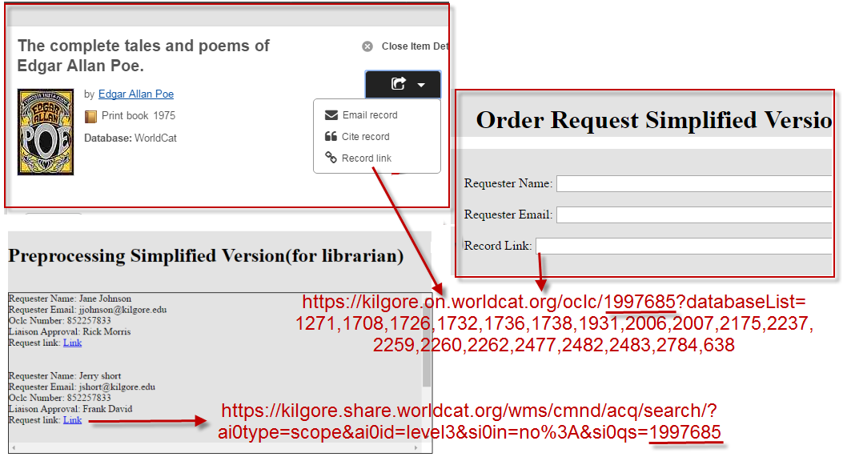
Appendix IV:
The link transformation explanation

Slide 45
Designer: transform the link from OCLC Discovery to the one can take us to OCLC WMS
Programming logic:
Automatically extract OCLC number from item link provided by OCLC Discovery
Add OCLC number to OCLC WMS prefix

Slide 46
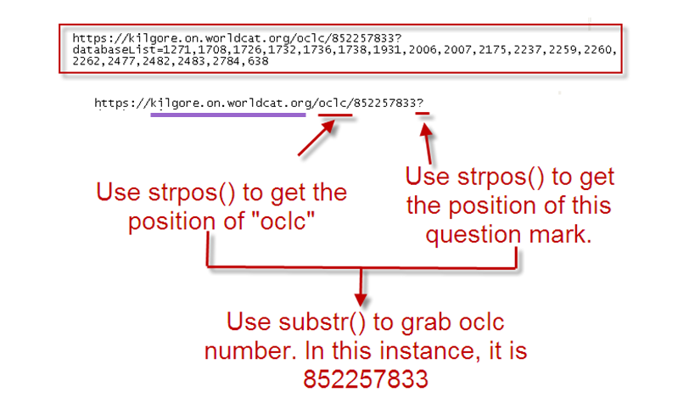
Programming logic: Automatically extract OCLC number from the item link provided by OCLC Discovery
Notes:
Designer: programming logic-Automatically extract OCLC number
strpos()
strpos — Find the position of the first occurrence of a substring in a string
mixed strpos ( string $haystack , mixed $needle [, int$offset = 0 ] )
2. substr()
substr — Return part of a string
string substr ( string $string , int $start [, int $length] )
3.Php script
$beginning_position=strpos($recordLink_post,"oclc");
$ending_position=strpos($recordLink_post,"?");
$number_string=$ending_position-($beginning_position+5);
$oclcNumber_processed=substr($recordLink_post,$beginning_position+5,$number_string);

Slide 47
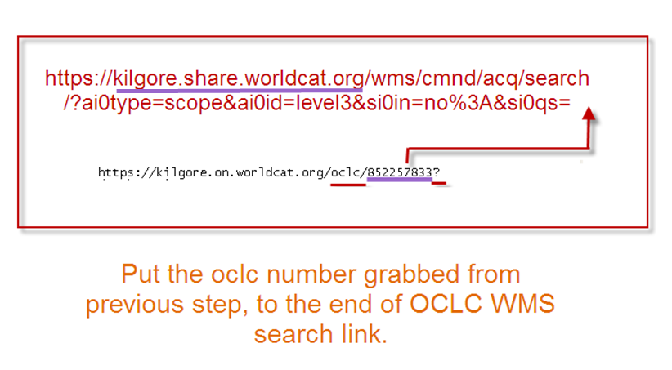
Add OCLC number to the right side of OCLC WMS website prefix
Notes:
Php script:
$recordLink_processed="https://kilgore.share.worldcat.org/wms/cmnd/acq/search/?ai0type=scope&ai0id=level3&si0in=no%3A&si0qs=".$oclcNumber_processed;

