Slide 1
Extracting Lexical Features
Intradocument Parsing
Search Engine
Different
Tools
Situation
By Andy Tang

Slide 2
Extracting Lexical Features
The three phases in developing the software tools
Well-defined
documents
A string of terms
A pile of
textual objects
A string of terms
A string of terms
A string of terms
Invert index
Query
Match
Building efficient
data structure
for index

Slide 3
Extracting Lexical Features
Interdocument parsing
Dirent
Corpus
Part1
Directory1
Directory N
file1
file2
file3
File N
Part2
Message1
Message2
Message3
Message4
………………………

Slide 4
Extracting Lexical Features
Intradocument parsing
File
Segment
A stream of
Character
Document N
Document1
Character by character
Whether it is a
meaningful token
Whether it is worth indexing

Slide 5
Extracting Lexical Features
Stemming and Other Morphological Processing
Root form
Stemming
surface marking
Plural question
Lovin’s technique
Suffix pattern
Porter stemmer
Compression
Advantage
Key word interchangeable
Disadvantage
Obscure words meaning

Slide 6
Extracting Lexical Features
Noise words
Noise words ->negative dictionary
Unsolved problem
The same tokens that are thrown away as noise because they have no meaning are precisely those function words that are most important to the syntactic analysis of well-formed sentences.

Slide 7
Extracting Lexical Features
Two example
Textual fields
ATI
Example
Structured attribute
Email

Slide 8
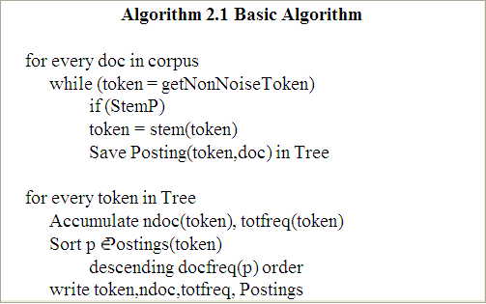
Extracting Lexical Features
Example of ATI
Doc 1
Doc 2
Doc 3
Doc 4
Doc 5
Doc N
Store stemmed token into
variable named token
Save returned results coming from
Posting function into TREE
Accumulate the document number which include
token and frequency of token inside it
Sorting postings on descending
order of document frequency
Write the value of token, document
token frequency into Postings.
Compute through a loop procedure
until every tokens in one document have been computed without omissions.

Slide 9
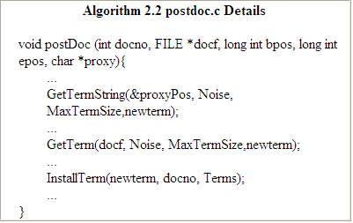
Extracting Lexical Features
Example of ATI (cont)
Illustrate the different
type of variable
Inserts a new posting
into the Terms tree

Slide 10
Extracting Lexical Features
Example of ATI (cont)
count the number of occurrences
of the keyword across
all the documents in the corpus.
Splay tree
Token 1
First step
totfreqk
Token 2
Token 3
Token 4
Token 5
how many documents
contain this keyword
Second step
docfreqk
Totfreqk=docfreqk
Totfreqk>docfreqk
Sorting
Compression

Slide 11
Extracting Lexical Features Important attention
Changing Indices
for Dynamic Corpora
Retention of raw keyword
frequency information
Posting Resolution
retain the exact character position
of the (beginning of the) keyword
Emphasizing Proxy
Text
emphasize the importance of words used
in the proxy over those
occurring in the raw text.
The tokens in subject /title is better
than the text in abstract
File number
Multiply combination
Document Number
Doc number
Isolated handling

Slide 12
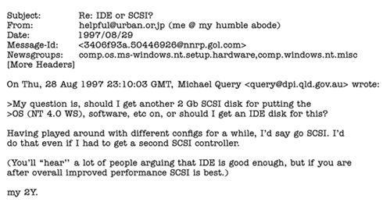
Extracting Lexical Features
A special consideration on Document type
Original
email
Email
They mean the message under
symbol “>”, has a duplication
on original email body

