Slide 1

The dive into Lucene
Andy Tang

Slide 2
What is Lucene?
Lucene is a free/open source information retrieval library, originally implemented in Java, and supported by the Apache Software Foundation. It is released under the Apache Software License.

Slide 3
Who is the creator of Lucene?
Lucene’s creator, Doug Cutting, has significant theoretical and practical experience in the field of IR. He’s published a number of research papers on various IR topics and has worked for companies such as Excite, Apple, and Grand Central.

Slide 4
Misunderstanding for Lucene!
People new to Lucene often mistake it for a ready-to-use application like a file-search program, a web crawler, or a web site search engine. That isn’t what Lucene is: Lucene is a software library, a toolkit if you will, not a full-featured search application.

Slide 5
Understanding Lucene
Application
DB
Web
User
Lucene lets your application deal with
business rules specific to its problem
domain while hiding
the complexity of indexing
and searching implementation
behind a simple-to-use API.
File
system
Manual
Input
Get users’
query
Present Search
Results
Gather Data
Lucene
Index
documents
Search Index
API 1
API 2
….
Index
API n

Slide 6
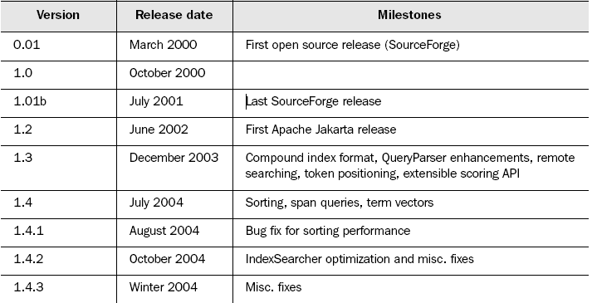
The history of Lucene!
23 February 2008 - Lucene Java 2.3.1 available
24 January 2008 - Lucene Java 2.3.0 available
23 January 2008 - Lucene at ApacheCon Europe
22 January 2008 - Lucene PMC Approves
Mahout Machine Learning Project
23 January 2008 - Hadoop promoted to Top Level Project
26 August 2007 - Lucene at ApacheCon Atlanta

Slide 7
Lucene
Text conversion before index working
HTML
Word
PDF
Text
POI
Parser
Parser
Parser
Class
PDFTextStripper
Analyzer
Analysis
Index

Slide 8
Lucene
How does index work?
Directory
Document 1
Document 2
Lucene
Indexer
Document 3
……
Document N

Slide 9
Lucene
The core indexing classes
IndexWriter
IndexWriter is the central component
of the indexing process. This class
Creates a new index and adds
documents to an existing index.
You can think of Index-Writer
as an object that gives you
write access to the index
but doesn’t let you read
or search it.
The Directory class represents
the location of a Lucene index.
Directory
Before text is indexed, it’s passed
through an Analyzer. The Analyzer,
Specified in the IndexWriter constructor,
is in charge of extracting tokens
out of text to be indexed and
eliminating the rest.
Analyzer
A Document represents a collection
of fields. You can think of it
as a virtual document—
a chunk of data, such as a web page,
an email message, or a text file—
that you want to make retrievable
at a later time.
Document
Each Document in an index contains
one or more named fields, embodied in a
class called Field. Each field corresponds
to a piece of data that is either queried
against or retrieved from the index
during search.
Field

Slide 10
Lucene
The core searching classes
IndexSearcher is to searching
what IndexWriter is to indexing.
IndexSearcher
A Term is the basic unit for searching.
Similar to the Field object, it consists
of a pair of string elements: the name
of the field and the value of that field.
Note that Term objects are also
involved in the indexing process.
Term
Lucene comes with a number of concrete
Query subclasses. Most basic Lucene
Query is TermQuery. Other Query types
are BooleanQuery, PhraseQuery,
PrefixQuery, PhrasePrefixQuery,
RangeQuery, FilteredQuery, and
SpanQuery.
Query
TermQuery is the most basic type of
query supported by Lucene, and
it’s one of
the primitive query types.
TermQuery
Hits
The Hits class is a simple container of
pointers to ranked search results
—documents
that match a given query.

Slide 11
Prefix Query
Searching with a PrefixQuery matches
documents containing terms beginning
with a specified string.

Slide 12
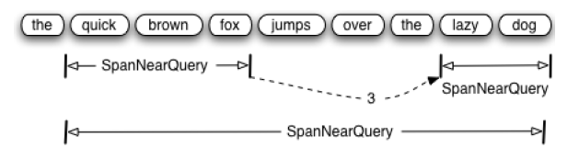
Span Query

Slide 13
Lucene
Sorting Results
Sorting by relevance
Sorting by index order
Sorting by a field
Reversing sort order
Sorting by multiple fields

Slide 14
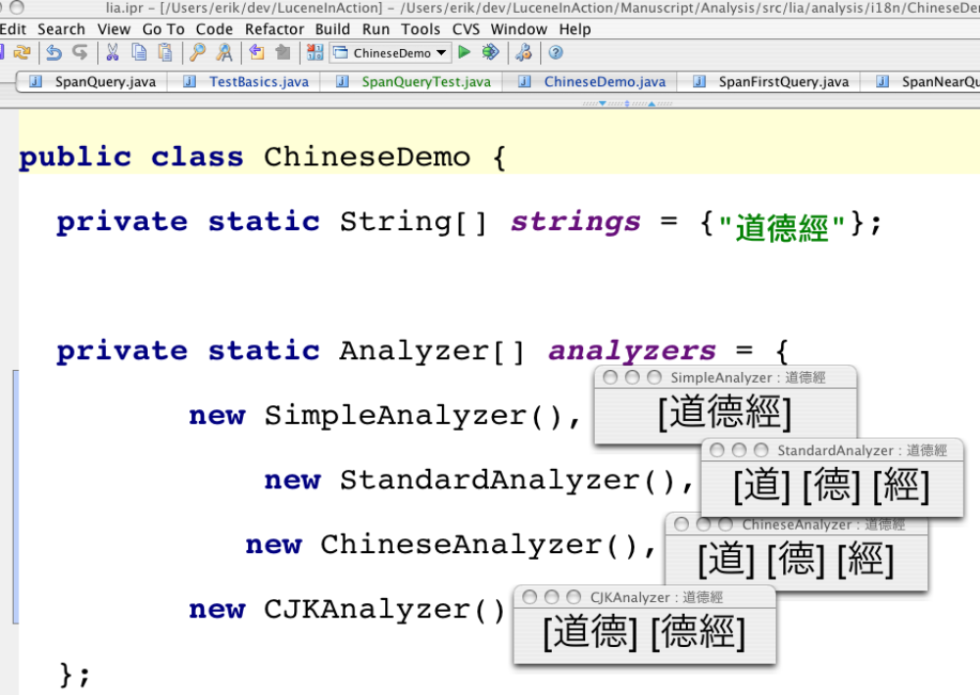
ChineseAnalyzer

Slide 15
Multiple search
Client
Remote searchable
Server
It through server,
search multiple indexes.
A
B
Z
……

Slide 16
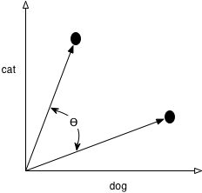

Lucene
Leveraging term vectors
Formula for computing the
angle between two vectors
<The algorithm>
Our getCategory method loops through all categories,
computing the angle between each category. The smallest angle
is the closest match, and the category name is returned.

Slide 17
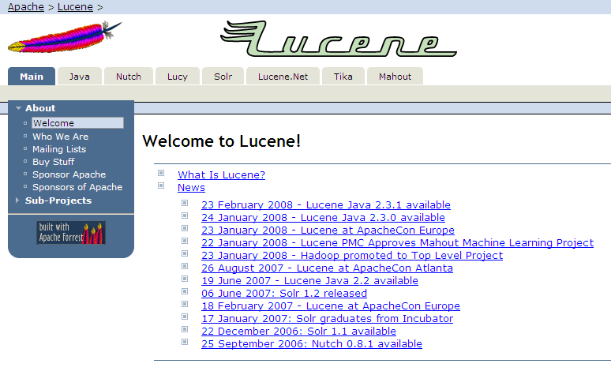
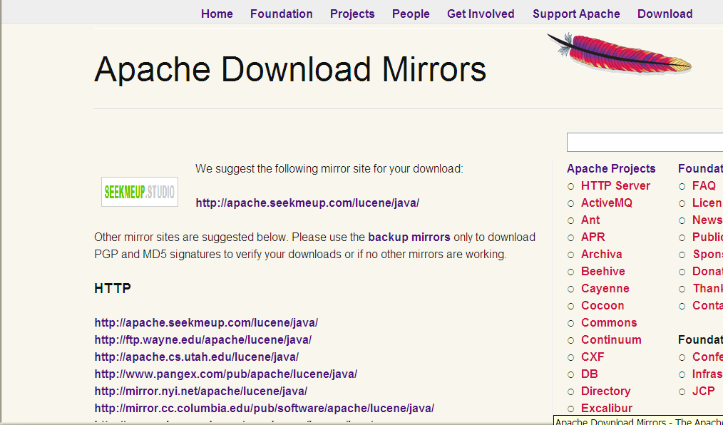
Installing Lucene 1#

Slide 18
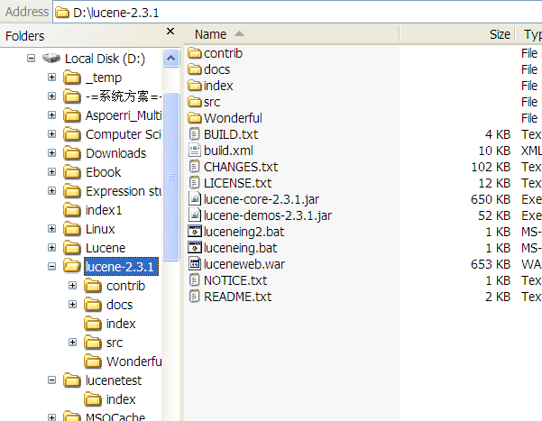
Installing Lucene 2#
Indexes store
Text files/documents require to
index and search.

Slide 19
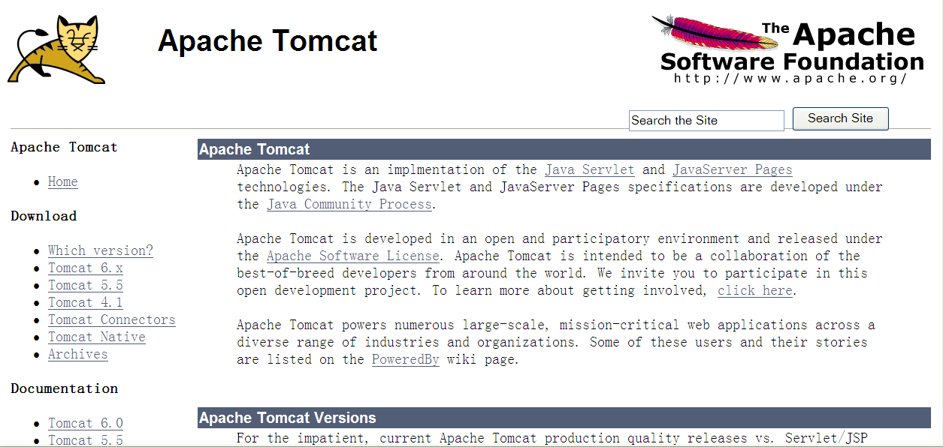
Installing Lucene 3#

Slide 20
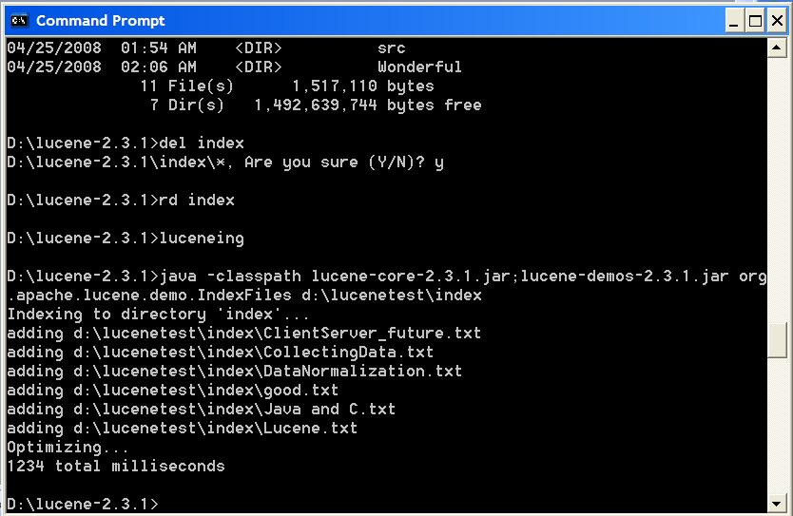
Lucene
Indexing
java -classpath lucene-core-2.3.1.jar;lucene-demos-2.3.1.jar
org.apache.lucene.demo.SearchFiles d:\lucenetest\index

Slide 21
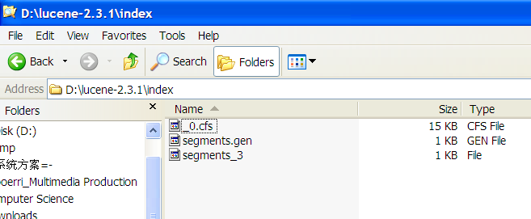
Lucene
Indexing store directory

Slide 22
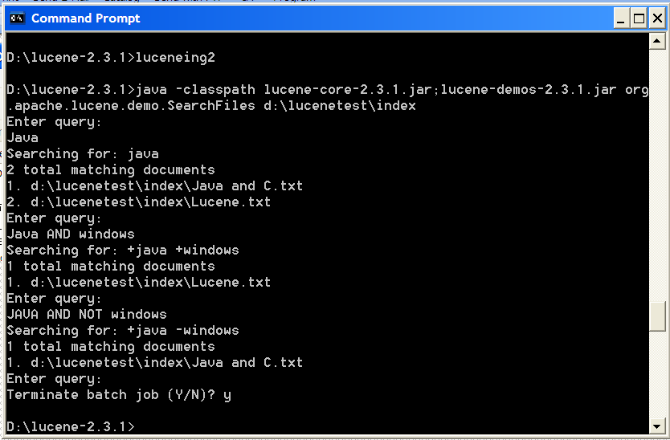
Lucene
Searching

