Slide 1
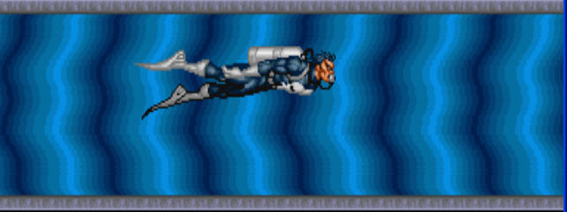
XQuery – The king of Query
By Xiaoxuan Tang

Slide 2

The un-queried life is not worth living
— Socrates (Plato, The Apology, 38a)

Slide 3
What is XQuery
Data in XML
Middleware language
XQuery
Web Application
development language
Existing situation
The changing situation

Slide 4
What is XQuery? (Cont)
XQuery is a standardized language that can be used to query XML documents.
Web Development
Application
Replace
XQuery
C++
Java

Slide 5
What is XQuery? (Cont)
It is a query language that uses the structure of XML intelligently, and can express queries across all these kinds of data, whether stored in XML or viewed as XML via middleware.
XQuery is designed to be broadly applicable across many types of XML data sources, such as structured, semi-structured data, object repositories.
From http://www.w3.org/TR/xquery/

Slide 6
The position of XQuery in XML architect
XQuery
XPath
XSchema
XSLT
XSLT is XML
XQuery isn’t
--SAXONICA
XQuery relies heavily on the system to optimize queries
XSLT gives more control to the developer
--SAXONICA
XQuery is great for query
XSLT is better for transformation
(designed for document rendering)
--SAXONICA
Mix XQuery and XSLT together is good strategy.

Slide 7
The position of XQuery in XML architect (Cont)
Results
Data
XQuery
Multiple Databases
XML files
Remote web
documents
XSLT
Web
Presentation
CGI scripts

Slide 8
The detailed syntax of XQuery
Many concepts need to understand
Some of statement verbose
Part of them same with Xpath
Diving: http://www.w3.org/TR/xquery/

Slide 9
XQuery demonstration
Its demonstration must be through the use of Software outside XML, except XQueryX.
Many choices
  Altova XML spy and XML Query processor
  Stylus Studio 5.0 (DataDirect)
  Oracle Berkeley DB XML 2.0
  Zorba
  Saxon

Slide 10
The relationship between Saxon and XQuery
Concrete
Application
Application
XSLT 2.0
XPath 2.0
XQuery 1.0
XML Schema
1.0
Saxon 9.1
API
Data
Data in XML

Slide 11
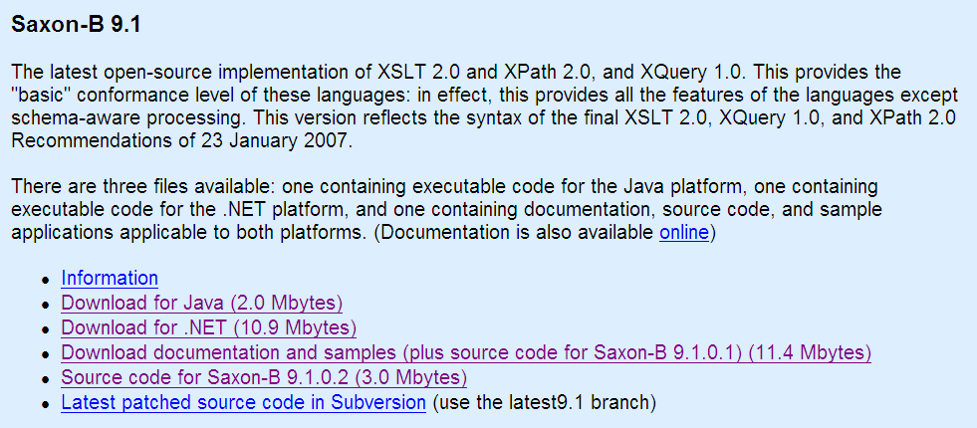
The installation of Saxon
1. Java installation (If you want to use this)
  The appropriate PATH and ClassPath is definitely required.
2. .net framework installation
3. Download corresponding version of Saxon-B9.1 and extract it in c:\saxonb9
http://saxon.sourceforge.net/
4. Download XML data (AppB.XML.zip) from textbook’s website.
http://www.wrox.com/WileyCDA/WroxTitle/Beginning-XML-Databases.productCd-0471791202,descCd-DOWNLOAD.html
4.1 demographics.xml
4.2 demongraphcisYLO.xml

Slide 12
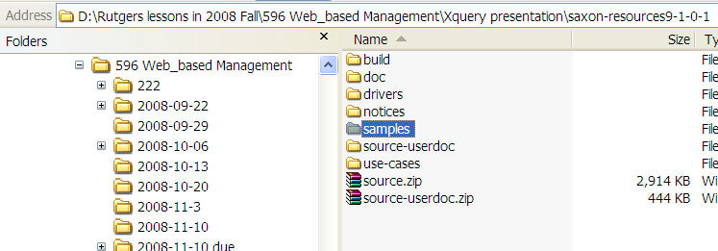
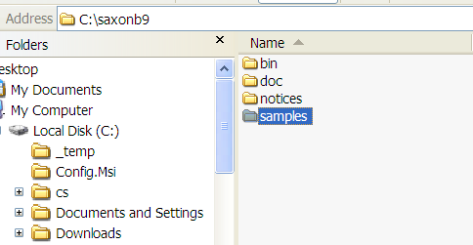
Copy the samples directory into C:\saxonb9 (.net) or C:\sazonb9j (java) for convenience of command line handling later.
Our default
working
directory

Slide 13
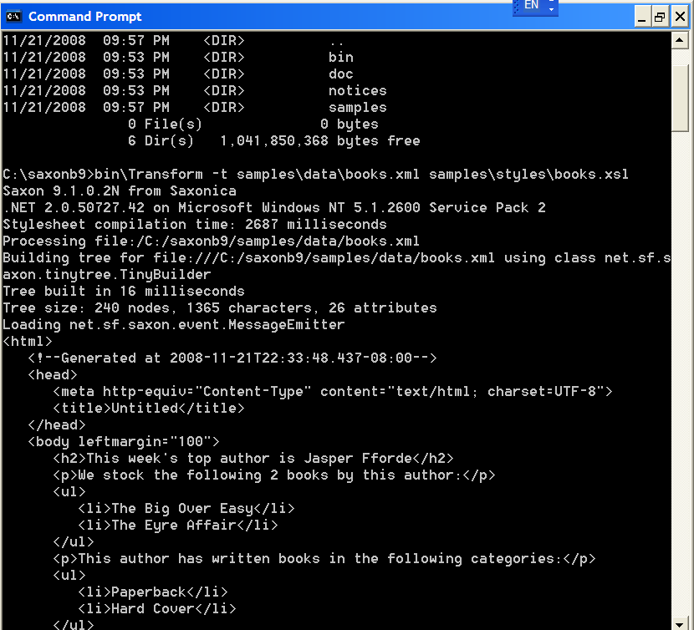
bin\Transform -t samples\data\books.xml samples\styles\books.xsl

Slide 14
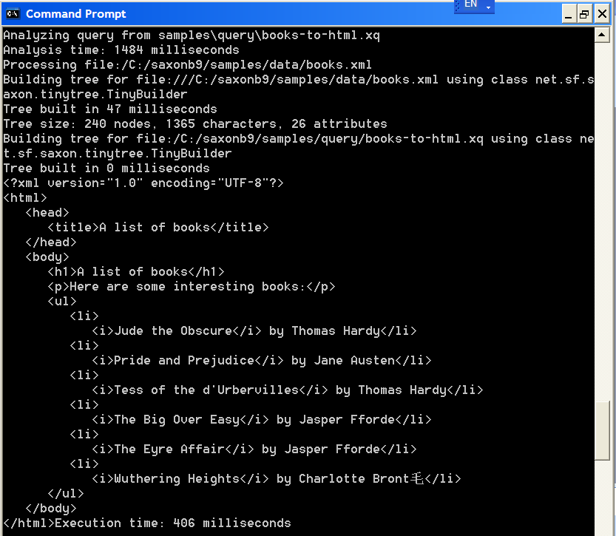
bin\query -t -s samples\data\books.xml samples\query\books-to-html.xq

Slide 15
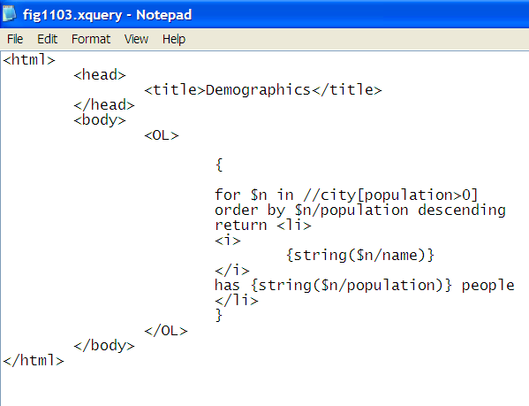
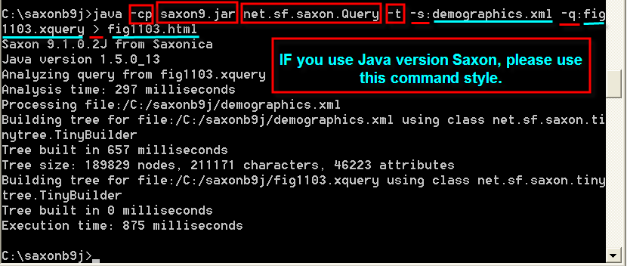
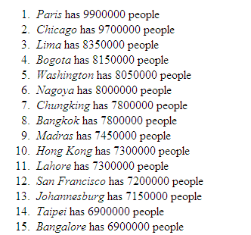
Example 1: Fig1103.xquery
1.Use XML editor to generate this XQuery file. (Already uploaded in Sakai)
2.c:\saxonb9>bin\query –s demographics.xml fig1103.xquery >fig1103.html
C:\saxonb9>bin\query –s demographics.xml fig1103.xquery
>fig1103.html
Source file options
Source file
command
Query requirements
Generated target files

Slide 16
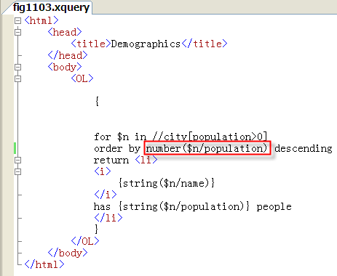
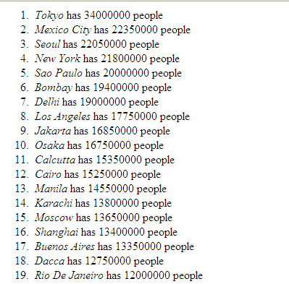
Fig1103.html
Please pay attention to the difference from the last one
C:\saxonb9>bin\query –s demographics.xml fig1103.xquery
>fig1103.html

Slide 17

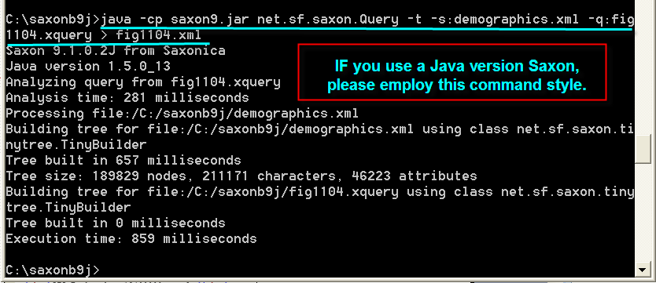

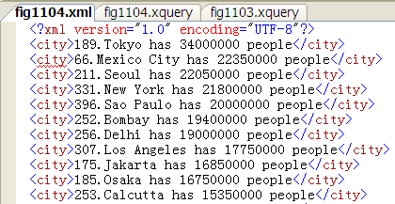
Example2:
For loop by using at keyword

Slide 18
FLWOR
FOR
Let
Where
Order by
Return

Slide 19
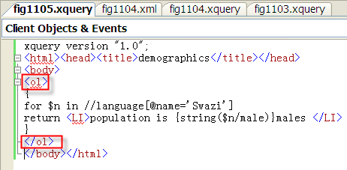
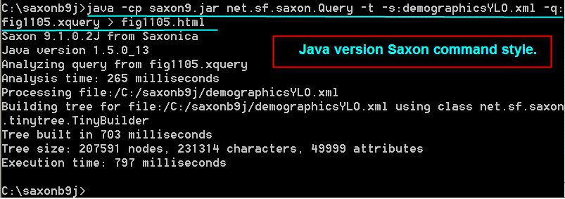

Example 3:
FLWOR: the basic for Loop and Return Clause

Slide 20

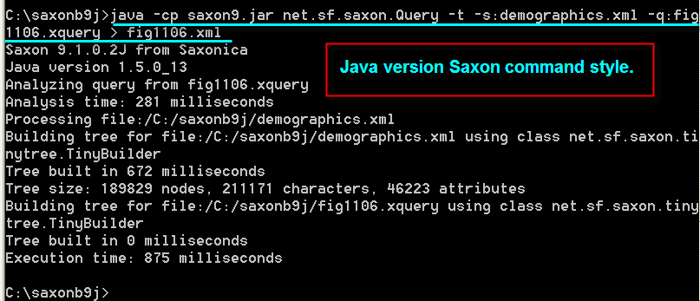
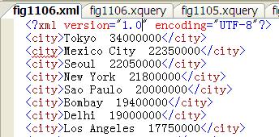
Example 4:
FLWOR: Adding an order by clause

Slide 21
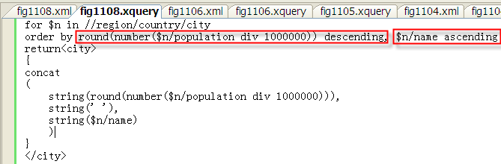
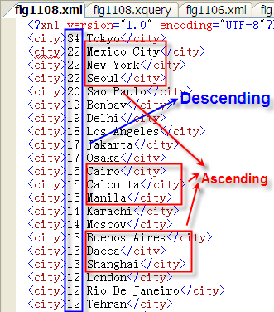
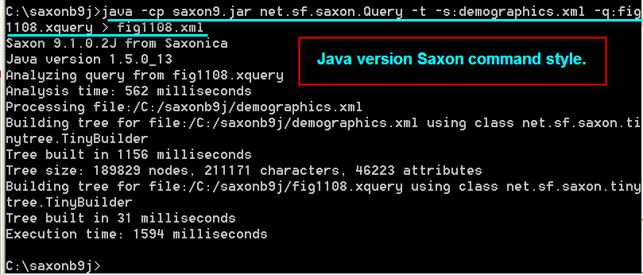
Example 5:
FLWOR: Adding an order by clause (cont)

Slide 22
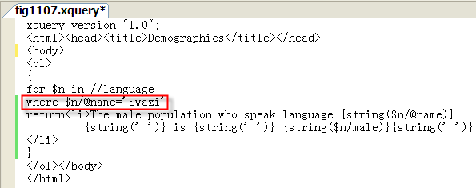
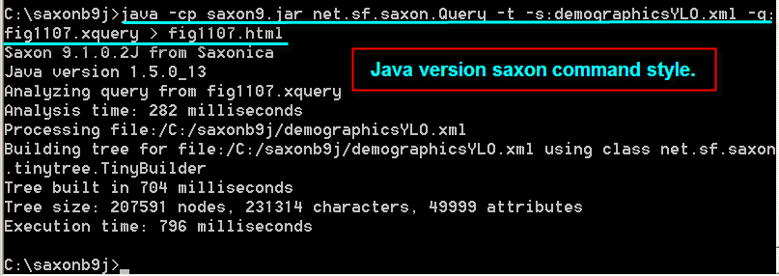

Example 6:
FLWOR: Adding a where clause

Slide 23

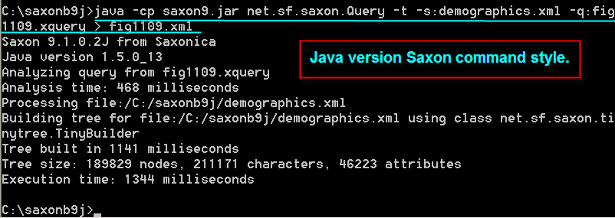
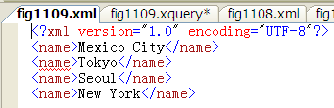
Examples 7:
FLWOR: Declaring Variables with the Let Clause

Slide 24
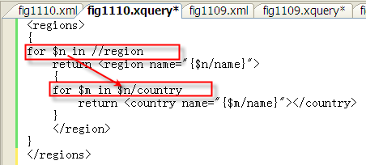
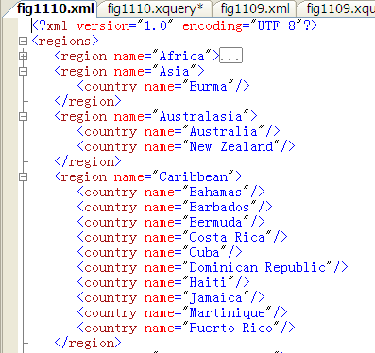
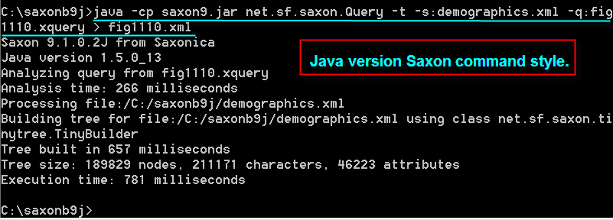
Example 8:
FLWOR: Embedded for Loops and Communication

Slide 25
What is XQueryX?
XQueryX is a query tool written in XML.
Saxon
Bypass
Oracle XML DB
A big nightmare with complexity
Similar to
write C code

Slide 26
The comprehension
XQuery commands are not written in XML
XQuery can be used to query XML data.
XQuery has capabilities similar to a primitive form of SQL
XPath and XQuery share many components, especially functions and axes.
Saxon is a very simple-to-use shell tool for executing XQueries.
XQuery commands can be embedded with HTML text and tags.
XQuery commands can be embedded with XML tags.
XQuery terminology and syntax is common to much of XML.
FLWOR represents “For, Let, Where, Order By, and Return.”

