Slide 1

Adding a counter to WebVoyage using JSP code
Andy Tang
Kilgore College Library

Slide 2

Acclaim
Backup each file before modification
Use at your own risk
Kilgore College and I are not responsible for damage or problems caused by the use of the code and method described in this PowerPoint.
No warranties or guarantees of any kind are implied or assumed.

Slide 3
Summary
Why add JSP code into WebVoyage?
How-To
  2.1 Preparation
  2.2 Create JSP code and compile them.
  2.3 Move created JSP into WebVoyage
  2.4 Configure WebVoyage
  2.5 Test
Source code

Slide 4
1. Why add counter to WebVoyage
Customization Requirement
Track user visit, not every search
    Voyager “OPAC search log” counts searches, not visits
Patron usually share the public computers in campus to browse OPAC
Some patrons log in OPAC, but do not search
Notes:
Kilgore College Library wants to keep statistics on how many patrons visit their WebVoyage. To count all visits, JavaServer Pages (JSP) can be included into WebVoyage. This presentation will explain step by step how to add the counter code into WebVoyage so all visits are counted.

Slide 5
1.1 Why use JSP code to implement counter
JSP is powerful
  CSS /XSLT: change the outlook of WebVoyage
  JavaScript: powerful, however
  JSP: very powerful without limitation
JSP is secure
Voyager Support JSP/Perl
  JSP has many advantage compared with Perl
  In Windows Platform, JSP is more easy to deploy.

Slide 6
1.2 What is JSP
JSP – JavaServer Pages
JSP is a technology that lets you add dynamic content to web pages
JSP is what happened when somebody introduced Java to HTML

Slide 7
Engine
1.3
Framework.xsl
Constants.xsl
Header.xsl
CSS
JavaScript
Footer.xsl
Others
Tools.xsl
Web page

Slide 8
1.4
Engine
Framework.xsl
Footer.xsl
Constants.xsl
Header.xsl
CSS
JavaScript
Others
Tools.xsl
JSP counter
Web page

Slide 9
1.5 Working Schema/Mode
Local computer
Compiled
Source
code
Apache
Source
code
Java
Tomcat
Test
WebVoyage Server
Environment configure
For Web page display
Tomcat
server.xml
Framework.xsl
xxxdb.httpd.conf
Footer.xsl
Apache
xxxdb.jkmounts.conf

Slide 10
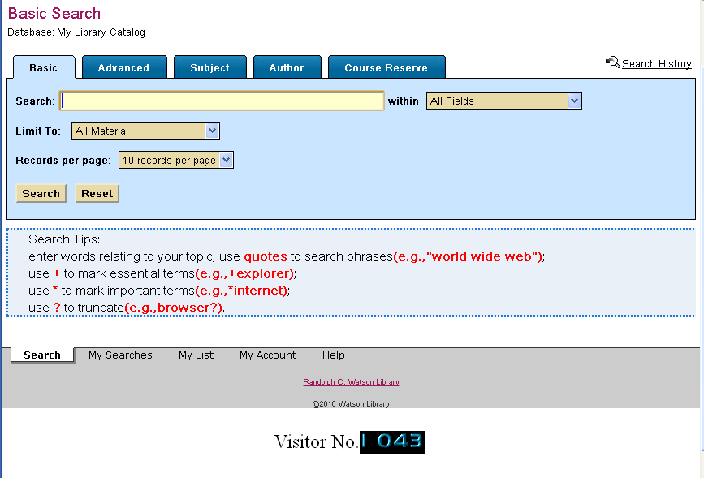
1.6 Our Target

Slide 11
2. How-To
  2.1 Preparation
  2.2 Create JSP code and compile them.
  2.3 Move created JSP into WebVoyage
  2.4 Configure WebVoyage
  2.5 Test

Slide 12
2. 1 Preparation (local computer)
Java 6.0
  http://www.java.com/en/download/index.jsp
Apache 2.2.21
  http://httpd.apache.org/download.cgi#apache22
Tomcat 6 (JSP run above Tomcat)
  http://tomcat.apache.org/download-60.cgi

Slide 13
2.2 Create JSP code and compile them
  2.2.1 Folder and file layout
  2.2.2 CountFile.java
  2.2.3 counter.jsp
  2.2.4 web.xml
  2.2.5 Put JSP code into appropriate folder and prepare to compile
2.2.6 Use Java to compile the code
2.2.7 Class is created
2.2.8 The folder layout after compile
2.2.9 Create the counter number image files
2.2.10 Move “counter” folder
2.2.11 Test results in local Tomcat server

Slide 14
2.2.1 Folder and file layout
Project
Folder
Counter
images
src
etc
classes
CountFile.java
counter.jsp
web.xml
File

Slide 15
2.2.2 CountFile.java
package com.chat1;
import java.io.*;
public class CountFile {
  public static void writeFile(String filename,long count)
  {
    try{
    PrintWriter pw = new PrintWriter(new FileWriter(filename));
    pw.print(count);
    pw.close();
    }catch(IOException e)
    {
    e.printStackTrace();
    }
  }
  public static long readFile(String filename)
{
  long count = 0;
    try{
      File f = new File(filename);
      if(!f.exists())
    {
    writeFile(filename,1);
    }
      BufferedReader br = new BufferedReader(new FileReader(f));
      count = Long.parseLong(br.readLine());
    }catch(IOException e)
    {
    e.printStackTrace();
    }
    return count;
}
}
Write counter value to file
Read counter value from file
If counter file does not exit, create a new one.
This file need to be compiled by using JAVA

Slide 16
2.2.3 counter.jsp
<%@ page language="java" import="java.io.*"
contentType="text/html; charset=UTF-8" pageEncoding="UTF-8"%>
<%@ page import = "com.chat1.*" %><%-- //import the package of java file --%>
<!DOCTYPE html PUBLIC "-//W3C//DTD HTML 4.01 Transitional//EN" "http://www.w3.org/TR/html4/loose.dtd">
<html>
<head>
<meta http-equiv="Content-Type" content="text/html; charset=UTF-8">
<title>Counter JSP by Andy</title>
</head>
<body>
<br>
<span style="float:left; font-size : 1.5em">Visitor No.</span>
<%
long count =CountFile.readFile("\\count.txt");
if(session.getAttribute("Visited")==null)
{
session.setAttribute("Visited","Y");
session.setMaxInactiveInterval(60*60*24);
count +=1;
CountFile.writeFile("\\count.txt",count);
}
String s1=""+count;
int length = s1.length();
String dd="";
int a=0;
for (a = 0; a < length; a++){
dd=s1.substring(a,a+1);
%>
<image style="float:left;“ src="images/<%=dd%>.gif" />
<%
}
%>
</body>
</html>
Count.txt file contains the counter value.
Session value.
A session is an object associated with a visitor.
Match each counter digit with related picture file.

Slide 17
2.2.4 web.xml
<web-app xmlns="http://java.sun.com/xml/ns/j2ee" xmlns:xsi="http://www.w3.org/2001/XMLSchema-instance" xsi:schemaLocation="http://java.sun.com/xml/ns/j2ee/web-app_2_.xsd" version="2.4">
<servlet>
<servlet-name>Chapter1 servlet</servlet-name>
<servlet-class>com.chat1.CountFile</servlet-class>
</servlet>
<servlet-mapping>
<servlet-name>Chapter1 servlet</servlet-name>
<url-pattern>/Serv</url-pattern>
</servlet-mapping>
</web-app>

Slide 18
2.2.5 Put JSP code into appropriate folder and prepare to compile
Project
Folder
Counter
images
src
etc
classes
CountFile.java
counter.jsp
web.xml
File

Slide 19
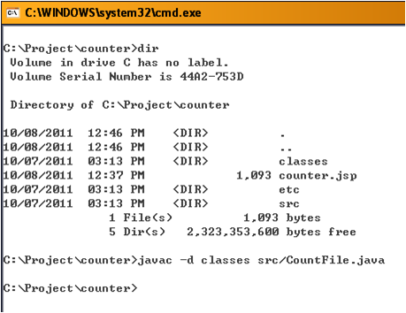
2.2.6 Use Java to compile the code
C:\Project\counter>javac –d classes src/CountFile.java

Slide 20
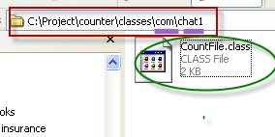
2.2.7 Class is created

Slide 21
2.2.8 The folder layout after compile
Project
Folder
Counter
classes
com
images
src
etc
chat1
CountFile.java
counter.jsp
web.xml
CountFile.class
File

Slide 22
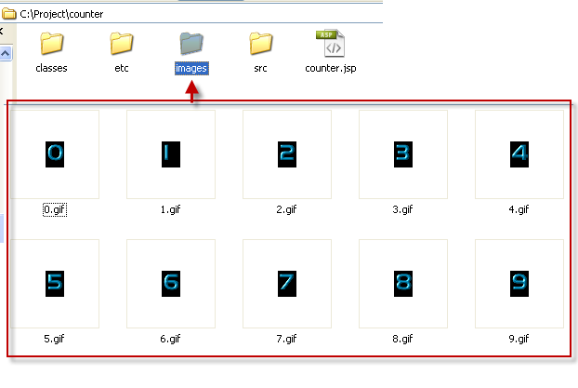
2.2.9 Create the counter number image files

Slide 23
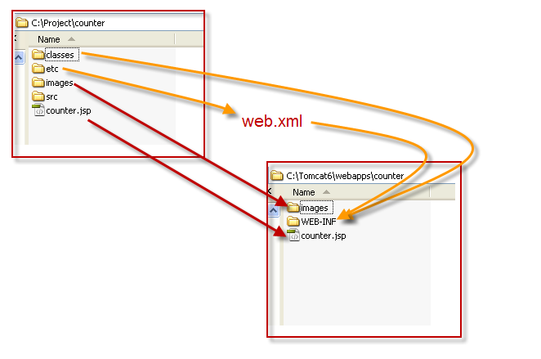
Copy “counter” folder selectively from c:\project in local computer to Tomcat webapps folder in local computer.
2.2.10 Move “counter” folder

Slide 24
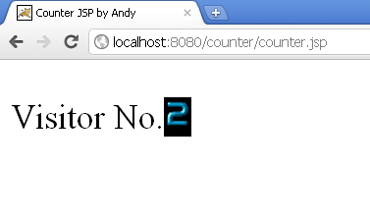
2.2.11 Test results in local Tomcat server

Slide 25
2.3. Move created JSP to WebVoyage
Copy created files from local computer to WebVoyage server
  Go to local computer, copy all of things in folder c:\Tomcat6\webapps\counter
  Go to WebVoyage server, locate the folder “x:\voyager\xxxdb\tomcat\vwebv\”, and create a child folder named “ch5”
  Paste everything into “x:\voyager\xxxdb\tomcat\vwebv\ch5\”

Slide 26
2.4 Configure WebVoyage and make the JSP counter display in OPAC
2.4.1 Modify server.xml
2.4.2 Modify xxxdb.httpd.conf
2.4.3 Modify xxxdb.jkmounts.conf
2.4.4 Modify framework.xsl
2.4.5 Modify footer.xsl

Slide 27
2.4.1 Modify server.xml
Modify server.xml in folder “X:\voyager\xxxdb\tomcat\vwebv\conf”
Add code below into <host></host>
  <Context path="/counter"
  className="org.apache.catalina.core.StandardContext"
  cachingAllowed="true"
  charsetMapperClass="org.apache.catalina.util.CharsetMapper"
  cookies="true"
  crossContext="false"
  displayName="Voyager counter"
  docBase="/m1/voyager/xxxdb/tomcat/vwebv/ch5"
  privileged="true"
  reloadable="false"
  swallowOutput="false"
  useNaming="true"
  wrapperClass="org.apache.catalina.core.StandardWrapper">
  </Context>
Path to JSP counter

Slide 28
2.4.2 Modify xxxdb.httpd.conf
Open the file xxxdb.httpd.conf in folder “X:\m1\shared\Apache2\conf\”
Add next line into xxxdb.httpd.conf
Alias /counter/ “X:/m1/voyager/xxxdb/tomcat/vwebv/counter/"

Slide 29
2.4.3 Modify xxxdb.jkmounts.conf
mod_jk is a completely new Tomcat-Apache plug-in that handles the communication between Tomcat and Apache.
Open the file xxxdb.jkmounts.conf in folder “X:\m1\shared\Apache2\conf\”
Add next line into xxxdb.jkmounts.conf
JkMount /counter* ajp13_lb_kilgoredb_vwebv

Slide 30
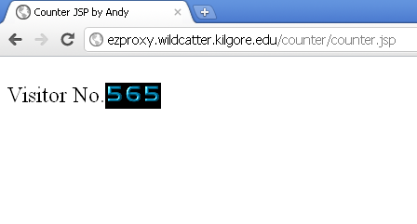
2.4.3.1 Test in WebVoyage before modifying framework.xsl

Slide 31
2.4.4 Modify framework.xsl
Locate framework.xsl in the folder X:\voyager\xxxdb\tomcat\vwebv\context\vwebv\ui\en_US\xsl\pageTools\
Open it and add the code like below
<xsl:call-template name="callcounter"/>

Slide 32
2.4.5 Modify footer.xsl
Locater footer.xsl in the folder X:\voyager\kilgoredb\tomcat\vwebv\context\vwebv\ui\en_US\xsl\pageFacets\
Add the code like below.
<xsl:template name="callcounter">
<xsl:call-template name="counterbar">
</xsl:call-template>
</xsl:template>
<xsl:template name="counterbar">
<div class="x">
<iframe class="zzz" src="/counter/counter.jsp" scrolling="no" frameborder="0"
style="width:220px; height:150px; border:0; padding-left:15px;">
</iframe>
</div>
</xsl:template>

Slide 33
2.5 Restart Voyager Apache and Tomcat and open OPAC page

Slide 34

3. Source code
Full package:
http://library.kilgore.edu/project/counter/Counter.zip
Separate ones:
CountFile.java
    http://library.kilgore.edu/project/counter/CountFile.java
Counter.jsp
http://library.kilgore.edu/project/counter/Counter.jsp
Web.xml
http://library.kilgore.edu/project/counter/web.xml
Image file
http://library.kilgore.edu/project/counter/images.zip
Compiled class http://library.kilgore.edu/project/counter/CountFile.class

Slide 35



Tomcat: The Definitive Guide
By Jason Brittain, Ian F. Darwin
June 2003
Java and XSLT
By Eric M. Burke
September 2001
Java InstantCode: Developing JSP and XML Integrated Solutions
By SkillSoft Company
2004

Slide 36


Head First Servlets and JSP: Passing the Sun Certified Web Component Developer Exam
by Bryan Basham, Kathy Sierra and Bert Bates
April, 2008
Java Cookbook
By Ian F. Darwin
June, 2011

Slide 37
Than you!
Questions?
atang@kilgore.edu

