Slide 1
Implementation of Analytical Solution for Transport Through a Single Fracture from of Tang et. al 1981
GEOL 754 Final Project
Andy Banks
Fall 2018

Slide 2
Outline
Background
General Equations and Derivation of Analytical Solutions
Methods
Implementing the Analytical Solution using numerical integration
Implementing time-dependent Co using Superposition
Integrating breakthrough curve to estimate mass discharge
Results
Breakthrough curves for Fracture and Matrix
Investigate mass discharge as a function of
Distance from source (z- coordinate)
Distance into Porous Matrix (x-coordinate)
Fracture width (2b)
Flow velocity along fracture axis (v)

Slide 3
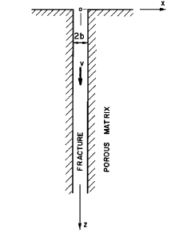
Contaminant Transport in Fractured Porous Media: Analytical Solution for a Single Fracture
D. H. TANG, E. O. FRIND AND E. A. SUDICKY
Presents general analytical solution for contaminant transport along a discrete fracture and surrounding porous matrix
Solution accounts for many transport mechanisms
Advective transport in the fracture
Longitudinal mechanical dispersion in the fracture
Molecular diffusion
Along the fracture
From the fracture to the rock matrix
Adsorption
From fracture to the face of the rock matrix
Adsorption within the rock matrix
Radioactive decay

Slide 4
Assumptions these folks made
Width of fracture is much smaller than its length
Transverse diffusion and dispersion within the fracture assure complete mixing across the fracture width at all times
The permeability of the porous matrix is very low and transport in the matrix will be mainly by molecular diffusion.
Transport along the fracture is much faster than transport within the matrix
Constant groundwater velocity in fracture
Contaminant source of constant strength exists at origin of fracture

Slide 5
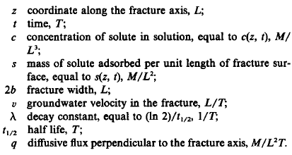

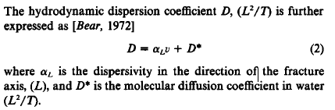


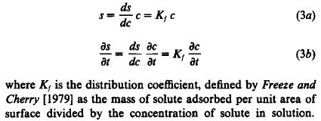
The Governing Equations: Fracture
?
Advection Along Fracture Axis
Fick’s 2nd Law (Diffusion Along Fracture Axis)
Adsorption onto Fracture Face
Radioactive Decay
Boundary Conditions for Fracture

Slide 6

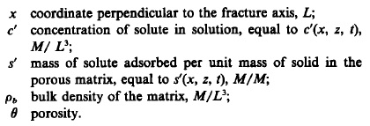


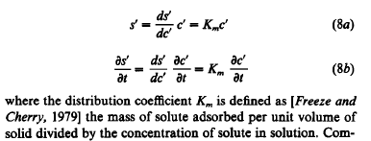
The Governing Equations: Matrix
Fick’s 2nd Law (Diffusion into Porous Matrix)
Adsorption Into Porous Matrix
Radioactive Decay
Boundary Conditions for Matrix

Slide 7


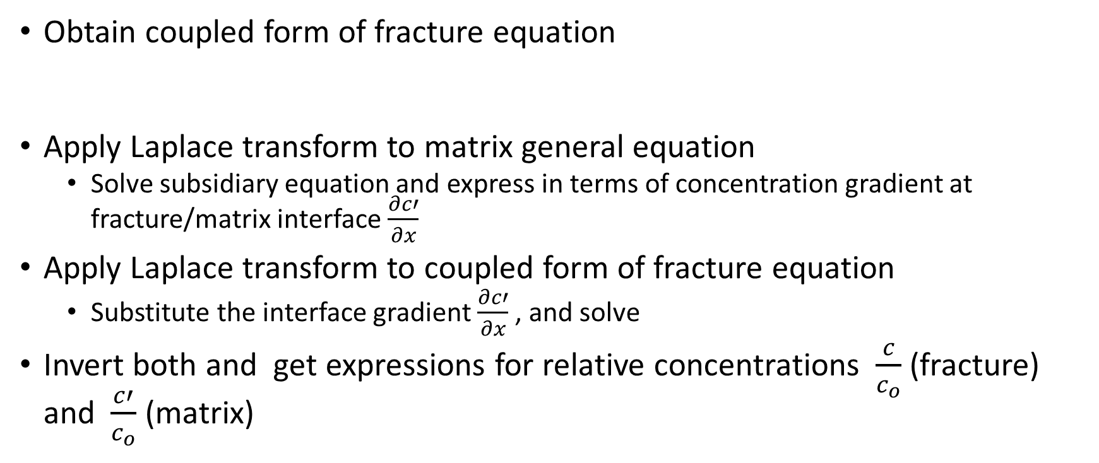
General Process for Analytical Solution
Obtain coupled form of fracture equation
Apply Laplace transform to matrix general equation
Solve subsidiary equation and express in terms of concentration gradient at fracture/matrix interface $\frac{∂c′}{∂x}$
Apply Laplace transform to coupled form of fracture equation
Substitute the interface gradient $\frac{∂c′}{∂x}$ , and solve
Invert both and get expressions for relative concentrations $\frac{c}{c_{o}}$ (fracture) and $\frac{c′}{c_{o}}$ (matrix)

Slide 8
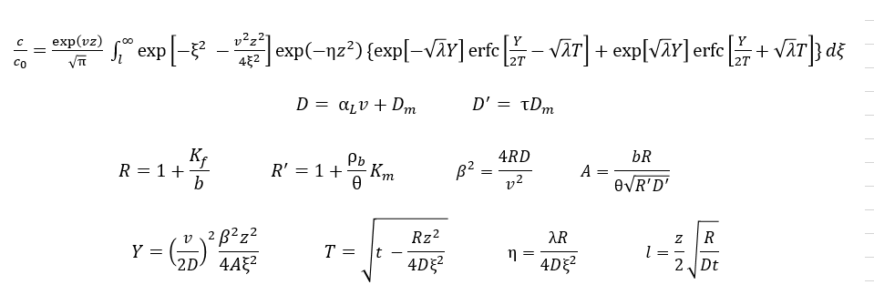
General Analytical Transient Solution: Fracture

Slide 9
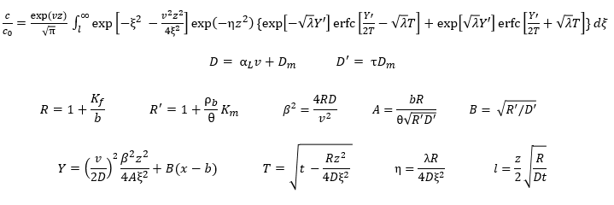
General Analytical Transient Solution: Matrix

Slide 10
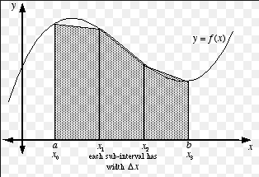

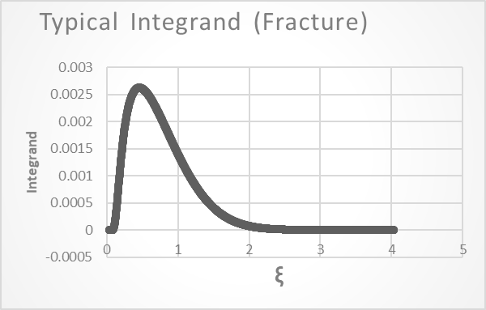
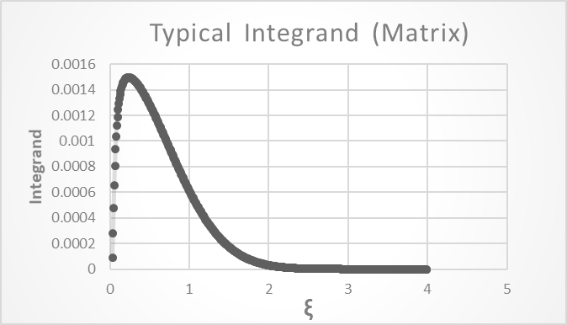
Evaluating the Semi-definite Integral
Trapezoid Rule
Special case of Gaussian quadrature
Works great for bell curves and 2nd order polynomials
Z = 0.66, t = 20000 days , v = 0.01 m/day
X = 0.5m , Z = 0.66m, t = 20000 days , v = 0.01 m/day

Slide 11
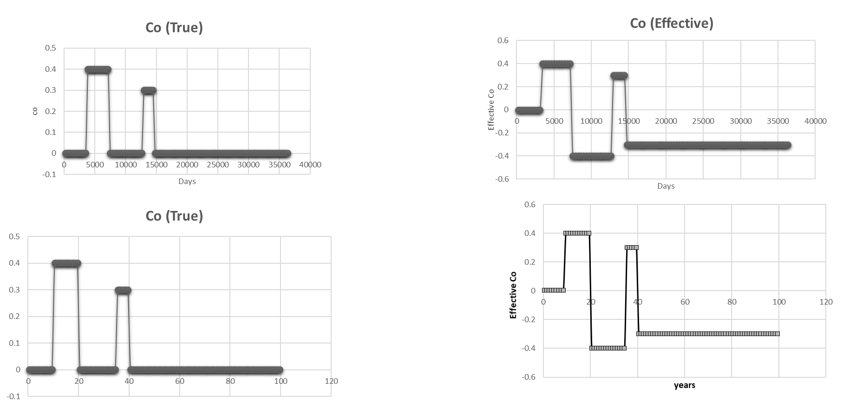
Superposition with time dependent Co

Slide 12
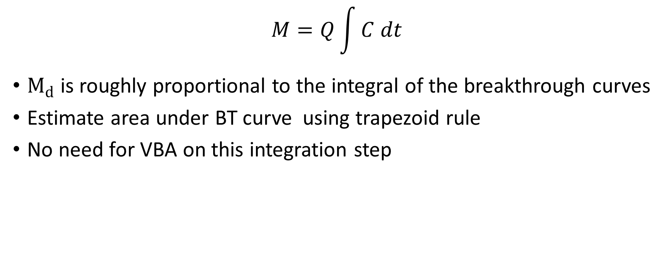
Estimating Mass Discharge
$$M=Q\int{C dt}$$
$M_{d}$is roughly proportional to the integral of the breakthrough curves
Estimate area under BT curve using trapezoid rule
No need for VBA on this integration step
Area = Mtot = 2044

Slide 13
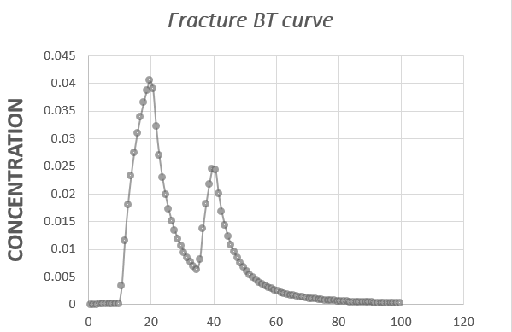
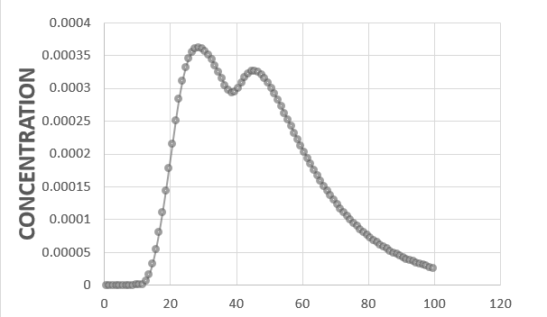
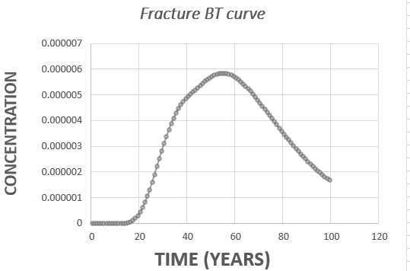
Breakthrough Curves: Fracture
z = 1.0
z = 3.0
z = 5.0
v = 0.01 m/day
b = 5E-6 m =0.000005 m
x = 0.0 m
Time = 100 years

Slide 14
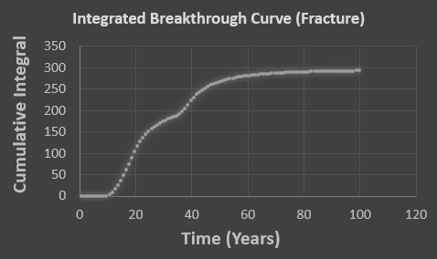
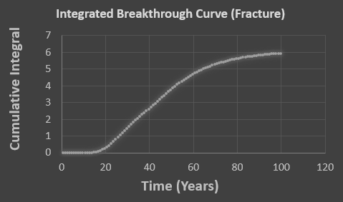
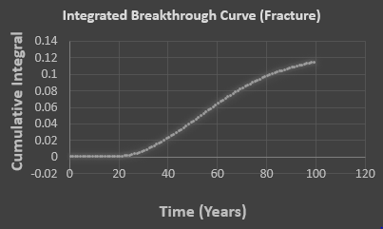

Fracture “Mass Discharge”
Md =300
z = 1.0
z = 3.0
Md =6
z = 5.0
v = 0.01 m/day
2b = 5E-6 m =0.000005 m
x = 0.0 m
Time = 40000 days (100 years)
Md =0.12
$$M_{d}=C∗q$$

Slide 15
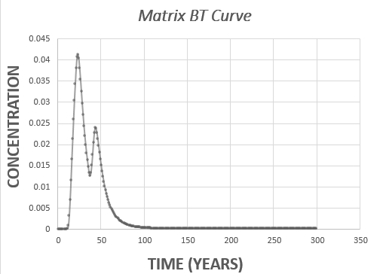
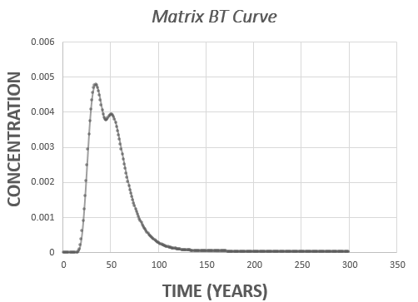
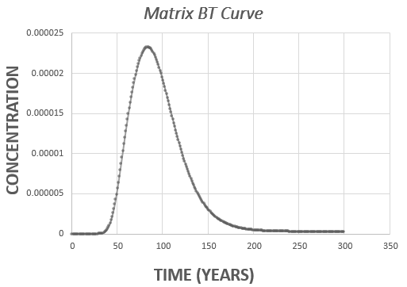
Breakthrough Curves: Matrix
z= 0.1 x = 0.1
z= 0.2
x = 0.1
z= 0.5
x = 0.1
v = 0.01 m/day
b = 5E-6 m =0.000005 m
Time = 300 years

Slide 16
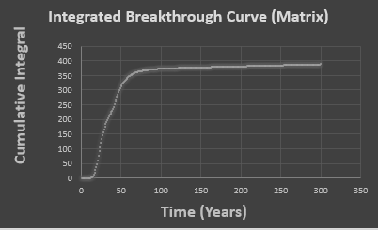
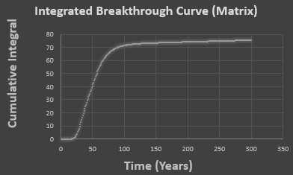
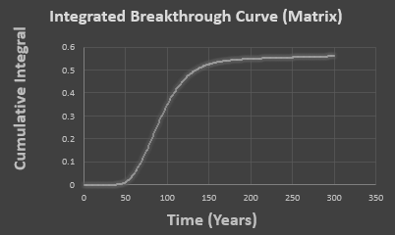
Matrix Mass Discharge
Md =391
z= 0.1 x = 0.1
z= 0.2
x = 0.1
Md =76
z= 0.5
x = 0.1
Md =0.57
v = 0.01 m/day
2b = 5E-6 m =0.000005 m
Time = 300 years
$$M_{d}=C∗q$$

Slide 17
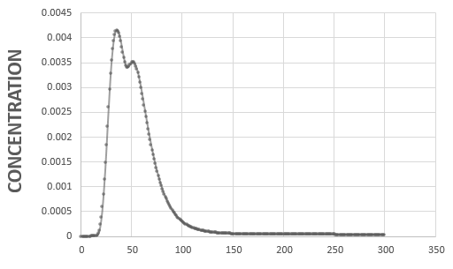
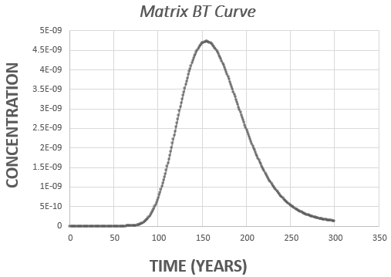
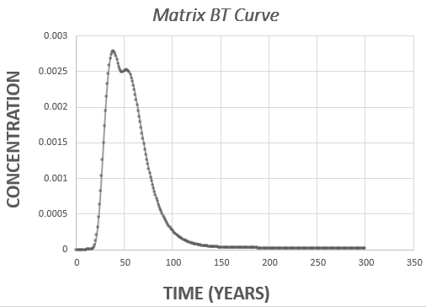
Breakthrough Curves: Matrix
z= 0.2 x = 0.1
z= 0.2
x = 1.0
z= 1
x = 0.1
z= 0.2
x = 3
v = 0.01 m/day
b = 5E-6 m =0.000005 m
Time = 300 years

Slide 18
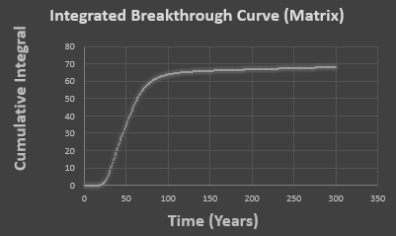
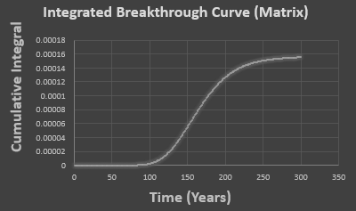
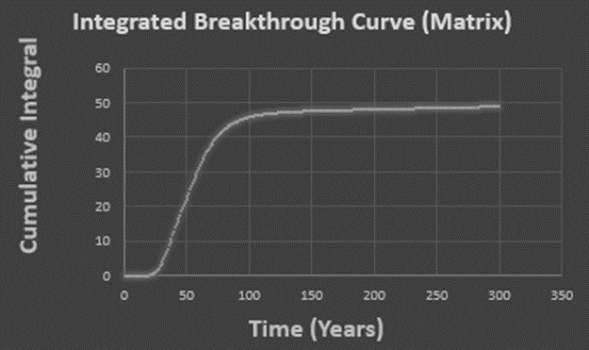
Matrix Mass Discharge
Md =76
z= 0.2 x = 0.1
z= 0.2
x = 1.0
z= 1
x = 0.1
Md =69.5
z= 0.2
x = 3
v = 0.01 m/day
2b = 5E-6 m =0.000005 m
Time = 300 years
Md =49.5
$$M_{d}=C∗q$$

Slide 19
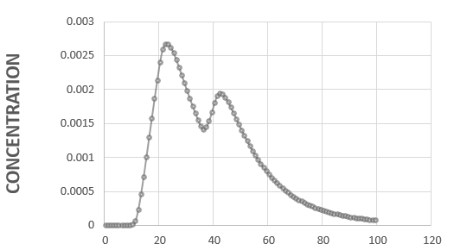
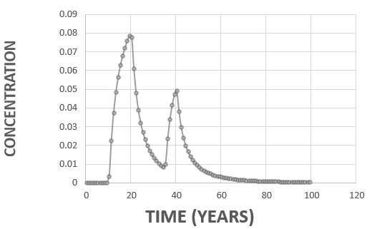
Vary Fracture Width (b): Fracture Breakthrough Curves
b = 0.5E-5
b = 1.0E-5
b = 10.0E-5
v = 0.01 m/day
x = 0.0 m
z = 3.0 m
Time = 100 years

Slide 20
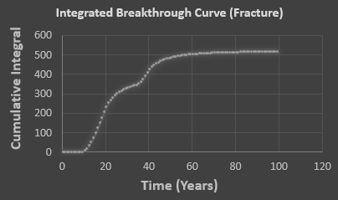
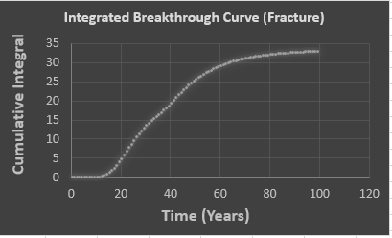
Vary Fracture Width (b): Fracture Mass Discharge
Md =514.5
b = 0.5E-5
b = 1.0E-5
Md =33.5
b = 10.0E-5
v = 0.01 m/day
x = 0.0 m
z = 3.0 m
Time = 100 years
Md =6

Slide 21
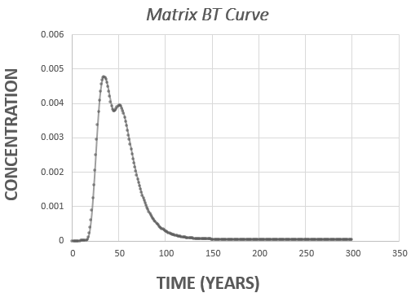
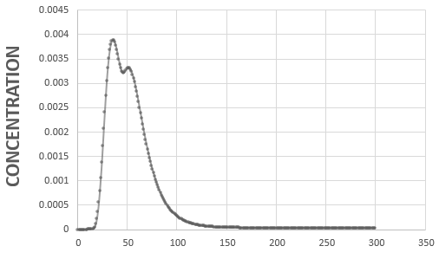
Vary Fracture Width (b): Matrix Breakthrough Curves
b = 0.5E-5
b = 1.0E-5
b = 10.0E-5
v = 0.01 m/day
x = 0.1 m
z=0.2 m
Time = 300 years

Slide 22
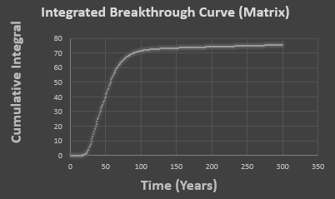
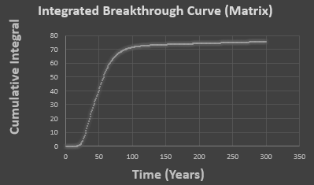
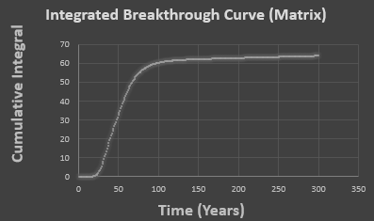
Vary Fracture Width (b): Matrix Mass Discharge
Md =76.35
b = 0.5E-5
b = 1.0E-5
Md =76
b = 10.0E-5
v = 0.01 m/day
x = 0.1 m
z=0.2 m
Time = 300 years
Md =64

Slide 23
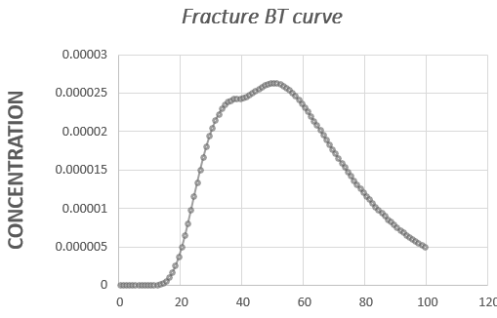
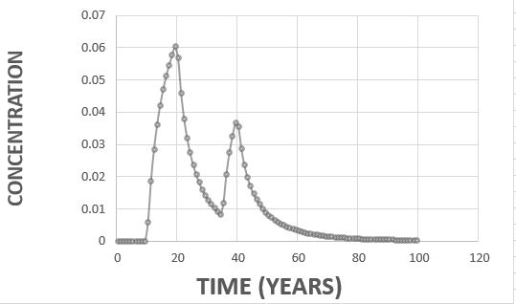
Vary Velocity (v): Fracture Breakthrough Curves
v = 0.005 m/d
v = 0.01 m/d
v = 0.1 m/d
b = 0.5E-5 m
x = 0.0 m
z = 3.0 m
Time = 100 years

Slide 24
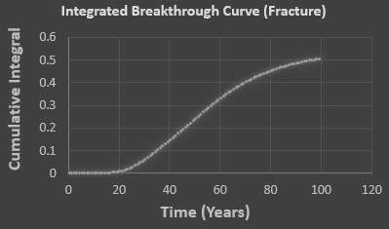
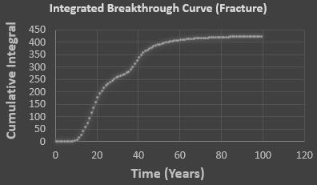
Vary Velocity (v): Fracture Mass Discharge
Md =0.51
v = 0.005 m/d
v = 0.01 m/d
Md =6
v = 0.1 m/d
b = 5E-5 m
x = 0.0 m
z = 3.0 m
Time = 100 years
Md =423

Slide 25
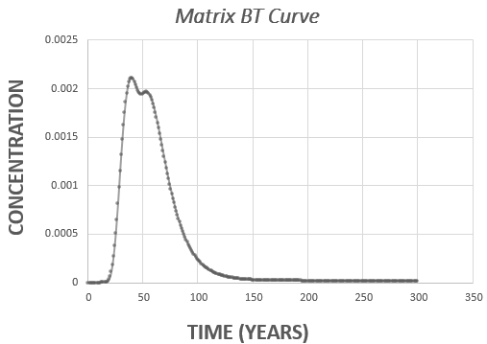
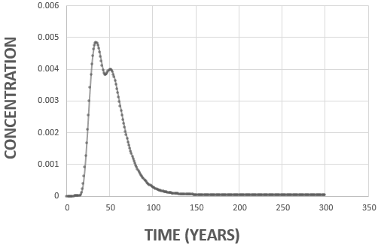
Vary Velocity (v): Matrix Mass Discharge
v = 0.005 m/d
v = 0.01 m/d
v = 0.1 m/d
b = 5E-5 m
x = 0.0 m
z = 3.0 m
Time = 300 years

Slide 26

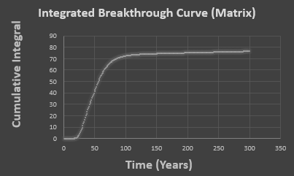
Vary Velocity (v): Matrix Mass Discharge
Md =37.5
v = 0.005 m/d
v = 0.01 m/d
Md =76
v = 0.1 m/d
b = 5E-5 m
x = 0.0 m
z = 3.0 m
Time = 100 years
Md =77

Slide 27
Summary
Increasing Z and/or X reduce maximum height of breakthrough curves for Matrix and fracture solutions
Reduces mass discharge estimate as well
Increasing width of fracture (b) reduces the Md estimate more in the fracture solution than in the matrix solution
Increasing velocity increases Md estimates for both solutions
Breakthrough curves require more time for matrix solution
Fracture solution unstable for large time values

