Slide 1
Customer Defection Project NPC Company
Isaac Sheets, Abhishek Majumdar and Andrew Cate

Slide 2

Group Collaboration
Weekly team huddle to brainstorm idea
Uniform coding standard and file naming convention followed from day 1
Individual branches created to put individual codes before merging to main.
Meet with project advisor to review approach, secure feedback and move forward
Focus on efficient Coding, Maintainability
Group Review before Merging
Individual Ideas/Code
Brainstorm
N
Consult Project Advisor
Agreement?
Y
Merge to Main branch

Slide 3
What is Churn?
The rate at which customers terminates business with an entity.
Types of Churn
Voluntary Churn – When Customer actively chooses to discontinue service due to reason like plan price, poor QoS etc.
Involuntary Churn – When Company decides to stop doing business with a customer due to reasons like Non-Payment, Misconduct, falsification etc.

Slide 4
Churn Management View - NPC
Customers with maximum number of entries in Complaints Table are more likely to churn out
Customers associated with Product IDs having maximum numbers of complaints are likely to churn out
Giving enough complaint credit is a good way to control voluntary churn
Newspaper delivery impact due to nonpayment is a good indicator on how management wants to manage involuntary churn

Slide 5
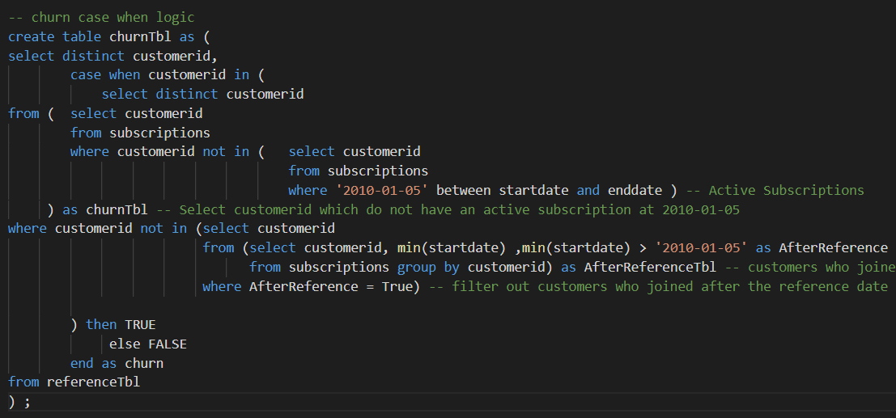
Identifying Churn
Reference Date of January 5th, 2010 (arbitrary)
Remove individuals with first subscription start date after the reference date
Check for active subscription on reference date
If customer does not have an active subscription, they have churned

Slide 6


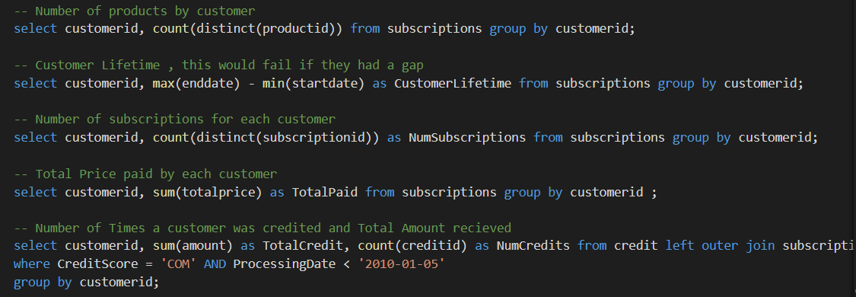
Data Engineering
Number of Products by Customer
Customer Lifetime in Days
Total Number of Subscriptions by Customer
Total Price paid by Customer
Number of times a Customer received Credit
Total $ of Credit received by Customer
Number of Complaints by Customer
Bad Product association

Slide 7
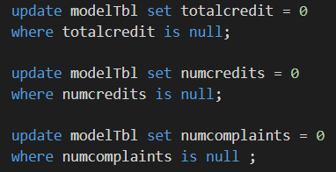
Model Table
Churn classification
8 predictors
Process:
1. Begin with reference table
2. Add churn flag
3. Join predictors via left outer joins
4. Missing values
5. Remove customerID
6. Ready for python

Slide 8
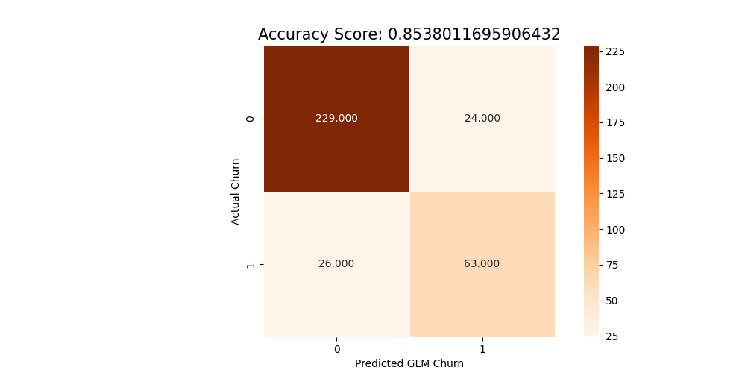
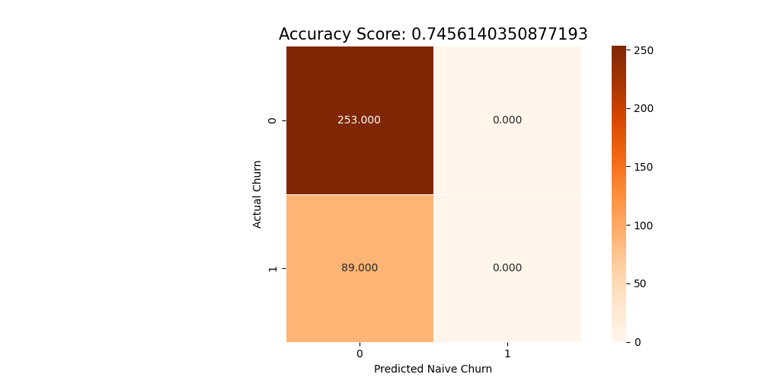
Logistic Regression - Results
Logistic Regression Accuracy: 85.38%
Naïve Accuracy: 74.56%
Logistic Regression Confusion Matrix
Naïve Confusion Matrix

Slide 9
Suggested Improvements
Complaint table should have SubscriptionID along with CustomerID like Credit or Delivery Table
This would enable simple DML for Data Visualization for Senior Management

Slide 10
Questions?

Slide 11
Q
Thank you
Questions?

Slide 12
Q
Appendix
Questions?

Slide 13
Best Practices
Data Dictionary
Frequent open-minded collaboration among team members

