Slide 1
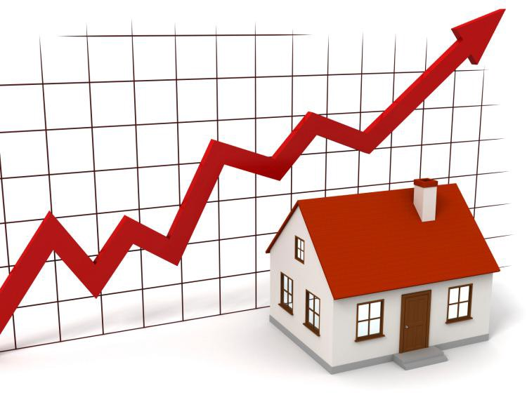
House Price Prediction
Andrew THENEDI
18079969D

Slide 2
Table of Contents
Main Objective
Configuration Setup
Data Cleaning
Association Rule Mining (Apriori)
Visualization
Predictive Analytics

Slide 3
Main Objective

Slide 4
Given 79 explanatory variables describing most aspect of residential homes in Ames, Iowa.
Predict final price of each home.

Slide 5
Configuration Setup

Slide 6
Google Colaboratory
Python
Libraries
Numpy
Matplotlib
Pandas
Seaborn
Datawig
Scikit-learn

Slide 7
Data Cleaning

Slide 8
Filter the train dataset to only contain the columns that its empty value counts < 25% of the row length of the dataframe).
Iterate through the columns that has an empty value and treat it as the dependent variable.
For each of the considered columns, the rest of the columns, except the ‘Id’ column, are treated as the independent variables.
Apply feature scaling using min-max normalization for numerical values.
Apply feature encoding using one hot for categorical values.
Predict the empty values using datawig library.

Slide 9
Association Rule Mining (Apriori)

Slide 10
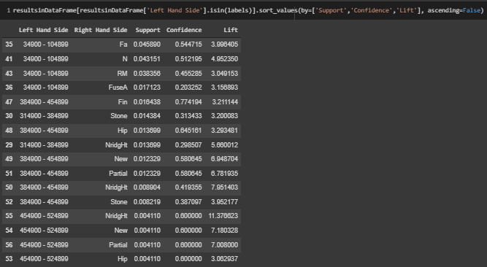

Slide 11
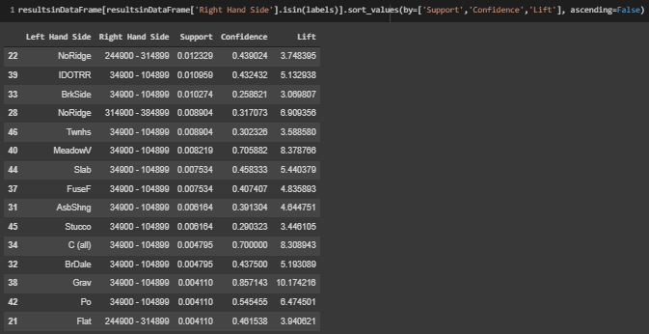

Slide 12
Visualization

Slide 13
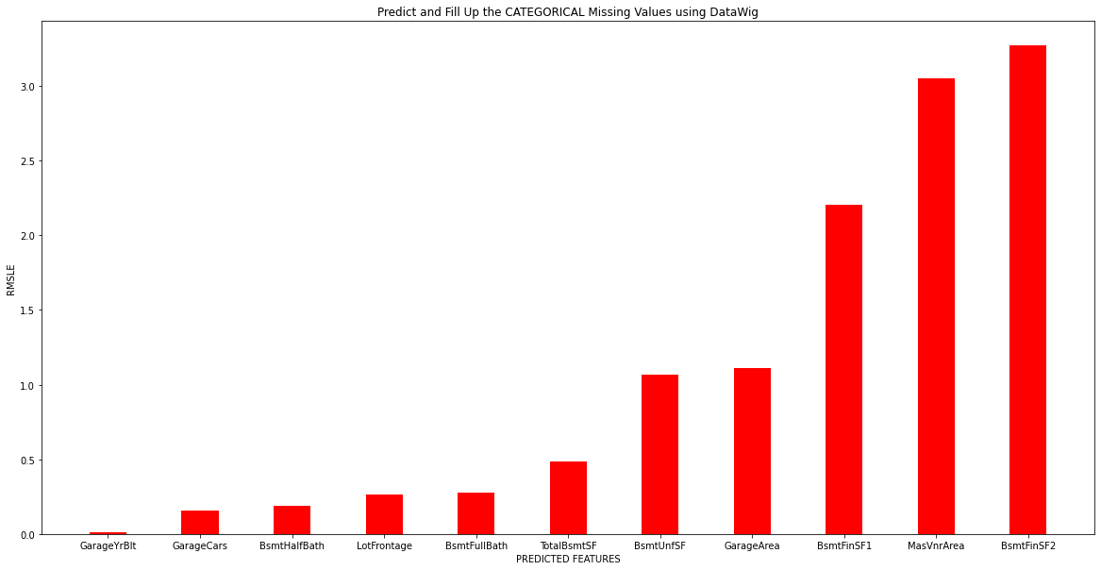

Slide 14
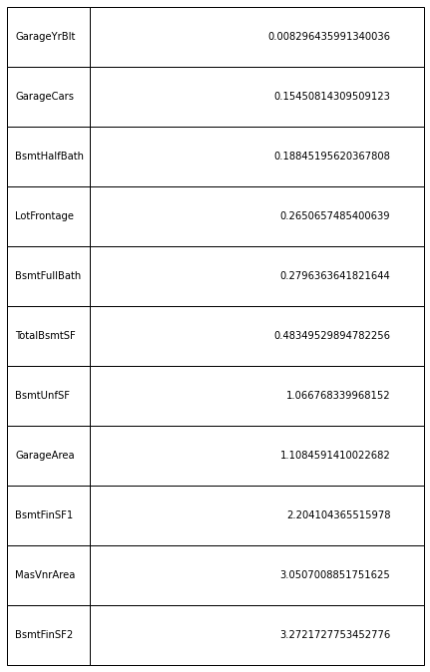

Slide 15
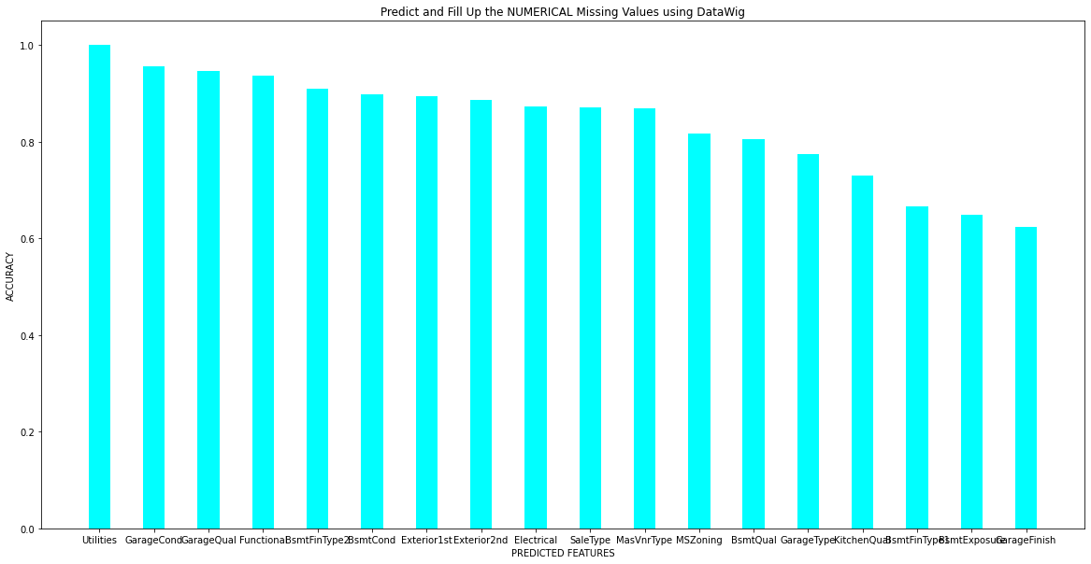

Slide 16
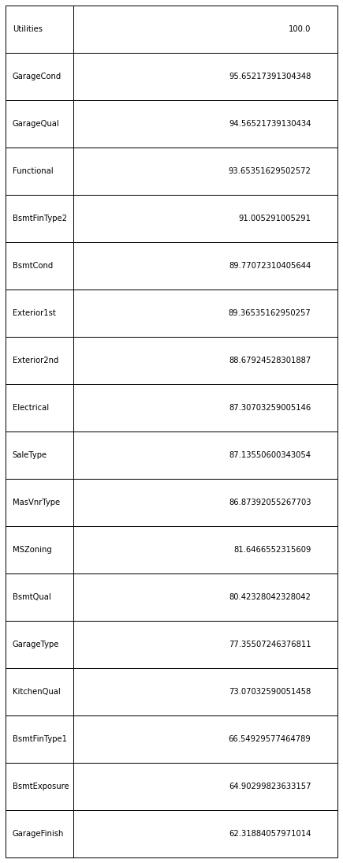

Slide 17
Predictive Analytics

Slide 18
Algorithms Considered
Support Vector Regression
Polynomial Regression
Decision Tree Regression
Random Forest Regression
Neural Network Regression
K-Nearest Neighbour
Gaussian Process regression
XGBoost Regressor

Slide 19
Model Evaluation and Prediction
Train Dataset
Treat the ‘SalePrice’ column values as the dependent variable -> ‘y’ variable.
The rest of the columns, except the ‘Id’ column, are treated as the independent variables -> ‘X’ variable.
Apply feature scaling using min-max normalization for numerical values.
Apply feature encoding using one hot for categorical values.
Evaluate the performance of the considered algorithms.
Test Dataset
Use the best algorithm and predict the ‘SalePrice’ column values.

Slide 20
