Slide 1
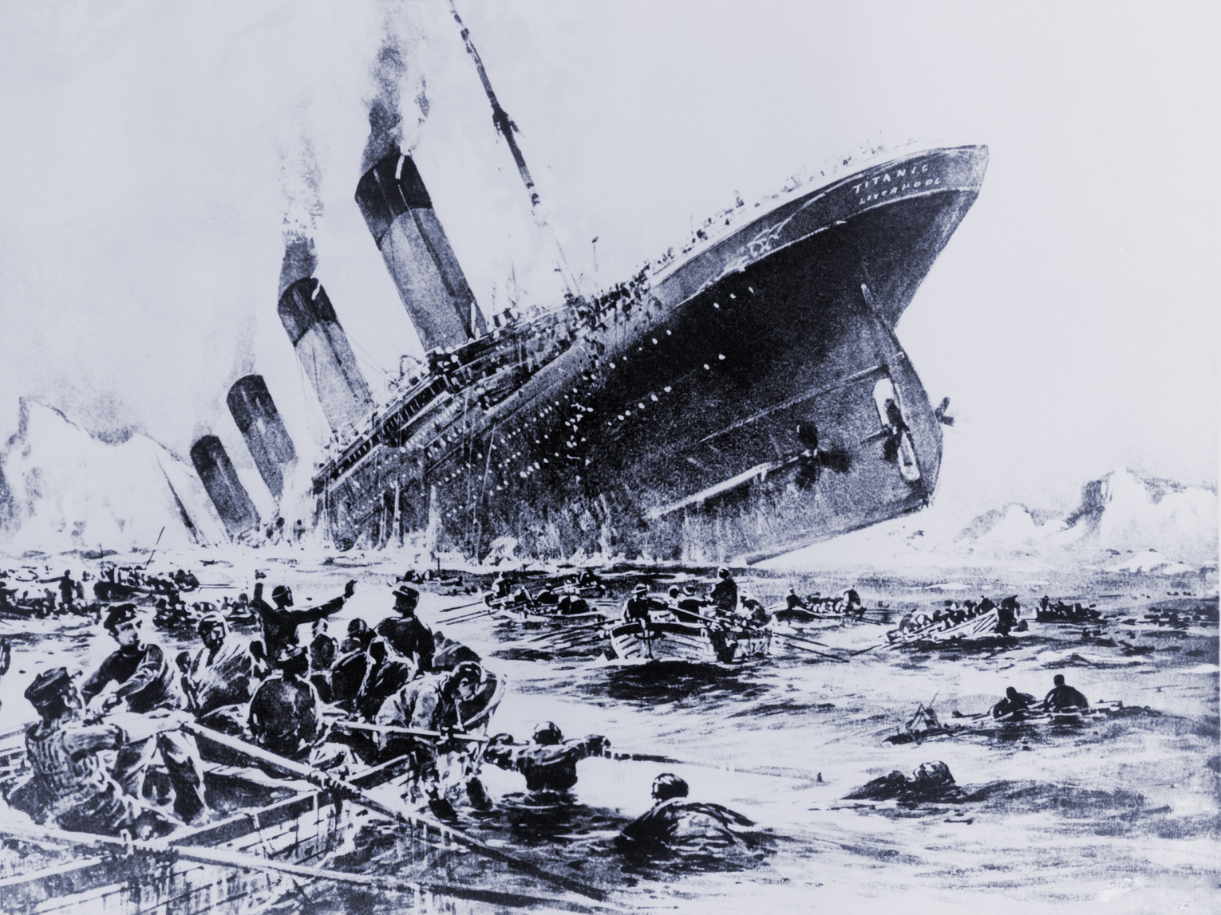
TITANIC:
MACHINE LEARNING FROM DISASTER
01
Team: The AndrewNG Bois

Slide 2
02
Table of Contents
Introduction
Data Cleaning
Feature Engineering
Machine Learning Model
Conclusion
Presentation Outline

Slide 3
03
Introduction

Slide 4
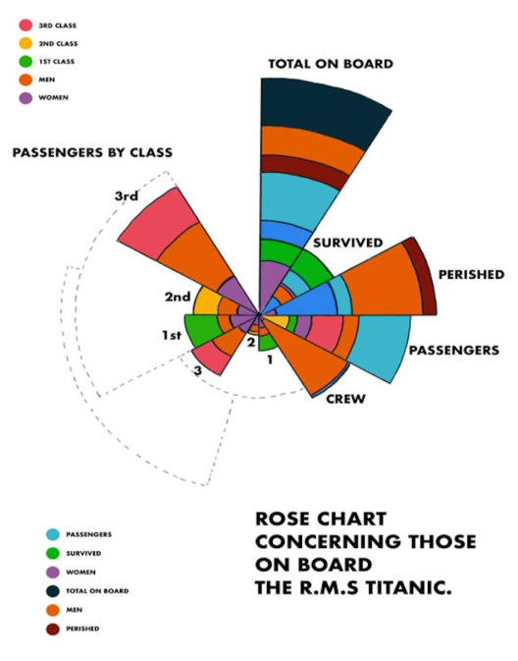
Titanic was considered to be an engineering marvel; thus it's crash raised several questions
The physical data went down with the Titanic.
Thus, the data on the surviving passengers become pivotal.
It is essential so ensure safety for the future endeavors.
04

Slide 5
05
Data Cleaning

Slide 6
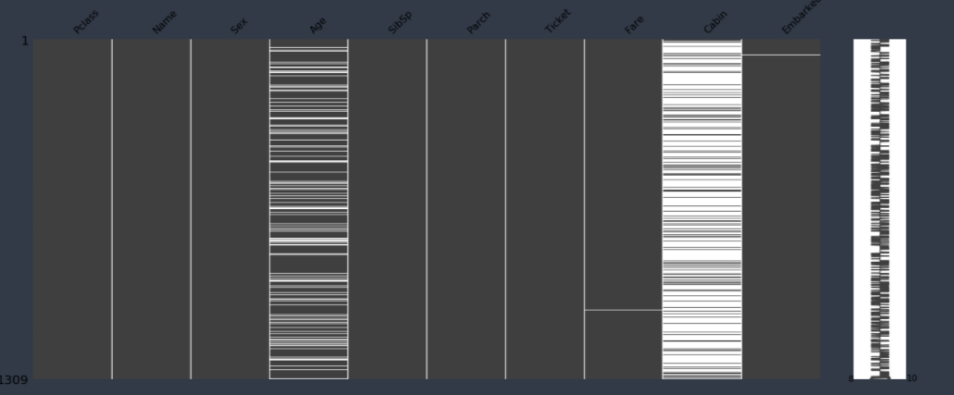
Using the missingno library, we get the following result for the missing value:
06

Slide 7
Clearly, Age and Cabin will require most of the work for cleaning
For the Cabin data, we can create a different dataframe only
containing the cabin data along with the PassengerId.
Later, one-hot encoding* could be used categorize the deck data
into several columns.
Each empty deck could be assigned to Deck_N.
Later, we drop the Cabin column as it is not required.
For the 'Age' data, we can use the K-mean clustering or the
KNNImputer** class from the Scikit-learn library.
07
*https://machinelearningmastery.com/why-one-hot-encode-data-in-machine-learning/
**https://scikit-learn.org/stable/modules/generated/sklearn.impute.KNNImputer.html

Slide 8
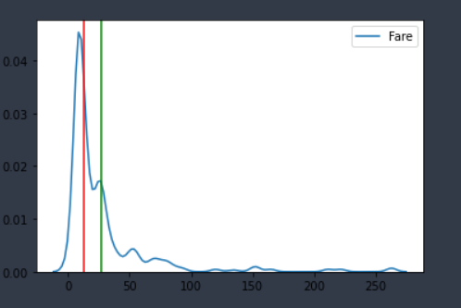
We see that the fare column only
has one missing value
We could either use mean or
median to fill this data.
On further analysis, we see that
the Passenger was embarked
from port 'S'.
Thereby plotting the density graph
for the fares of people embarked
from port 'S', we get the graph on
right. (Green - Mean, Red - Median)
Clearly, median is the correct choice for
cleaning the 'Fare' data.
08

Slide 9
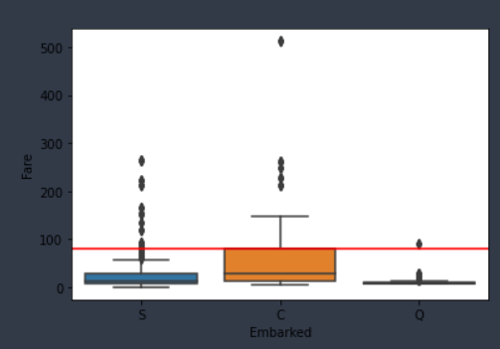
On analyzing the Embarked data of
two missing values, we see that the
missing values have same fare of $80.
Most probably, they were embarked
from the same port.
Using the boxplot, and adding the
horizontal like for $80 mark,
we get the following graph on the right
Clearly, the passengers were embarked
from port 'C', or from the Cherbourg port.
09

Slide 10
10
Feature Engineering

Slide 11
For a classification model to work properly, it is important to feature engineer
certain aspects of the program.
Given the data, we need to classify some datasets into different classes.
We will map the 'Sex' column into two classes: 0 for 'male and 1 for 'female.
We will classify 'Embarked' into three classes: 0 for port 'S',
1 for port 'C' and 2 for port 'Q'.
We will now classify 'Age' into 5 classes: 0 for age less than 16
1 for age less than 32 but greater than 16, 2 for age greater than 32
but less than 48, 3 for age greater than 48 but less than 64, and 4 for age
greater than 64.
Categorize 'Fare' into 4 classes: 0 for fare less than 7.91, 1 for fare less than
14.45 but greater than 7.91, 2 for class greater than 14.45 but less than
31, and 3 for age greater than 31.
11

Slide 12
Next, it is important to understand that the people having a family
might have bigger chance of survival with their family, so it is
important to make a column to classify that. We will call it 'isAlone'.
It can be calculated by taking the sum of 'SibSp' and 'Parch' column
and add it with 1 (for the person itself). We can classify it as 0 for
alone and 1 for not alone.
12
These classifications help the model to better predict the outcome

Slide 13
13
Machine Learning Model

Slide 14

RANDOM FOREST
14
Random Forest is an ensemble method
for classification which uses multiple
decision tree during training and outputs
the class that is the mode or the mean
of the individual trees.
Source: Wikipedia

Slide 15
Why are we using Random Forest?
It is unexcelled in accuracy.
It runs effectively on a big dataset.
It estimates properly which feature is important for classification.
It corrects the Decision Tree's habit of overfitting.
It maintains accuracy even if data is missing.
It can handle several input features effectively.
15
We will be using RandomForestClassifier class of Sci-kit learn library.
Source: https://www.stat.berkeley.edu/~breiman/RandomForests/cc_home.htm

Slide 16
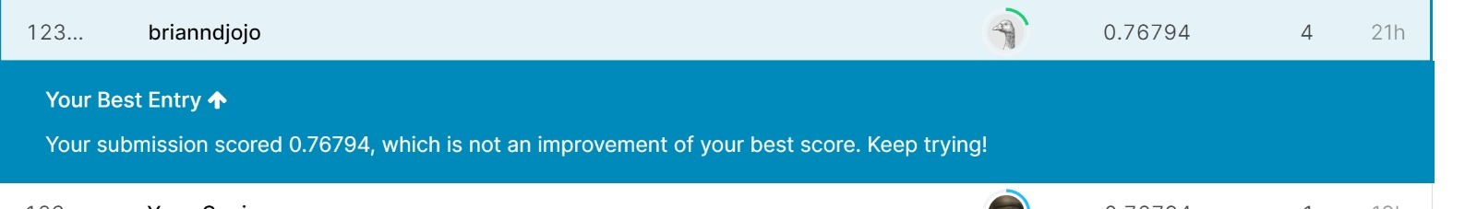
Kaggle Submission
After submitting on kaggle, we get following results:
16
Thus, our accuracy is 76.794%.

Slide 17
17
Conclusion

Slide 18
What we can learn from the model?
Evident parallels between the survivors and deaths.
Smaller groups = higher survival.
Passenger chance of survival also rely on uncontrollable variables.
18

Slide 19
Scope of improvement
Adding more features might determine passenger’s survival.
Could consider Gradient Boosted Trees.
19

Slide 20
20
Thank You!

