Slide 1
Instrument Tuner
Andrew Timmons
Brian Cummings
ECE433 Final Project

Slide 2
Purpose of the Product
Easy to use guitar tuner for beginners
Not required to know anything about musical notes or the note of each string
We wanted to learn how they work

Slide 3
General Design Overview
Samples analog audio signal from KY-037 microphone
Signal processing algorithms to calculate fundamental frequency
Compare calculated frequency to frequencies in the target tuning
Indicate the string being tuned using LED bar
Indicate difference between target frequency and calculated frequency using on-board RGB LEDs

Slide 4
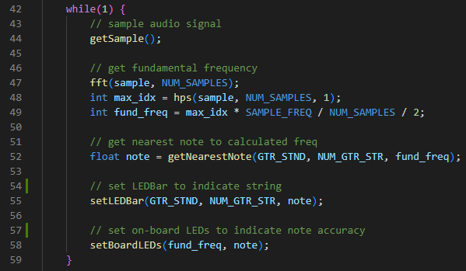
General Design Overview

Slide 5
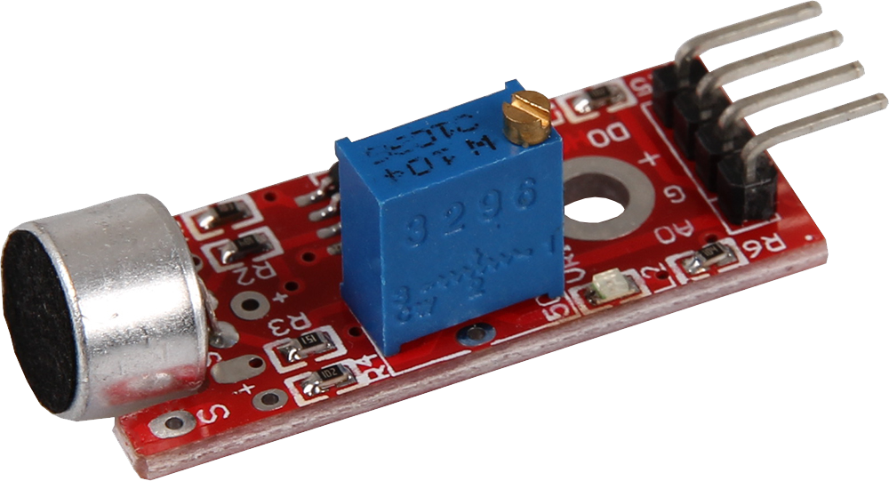
Ky-037 Microphone
Analog and digital output pins
Poor technical documentation
Analog signal is relatively weak (~200 mv pk-pk)
Potentiometer adjusts “sensitivity” and resting voltage

Slide 6
Audio Sampling
Analog signal is relatively weak on its own
Analog output is connected to OPAMP1 input for amplification
PGA gain set to 2x gives best quality signal
Higher gain requires microphone potentiometer to be set lower, reducing sensitivity

Slide 7
Audio Sampling
OPAMP1 output routed to ADC1 input
ADC1 conversion is controlled by TIM2 interrupt to control sampling time
Sampling rate: 4 kHz
# Samples: 1024
Determined experimentally
ADC1 samples are stored in an array

Slide 8
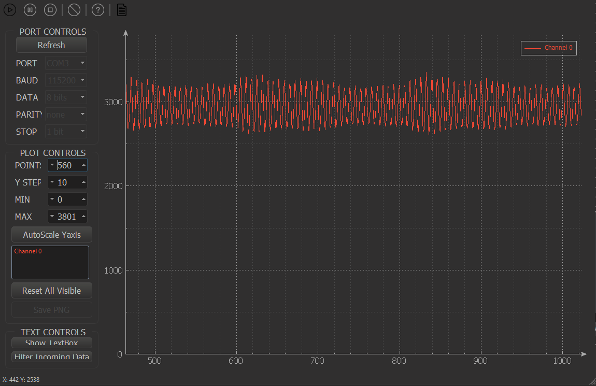
Audio Sampling

Slide 9
Signal Processing
Fast Fourier Transform on full audio sample array
O(n) algorithm from RosettaCode.org
FFT signal parsed for its highest magnitude index
Harmonic Product Spectrum algorithm initially considered but ultimately discarded
Must set index 0 of FFT to 0 in software
Calculated Frequency = Index of max magnitude * Sampling freq / Number of samples
Signal processing relatively slow
Increase system clock to max (110 MHz)
Only use half of FFT (symmetry)

Slide 10
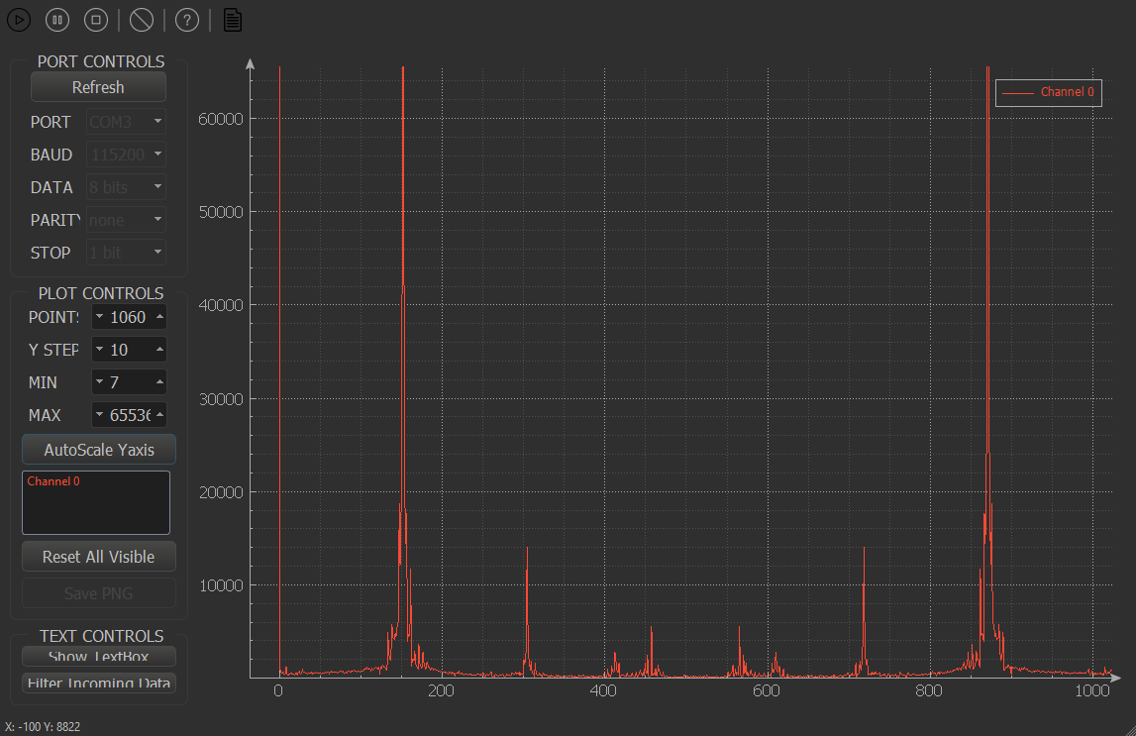
Signal Processing

Slide 11
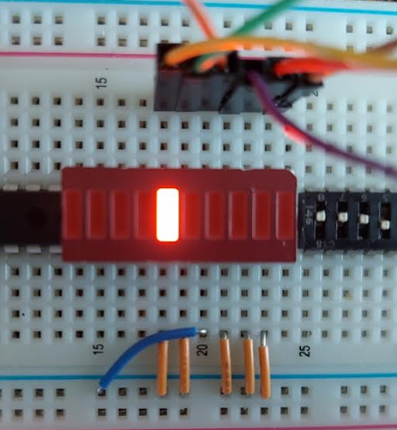
Indicate Target String
Tuning frequencies (array) are parsed searching for the nearest note to the calculated frequency
String correlating to the nearest note is indicated with the LED bar
Nearest note also selected as target note for next step
Lowest string

Slide 12
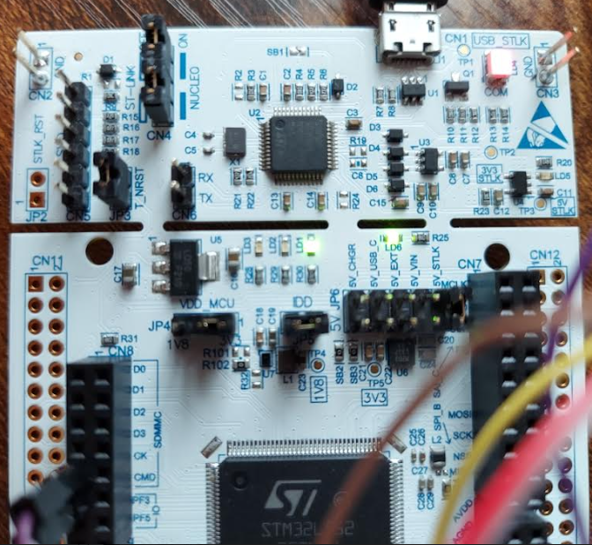
Indicate Distance to Target Note
The difference between the calculated frequency and target frequency is obtained
On-board LEDs are set based on the difference:
Green LED: calc. frequency is lower than target
Blue LED: calc. frequency is higher than target
Red LED: calc. frequency is within 1 Hz of target

Slide 13
Issues
Some notes start high and decay low
Never truly on note, red LED won’t come on
Can be a problem with commercial tuners as well
Specific frequencies on some strings will briefly be calculated incorrectly
Usually corrects itself as the signal decays
1 Hz frequency tolerance isn’t great
Trained ears can detect ~0.3% frequency differences

Slide 14
Future Improvements
LEDs displaying distance from target note can blink or change brightness based on magnitude of difference between calculated and target frequencies
More tunings and a user interface for selecting tunings and displaying notes
Better microphone, tighter frequency tolerance
Accelerometer instead of microphone?
Better frequency parsing algorithm from FFT
Zero-crossing (used in most cheap guitar tuners)
Auto-correlation

Slide 15
Demonstration

