Slide 1
Research Question: Which Roads needs Traffic Signs in Victoria?

Slide 2
Structure
Objective
Why is it worth tackling and who would care?
Dataset
Visualisations
Wrangling Plan
Risk and Challenges

Slide 3
Objective
Investigate which roads in Victoria is needing traffic signs based on accident and traffic volume statistics.
Help us understand the current livability state of Victoria as we find out the current state of roads in Victoria
To an extent, improve the livability in victoria as in the right hands , it can improve state of roads through out Victoria as it may reduce traffic and reduce accidents

Slide 4
Why is it worth tackling and who would care?
This research will be most useful to traffic management department such as VicRoads to make decision on improving traffic
It will narrows down the location where traffic lights is needed
Therefore, it will possibly help narrows down the amount of traffic light simulation needed to be run

Slide 5
Dataset
Traffic Volume in victoria
Type: csv
Size: 14,675 rows
Info: Average Annual daily traffic for all different type of vehicles in each road
Organization: VicRoads
Link: https://vicroadsopendata-vicroadsmaps.opendata.arcgis.com/datasets/5512df2ff41e4941bacf868053dbfba9_0
Metadata: http://data.vicroads.vic.gov.au/metadata/evol.html
Crash Statistics
Type: csv
Size: 176,938 rows
Info: Location of accidents
Organization: DataVic
Link: https://vicroadsopendata-vicroadsmaps.opendata.arcgis.com/datasets/1f3cb954526b471596dbffa30e56bb32_0
Metadata:http://data.vicroads.vic.gov.au/metadata/Crash%20Stats%20-%20Data%20Extract%20-%20Open%20Data.html
Traffic Lights in victoria
Type: csv
Size: 4,582 rows
Info: Shows the location of traffic signals across Victoria
Organization: VicRoads
Link: https://vicroadsopendata-vicroadsmaps.opendata.arcgis.com/datasets/1f3cb954526b471596dbffa30e56bb32_0
Metadata: http://data.vicroads.vic.gov.au/metadata/traffic_lights.html

Slide 6
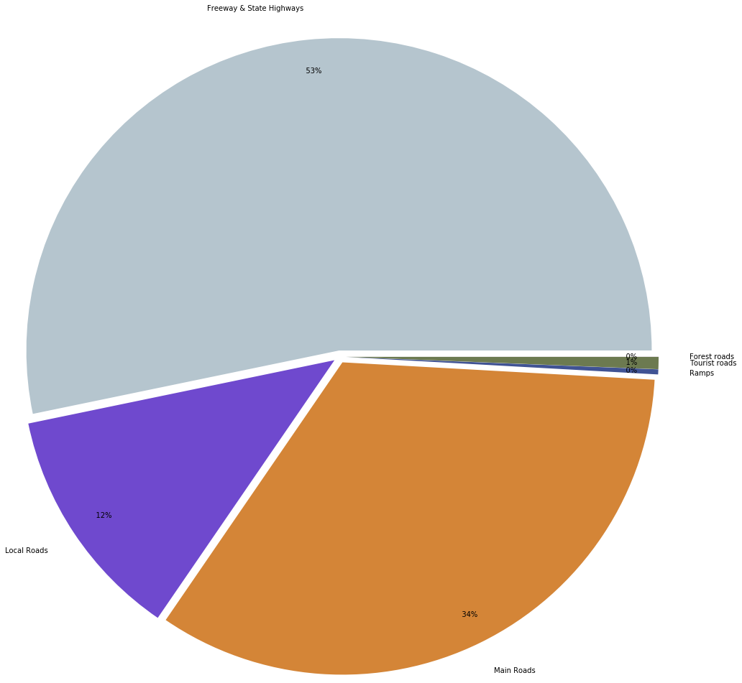
Visualisations
Percentage of Sum of ALLVEHS_AADT for each Road Classification

Slide 7
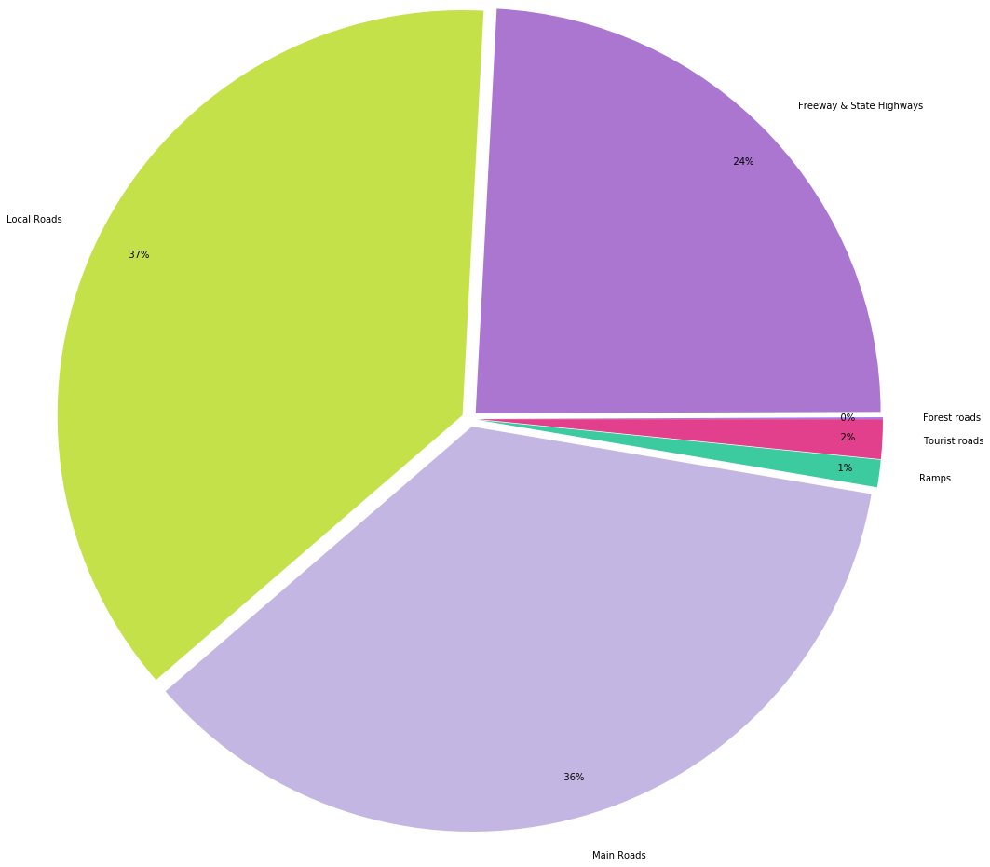
Visualisations
Percentage of Num of Accident for each Road Classification

Slide 8
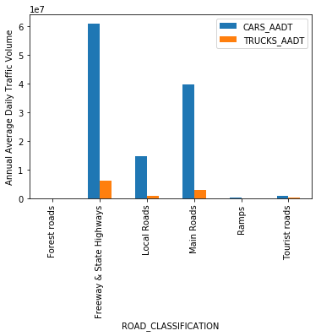
Visualisations
--- Top 10 Road Accident ---
1: PRINCES 4438 accidents
2: HIGH 2730 accidents
3: NEPEAN 2107 accidents
4: SPRINGVALE 1447 accidents
5: SOUTH GIPPSLAND 1409 accidents
6: MONASH 1398 accidents
7: SYDNEY 1381 accidents
8: BURWOOD 1339 accidents
9: DANDENONG 1248 accidents
10: MAROONDAH 1172 accidents

Slide 9
Wrangling Plan
Data cleaning
Case deletion on accident location dataset
Accident location dataset has small records where the roads is not specified
Meaning the accident may not exactly happen on the road, thus removing would be the best option
Integration
Join Traffic Volume and Accident Location dataset through blocking of road number and road name
Using group by method on both data set
Create Percentage Likely Accident feature for every blocking
This is better than raw data as we can now do analysis and prediction on this data

Slide 10
Wrangling Plan
Correlation on Number of accidents and Annual Average Daily traffic
By using both mutual information and Pearson correlation on ALLVEHS_AADT and Percentage Likely Accident both discretized with equal length method using appropriate bin
Aiming to know if both factors actually has correlation
Expecting Heat maps of pearson correlation to be fairly clustered but not mostly clustered as accident may not be caused by amount of vehicles
Line graphs of ALLVEHS_AADT and Percentage Likely Accident to be more towards increasing straight line as number of bins goes up
Make a model using train and test split methodology on existing traffic lights
Set a data frame where the traffic signs location with Percentage Likely Accident and average annual daily traffic of vehicles
Run the train and split function with possibly 80% as training set
Run K-nearest neighbor on new roads to show the accuracy of the conditions of new roads to be placed with traffic light to current roads with traffic lights
Expecting list of roads with sorted from high to low of accuracy

Slide 11
Risk and Challenges
Finding up to date open data
Political and budgeting decision
As receiving audience has the final decision, it may trump over this research
Not all factors are considered
E.g: Parking, reputation

