Slide 1

Data Quality Report
Andrew Tobin
Final Year Project
18318274

Slide 2
6 Dimensions of data quality
Timeliness:
Completeness
Uniqueness
Validity
Consistency
Accuracy
Source:
https://www.cdc.gov/ncbddd/hearingloss/documents/dataqualityworksheet.pdf

Slide 3

Timeliness
The latency between when the data is expected to be available and when it is available.
We want to minimize this latency.
This dimension is more applicable to projects where a data pipeline is in use to populate a backend database.
As there is no backend database in this project the Timeliness dimension will be ignored.

Slide 4
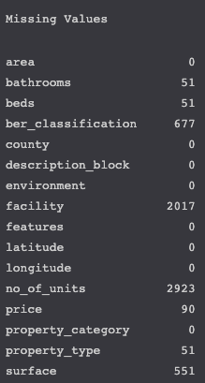
Completeness
Data completeness in the context of this project refers to the number of null values present in the dataset.
Where possible null values can be imputed or rows with null values can be removed.
In the picture to the right, we see the number of missing values in each column prior to any cleaning
Many of the missing values are caused by ads that fall under the ‘new_development_parent’ category.

Slide 5
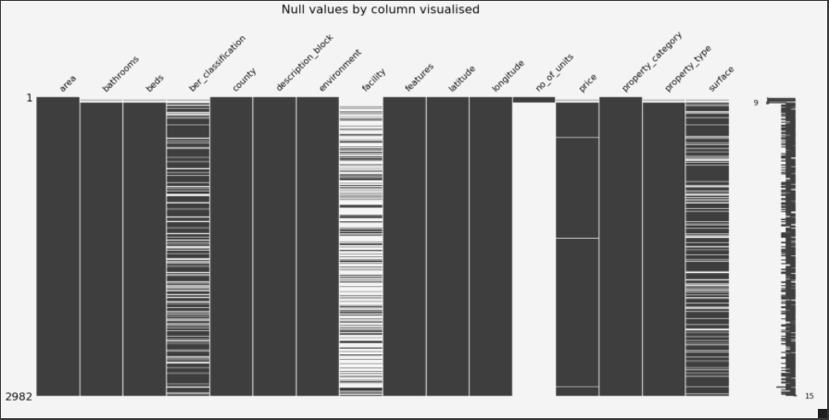
Visualising Missingness

Slide 6
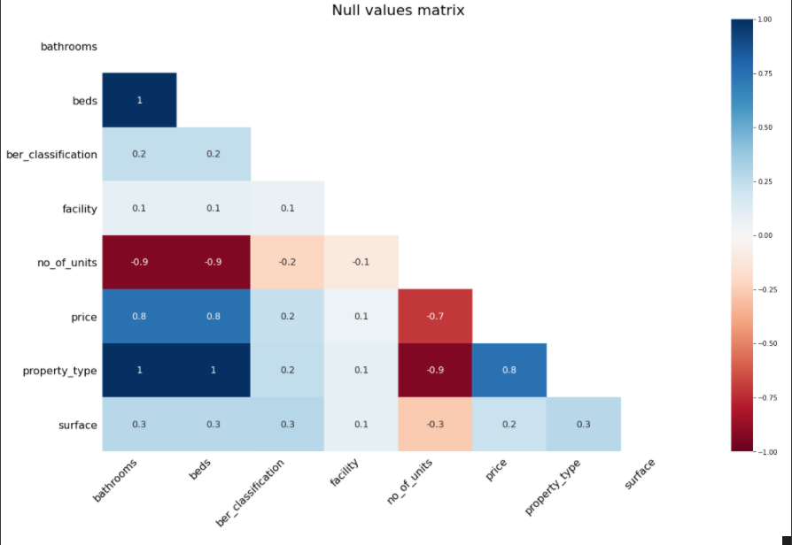
Missingness Paterns
As we can see from the missingness matrix, no_of_units is an influential variable in causing missingness.
This suggests that ads the fall under the ‘new_development_parent’ category contain many missing features.
Removing these features will enhance our data completeness.

Slide 7
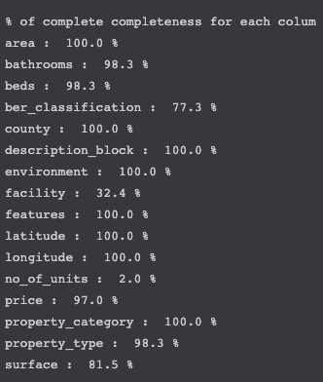
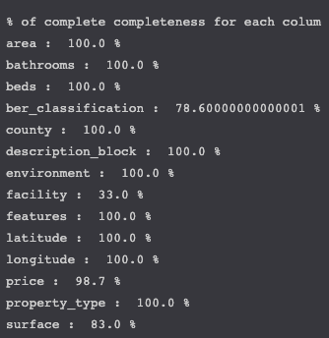
Completeness pre-Cleaning
Completeness Post-Cleaning

Slide 8
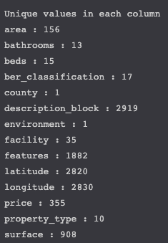
Uniqueness
Uniqueness is a measure of how many duplicates are present in the data.
There are no duplicate records in our data.
The picture to our left displays the number of unique values for each variable.
Any variables with only 1 unique value are dropped as they add no information to our model.

Slide 9
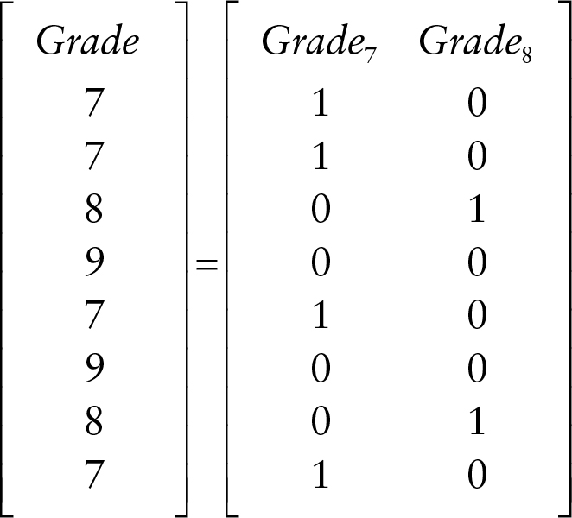
Validity
Dummy Matrix Example
Validity is the extent to which the data conforms to a given format.
A good example would be date formats, these must be consistent to avoid error.
There was little trouble with validity in the data. One change to be made to the BER variable to remove symbols from certain values.
The facility variable was also parsed to become a structured series of dummy variables rather than an unordered list.

Slide 10

Consistency
Consistency is most applicable to interconnected databases or variables.
For example, where a student's total mark is recorded in one database but the breakdown of each of the student’s exam results is stored in another.
It is important that the individual exam results and the total mark are consistent and match up with one another.
Consistency is not directly applicable to this project and therefore will be ignored.

Slide 11

Accuracy
Accuracy refers to the degree to which the data reflects the real world.
For example, if a property is recorded as having 3 floors but only has 2 in the real world our data is inaccurate.
This is a difficult dimension to measure and not applicable to this project.

Slide 12
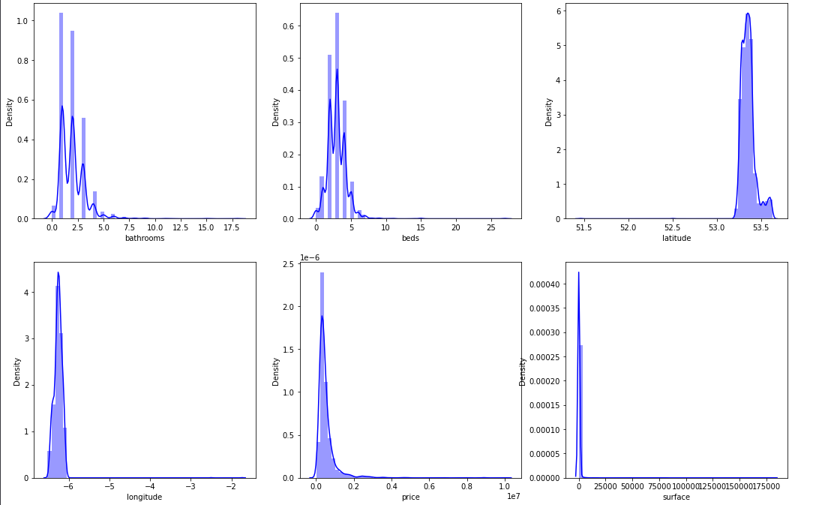
Part 2: Outliers

Slide 13
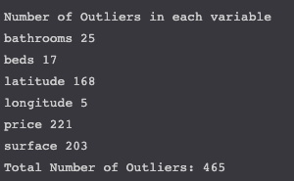
Outliers Detection & Removal
As we can see from the previous slide most of our variables are skewed.
As such using Z-scores will not successfully detect outliers.
Instead, we use the Inter-Quartile Range (IQR) method.
Bounds
Upper Bound: Q3+1.5*IQR
Lower Bound: Q1-1.5IQR
Any records with a value outside of these bounds is removed as an outlier
Total Records before removal: 2923
Total Records after removal: 2458

