Slide 1

Predicting House Prices: EDA and First Changes
Andrew Tobin – FYP - 18318274
This Photo by Unknown Author is licensed under CC BY

Slide 2
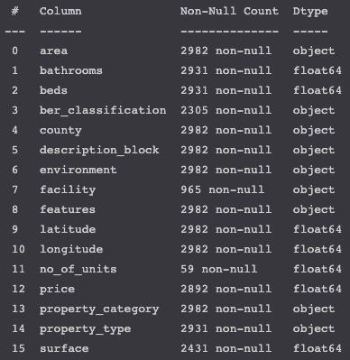
The Data Set
2982 Rows, 15 Columns
Unstructured Data: ‘description_block’ & ‘features’
0 duplicates
Notes:
Breakdown of the dataset:
Shape, 2982 Observations, 15 Columns
Mixture between structured and unstructured data
Initial focus on the structured data only
Exclude columns such as description block and features
No duplicates which is nice

Slide 3
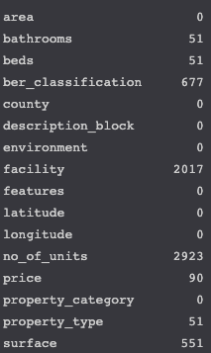
Missing Data
Missing Values for Each Column
Some missing data present
Price, Surface, Beds and Baths the most important areas of missing data
We can impute the data for missing values (sophisticated regression trees XGBoost can do this, or kNN is another potential option)
Facility, Property Type, BER converted to dummy matrices
Notes:
Missing Data
Some missing values across the data
Most important missing data <<< numeric variables (Price, Surface, Beds and Baths)
These can be imputed (some ensemble methods like XGBoost can impute data as they’re trained)
Non-numeric data is converted to dummy variables, this should mitigate the missingness

Slide 4
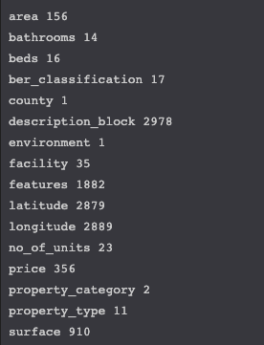
Unique Values for each Variable
Dropped from dataset
Dropped from dataset

Slide 5
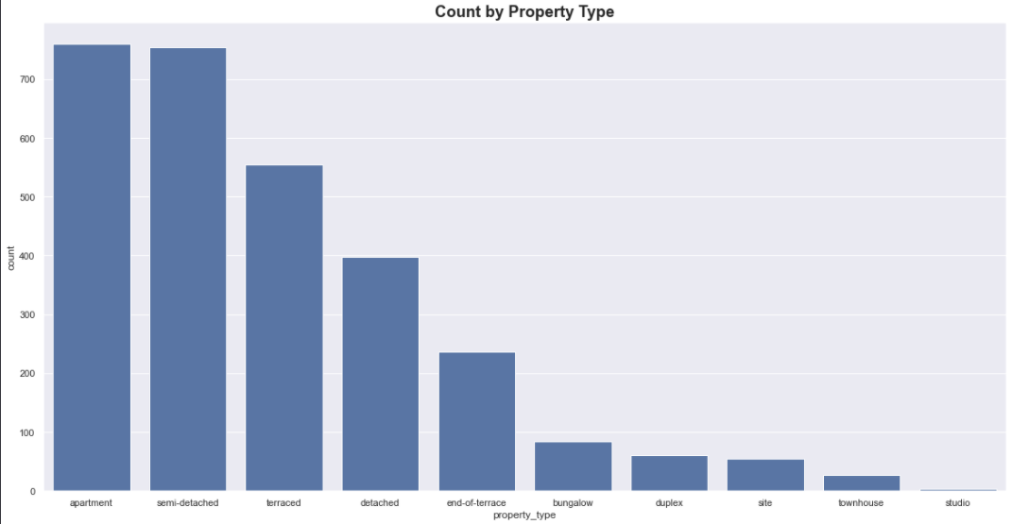

Slide 6
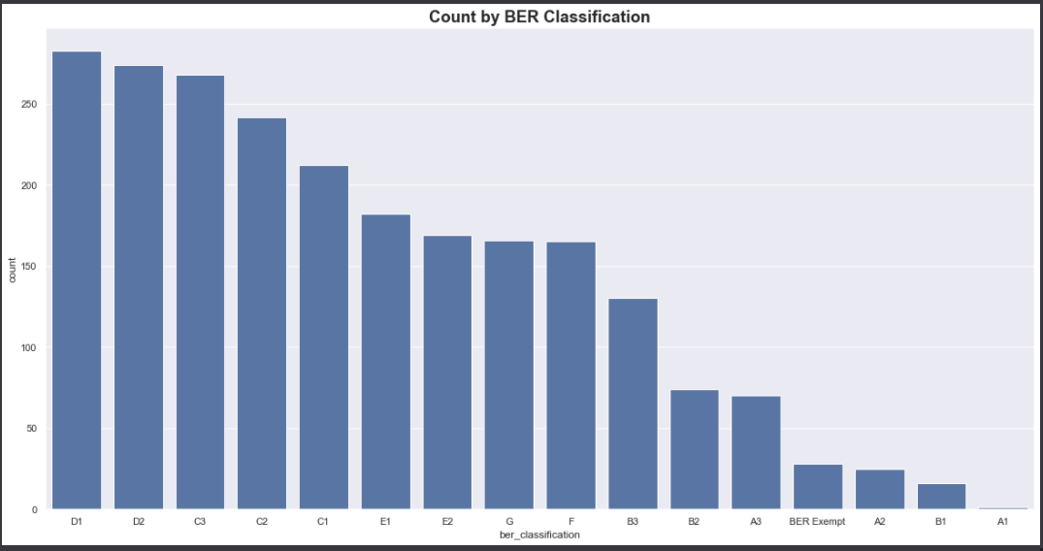

Slide 7
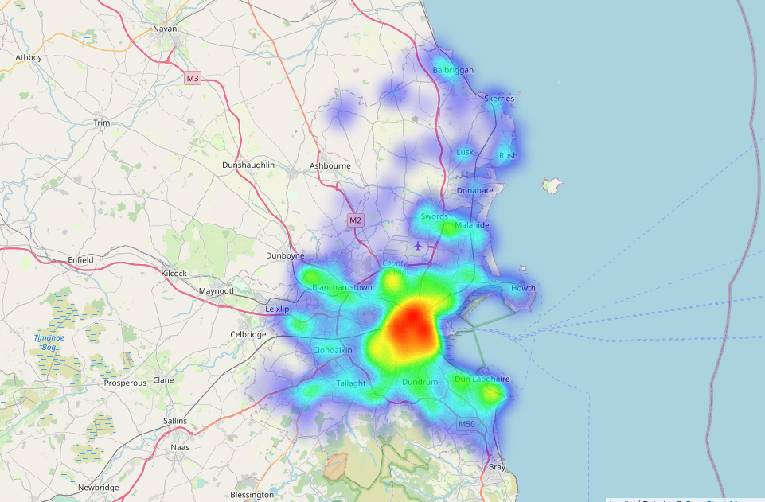
Where are these properties located?
file:///Users/andrewtobin/College/final_year/FYP/House_pricing_dataset-master/map1.html

Slide 8
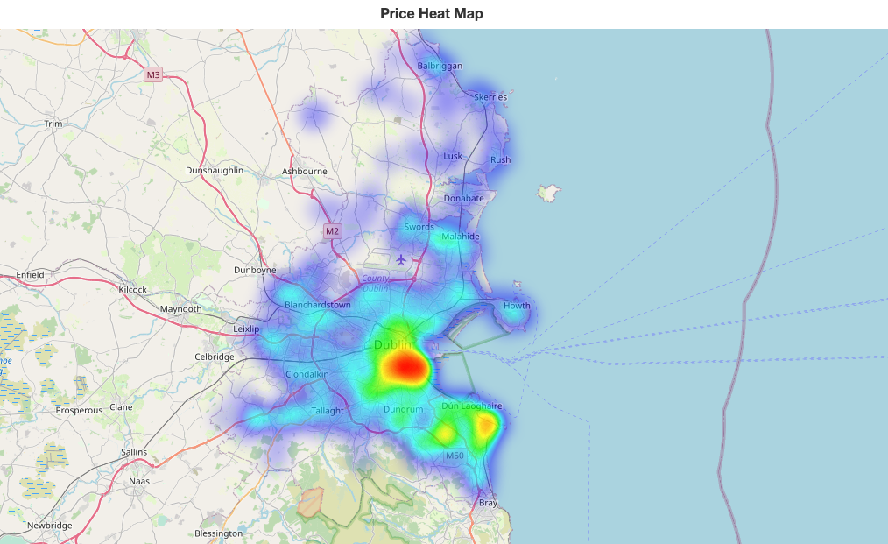
file:///Users/andrewtobin/College/final_year/FYP/House_pricing_dataset-master/map2.html

Slide 9
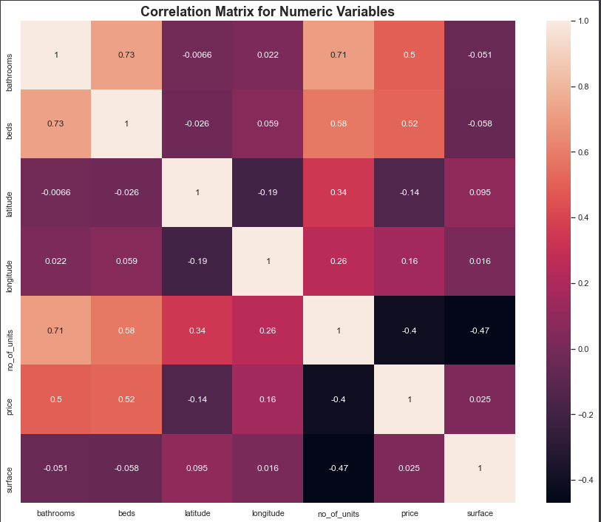
Correlations:
Some interesting correlations:
-0.4 for Price and No. of Units
No. of Units and Bathrooms: 0.71
New homes might have more bathrooms

Slide 10
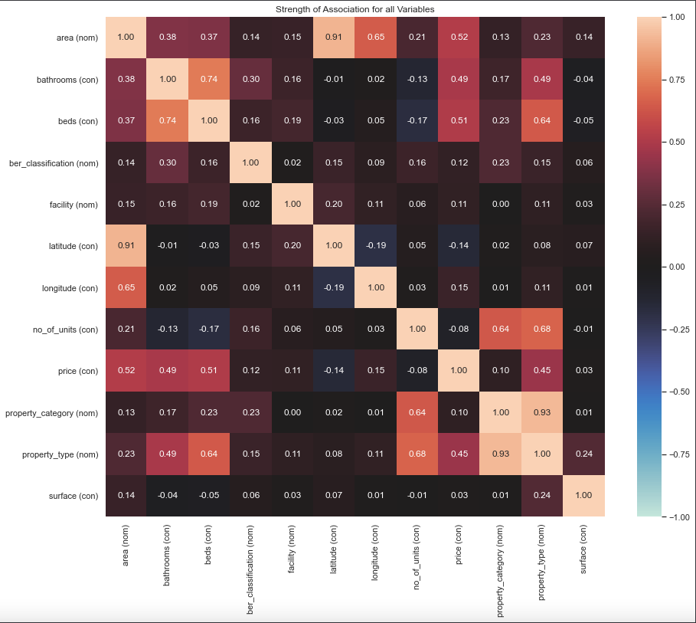
Area’s an effect on price confirmed here
We see longitude and latitude effect
Further west lowers price
Further North lowers the price
Property Type positively correlated with price
Overall, not a whole lot of multicollinearity which is good

Slide 11
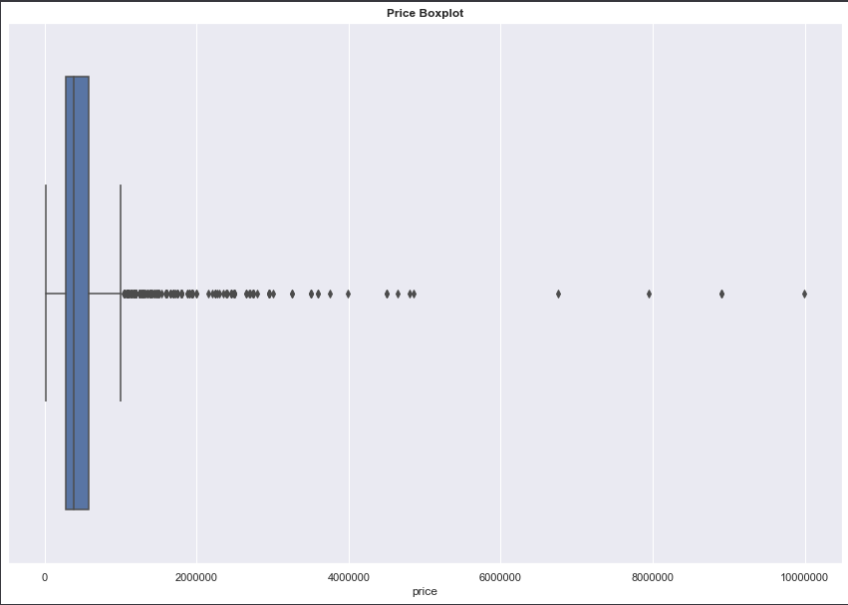
Outliers

Slide 12
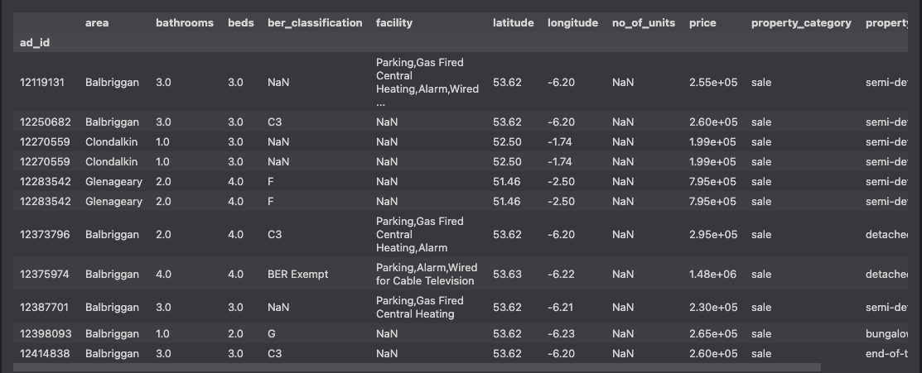
Most outliers relate to longitude and latitude
Further work needed to weed out outliers.

Slide 13

Improvements to predictive performance
Steps taken
Include categorical data such as area, ber_classification, facility, property_type by using dummy variables
Original training set had 4 columns; new training set has 188
Use log_price transformation
Some basic imputation (where missing values are present replace with the mean of the column)
Without Log Transforming Price
Error cut by 11.9%, improvement of 24.8%

Slide 14
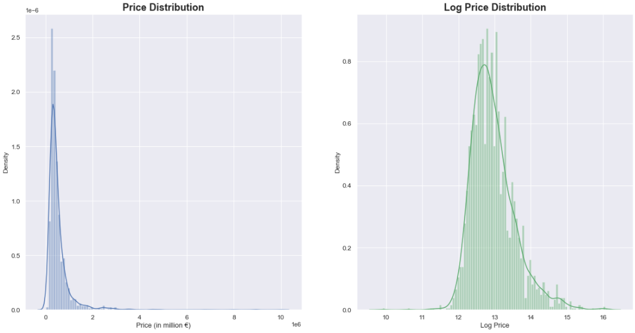

Slide 15
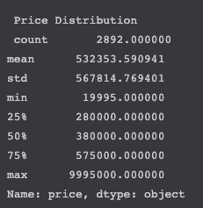
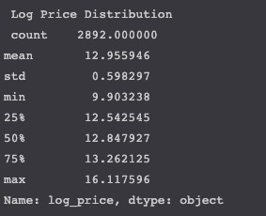
Real Price vs Log Price Distributions

Slide 16

Next Steps
Investigate how interactions between terms might improve accuracy of the model.
Implement a more sophisticated predictive model (Gradient Boosted Regression or XGBoost)
Begin investigating unstructured data, description_block and features as well as images
Current Lowest Error Rate: Error cut by 28.88%, improvement of 60.5%

