Slide 1
Predicting Gene Start Sites Using Machine Learning on Human and Bacterial Genomes
CSCI 4481: Computational Techniques for Genomics
By: Nur Daud, Jose Hernandez, Rebecca Hoff, Andrew Tomfohrde, Nipun Bhatnagar

Slide 2
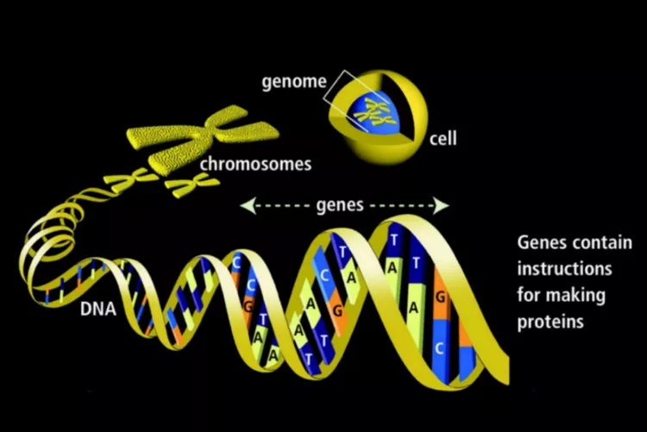
Background
Genes contain the instructions to build proteins
The importance of predicting gene start sites enables evolutionary studies and gives insights about the functionalities and structure of proteins.
Gene start site identification is important for accurate genome annotation.
In humans, start codons appear within highly variable 5’ UTRs and introns
In bacteria, start codons are often predicted by strong sequence motifs
Machine learning can capture local nucleotide patterns and assist in identifying start sites.
Bailey, 2019
https://www.thoughtco.com/genes-373456
Notes:
RH

Slide 3
Approach
Human Dataset:
GRCh38 Homo sapiens RefSeq
Extracted 100–300 bp windows around annotated start codons
Negative windows: ATG-centered but non-start regions
Encodings used:
1-hot (4 channels)
4-mer / 5-mer frequencies
Bacterial Dataset:
Genome: E. coli K-12 MG1655
Window size: 401 bp
New “Iteration 2” negative sampler:
Scans all ATG/GTG/TTG codons
Removes true CDS starts
Filters boundary cases
Guarantees balanced dataset (4340 pos / 4340 neg)
Notes:
Andrew
We used labeled data from RefSeq.
For humans, we extracted 100 to 300 base-pair windows centered around annotated start codons, and created negative examples from similar non-start regions.
We encoded sequences using one-hot encoding as well as k-mer frequency features.
For bacteria, we used the E. coli K-12 genome and built a cleaner dataset by scanning all possible start codons and removing true gene starts, ensuring a balanced dataset.

Slide 4
Models Evaluated
Logistic Regression (Baseline)
max_iter=1000, l-bfgs solver
Random Forest with 4-mer Features
200 trees, balanced class weights, no max depth limit
XGBoost with 5-mer Features (v1.7.6)
500 trees, max depth 6, learning rate 0.1
Deep Multi-Layer Perceptron (MLP)
One-hot encoded DNA sequences (A=0, C=1, G=2, T=3)
5-layer network (1200 → 1024 → 512 → 256 → 128 → 1)
Deep 1D Convolutional Neural Network
Integer encoding (A=0, C=1, G=2, T=3)
3 convolutional layers + classifier
Notes:
RH

Slide 5
Human Genome - Logistic Regression
100 bp Window Results
300 bp Window Results
Metric | Class 0 | Class 1
Precision | 0.558 | 0.568
Recall | 0.569 | 0.549
F1-Score | 0.563 | 0.554
Support | 4662 | 4659
Training Accuracy: 57.4% Overall Test Accuracy: 55.9%
Metric | Class 0 | Class 1
Precision | 0.565 | 0.565
Recall | 0.565 | 0.566
F1-Score | 0.565 | 0.566
Support | 4662 | 4659
Training Accuracy: 60.5% Overall Test Accuracy: 56.5%
+0.6%
overall improvement
Observation: Increasing the bp window 3x led to a improvement of +0.6% revealing the limitation lies in one-hot encoding, not window size.
Notes:
Andrew
For logistic regression on the human dataset, increasing the window size from 100 bp to 300 bp led to a small improvement in accuracy, from about 55.9% to 56.5%.
This suggests that simply increasing sequence context isn’t enough the limitation is likely in the one-hot encoding rather than window size.
Overall performance stayed close to random guessing.

Slide 6
Human Genome - Deep MLP, and 1D CNN
Deep MLP: one hot
1D CNN: 5-mer counts
Metric | Class 0 | Class 1 | Macro Avg
Precision | 0.547 | 0.545 | 0.546
Recall | 0.536 | 0.556 | 0.546
F1-Score | 0.541 | 0.550 | 0.546
Overall Test Accuracy: 54.6%
Metric | Class 0 | Class 1 | Macro Avg
Precision | 0.555 | 0.601 | 0.578
Recall | 0.718 | 0.424 | 0.571
F1-Score | 0.626 | 0.497 | 0.562
Overall Test Accuracy: 57.1%
Observation: Despite complex architectures and regularization, deep learning underperformed traditional ML. Possible causes:
Dataset size (~46k) may be insufficient for deep learning with limited parameters
One-hot and simple embeddings inadequate for capturing biological signals
Problem requires inductive bias that tree-based models provide naturally
Notes:
Nipun

Slide 7
Human Genome - Top Performers
Random Forest: 4-mer counts
XgBoost: 5-mer counts
Metric | Class 0 | Class 1 | Macro Avg
Precision | 0.585 | 0.636 | 0.610
Recall | 0.720 | 0.489 | 0.604
F1-Score | 0.563 | 0.554 | 0.599
Overall Test Accuracy: 60.4%
Metric | Class 0 | Class 1 | Macro Avg
Precision | 0.585 | 0.592 | 0.588
Recall | 0.611 | 0.566 | 0.588
F1-Score | 0.597 | 0.579 | 0.588
Overall Test Accuracy: 58.8% *Generated visualization of top 20 most important 5-mers
Observation:
Random Forest with 4-mers achieved 60.4% accuracy (best overall)
XGBoost with 5-mers: 58.8% accuracy
Both significantly better than one-hot + neural networks
Notes:
Nipun

Slide 8
Bacteria Genome- Logistic Regression & Random Forest
Logistic Regression - 400 bp windows
Random Forest - 400 bp windows
Metric | Class 0 | Class 1 | Macro Avg
Precision | 0.900 | 0.880 | 0.890
Recall | 0.870 | 0.910 | 0.890
F1-Score | 0.890 | 0.890 | 0.890
Overall Test Accuracy: 89%
Metric | Class 0 | Class 1 | Macro Avg
Precision | 0.82 | 0.96 | 0.89
Recall | 0.97 | 0.79 | 0.88
F1-Score | 0.89 | 0.87 | 0.88
Overall Test Accuracy: 88%
Observation:
No significant difference between both models.
Higher accuracy than the human genome
Notes:
Jose

Slide 9
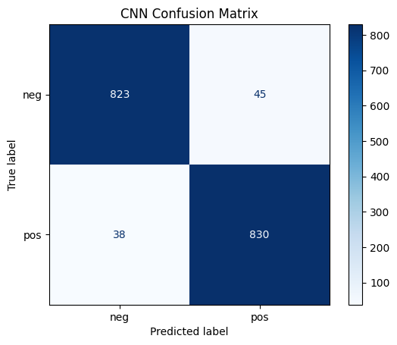
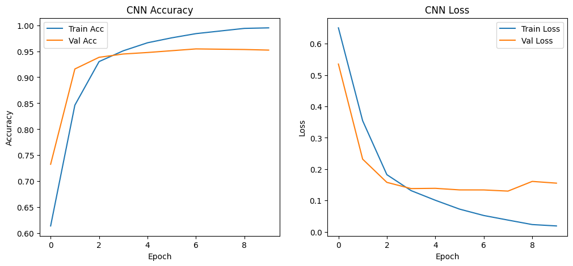
Bacteria Genome - CNN
Convolutional Neural Network
Metric | Class 0 | Class 1 | Macro Avg
Precision | 0.96 | 0.95 | 0.955
Recall | 0.95 | 0.96 | 0.955
F1-Score | 0.95 | 0.95 | 0.95
Overall Test Accuracy: 95.5%
Observation:
Why CNN is able to perform best:
Captures Shine–Dalgarno motifs.
Learns spacing between motif and start codon.
Detects subtle multi-base patterns humans cannot manually engineer.
Notes:
Jose

Slide 10
Conclusion
Why bacteria worked:
Bacteria have no introns, have clear start codons, strong upstream motifs(Shine-Dalgarno), compact genes and consistent annotation
CDS annotations are extremely accurate and standardized.
CNNs excel when motifs are localized and position dependent
Logistic regression and Random Forest work well due to the strong motif structure.
Human dataset models were limited by weak biological signals.
Human genes have introns, UTRs, alternative start sites and multiple isoforms
Many of the extracted windows did not actually contain the canonical start codon in the expected reading frame
Many windows were filled with bases like NNNN, meaning that the true sequence was not known
All of these resulted in training labels that were unreliable.
Lack of a consistent motif meant that the models would saturate at ~55-60%
Any attempt at adding window length or utilizing deeper models does not help because the underlying biological signal is weak.
This shows how the machine learning ceiling for human start site prediction is biologically imposed
Notes:
Nur

