Slide 1


Calorie Counter
Whatcha gunna eat?

Slide 2

Future Development
Adding a calendar page that allows the user to access their caloric history

Slide 3
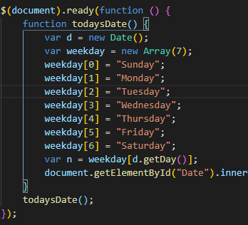
CSS
Moment.js

Slide 4
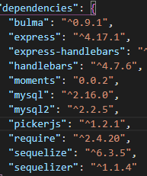
Dependencies

Slide 5

Models
index.js
exercise.js
food.js
moment.js

