Slide 1
NSF Training Standard
Apprentice
Skills
Security Unit Duties and Functions
Topic 1.2
1-2-<number>

Slide 2





Classroom Policy
1-2-<number>

Slide 3
Enabling Objectives
DESCRIBE the Navy security department duties and functions
IDENTIFY the chain of command for a typical security department
1-2-<number>

Slide 4
Security/Law Enforcement Programs
Measures taken to protect the installation against all acts designed to impair its effectiveness
Both Law Enforcement personnel and security personnel provide “security” as it’s defined by the DoD dictionary of Military and Associated Terms
1-2-<number>

Slide 5
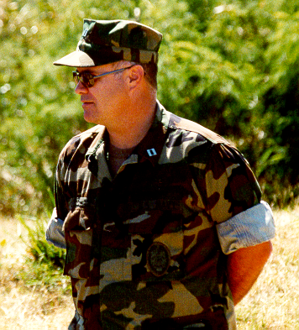
Chain of Command for Security
Commanding Officer
  Responsible for:
    Implementing security and law enforcement policies and procedures
    Report to the Regional Commander
    Physical security of the command
    Integrate all security and law enforcement forces at installations into a single force structure.
    Installation perimeter and area security
1-2-<number>

Slide 6
Chain of Command for Security
Security Officer
  Focal point for security and law enforcement
  Designated in writing by the Commanding Officer
  Responsible for coordinating the activity security and law enforcement programs
  Shall provide leadership to the security unit within several areas.
1-2-<number>

Slide 7
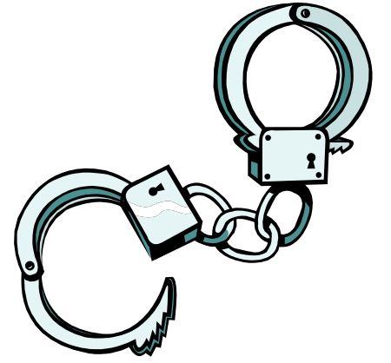
Naval Security Forces Mission
Responsible for law enforcement, physical security, and AT.
Primarily to conduct operations and maintain readiness to deter, defeat, and defend against criminals and terrorist activities
Maintain and support a lawful, orderly, and safe operating environment
1-2-<number>

Slide 8
The Security Unit
Responsible for:
  Managing and supervising NSF
  Producing/maintaining records & correspondences
  Conducting security and law enforcement patrols and manning security post
  Conducting criminal and security investigations
  Manage training IAW OPNAVINST 5530.14E Ch6
  Conducting security inspections
  Posting orders
1-2-<number>

Slide 9
The Security Unit
Responsibilities, cont’d
  Posting orders
  Antiterrorism Officer
  Military Working Dogs (MWD)
  Response Forces
  Surveillance Detection Units
  Civilian Members of a Commanders Security Force
  Composite Security Forces
1-2-<number>

Slide 10
The Security Unit
Responsibilities, cont’d
  Composite Security Forces
  Emergency Dispatch Services
  Augmentation of Naval Security Force for Emergencies
  Shipboard Security Reaction Force (SRF)
1-2-<number>

Slide 11
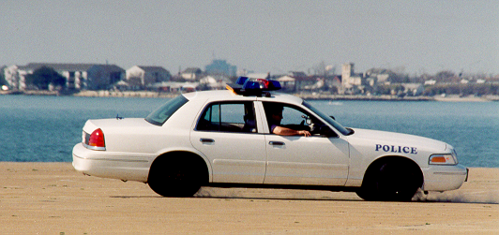
Functions of a Security Department
  Physical Security
  Law Enforcement
  Security and Law Enforcement Planning
  Antiterrorism and Force Protection
  External Entry Control and Restricted Area Access Control
  Emergency Management
  Investigations
1-2-<number>

Slide 12
Review and Summary
Security and Law Enforcement Programs
Chain of Command for Security
Naval Security Forces Mission
The Security Unit
Functions of a Security Department
1-2-<number>

Slide 13

Questions
1-2-<number>

