Slide 1
NSF Apprentice Training Standard
Apprentice Training
Skills
Forms and Reports/Report Writing
Topic 1.4
1-4-<number>

Slide 2





Classroom Policy
1-4-<number>

Slide 3
Enabling Objectives
IDENTIFY reports used in support of physical security duties
COMPLETE reports used in support of physical security duties
1-4-<number>

Slide 4
Physical Security
That part of security concerned with physical measures designed to safeguard personnel; to prevent unauthorized access to equipment, installations, material and documents; and to safeguard them against espionage, sabotage, damage and theft.
1-4-<number>

Slide 5
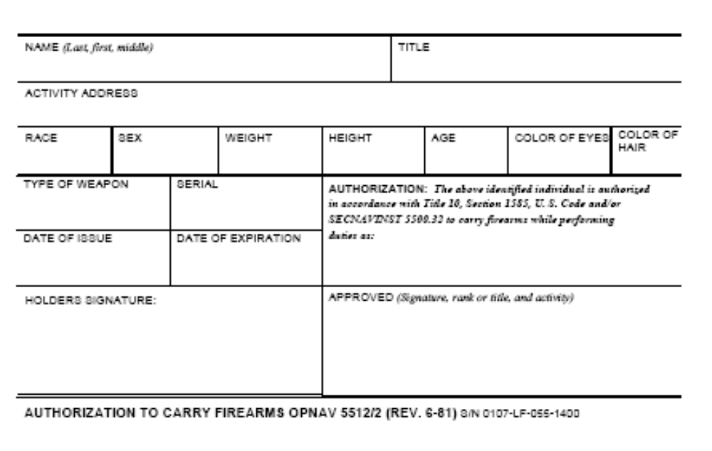
Physical Security Reports
OPNAV 5512/2: Authorization to Carry Firearms
1-4-<number>
Notes:
As recent developments at GTMO have shown, its necessary to understand the difference between a Detainee and a POW/EPW.
-All personnel that are in custody will be considered Detainees initially. This will include civilians as well as combatants, regardless of their outward appearance.
-A Prisoner of War (POW) on the other hand, is a specific classification defined in the Geneva Conventions as defined here on in the slide. POWs are guaranteed certain rights by the GCs.
Depending on the tactical level the CVN/ARG personnel will be operating at, your SOPs should be based on handling detainees with the appropriate rights set forth by the Geneva Conventions. In other words, humane treatment, appropriate meals & living conditions, etc.
Remember, these detainees may face a criminal prosecution in the US. Treatment that is considered excessive or harsh during their detainment may have a bearing on the trial.

Slide 6
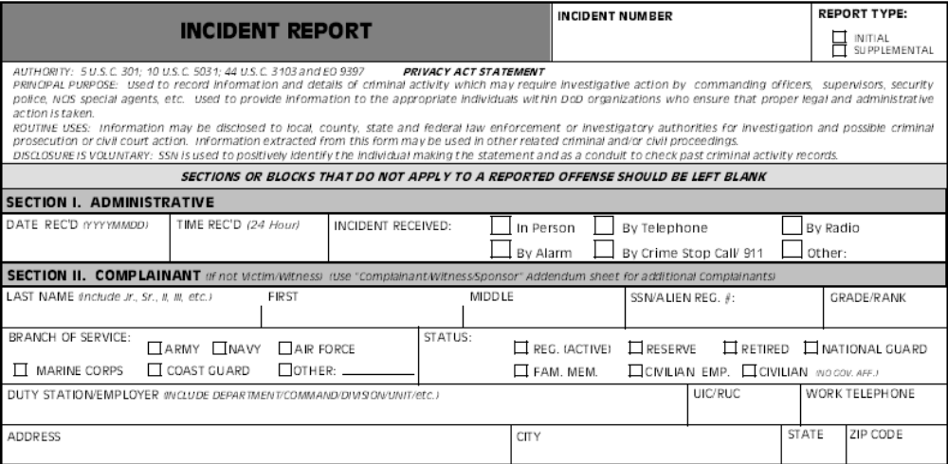
Physical Security Reports
OPNAV 5580/1: Incident Report (page 1)
1-4-<number>

Slide 7
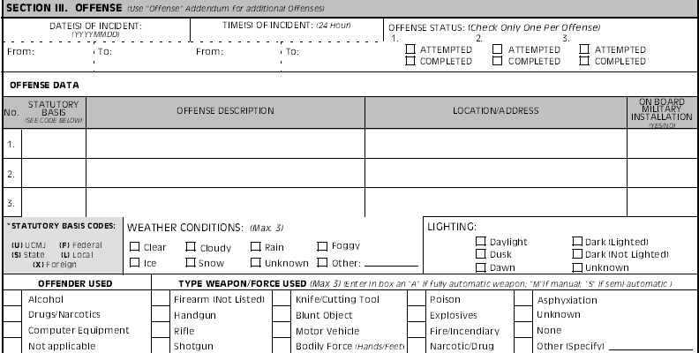
Physical Security Reports
OPNAV 5580/1 (page 1 )cont’d
1-4-<number>

Slide 8
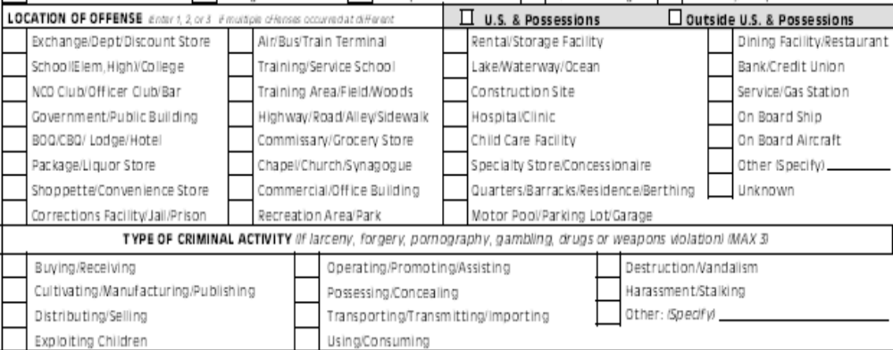
Physical Security Reports
OPNAV 5580/1 (page 1) cont’d
1-4-<number>

Slide 9
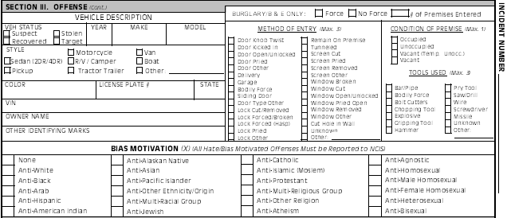
Physical Security Reports
OPNAV 5580/1 (page 2)
1-4-<number>

Slide 10
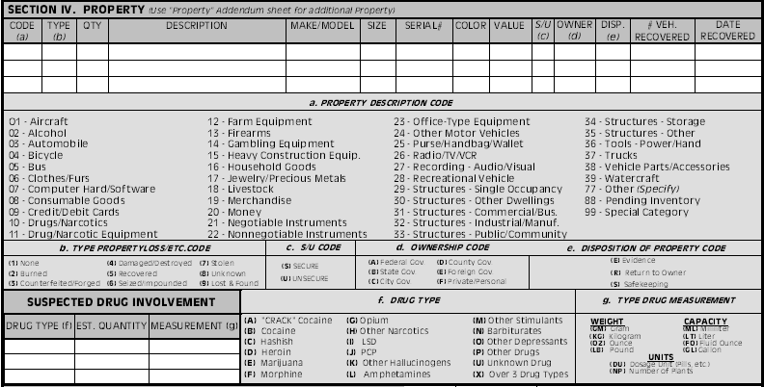
Physical Security Reports
OPNAV 5580/1 (page 2) cont’d
1-4-<number>

Slide 11
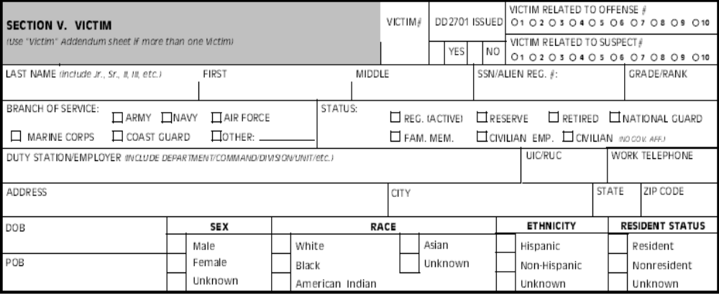
Physical Security Reports
OPNAV 5580/1 (page 2) cont’d
1-4-<number>

Slide 12
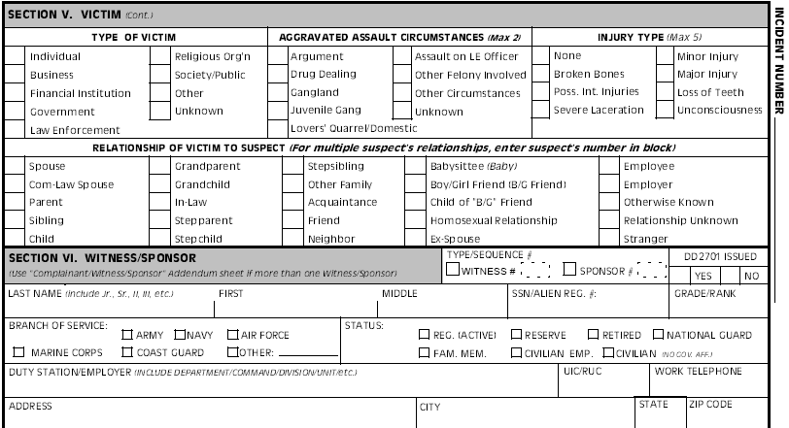
Physical Security Reports
OPNAV 5580/1 (page 3)
1-4-<number>

Slide 13
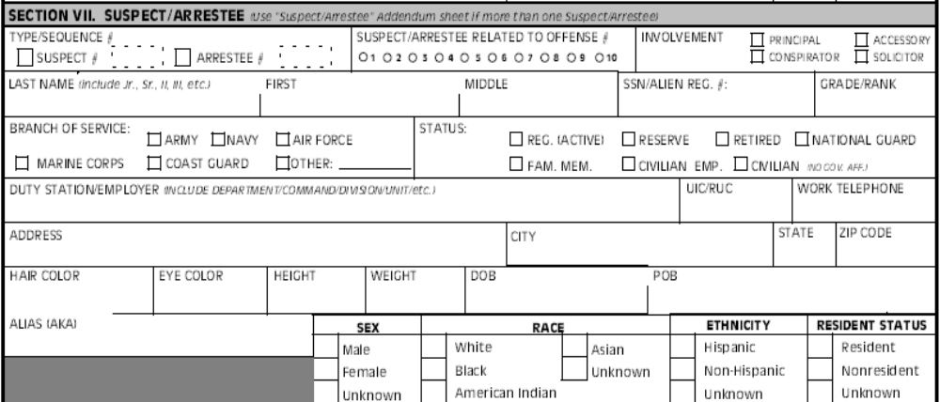
Physical Security Reports
OPNAV 5580/1 (page 3) cont’d
1-4-<number>

Slide 14
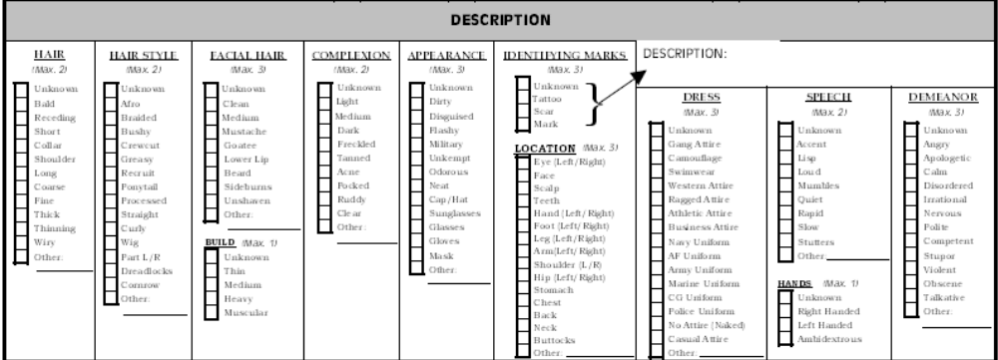
Physical Security Reports
OPNAV 5580/1 (page 3) cont’d
1-4-<number>

Slide 15
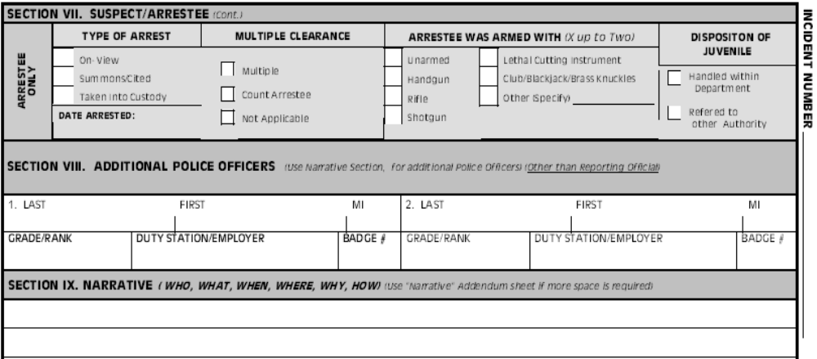
Physical Security Reports
OPNAV 5580/1 (page 4)
1-4-<number>

Slide 16
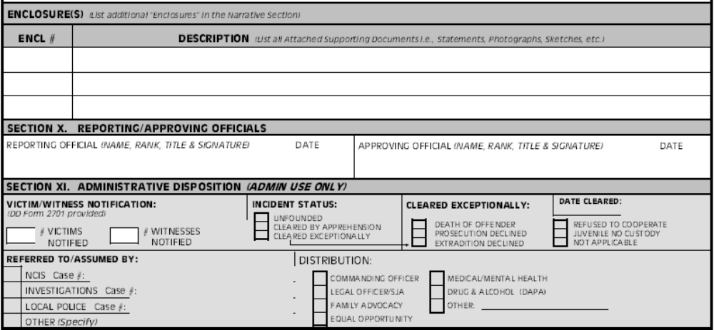
Physical Security Reports
OPNAV 5580/1 (page 4) cont’d
1-4-<number>

Slide 17
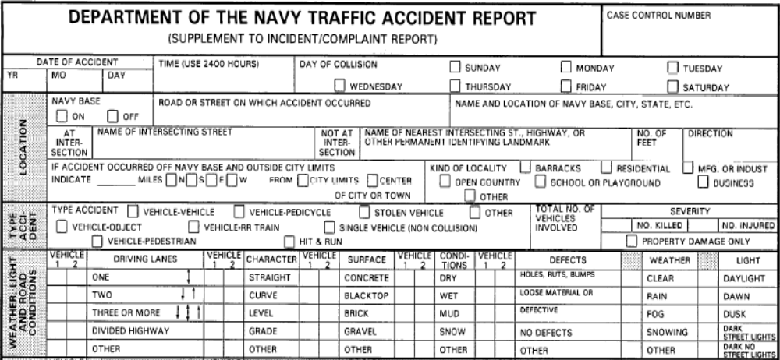
Physical Security Reports
OPNAV 5580/1A: Traffic Accident Report
1-4-<number>
Notes:
As recent developments at GTMO have shown, its necessary to understand the difference between a Detainee and a POW/EPW.
-All personnel that are in custody will be considered Detainees initially. This will include civilians as well as combatants, regardless of their outward appearance.
-A Prisoner of War (POW) on the other hand, is a specific classification defined in the Geneva Conventions as defined here on in the slide. POWs are guaranteed certain rights by the GCs.
Depending on the tactical level the CVN/ARG personnel will be operating at, your SOPs should be based on handling detainees with the appropriate rights set forth by the Geneva Conventions. In other words, humane treatment, appropriate meals & living conditions, etc.
Remember, these detainees may face a criminal prosecution in the US. Treatment that is considered excessive or harsh during their detainment may have a bearing on the trial.

Slide 18
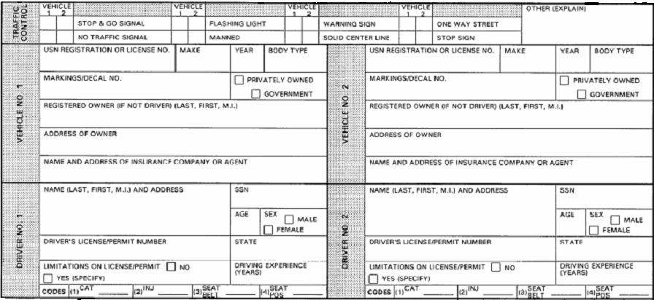
Physical Security Reports
OPNAV 5580/1A cont’d
1-4-<number>

Slide 19
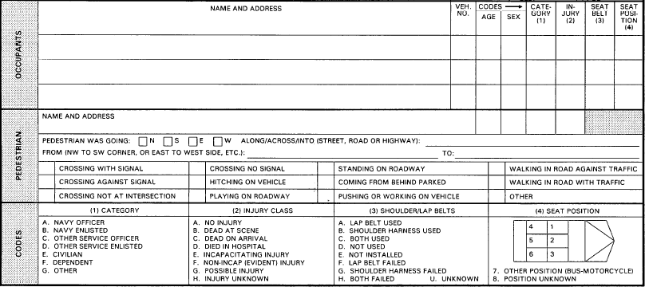
Physical Security Reports
OPNAV 5580/1A cont’d
1-4-<number>

Slide 20
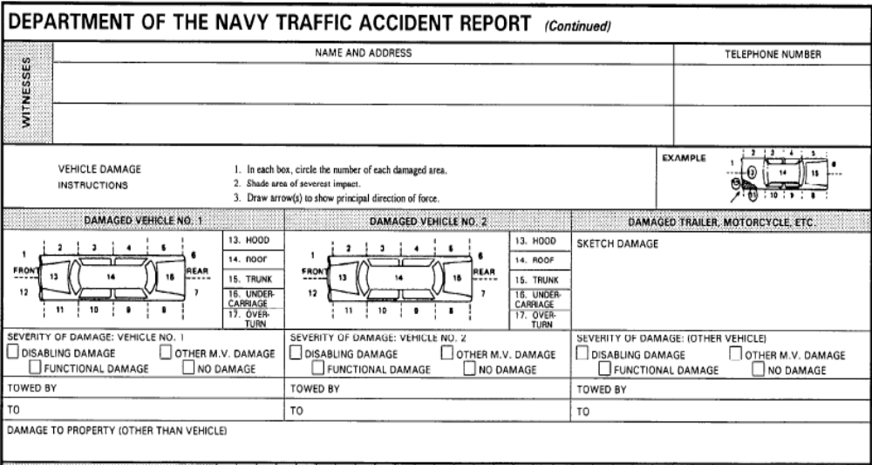
Physical Security Reports
OPNAV 5580/1A cont’d
1-4-<number>

Slide 21
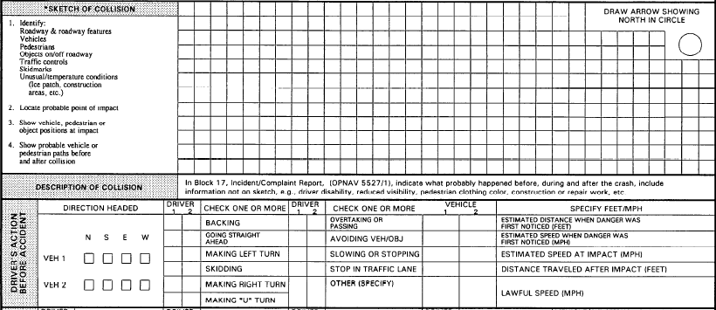
Physical Security Reports
OPNAV 5580/1A cont’d
1-4-<number>

Slide 22
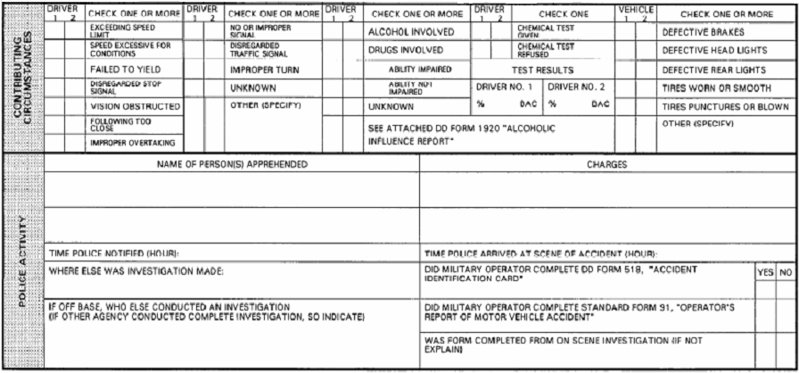
Physical Security Reports
OPNAV 5580/1A cont’d
1-4-<number>

Slide 23
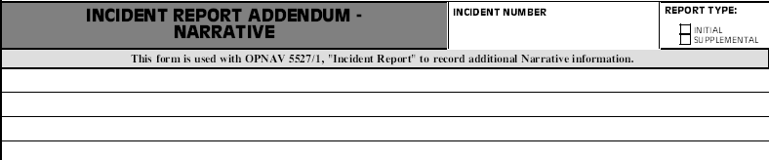
Physical Security Reports
OPNAV 5580/1B: Narrative
1-4-<number>

Slide 24
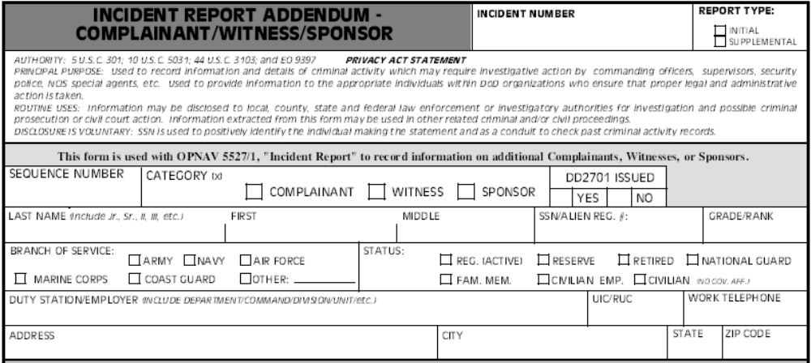
Physical Security Reports
OPNAV 5580/1C: Witness/Complaint/Sponsor
1-4-<number>

Slide 25
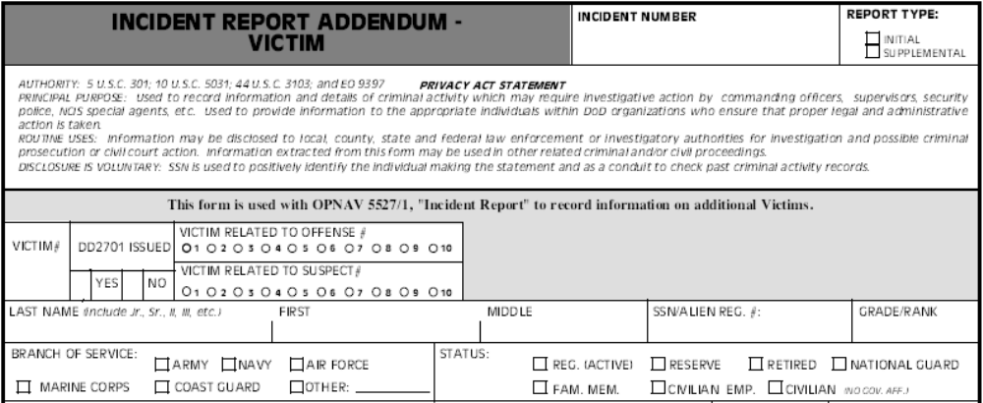
Physical Security Reports
OPNAV 5580/1D: Victim
1-4-<number>

Slide 26
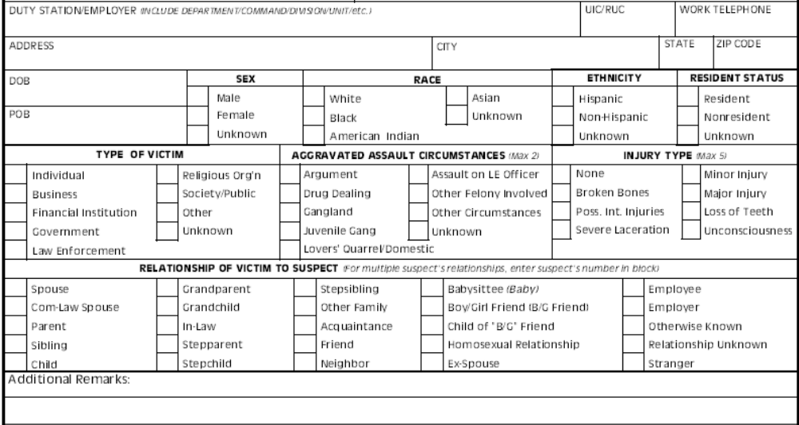
Physical Security Reports
OPNAV 5580/1D cont’d
1-4-<number>

Slide 27
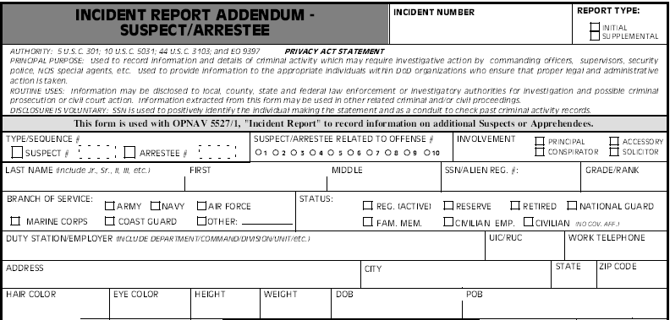
Physical Security Reports
OPNAV 5580/1E: Suspect/Arrestee
1-4-<number>

Slide 28
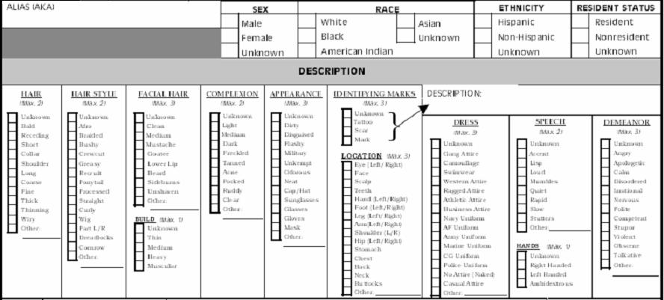
Physical Security Reports
OPNAV 5580/1E cont’d
1-4-<number>

Slide 29
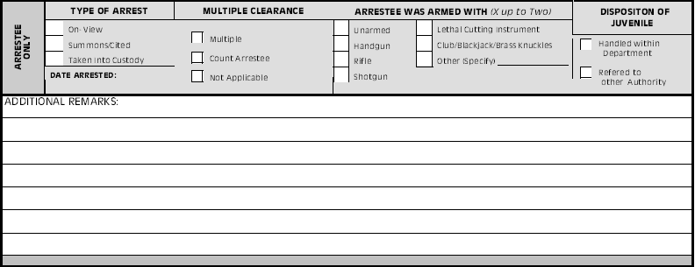
Physical Security Reports
OPNAV 5580/1E cont’d
1-4-<number>

Slide 30
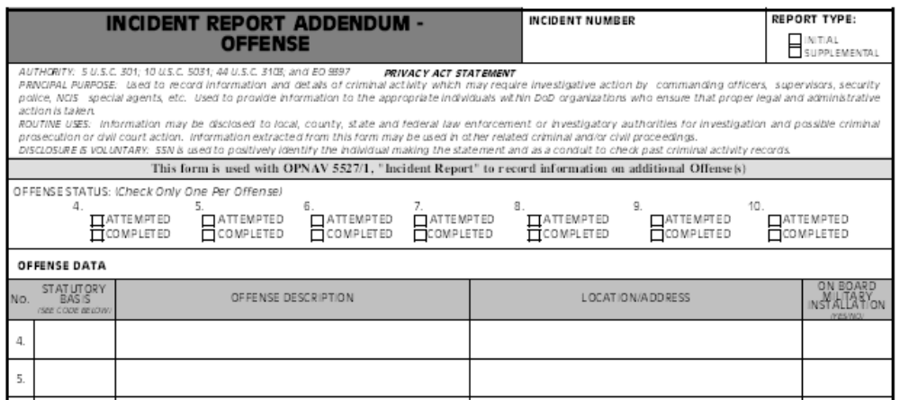
Physical Security Reports
OPNAV 5580/1F: Offense
1-4-<number>

Slide 31
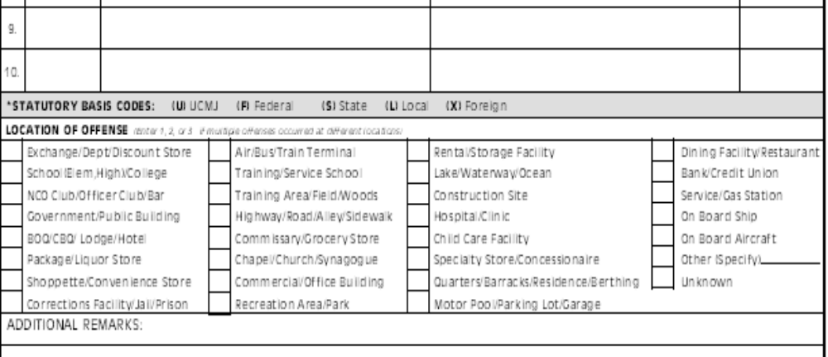
Physical Security Reports
OPNAV 5580/1F cont’d
1-4-<number>

Slide 32
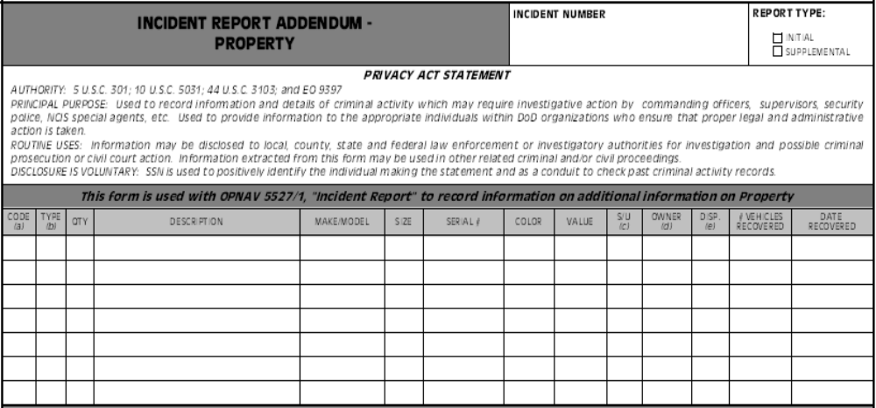
Physical Security Reports
OPNAV 5580/1G: PROPERTY and NARCOTICS Info
1-4-<number>

Slide 33
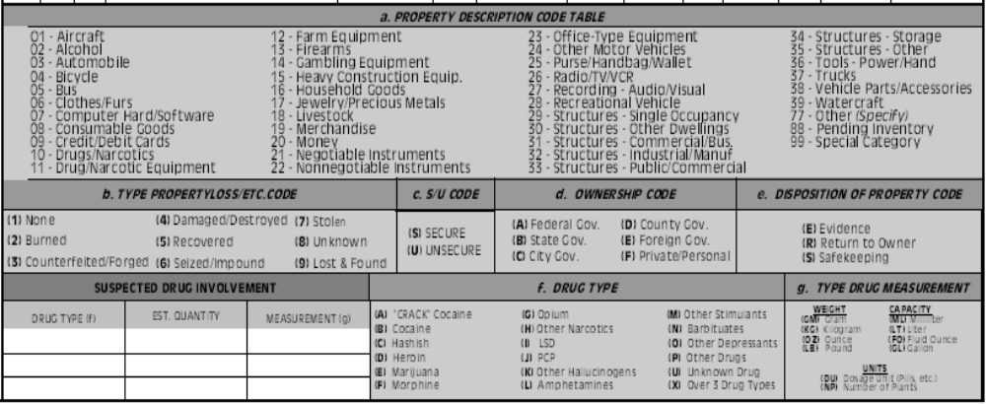
Physical Security Reports
OPNAV 5580/1G cont’d
1-4-<number>

Slide 34
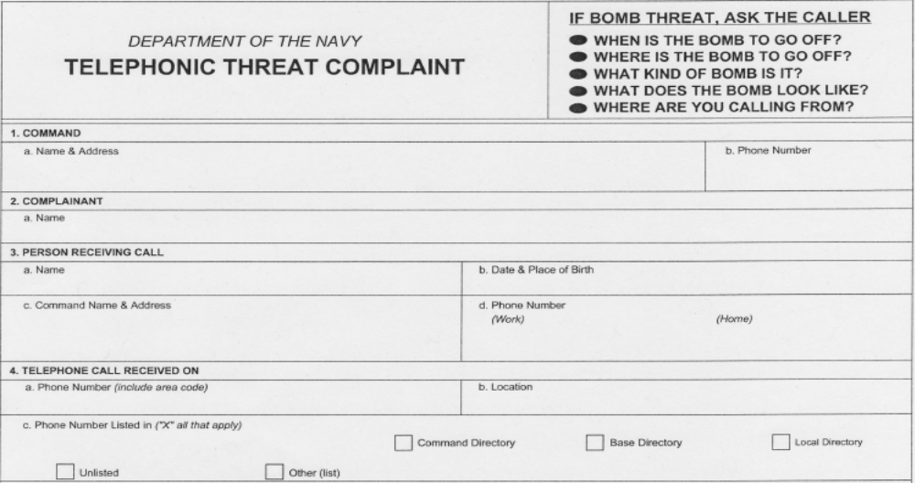
Physical Security Reports
OPNAV 5580/8: Telephone Threat Complaint
1-4-<number>
Notes:
As recent developments at GTMO have shown, its necessary to understand the difference between a Detainee and a POW/EPW.
-All personnel that are in custody will be considered Detainees initially. This will include civilians as well as combatants, regardless of their outward appearance.
-A Prisoner of War (POW) on the other hand, is a specific classification defined in the Geneva Conventions as defined here on in the slide. POWs are guaranteed certain rights by the GCs.
Depending on the tactical level the CVN/ARG personnel will be operating at, your SOPs should be based on handling detainees with the appropriate rights set forth by the Geneva Conventions. In other words, humane treatment, appropriate meals & living conditions, etc.
Remember, these detainees may face a criminal prosecution in the US. Treatment that is considered excessive or harsh during their detainment may have a bearing on the trial.

Slide 35
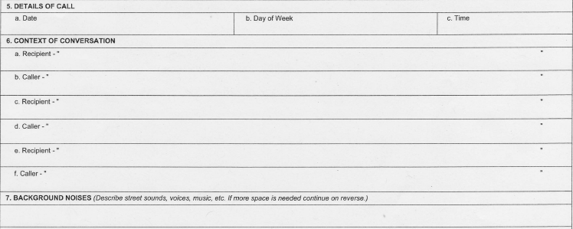
Physical Security Reports
OPNAV 5580/8 cont’d
1-4-<number>

Slide 36
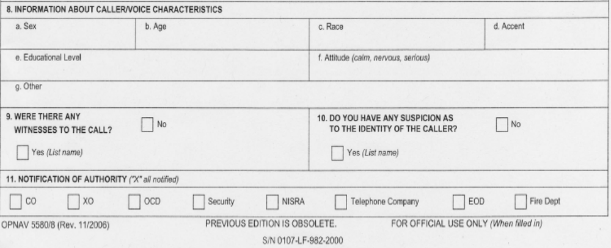
Physical Security Reports
OPNAV 5580/8 cont’d
1-4-<number>

Slide 37
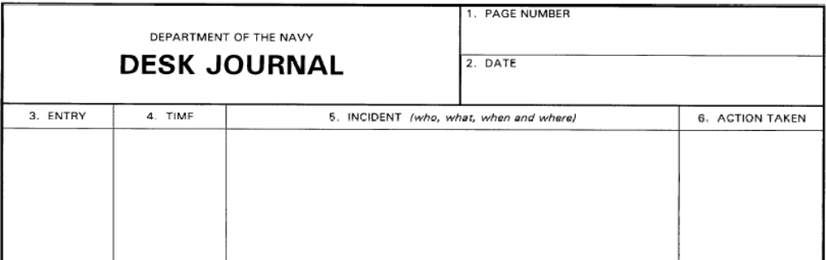
Physical Security Reports
OPNAV 5580/19: Desk Journal
1-4-<number>

Slide 38
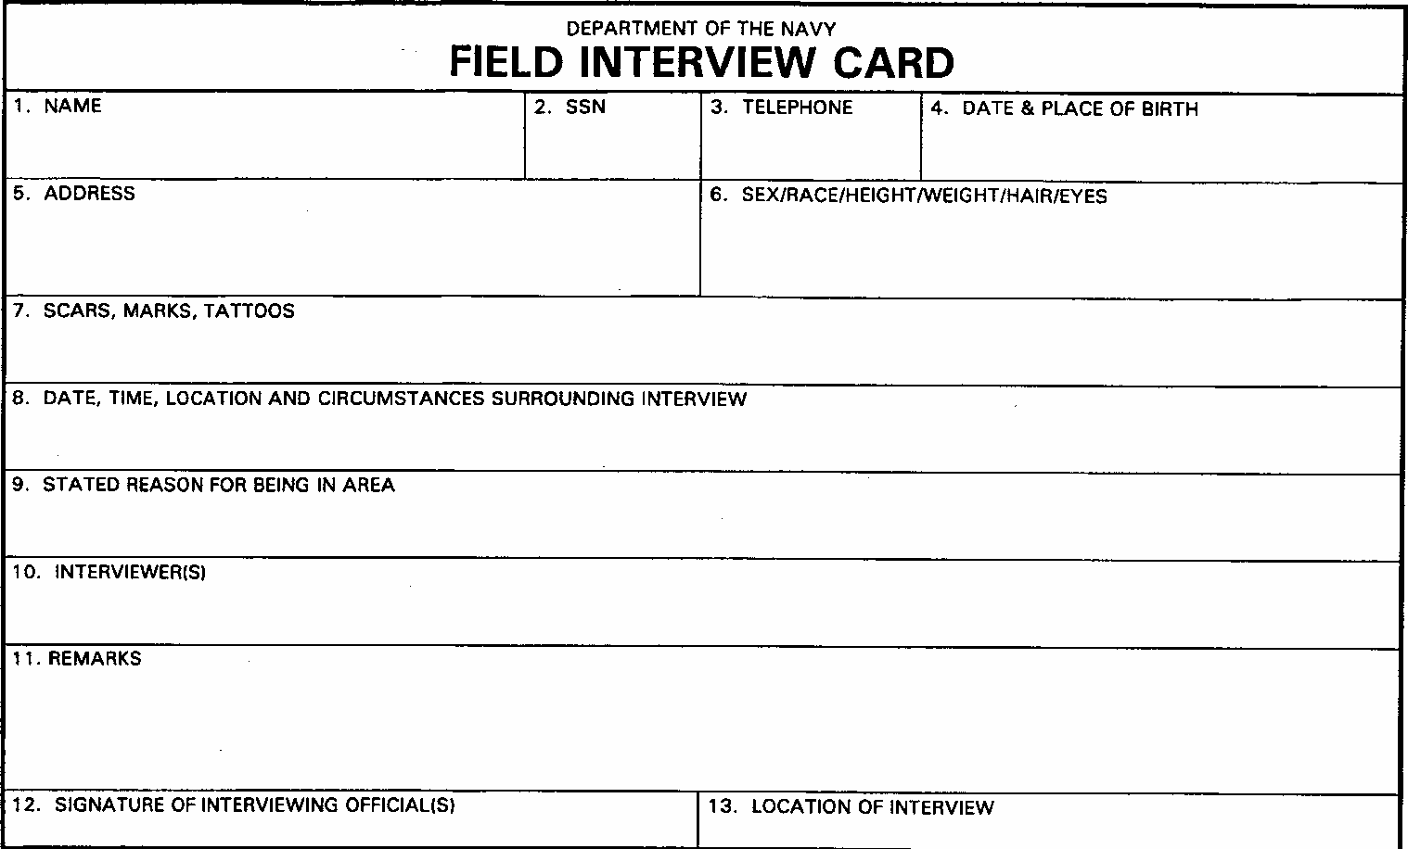
Physical Security Reports
OPNAV 5580/21: Field Interview Card
1-4-<number>

Slide 39
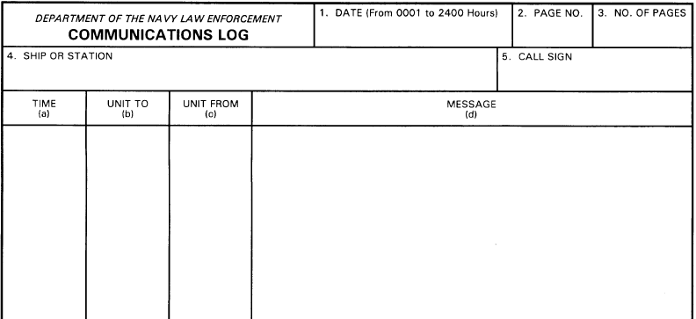
Physical Security Reports
OPNAV 5580/25: Communications Log
1-4-<number>
Notes:
As recent developments at GTMO have shown, its necessary to understand the difference between a Detainee and a POW/EPW.
-All personnel that are in custody will be considered Detainees initially. This will include civilians as well as combatants, regardless of their outward appearance.
-A Prisoner of War (POW) on the other hand, is a specific classification defined in the Geneva Conventions as defined here on in the slide. POWs are guaranteed certain rights by the GCs.
Depending on the tactical level the CVN/ARG personnel will be operating at, your SOPs should be based on handling detainees with the appropriate rights set forth by the Geneva Conventions. In other words, humane treatment, appropriate meals & living conditions, etc.
Remember, these detainees may face a criminal prosecution in the US. Treatment that is considered excessive or harsh during their detainment may have a bearing on the trial.

Slide 40
Review and Summary
Physical Security
Physical Security Reports
1-4-<number>

Slide 41

Questions
1-4-<number>

