Slide 1
NSF Training Standard
Apprentice
Skills
Crime Scene/ Preservation of Evidence
Lesson Topic 5.1
5-1-<number>

Slide 2





Classroom Policy
5-1-<number>

Slide 3
Enabling Objectives
IDENTIFY investigative responsibilities for processing a crime scene related to proceeding, arrival, secondary actions, safety, and awareness
COMPARE and contrast the tools used and the requirements necessary to document a crime to include notes, photographs, and sketches
DISTINGUISH between the types of evidence and the hearsay rule; and recall basic rules for gathering and collecting evidence at crime scenes
IDENTIFY sections and the contents that should be entered in each block of OPNAV 5580/2
5-1-<number>
Notes:
1

Slide 4
Overview
Investigative responsibility
Note-taking
Crime scene process
Investigative awareness
Evidence
Search the crime scene
Documentation of evidence
5-1-<number>
Notes:
2

Slide 5
Process Crime Scenes
Investigate Responsibility
  NCIS
    Responsible for investigating major criminal offenses and counter intelligence matters
  Command investigators
    Work at the command level and investigate cases not handled by NCIS
5-1-<number>
Notes:
3

Slide 6
Process Crime Scenes
Note Taking
  Taken to remember details of situation.
  Start when you receive call from dispatch.
  Use short meaningful phrases
  Include the who, what, when, where and how as it pertains to the incident
5-1-<number>
Notes:
4

Slide 7
Process Crime Scenes
Note taking cont’d
  Note date / time / weather conditions, etc.
  Get complete identity information.
  Include anything considered pertinent to the investigation
  Your notes are the property of the Navy.
5-1-<number>
Notes:
4

Slide 8
Process Crime Scene
Crime Scene Process
  Proceeding to the crime scene
    The dispatcher will attempt to give you all information collected.
    Mentally prepare your self before arriving and pay attention to surroundings
    Additionally, while enroute, be aware of suspects leaving the scene and of possible escape routes that may need to be blocked off
5-1-<number>
Notes:
5

Slide 9
Process Crime Scene
Crime scene process
  Arriving at the scene
    Immediately notify dispatch.
    Assist injured persons and safeguard crime scene
    Check for signs of life and initiate CPR
    Not date, time and weather conditions
5-1-<number>
Notes:
5

Slide 10
Process Crime Scene
Crime Scene Process
  Arriving at the scene (cont)
    Always stay alert, suspect could come back or still be on scene
    Note all alterations to the crime scene to safeguard evidence
    Get a description of the suspect(s) and/or the vehicle(s) used, and the direction they left in
5-1-<number>
Notes:
5

Slide 11
Process Crime Scene
Crime Scene Process
  Arriving at the scene (cont)
    Weapons used
    Relay all this information to the dispatcher who will put it over the radio for other units to be on the lookout.
    If upon arrival you decide the crime needs an NCIS response, notify the dispatcher
5-1-<number>
Notes:
5

Slide 12
Process Crime Scene
Crime Scene Process
  Secondary actions
    Control the flow of traffic
    Notify proper agencies
    Prevent unauthorized persons from entering the scene
    Prevent victim(s) and or witnesses from leaving the scene
5-1-<number>
Notes:
5

Slide 13
Process Crime Scene
  Secondary actions (cont)
    Protect evidence from damage or contamination
    Identify and separate potential witness(s) and suspect(s) to prevent rehearsal of, or changing of, stories by witnesses
    Conduct preliminary questioning to determine what happened. Be prepared to read rights advisement to any person who becomes a suspect
5-1-<number>
Notes:
5

Slide 14
Process Crime Scene
  Secondary actions (cont)
    Prevent unnecessary movement within the crime scene and the immediate vicinity. Take precautions in areas where impressions, footprints, or tire tracks might be
    Avoid unnecessarily touching doors, doorknobs, light switches, floors and windows
5-1-<number>
Notes:
5

Slide 15
Process Crime Scene
Crime Scene Process
  Officer Safety
    Upon arrival, make sure the area is secure from additional or continued threats to your or others’ safety
    Do not attend to injured person(s) until the scene is secured and under control
5-1-<number>

Slide 16
Process Crime Scene
  Officer Safety cont’d
    When arriving at the scene of violence on the street, vacant area, or in a parking lot, make sure the suspect is not in the area and you have enough back‑up to control the situation before taking any further action.
    When arriving at the scene of violence in a domicile or commercial structure, clear the building before rendering aid or commencing your preliminary investigation
5-1-<number>

Slide 17
Process Crime Scene
  Officer Safety cont’d
    Brief questions concerning who or where the suspect is may be appropriate, but distraction during this time puts your life and the lives of others in danger. Do not totally trust the victim's responses
    Communicate the situation to the dispatcher when you are reasonably sure you can do this safely. Stay focused and secure the scene first
5-1-<number>

Slide 18
Process Crime Scene
Investigate Awareness
  Be aware of and note comments made by persons on the scene
  Look for and at the body language and glances made by people at the scene
  Other details to be noted include:
Doors
Odors
Photography
Windows
Blinds
Lights
Sketches
5-1-<number>
Notes:
6

Slide 19
Process Crime Scene
Investigate Awareness
  Photography
    Normally a photographer from the Base Photo Lab will respond, or NCIS investigators may take their own pictures
    Photographs supplement notes and sketches, clarify written reports, provide personnel identification, and provide a permanent record of fragile evidence
5-1-<number>

Slide 20
Process Crime Scene
  Photography cont’d
    Photograph all evidence or possible evidence before anything is moved or touched.
      Place a ruler next to the item to show size.
      Use tags or pointer tags
      Completely identify each photograph
5-1-<number>

Slide 21
Process Crime Scene
Investigate Awareness
  Photography Log
    Record technical data for each photograph in your notes.
    A photo log is a detailed record of each photo taken at a crime scene.
      Tells what time and type of photo.
      Tells what camera was used, along with technical data.
5-1-<number>

Slide 22
Process Crime Scene
Investigate Awareness
  Sketches
    A rough sketch is completed at the scene and should not be changed after departing the scene.
    Sketch should include:
      Location of approaches, roadways, entrances, etc.
      The size of the area or building
5-1-<number>

Slide 23
Process Crime Scene
  Sketch cont’d
    Specific location ad relative position of all evidence found at the scene
    A legend to explain objects in the sketch
    A title block identifying date, time, location, offense, victim, investigator, and incident number.
5-1-<number>

Slide 24
Process Crime Scene
Crime Scene Process
  Evidence
    Real
      Physical objects and marks or wounds on a person’s body.
    Testimonial
      Oral or written statements
5-1-<number>
Notes:
7

Slide 25
Process Crime Scene
  Evidence cont’d
    Direct
      Evidence which tends to directly prove or disprove a fact in an issue.
    Circumstantial
      Evidence which tends to indirectly involve a person in an offense.
5-1-<number>
Notes:
7

Slide 26
Process Crime Scene
  Evidence cont’d
    Documentary
      Anything in writing
    Hearsay Rule
      Testimony given by a witness who relates, not what he knows personally, but what others have told him, or what he has heard said by others.
5-1-<number>
Notes:
7

Slide 27
Process Crime Scene
  Evidence cont’d
    Dying Declaration
      A statement made when the victim was aware of his/her impending death and without the hope of recovery
5-1-<number>
Notes:
7

Slide 28
Process Crime Scene
  Evidence cont’d
    Excited Utterance
      A statement concerning the circumstances of a startling event made by a person while he was in such a condition of excitement, shock, or surprise, caused by his participation in or observation of the event, as to warrant a reasonable inference that he made the utterance as an impulsive and instinctive outcome of the event, and not as a result of deliberation or design.
5-1-<number>
Notes:
7

Slide 29
Process Crime Scene
Searching the Crime Scene
  Once the scene is secured and victims have been treated or removed, you are ready to search for evidence
  Basic rules:
    Ensure the crime scene has been dusted for fingerprints prior to opening and closing drawers, closets, etc
5-1-<number>
Notes:
8

Slide 30
Process Crime Scene
  Basic rules: cont’d
    Develop definite plans for the search to include what to look for, who will search where, what to do when evidence is found, and what search method is suitable for the scene
    Complete the search once started, regardless of when or where a piece of evidence is found
5-1-<number>
Notes:
8

Slide 31

Process Crime Scene
  Basic rules cont’d
    Any additional evidence found during the search must be noted, photographed, & added to the sketch prior to their collection
5-1-<number>
Notes:
8

Slide 32
Process Crime Scene
Collecting Evidence
  Give first priority to fragile evidence that can be altered by time or elements.
  Collecting evidence is usually done after the search is completed, but under certain conditions, fragile items may be collected as they are found.
  Next, collect items that could impede the search. It is essential that evidence be carefully and properly collected
5-1-<number>
Notes:
9

Slide 33
Process Crime Scene
Collecting Evidence cont’d
  Place your initials, date and time of discovery on each piece of evidence.
  Place the information where it is least likely to affect the appearance, monetary value, use, and evidentiary value of the item
  Examine, photograph, sketch, record, and collect major evidence in the most logical order
5-1-<number>
Notes:
9

Slide 34


Process Crime Scene
Collecting Evidence cont’d
  Do not move any item until it has been examined for trace evidence.
  Search for and collect trace evidence
5-1-<number>
Notes:
9

Slide 35
Process Crime Scene
Documenting Evidence
  There are several different documents that you will use when dealing with evidence.
  The most important form is the OPNAV 5580/22 (Evidence/Property Custody Receipt).
  This form is used for evidence, found property, or other items taken by the security patrolman because it is of evidentiary value
5-1-<number>
Notes:
10

Slide 36
Process Crime Scene
Documenting Evidence cont’d
  The chain of custody identifies evidence and shows who handled the evidence as it was processed
  Evidence should be turned over to the evidence custodian or locked in an evidence locker until the evidence custodian is ready to receive it
5-1-<number>
Notes:
10

Slide 37
Process Crime Scene
Documenting Evidence cont’d
  The chain of custody begins with the first person that collected the evidence.
  As the evidence goes from person to person, everyone must sign the receipt.
  This pattern will continue until final disposition of the property is made after the case is adjudicated.
5-1-<number>
Notes:
10

Slide 38
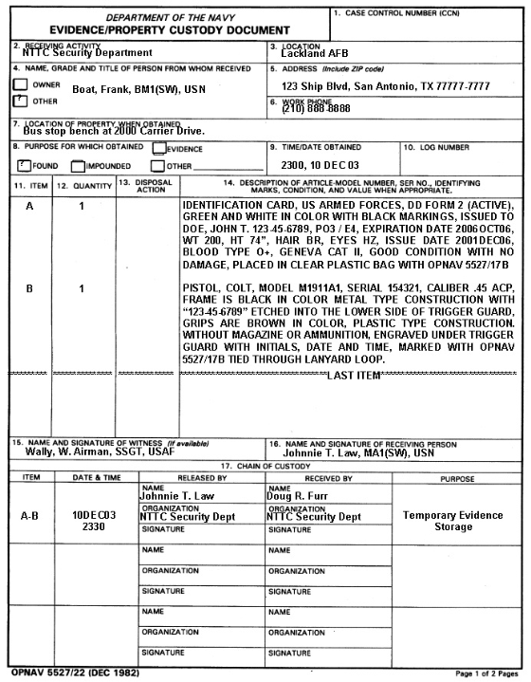
DD Form 5580/22
5-1-<number>
Notes:
12

Slide 39
Block 1, Case Control Number (CCN). Enter the CCN from the original Incident Report (IR)
Block 2, Receiving Activity. Enter the name of the activity which has received the evidence/ property.
Block 3, Location. Enter the location of the receiving activity.
Block 4, Name, Grade and Title of Person from Whom Received. This block is primarily used to document the individual turning the evidence/property over to the Security Department.
When the evidence is received from an individual, mark “OWNER” or “OTHER” block as appropriate, and enter the individuals full name. You will also need to document the individuals grade. For military personnel rate or rank; government civilian personnel the position classification rating; military dependents “DEP WIFE”, “DEP SON”, etc.; and civilians with no government affiliation, “CIV”. You must also document the individuals title if applicable, e.g., Barracks Chief, Duty Driver, etc.
Block 6, Work Phone. Enter the work telephone number of the individual, if military, from whom the evidence was received. For all others enter the home telephone number.
When evidence is not received from an individual, the “OTHER) block will be marked and an appropriate term such as “Crime Scene” will be entered in this block
Block 5, Address. Enter the address of the person from whom the evidence/property was received. If it was not received from an individual, enter “N/A.”
5-1-<number>
Notes:
12

Slide 40
DD Form 5580/22
Block 7, Location of Property When Obtained. Enter in detail the EXACT location the evidence/property was obtained.
Block 9, Time/Date Obtained. Enter the EXACT time and date the evidence/property was obtained by security personnel.
Block 8, Purpose fro Which Obtained. Mark the appropriate box to describe the purpose for which the evidence/property was obtained. If “other” is marked, enter a brief description in the space provided (e.g., “left by owner”).
Block 10, Log Number. This block will be filled in by the Evidence Custodian or alternate
5-1-<number>
Notes:
12

Slide 41
After the last item has been listed, type or draw a solid line, “Xs” or asterisks (*), at the bottom of the entry to the margin on each side of the form (block 11 to block 14). Under the line enter the words “LAST ITEM”.
Block 12, Quantity. Enter the number of each item of evidence listed on the Evidence Tag. For example, if there are four briefcases listed as Item A, the Quantity is “4”.
Block 11, Item. Alphabetically identify each item of evidence with the first item being “A”, the second “B”, etc. In the event that all letters (A-Z are used, continue using double letters, i.e., AA, BB etc.
Block 13, Disposal Action. This block is used by the Evidence Custodian or alternate to enter a number and letter code. These codes are described in block 20 of this form.
Block 14, Description of Article. Enter a description of teach item of evidence, detailed accurately and based upon what is actually observed about the item at the time it is acquired.
List the brand, model number and serial number
List identifying marks
Describe the physical characteristics and conditions of the item(s), especially if they appear to be valuable. Any obvious damage should also be noted.
Estimate current value based on your experience and any records or information provided by the victim. To determine if estimating current value is appropriate, check your local SOP or with your local JAG.
Additional Evidence/Property Custody Receipts may be used as continuation sheets to list additional items in block 11 through 14. If continuation sheets are necessary, the first six blocks will be filled in exactly as found on the first form, except that in block 1, to the right of the CCN the page number will be entered, i.e., “Page One”, “Page Two”, etc.
5-1-<number>

Slide 42
In the block labeled “Released By”, enter the name and organization, with the signature of the person releasing the evidence.
In the “Received By” block, enter the name and organization, with the signature of the individual receiving the evidence/property. If the items are placed in temporary storage pending pickup by the Evidence Custodian, enter working such as “Temporary Evidence Locker Number One”, etc.
In the block labeled “ITEM”, enter the alphabetic identification form column 11 of each item transferred to the custody of another individual. For example, if several, or all, items are transferred enter as appropriate, “A through L”, “C and D”, etc.
Block 15, Name and Signature of Witness. If a witness is available, enter the printed or typed name and have the witness sign it.
Block 16, Name and Signature of Receiving Person. Enter the printed or typed name with the signature of the security person who first received the evidence/property at the location.
The Evidence/Property Custody Receipt has a hard copy of the identification part attached as the back page of this multi-copy from. It only includes blocks 1 through 16. This hard copy is provided to the person identified in block 4 as a receipt for the property and must be presented to obtain release (if appropriate) of the items listed.
Block 17, Chain of Custody: This area of the form establishes accountability. Each of the sub-blocks in block 17 must be completed as each person in the chain releases and receives the evidence/property, until the final disposition of the evidence/property is made. This block is continued on the back of the page, with reminder to remove and reverse the carbons before completing the form.
In the next block, enter the date and time of the transaction.
In the block labeled “Purpose”, state the purpose of the transaction (e.g., “Temporary Storage”, “Returned to Owner”, etc.).
5-1-<number>

Slide 43
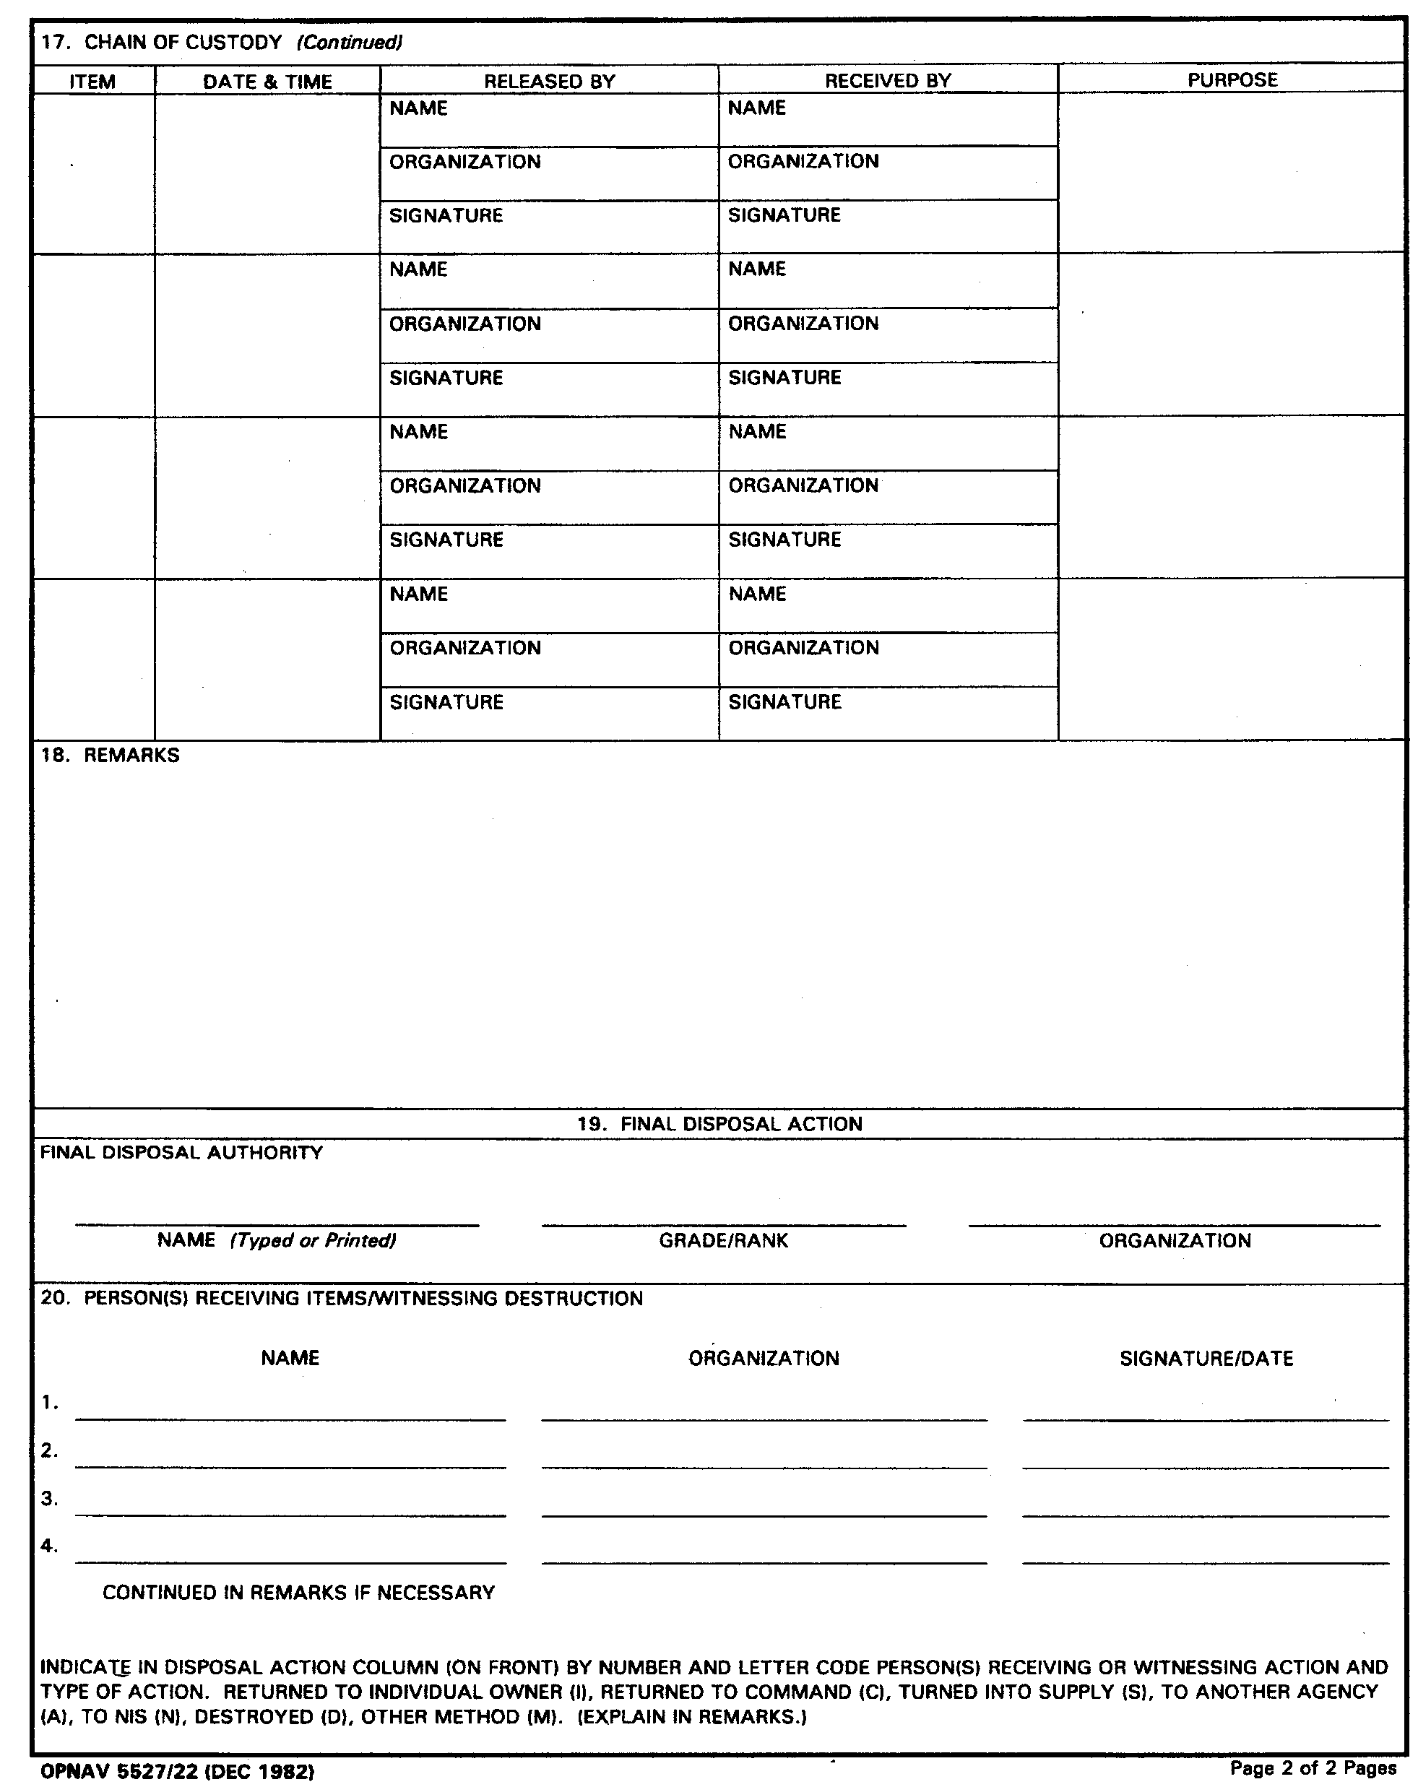
Block 18, Remarks. This is a blank space in which additional information concerning the evidence/property can be recorded
Block 19, Final Disposal Action. Enter the typed or printed name, grade/rank and organization of the individual with final disposal authority.
Block 20, Person(s) Receiving Items/Witnessing Destruction. List all individuals and their organizations, along with their signatures, who witness the final disposal and/or receive the evidence/property. If additional space is needed, the list can be continued in block 18. Below this information is the listing code letters to use in block 13 (Disposal Action)
5-1-<number>

Slide 44
Search for Evidence
General Observations
  Consider the size and shape of the building/area to be searched.
  Decide what method to use
  Brief searchers on a description of the item being searched for (if known) and what action to take when the item sought is found.
5-1-<number>

Slide 45
Search for Evidence
General Inspections cont’d
  You must formulate a plan when searching for evidence. An effective plan uses a systematic and methodical approach.
5-1-<number>

Slide 46


Search for Evidence
Types of Search Patterns
  Concentric circle
    Used when searching a single room or outdoors when evidence has been dropped or placed a specific distance from a crime scene.
    Use clockwise ever widening or ever narrowing search pattern.
5-1-<number>

Slide 47
Search for Evidence
Types of Search Patterns cont’d
  Strip & Grid
    Normally used in large outdoor areas.
    When using the strip search, divide the area into strips approximately 4 feet wide. The search starts at one end and moves back and forth across the area from one side to the other.
5-1-<number>

Slide 48
Search for Evidence
  Strip & Grid (cont)
    Perform the grid search following the strip search. It covers the same area except from end to end instead of side to side.
    Multiple searchers can be used with this search method with each searcher being responsible for a particular area.
5-1-<number>

Slide 49
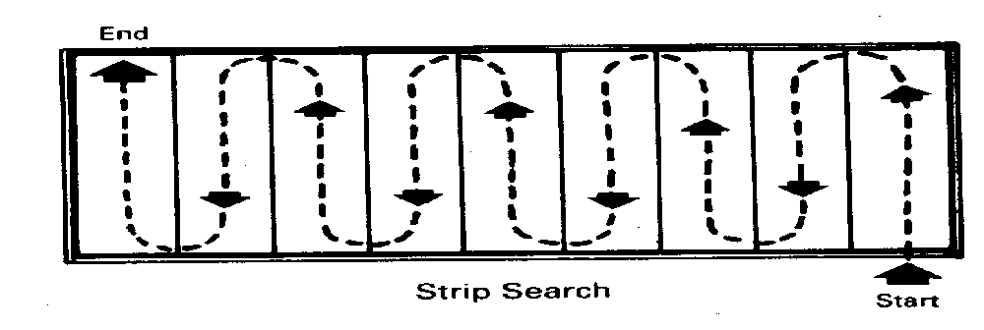
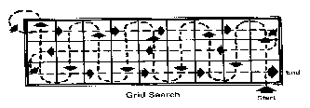
Strip & Grid
5-1-<number>

Slide 50
Search for Evidence
Types of Search Patterns
  Zone or Sector
    Can be used to prioritize areas by importance or break large areas up into smaller ones. Use in large areas; i.e. an aircraft hangar.
    Used to assign a number to an area to be searched based on its importance or likelihood to yield evidence.
5-1-<number>

Slide 51
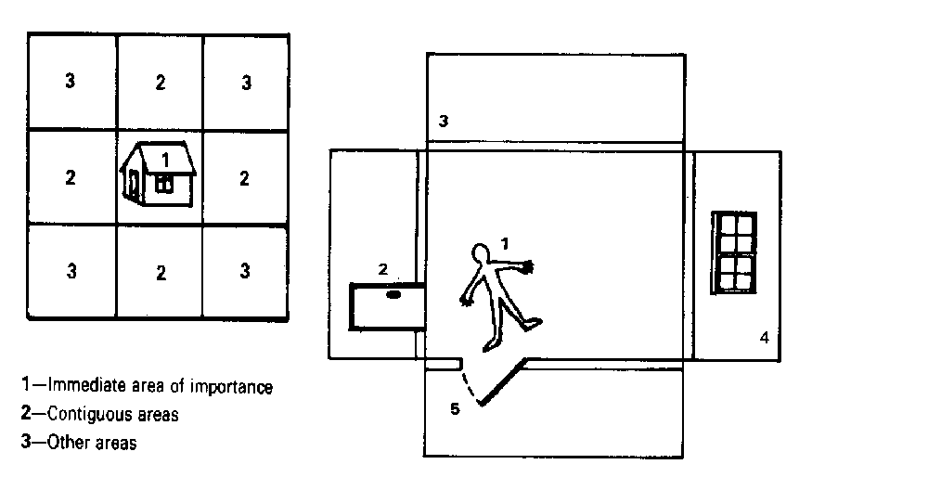
Types of Searches
Zone or Sector
5-1-<number>

Slide 52
Review and Summary
Investigative responsibility
Note taking
The crime scene process
Investigative awareness
Evidence
Search the crime scene
Collecting evidence
Documenting evidence
5-1-<number>
Notes:
11

Slide 53
Review and Summary
Forms: OPNAV 5580/16 and 5580/22
General inspections
Types of search patterns
5-1-<number>
Notes:
11

Slide 54

Questions
5-1-<number>

