Slide 1
NSF Training Standard
Apprentice
Skills
Vehicle Stops/ Search of Vehicles
Lesson Topic 5.6
5-6-<number>

Slide 2





Classroom Policy
5-6-<number>

Slide 3
Enabling Objectives
DIFFERENTIATE when law enforcement challenges are warranted and how to perform them
SPECIFY techniques used to challenge a suspect on foot
SPECIFY techniques used to challenge a suspect in a vehicle
SPECIFY techniques used to challenge a suspect during a felony stop
IDENTIFY entry requirements to a military installation.
5-6-<number>

Slide 4
Enabling Objectives
DESCRIBE procedures to conduct vehicle inspections.
DEMONSTRATE procedures to conduct vehicle inspections.
DEMONSTRATE techniques to identify potential Improvised Explosive Devices (IED)
DEMONSTRATE actions to take when a suspected Improvised Explosive Devices (IED) is discovered
5-6-<number>

Slide 5
Vehicle Stops
Purpose is to determine “Friend from Foe” and to make a positive identification.
Contact Officer will do all the talking, searching, etc…
Cover Officer concentrates on watching and controlling the suspect. His positioning allows him to respond to any actions by the suspect.
5-6-<number>

Slide 6
Vehicle Stops
Stopping Individuals in Vehicles
  Advise Dispatch of vehicle description
  Take cover and concealment and come to the ready pistol
  Issue commands
5-6-<number>

Slide 7
Vehicle Stops
“Halt!!!”
“Put your vehicle in park,turn off the engine and set the parking brake”
At night, tell driver to leave headlights on and to turn on the dome light
Place hands in the air or on the windshield
5-6-<number>

Slide 8
Vehicle Stops
Have driver use their right hand to remove the keys from the ignition, then place both hands outside the window and drop the keys on the ground. Have them release the seatbelt with their left hand and slowly place that hand back outside the window
5-6-<number>

Slide 9
Vehicle Stops
Have driver open the door from the outside, and push it open with their left foot, and step out of the vehicle.
Have suspect remove ID just like a normal foot challenge, and place it on arm rest of vehicle.
Suspect will then side step away from the vehicle, and walk forward approx. 6 paces, and come to final challenge
5-6-<number>

Slide 10
Vehicle Stops
If there are other occupants have them exit from the same side as the driver. Stager suspects at a 45 degree angle from the driver either forward or back from the driver.
Do not leave your cover until all suspects are in the final challenge position, then move up, checking the vehicle as you approach.
5-6-<number>

Slide 11
Vehicle Stops
With your weak hand push/pull the trunk
Advance to the vehicle keeping 80 % of your attention on the suspects and 20 % on the vehicle.
Once at the door, retrieve the suspect’s ID and verify credentials.
5-6-<number>

Slide 12
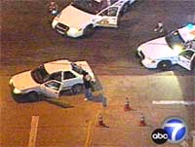
Vehicle Stops
Felony Stop
5-6-<number>

Slide 13
Vehicle Stops
Felony stops are extremely dangerous
The vehicle might have been identified as stolen or the suspects in the vehicle might be suspected of serious offenses.
A primary and back up unit will normally conduct a felony stop. Officer and bystander safety is paramount.
5-6-<number>

Slide 14
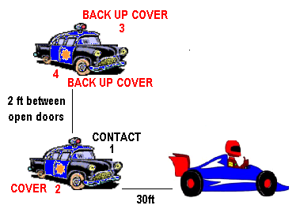
Vehicle Stops
5-6-<number>

Slide 15
Vehicle Stops
Open police car doors.
Contact/Patrol officer 1 will establish contact with the PA system, while Patrol officer 2 operates the police radio.
Contact officer will identify himself, the reason for stop, and will have the suspect turn on the dome light at nighttime.
5-6-<number>

Slide 16
Vehicle Stops
Do not remove suspects until back up has arrived
Contact / Patrol officer 1 will communicate with the suspect, all other officers will have their weapon out, safety off and finger on the trigger while covering the vehicle
5-6-<number>

Slide 17
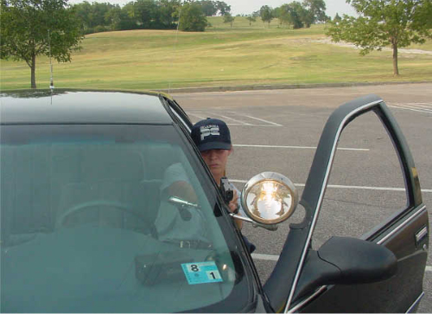
Vehicle Stops
5-6-<number>

Slide 18
Vehicle Stops
Contact/ Patrol officer 1 will have the driver get out of the vehicle in the same manner as a vehicle challenge. Dropping the keys on the ground
5-6-<number>

Slide 19
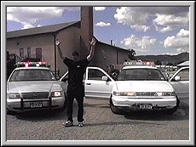
Vehicle Stops
Contact / Patrol officer 1 will tell the suspect to walk backwards behind the units bumper, but in front of the doors. Suspect will then be placed in the kneeling position
5-6-<number>

Slide 20
Vehicle Stops
Patrol Officer 3 will come around from his position, handcuff, and move suspect behind primary vehicle for a kneeling search.
Patrol officer 4 will provide a weaponless glance back towards 3 in case he needs assistance.
Any other suspects will be directed to exit on the driver side and will be handled the same way as the driver.
5-6-<number>

Slide 21
Vehicle Stops
Handcuffed and searched suspects will be placed in the primary vehicle with seatbelts on.
Once all the suspects have been secured the vehicle will be cleared. Patrol officer 3 will approach the vehicle at a 45% angle.
While patrol 3 is clearing, other officers will have fingers off the trigger.
5-6-<number>

Slide 22
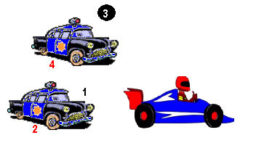
Vehicle Stops
5-6-<number>

Slide 23
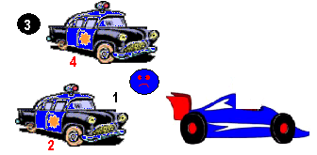
Vehicle Stops
5-6-<number>

Slide 24
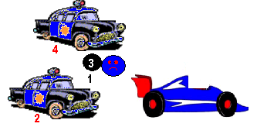
Vehicle Stops
5-6-<number>

Slide 25
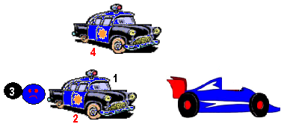
Vehicle Stops
5-6-<number>

Slide 26
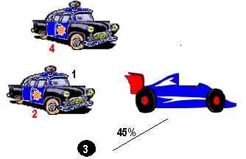
Challenge Individuals
5-6-<number>

Slide 27
Entry Control Point
Entry onto Military Installations
  CO determines degree of control over traffic flow
  Designed to provide required amount of security without hindering base mission
  Objectives
    Smooth flow of traffic at gates
    Establish positive entry control
    Establish visitor control
    Provide information / directions
5-6-<number>

Slide 28
Entry Control Point
Base Entry Requirements
  Vehicles
    DOD Decal - DD Form 2220
      Color - white background with border & numbers/lettering in blue
      Base registration number affixed
      Registration decal should be attached where it can easily be seen or where local policy dictates
5-6-<number>

Slide 29
Entry Control Point
Base Entry Requirements, cont’d
  Installation Tab: DD Form 2219
    Name of base where vehicle is registered
    Blue - Officer
    Red - Enlisted
    Green - Civilian Employees
    White - Contractors
    Affixed below the DOD Decal
5-6-<number>

Slide 30
Entry Control Point
Arrange a covert code with your cover sentry
Establish reactionary gap
Establish triangulation position in relation to vehicle
Monitor person(s) eye/body movements
5-6-<number>

Slide 31
Initial Contact
Make eye contact
Signal vehicle to halt
Greet driver
Direct the drive to inspection point
Ask for identification (IDs) of all occupants of the vehicle
  Check every ID
  Match picture on ID to bearer
  Ensure ID is authentic
5-6-<number>

Slide 32
Initial Contact
Ask for IDs, cont’d
  Ask driver if there is anything in vehicle that should not be there
  Have driver remove all baggage from vehicle
  Direct ALL occupants away from the vehicle
  Conduct the inspection
5-6-<number>

Slide 33
Inspection
Note the time inspection begins
Driver opens all compartments; NOT YOU!
Utilize a systematic search procedure
  Search from outside to inside, and top to bottom
  Work in pairs
    Contact Sentry
    Cover Sentry
  Move from higher risk areas to lower risk areas
5-6-<number>

Slide 34
Inspection
Systematic Procedure, cont’d
  Exterior
    Trunk or cargo area (largest cavity, best place for a large WMD)
    Engine compartment
    Undercarriage
5-6-<number>

Slide 35
Inspection
Systematic Procedure, cont’d
  Interior
    Driver area
    Front passenger area
    Rear passenger area
  Tools:
    Eyes, hands, nose
    Flashlight
    Optional Items
5-6-<number>

Slide 36
Inspection
External Search Priority Area #1
  Have the driver open the trunk (NOT YOU)
  Trunk lid
    Shake gently, note unusual heaviness, weight distribution, loose object
    Check cavities behind light clusters
  Trunk contents
    Request driver to explain contents of luggage, boxes
    Driver removes all items from trunk/cargo area
    Open random items, compare with driver's explanation
    Use your nose: most explosives will give off an odor
5-6-<number>

Slide 37
Inspection
External Search, cont’d
  Trunk mouth
    Carefully examine weather-stripping for concealed objects
  Trunk interior
    Pull back side fabric from metal body and examine
    Examine spare tire well for foreign objects
    Examine speaker housing and wiring
    Tap all remaining trunk spaces (false compartments)
5-6-<number>

Slide 38
Inspection
External Search, cont’d
  Tap entire length of the rear bumper
  Check the rear underside of the vehicle including exhaust compartments and spare tire area for attachments
    Check gas tank for false compartments by tapping and listening
5-6-<number>

Slide 39
Inspection
External Search Priority Area #2
  Hood
    Instruct driver to open hood
    Shake gently; note unusual heaviness, weight distribution and loose objects
    Pull liner back and check behind
  Engine
    Open air filter and check for hidden objects
    Check fluid in radiator overflow reservoir
    Check fluid in windshield washer reservoir
    Is radiator/oil filter/engine block cold? Why
5-6-<number>

Slide 40
Inspection
External Search #2, cont’d
  Are any extra wires attached to battery?
  Tap entire length of the front bumper
  Check for attachments to engine block and front grill
  Look for ‘clean’ or newly installed parts
5-6-<number>

Slide 41
Inspection
External Search Area#3
  Check for horizontal clearance; investigate any abnormalities
  Check wheel wells
  Anything taped or attached to frame?
  Oil pan cold? Why?
  Does the floor look unusually thick?
  Is there any unusual tanks or items that have no apparent use or purpose?
  Does the fuel tank look normal?
5-6-<number>

Slide 42
Inspection
Internal Search Priority Area#1
  Before entering vehicle, scan interior and familiarize yourself with the area you are about to search
  Driver door:
    Shake gently; note unusual heaviness, weight distribution and loose objects
    Carefully examine weather-stripping for concealed object
    Check door pockets for hidden objects
5-6-<number>

Slide 43
Inspection
Internal Search #1, cont’d
  Driver area
    Run fingers along surface of visor checking for objects concealed under fabric or trim
  Check dash board as well as accessory panels, (radio, heater/A/C vents, etc.)
  Explore cavities under dashboard, use mirrors and flashlight as well
5-6-<number>

Slide 44
Inspection
Internal Search #1, cont’d
  Seat
    Head Rest
    Seat Cushions
  Under seat
  Foot well
  Floor Area
  Center Console
5-6-<number>

Slide 45
Inspection
Internal Search Priority Area #2
  Front passenger door
    Shake gently, and note heaviness, weight distribution, and loose objects
    Carefully examine weather-stripping for concealed object
    Check door pockets for hidden objects
5-6-<number>

Slide 46
Inspection
Internal Search #2, cont’d
  Front passenger area
    Run fingers along surface of visor checking for objects concealed under fabric or trim
    Check dash board as well as accessory panels, (radio, heater/A/C vents, etc.)
    Check Glove box/ash tray, etc.
    Explore cavities under dashboard, use mirrors and flashlight as well
5-6-<number>

Slide 47
Inspection
Internal Search #2, cont’d
    Seat:
    Foot well
    Floor area
    Center console, compartments, and cup holders, etc.
5-6-<number>

Slide 48
Inspection
Internal Search #2, cont’d
  Check under the seat
  Foot well
  Floor area
  Center console, compartments, and cup holders, etc.
5-6-<number>

Slide 49
Inspection
Internal Search Priority Area #3
  Check rear doors (if applicable) the same as driver / passenger door
  Rear flooring
  Seatback pockets
  Seat cushions
  Check ash trays, cup holders, etc
  Floor area
Complete Inspection/note time completed
5-6-<number>

Slide 50
Immediate Actions
If something is discovered:
  Covertly – Alert cover man
  Secure the vehicle occupants
  Secure and evacuate the area
  Notify Chief of the Guard
5-6-<number>

Slide 51
Immediate Actions
If nothing is discovered:
  Return the ID card (s)
  Thank the driver and occupants for their cooperation
5-6-<number>

Slide 52
Review and Summary
Purpose for challenging
Contact / Cover
Foot Challenge
Vehicle Challenge
Felony stop
5-6-<number>

Slide 53
Review and Summary
Entry Control Point (ECP)
Initial Contact
Inspection
  Utilize systematic search procedure
  External Search
  Internal Search
Immediate Action
  If something is found
  If nothing is found
5-6-<number>

Slide 54

Questions
5-6-<number>

