Slide 1

Predicting Bitcoin
Group 7
Alexander McMullan
Andrew Unruh
Ahudiya Osiri
Muhammad A Butt
Andrew Lim

Slide 2
Table of contents
Motivation/Summary Slide
Model Summary
Data Clean up and Model Training
Model Evaluation
Discussion
Postmortem
Questions

Slide 3
Motivation/Summary Slide
Our project is to predict the price of Bitcoin.
To do this, we first sourced data on Kaggle.com which provided us with tweets from @BTCTN, Official Twitter account for http://news.bitcoin.com.
Then we created a predictive model using the Random Forest Regressor model. We also fit a Deep neural network model to the data and compared the performance of both models to determine which has sufficient predictive power.
In addition to the above, we used the Sentiment Analyser, Named Entity Analysis (NER) and Word cloud to carry out text analysis on the data.
Bitcoin is important to our financial future, our intent is to demonstrate that just like Gold, Bitcoin is also a store of value, with price driven by sentiment, market demand and supply.

Slide 4
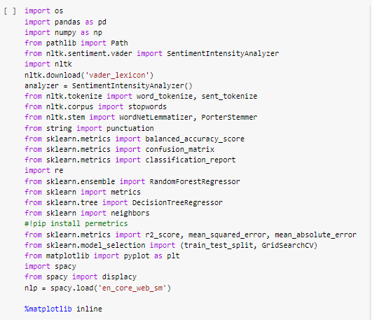
Libraries in use
We created a notebook on Google Collab.
Imported the following libraries
Pandas
Numpy
NLTK
SKLearn
Matplotlib
Spacy

Slide 5
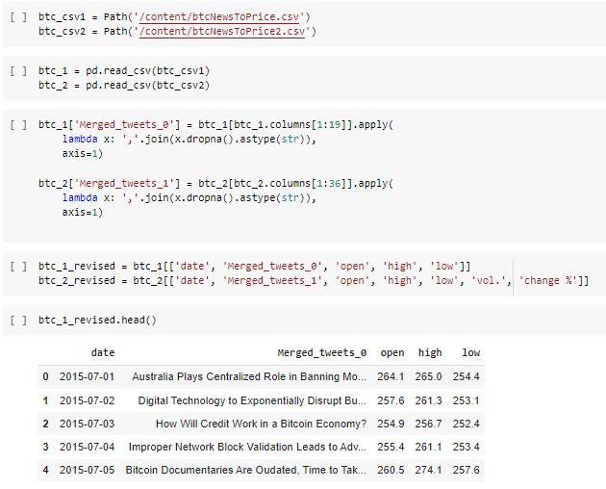
Data clean up
Actions taken include
Read csv
Merged tweets using lambda function
Renamed columns
Output was two btc_revised dataframes

Slide 6
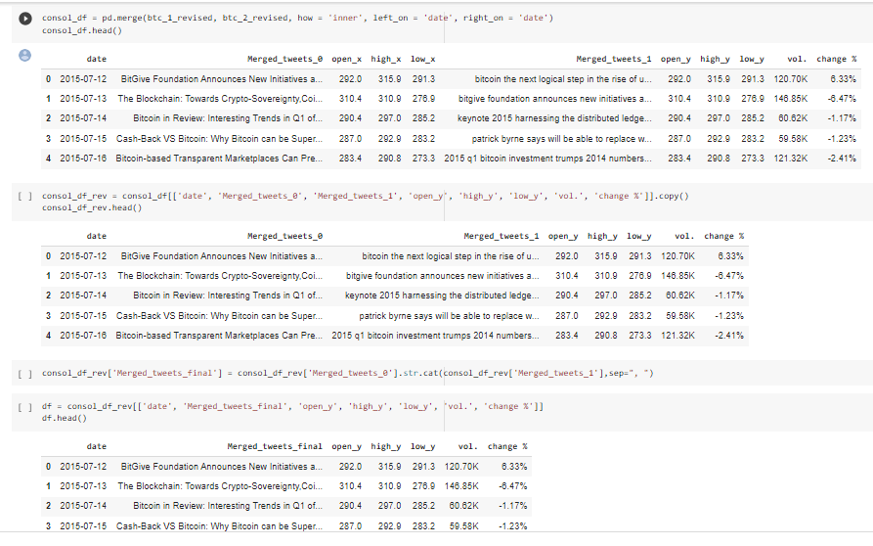
Data clean up
Merged dataframes
Checked for nulls and duplicates
Dropped columns
Output was a final dataframe ‘df’

Slide 7
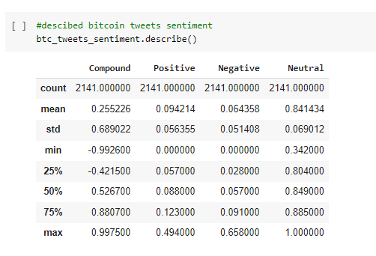
Sentiment analysis
We ran Sentiment analysis on the final dataframe with result as follows;
Generally positive sentiment about Bitcoin on average
Standard deviation, min, max numbers shows the high volatility characteristic of Bitcoin itself.

Slide 8
Model used & motivation – Random forest regressor model
Tree based algorithm that samples data and builds several smaller decision trees which combined create a strong classifier (ensemble learning).
RFR is very robust against overfitting and can be used with various types of data.
Used to rank importance of input variables in a natural way
Can handle thousands of input variables without variable deletion
Robust to outliers and non-linear data
Can be used on large databases.

Slide 9
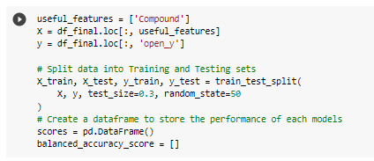
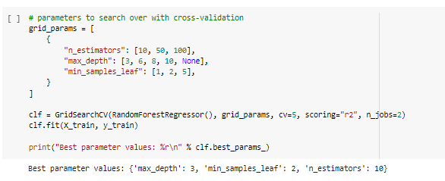
model summary
Outlined useful features in the cleaned-up data
Split into Training and Testing sets
Created a dataframe to store model performance
Determined best parameters for the ML model using defined function
Fit data into model
Make predictions

Slide 10
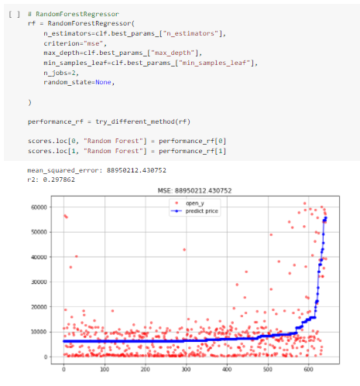
Model evaluation
We evaluated this model performance using the balanced accuracy score and mean squared error.
The accuracy score of 0.29 shows that the model is 30% accurate at predicting the price of Bitcoin. We believe this is due to limited data.
Though based on the research, it was found out that in many cases despite the lower r2 score the model performance was still considered good.

Slide 11
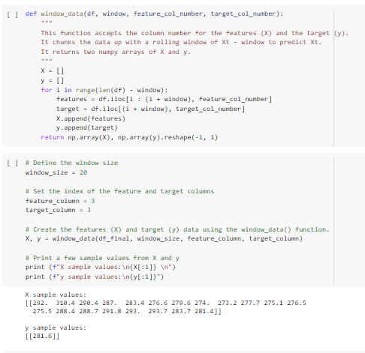
Model 2 – LSTM- RNN (Long short-term memory Recurrent Neural network)
Deep learning model, also very good at modelling sequence data.
Intention is to compare with Random Forest Regressor Model for accuracy in predicting Bitcoin
STEPS INVOLVED
Window size = 20
Train, test and split
Scale Data using MinMaxScaler
Reshape data features
Compiled Sequential model +dropout
Fit model into training data
Make predictions

Slide 12
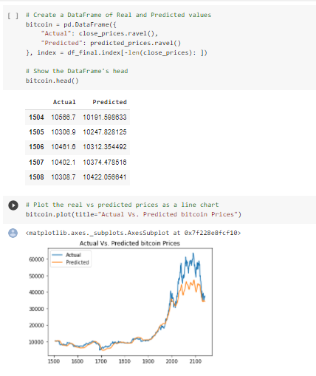

Model 2 evaluation
We evaluated this model performance using the mean squared error below
The score of 0.006 shows that the model error is very low which is good.

Slide 13
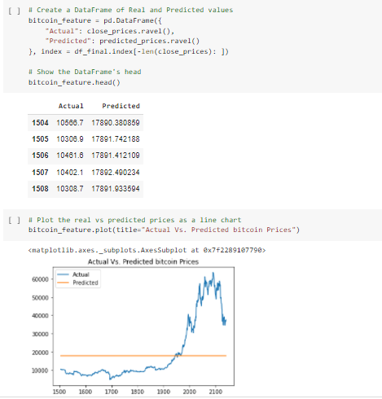

Model 2 evaluation
We also attempted to improve the performance of this model by reducing the number of feature column. Number of layers and dropout was retained.
Result : Mean squared error increased to 0.08 and predictions flattened.

Slide 14
Discussion
We were able to get good directionality from both models. However, while lower mean square error and better mirroring of the movement of actual bitcoin price was evident with the LSTM RNN model, the team believes the Random Forest Regressor model performed better in predicting the price of Bitcoin vis-à-vis the actual numbers.

Slide 15
postmortem
Deciding on the direction of this project took several takes.
Other issues encountered include:
In Deep neural network model when Compound rate was taken as its features, yielded completely wrong values, but worked great when Close price was taken as its feature

Slide 16

word cloud

Slide 17
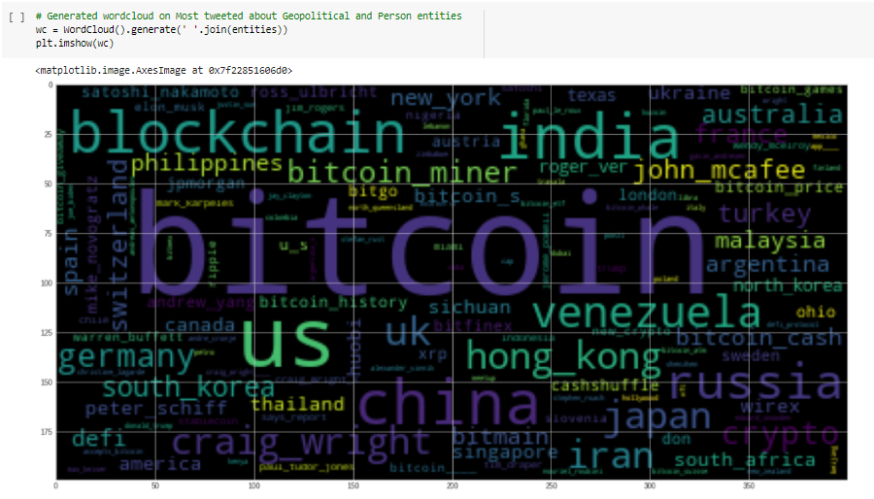
word cloud – Geopolitical entities

Slide 18
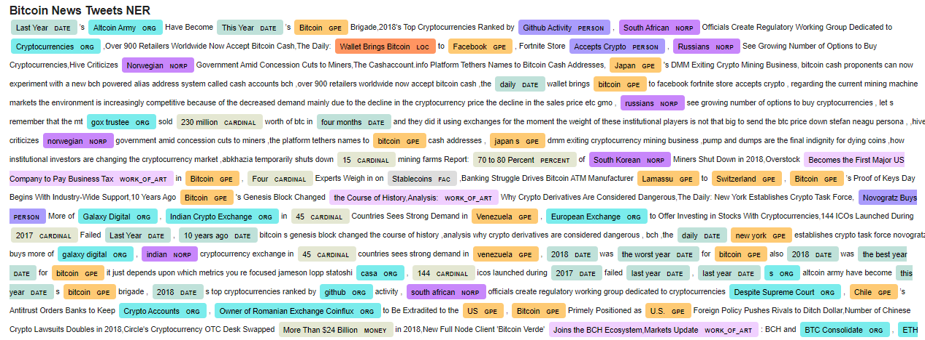
NER

Slide 19
questions

