Slide 1
Designing a Beam Under "Messy" Physics
ME 323 Module 1 — Lecture 1
Design a 3D-printed I-beam that carries the most load per gram. Here, “messy” means uncertain properties, interacting failure modes, and test-to-test variation.

Slide 2
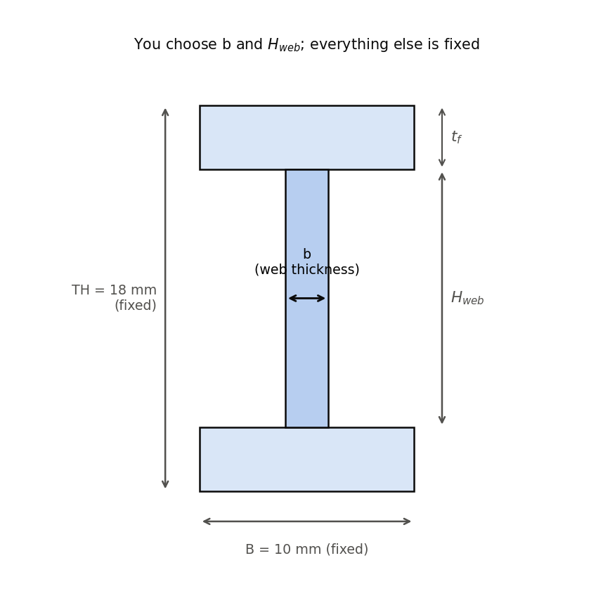
The challenge
• Fixed: total height 18 mm, flange width 10 mm, test span 150 mm, printed length 172 mm, PLA.
• You choose: web thickness b and web height H_web (which sets flange thickness).
• Goal: maximize strength-to-weight.
• Constraint you can't dodge: each print-and-test is slow and expensive, so you must make decisions with limited data.

Slide 3
The challenge

Slide 4
Why this is hard
Three things stand between you and a clean optimization:
Printed beams can fracture along the layer lines: the flange peels off the web at a printed interface whose strength appears in no handbook.
Lateral-torsional buckling depends on the fixture, not just the beam.
The failure modes overlap. Real beams fail in mixed, progressive ways.
Material properties and measured strengths vary from print to print and test to test.

Slide 5
Three modeled capacity branches
Bending: the beam yields in flexure.
Flange–web separation: shear at the printed junction exceeds the layer-line bond strength.
Lateral-torsional buckling (LTB): the beam tips over sideways.
The class model takes the minimum of these three capacities. Its governing-mode label is a prediction, not proof of the observed fracture mechanism.
The model is incomplete: modes can interact, other mechanisms may contribute, and tests vary.

Slide 6
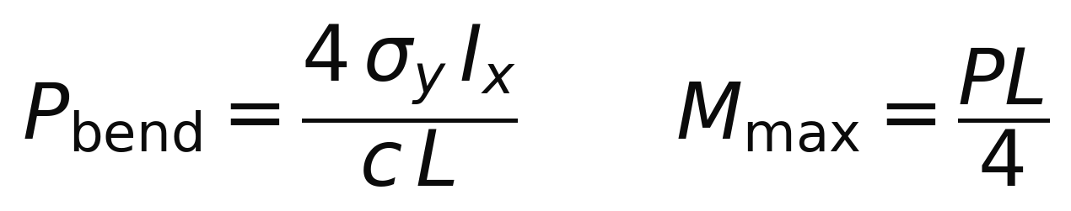
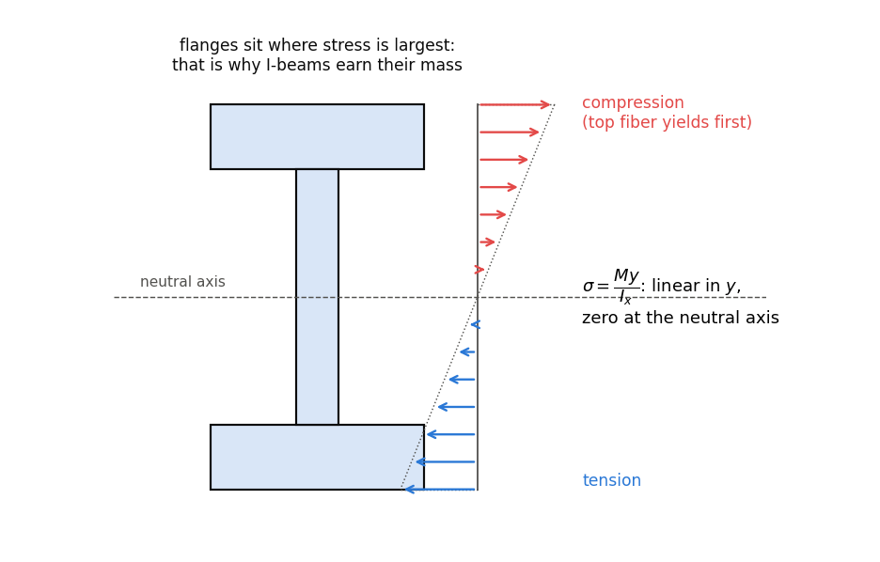
Bending

Slide 7
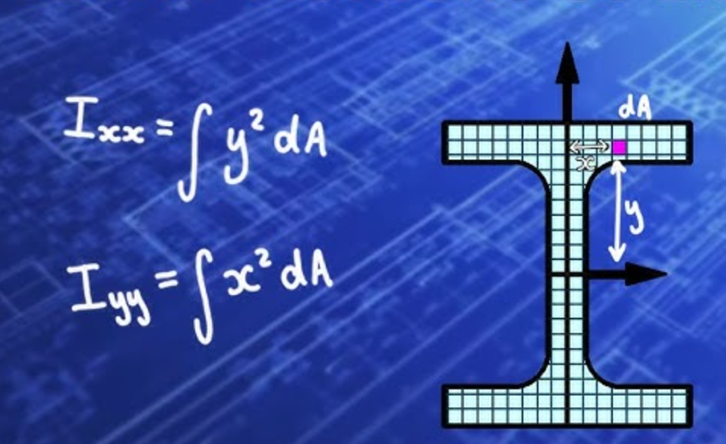
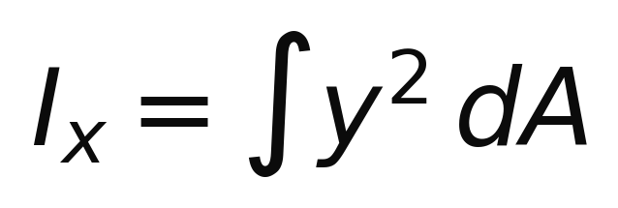
Why I-beams work
Bending strength is carried by I_x, and I_x counts each bit of area by the square of its distance from the neutral axis.
Material at the edges earns its mass; material near the center barely helps.
So put the mass in flanges far out, top and bottom. The web holds them apart (sets the lever arm) and carries the shear.
Maximize I_x per gram: that is the strength-to-weight game this module plays.

Slide 8
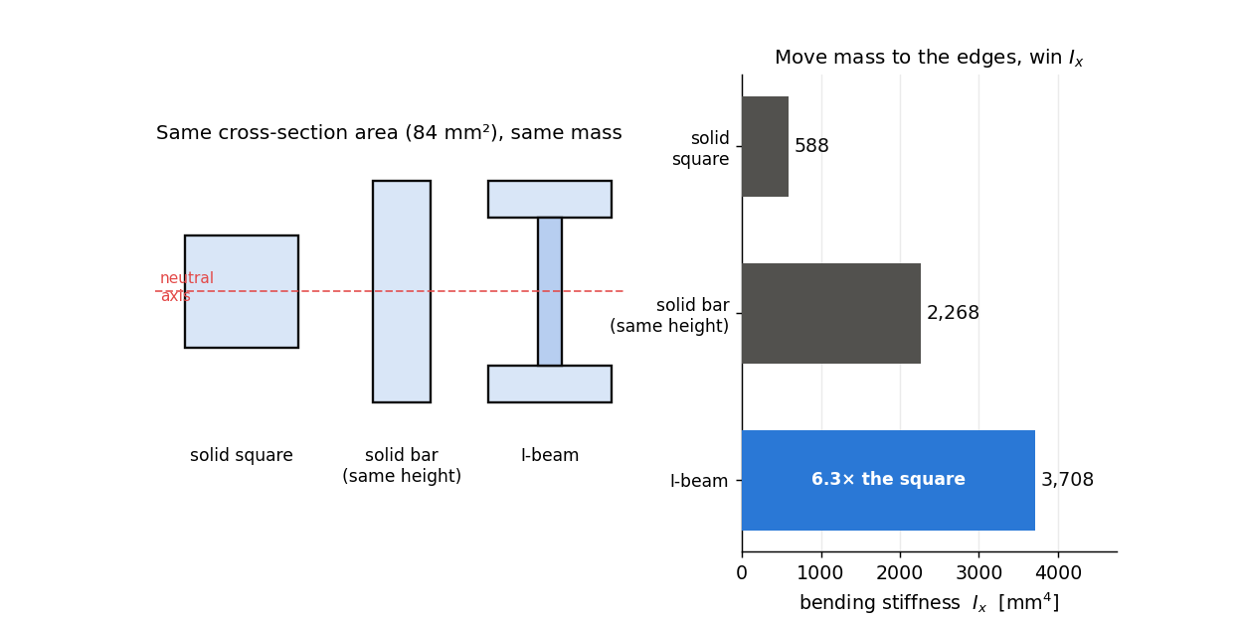
Same mass, more stiffness
Three sections of equal area. Relocating the same material to the flanges multiplies I_x.
Even against a solid bar of the same height, the I-beam wins: its mass sits at the extreme fibers.

Slide 9
The catch
The I-beam logic says: thinner web, taller section, mass pushed outward.
Push too far and you get the other two modes:
a thin, short web can overload the printed flange–web junction;
a tall, narrow section can tip over (LTB) before it yields.
The efficient shape and the failure modes pull against each other. The design problem is to balance that tradeoff while accounting for uncertain model parameters and test variability.

Slide 10

One shear equation; choose the plane you want to check
V — internal shear force at the beam section. In either half of our three-point-bend span, V = P/2.
Iₓ — second moment of area of the entire cross-section about the neutral axis.
Q — first moment of the area above (or below) the horizontal plane being checked.
t — width of material along that plane.
Change the plane → Q and t change. The highest-stress plane need not be the weakest plane.
Notes:
[Sources]
- Internal course source: ME323_Lecture1_slides.md, beam-shear sequence.
- Standard relation already present in the source deck: τ = VQ/(Iₓt).

Slide 11
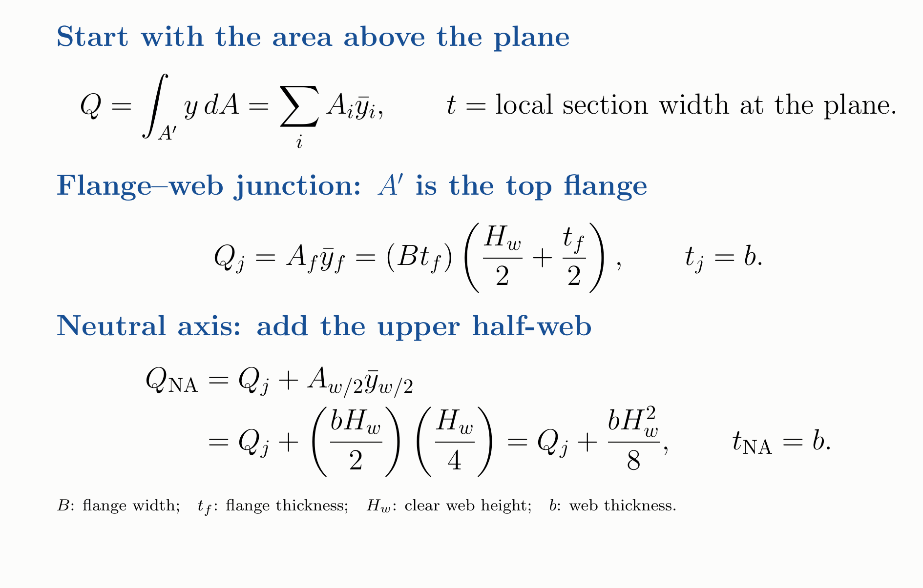
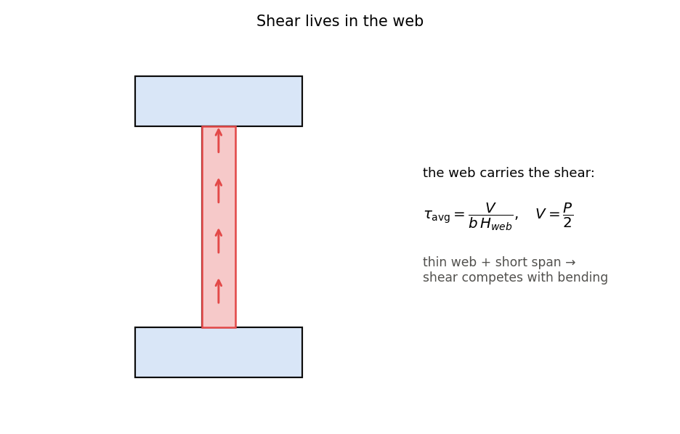
Q comes from area; t comes from the cut width
Same cut width, different area: both planes cut through the web, but Q changes because the area above the plane changes.
Example (b, Hweb) = (2, 12 mm): tf is 3 mm. The formulas give a junction Q of 225 mm³ and neutral-axis Q of 261 mm³ with a 2 mm cut width. Junction stress is 0.862 times the neutral-axis stress (14% lower).
Notes:
[Sources]
- Internal formula source: ME323_Module1_Submission1_Design_student.ipynb.
- Geometry assumption: symmetric rectangular I-section with equal flanges, clear web height Hweb, and flange thickness tf=(18-Hweb)/2.
- Derivation: Q=integral(y dA)=sum(A_i ybar_i) over the area above the checked plane; t is the local width intersected by that plane.
- Independent check for (b,Hweb)=(2,12 mm): tf=3 mm, Q_junction=225 mm^3, Q_NA=261 mm^3, t=2 mm, and Q_junction/Q_NA=0.8621.

Slide 12
What the separation check assumes
Stress model: evaluate the beam-shear equation at the printed flange–web junction.
Strength model: τᵢ is the bond strength along the printed layer lines—not the bulk-plastic strength. No handbook gives this joint property.
Pre-lab calibration: start from the bulk shear-yield estimate of 43.9 MPa, then infer τᵢ from the beam tests. This campaign lands near 18 MPa; print session and support condition can move it.
Claim boundary: this check predicts a capacity trend for one candidate plane. It does not diagnose a fracture mechanism from a force–displacement trace, and real failures can mix modes.
Notes:
[Sources]
- Internal course source: ME323_Lecture1_slides.md.
- Campaign interface-strength statement is a calibrated class-model result, not a transferable material constant.

Slide 13
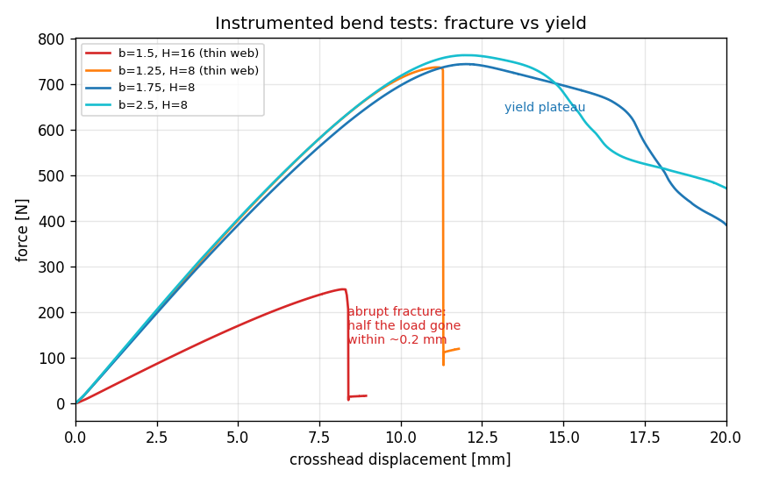
Trace shape tells you when load was lost—not why
Thin webs can lose load abruptly; thicker webs can plateau or shed load gradually.
Claim boundary: the curve describes the timing and style of load loss. Mechanism requires specimen and fixture observations too.
Notes:
[Sources]
- Internal figure: figures/fig_brittle_traces.png.
- Claim boundary checked against student_traces_4beams.csv and recorded fixture/specimen notes.

Slide 14

LTB starts from an elastic critical moment
Mcr — elastic moment at which the idealized beam becomes laterally unstable.
E — Young’s modulus; Iy — weak-axis second moment of area.
Lb — effective unbraced length; zg — load height measured from the shear center.
C1 and C2 — dimensionless coefficients for the moment diagram and load-height effect.
This predicts an elastic instability of an idealized beam; it is not an observed fracture label.
Notes:
[Sources]
- Internal governing equation: ME323_Module1_Prelab1_FailureModes_KEY.ipynb, P_LTB implementation.
- Mcr is used as an elastic critical moment under the stated LTB idealizations.

Slide 15

Every term under the root is a squared length
Cw / Iy — warping length scale; Cw has units m⁶ and Iy has units m⁴.
Torsion term — combines effective length, shear modulus G, and St. Venant torsional constant J.
Load-height term — top-flange loading is destabilizing because its contribution is subtracted after the square root.
Dimensional check: R is in m², the bracket in the critical-moment equation is in m, and Mcr is in N·m.
Course values: E = 2.50 GPa, G = 0.962 GPa, C1 = 1.35, and C2 = 0.55.
Notes:
[Sources]
- Internal governing equation: ME323_Module1_Prelab1_FailureModes_KEY.ipynb, R and Mcr definitions.
- Dimensional check: all three R terms have units of length squared.

Slide 16
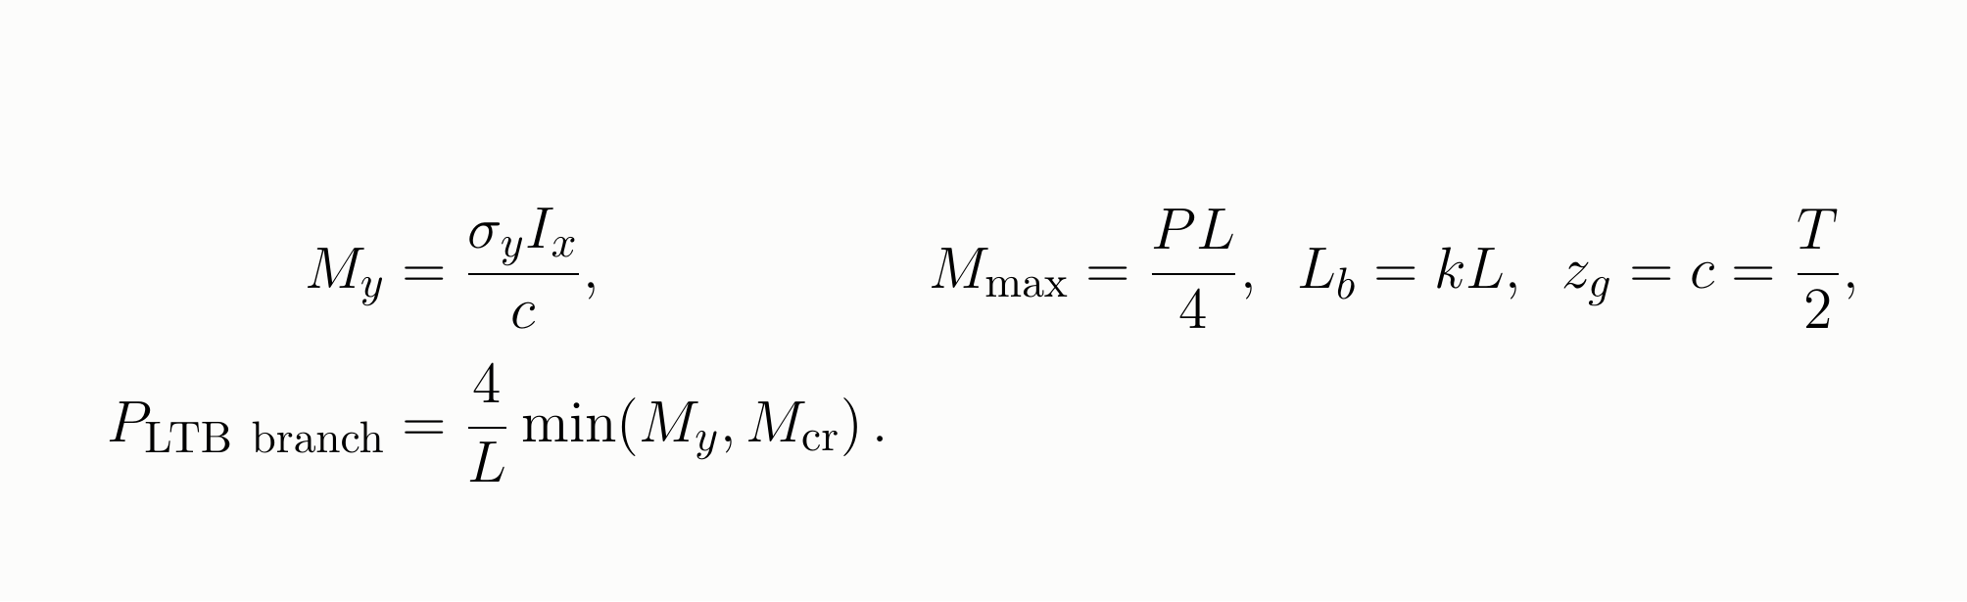
The course converts moment to load—and caps at yield
σy — effective flexural yield strength; Ix — strong-axis second moment; c — neutral axis to the outer surface.
P — center load; L = 150 mm — support span. The moment relation assumes simply supported three-point bending.
k sets effective length. For top-surface loading, zg = c = T/2 = 9 mm.
The minimum is a pragmatic yield cap used by the class model—not a full inelastic-buckling theory.
Notes:
[Sources]
- Internal governing equation: ME323_Module1_Prelab1_FailureModes_KEY.ipynb, P_LTB implementation.
- The min(My,Mcr) operation is a course-model yield cap, not a derived inelastic-buckling solution.

Slide 17
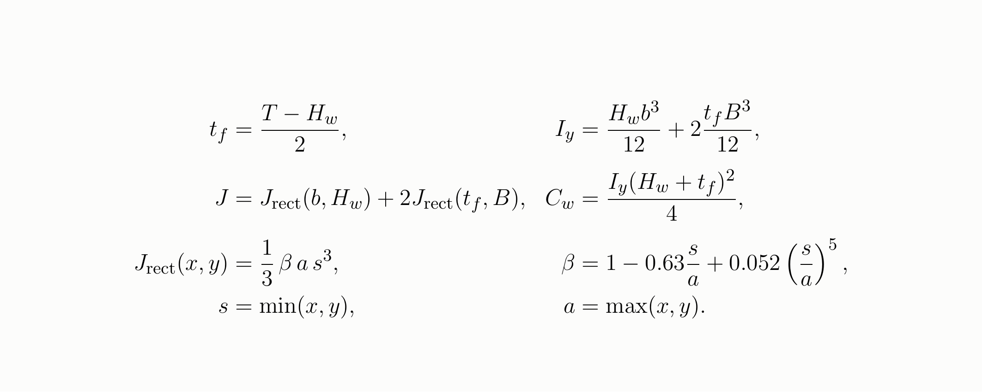
Section geometry supplies Iy, J, and Cw
Geometry: b and Hw are design variables; flange width B = 10 mm and total height T = 18 mm are fixed.
Properties: Iy is weak-axis bending resistance, J is St. Venant torsion, and Cw is the warping constant.
Units: the code converts every dimension from mm to m before returning Iy and J in m⁴ and Cw in m⁶.
The rectangular β correction is retained for finite aspect ratio; interpretation is yours, while derivation remains background.
Notes:
[Sources]
- Internal geometry source: run13_build_student_notebooks.py, section_props.
- J_rect uses the finite-aspect-ratio beta correction implemented in the student notebook.

Slide 18
The LTB equation is conditional on five idealizations
Section geometry: open, doubly symmetric, and thin-walled. The torsion approximation is least credible for the thickest webs.
Elastic stability: linear material, initially straight beam, and no residual stress; printed parts violate all three.
Warping and supports: end restraint is compressed into fitted k rather than modeled from the fixture geometry.
Material: isotropic E and G. Printed PLA is layered and direction-dependent; the model uses E = 2.50 GPa and G = 0.962 GPa.
Loading: central top-flange load represented by fixed C1, C2, and zg.
Consequence: the LTB branch is a fixture-conditional capacity proxy with model uncertainty.
Notes:
[Sources]
- Internal model source: ME323_Module1_Prelab1_FailureModes_KEY.ipynb.
- The slide states the closed-form LTB branch assumptions and its fixture/material claim ceiling.

Slide 19
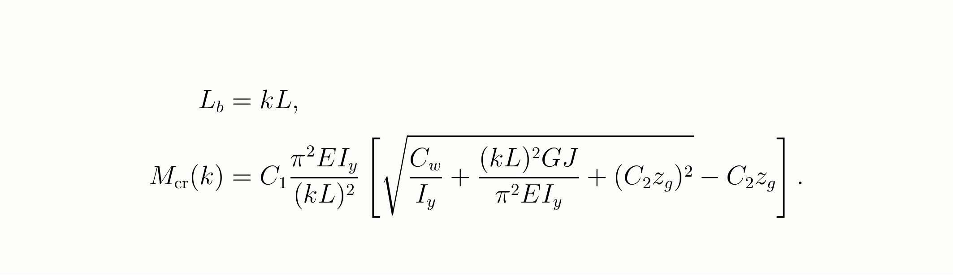
k changes effective length—and enters Mcr twice
k is a dimensionless effective-length factor for the fixture; lower k means stronger restraint.
Handbook starting value: 0.33. Fifteen-beam class fit: 0.377.
Not a pure inverse-square law: kL also appears inside the square root.
At the equation design, changing k from 0.33 to 0.377 lowers elastic Mcr from 28.6 to 23.1 N·m; the yield moment is 23.3 N·m.
Because k absorbs fixture behavior and omitted physics, it does not transfer automatically to another test setup.
Notes:
[Sources]
- Internal model source: ME323_Module1_Prelab1_FailureModes_KEY.ipynb.
- Independent equation-design check: Mcr=28.64 N m at k=0.33, Mcr=23.14 N m at k=0.377, My=23.28 N m.

Slide 20
What you must understand about the LTB branch
Recognize the mode: tall, thin sections can roll sideways and twist before flexural yield.
Read the design variables: decreasing web thickness b and increasing clear web height Hw can make LTB more competitive.
Interpret k physically: it summarizes effective restraint and is fixture-specific.
Separate quantities: Mcr is an elastic moment; the course LTB branch converts it to load and applies a yield cap.
Read margins: a near-tie between branches makes the single governing label fragile.
Background, not assigned: deriving Iy, J, Cw, or the C1/C2 closed form.
Notes:
[Sources]
- Internal course scope: ME323_Lecture1_slides.md and Pre-lab 1 student/KEY notebooks.

Slide 21
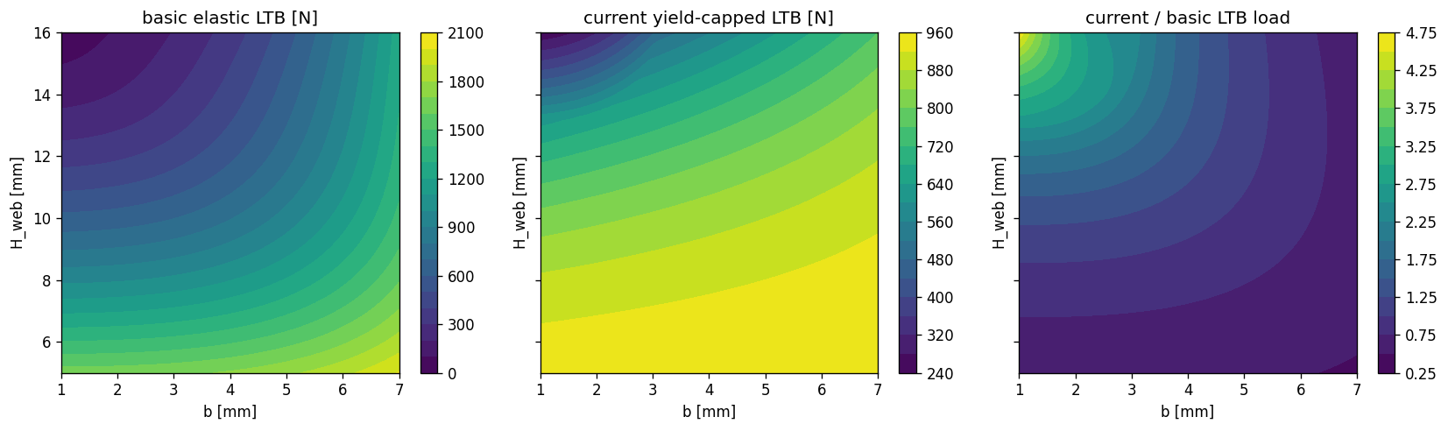
Model choices reshape the LTB branch
Axes: b is web thickness and Hw is clear web height, both in mm.
Left: stripped-down elastic LTB. Center: current yield-capped class branch. Right: current divided by basic.
The correction is design-dependent; it cannot be replaced by one constant scale factor.
Notes:
[Sources]
- Internal current output extracted from ME323_Module1_Prelab1_FailureModes_KEY.ipynb, basic-versus-current LTB comparison.

Slide 22
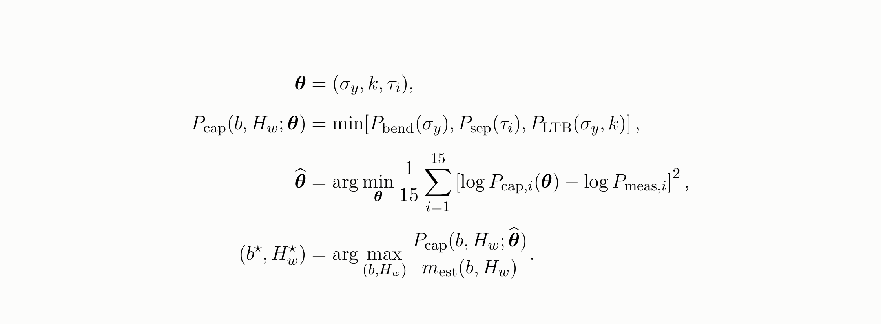
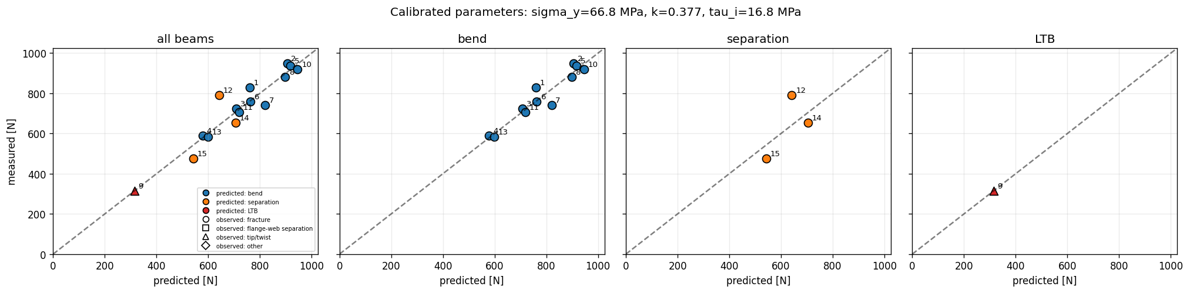
The parity plot is an in-sample diagnostic
How to read it: x is predicted load, y is measured load, and the dashed line is equality.
Color encodes the predicted branch; marker shape encodes the observed specimen or fixture note class.
Fitted parameters: σy = 66.83 MPa, k = 0.377, and τi = 16.76 MPa.
Claim ceiling: the same 15 beams set the parameters and appear in the plot. This shows fitted capacity, not held-out generalization.
Notes:
[Sources]
- Internal current output extracted from ME323_Module1_Prelab1_FailureModes_KEY.ipynb, calibrated 15-beam diagnostic.
- This is an in-sample post-calibration plot, not held-out validation.

Slide 23
Calibrate parameters first; then freeze them for design
Parameters: σy controls bending and the yield cap, k controls effective length, and τi controls interface separation.
The 15-beam fit gives 66.83 MPa, 0.377, and 16.76 MPa. This same-data fit is not a held-out score.
With those values frozen, the 0.05 mm grid search returns b = 1.10 mm and Hw = 13.25 mm at 48.7 N/g predicted strength-to-estimated-mass.
Notes:
[Sources]
- Internal current values: run13_build_student_notebooks.py and ME323_Module1_Prelab1_FailureModes_KEY.ipynb.
- Calibration objective is mean squared log-capacity error over 15 beams; design search uses frozen fitted parameters on a 0.05 mm grid.

Slide 24
The physics model is useful because its limits are explicit
It does provide a capacity estimate and a dominant-branch proxy for each design.
It does not provide a unique fracture diagnosis from a force–displacement trace.
Its calibration is conditional on this fixture, print campaign, and 15-beam dataset.
Its labels are least stable near intersections of capacity branches—the region an optimizer often favors.
Next lecture: model the remaining discrepancy and uncertainty with a Gaussian Process; do not erase the physics.
Notes:
[Sources]
- Internal claim boundaries synthesized from the preceding equations, calibration diagnostic, and recorded failure notes.

Slide 25
The module adds evidence one decision at a time
15 measured beams
calibrate the class physics
Equation query
(1.10, 13.25) 475.7 N
GP query
(1.00, 13.39) 445.8 N
Group design
preregister print + bend
Refit + redesign
add the real result ask what moved
→
→
→
→
one dataset, one new decision at a time
Beams 16 and 17: frozen model responses, not new physical tests.
Your group beam is the new print-and-bend observation. Physics structures the decision; the added test reveals discrepancy and changes the next model.
Notes:
[Sources]
- Internal frozen responses verified in ME323_Module1_Submission1_Design_student.ipynb: beam 16 = 475.7 N, beam 17 = 445.8 N.
- Those responses come from the frozen ground-truth model; only the group design is newly printed and tested.

Slide 26
Pre-lab 1: turn equations into a testable model
Notebook: ME323 Module 1 — Pre-lab 1, Failure Modes
reduce four force–displacement traces to strength, including the beam 9 fixture/twist event;
code and unit-check the bending, printed-junction separation, and yield-capped LTB branches;
treat 43.9 MPa as the starting bulk ceiling for τi—not a measured interface strength;
calibrate σy (effective flexural strength), k (fixture effective-length factor), and τi (printed-interface shear strength);
compare predicted and measured loads while keeping predicted branches separate from observed notes;
freeze the fitted parameters, then optimize predicted strength divided by estimated mass.
Bring one question about a variable, one about an assumption, and one about a mismatch.
Notes:
[Sources]
- Internal task and parameter contract: ME323_Module1_Prelab1_FailureModes_student.ipynb and KEY notebook.

