Slide 1
From Data to Decisions Under Uncertainty
ME 323 Module 1 — Lecture 2
A model that learns from sparse data and tells you how much it does not know. Flow and examples adapted from Prof. Bilionis's data-science lecturebook.

Slide 2
The equations overpredicted a strong beam
• The three calibrated capacity equations selected b = 1.10 mm, H_web = 13.25 mm and predicted 48.7 N/g.
• Ground-truth data from earlier tests gave 475.7 N = 37.48 N/g, about 23% below the equation prediction.
• All three modeled capacities tie within about 1% there, so the design sits on a mode boundary.
The equations found a strong beam, but overpredicted its performance. Today's tool adds a statement of confidence to the point estimate.

Slide 3
You already have most of this
From ME 239:
• Bayes' rule, Gaussian distribution
• Multivariate Gaussian and covariance
• Conditioning a Gaussian on data
New today, but only one step past 239:
• Gaussian Process; acquisition functions (Bayesian optimization)

Slide 4
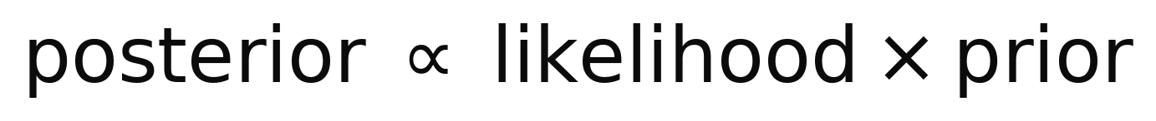
Bayes, in one line
You start with a belief about beam strength. You test a beam. You update the belief.
Prior: belief before the test. Likelihood: compatibility with the result. Posterior: belief after the test.
Carry a distribution over unknown beam strength, not a single guess.

Slide 5
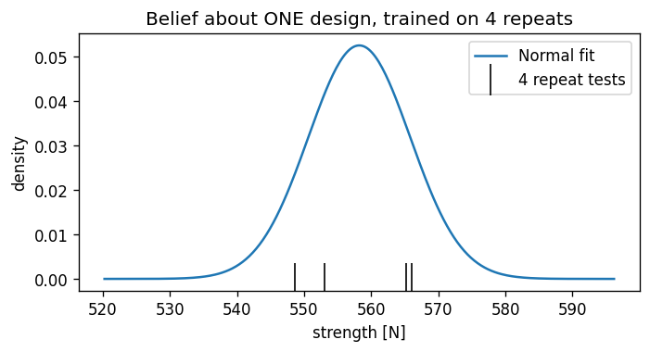
A Gaussian is a belief about one beam
Four repeat tests at one design give mean 558.2 N and fitted scatter 7.6 N, about 1.4%.
Pooled campaign repeats give about 4.4% with session/printer structure. The class uses 3% as a working assumption and checks its effect.

Slide 6
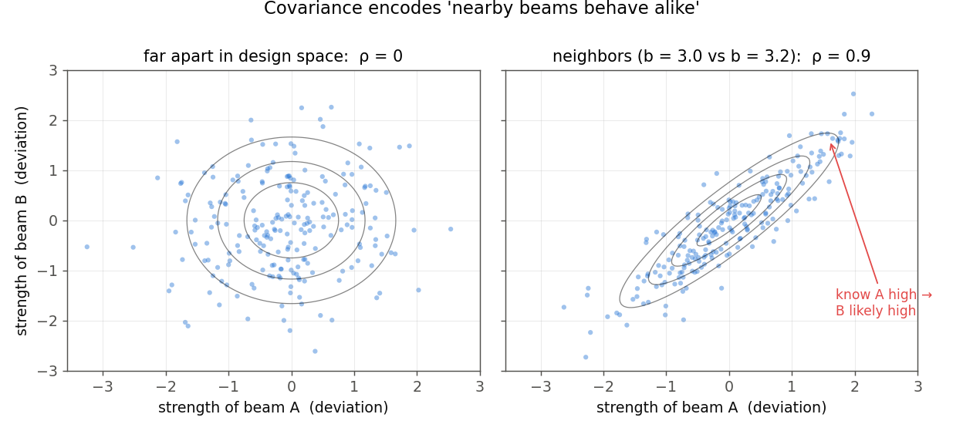
Two beams at once: covariance
Nearby designs share material, geometry, and physics, so their strengths move together.
The covariance matrix writes that down. This is the piece the GP is built on.

Slide 7
Conditioning: measure one, update the other
Measure beam A and the joint Gaussian conditions: belief about B shifts and tightens.
You did this algebra in ME 239. Everything today is this move, repeated. (animated in slideshow)

Slide 8
A GP links predictions across many designs
The same joint-Gaussian update can cover 2 designs or 120.
A kernel makes a test influence nearby designs more than distant ones. (animated in slideshow)

Slide 9
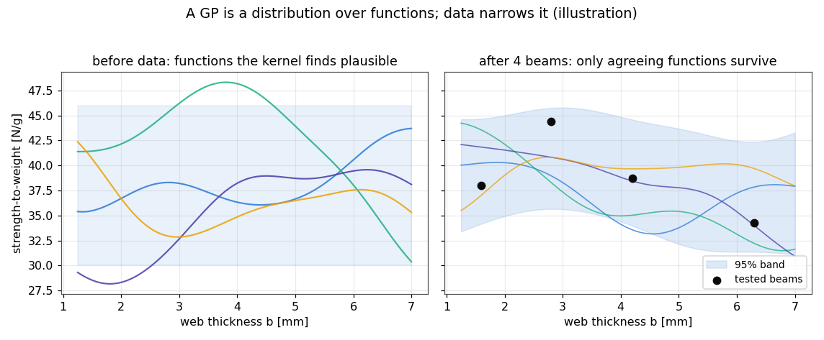
A Gaussian Process, before and after data
Before data the kernel proposes candidate curves; each test kills the ones that disagree.
The module models log(str/w): exp(mu_log) is the posterior median in N/g; the band is conditional uncertainty.

Slide 10
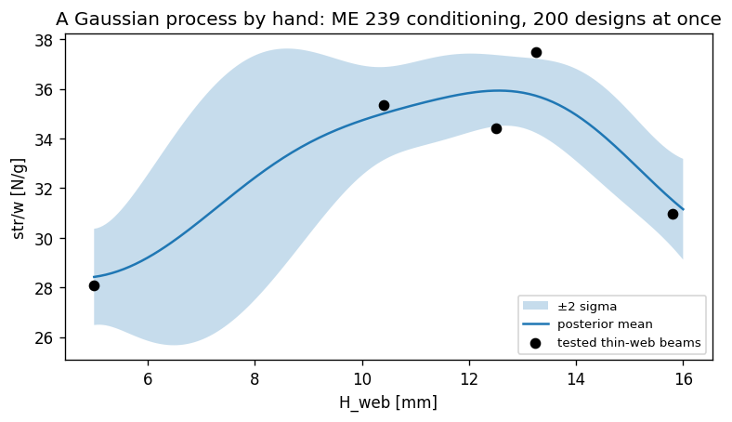
Each test reshapes nearby predictions
Current class-campaign data on a thin-web slice: the band narrows near tested beams.
The band stays wide where the model has less support.

Slide 11
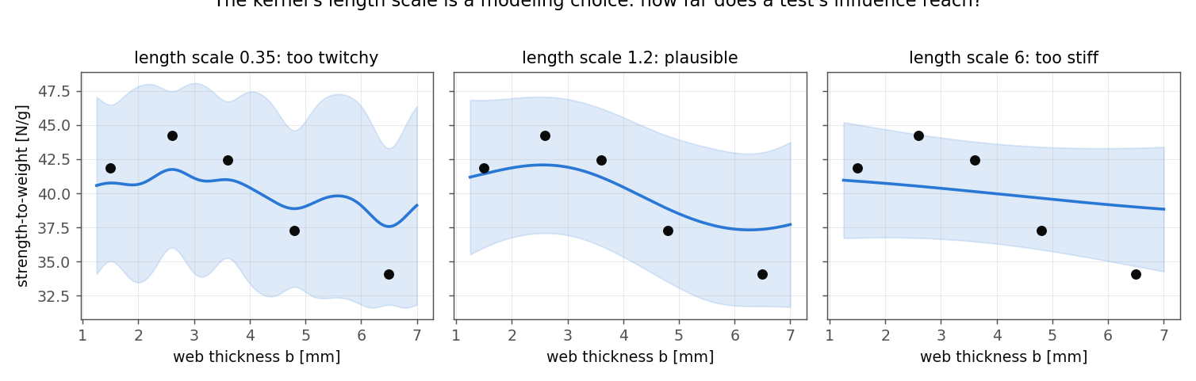
The kernel is a modeling choice
The length scale answers: how far does one test's influence reach?
No single right answer; there are defensible and indefensible ones.

Slide 12
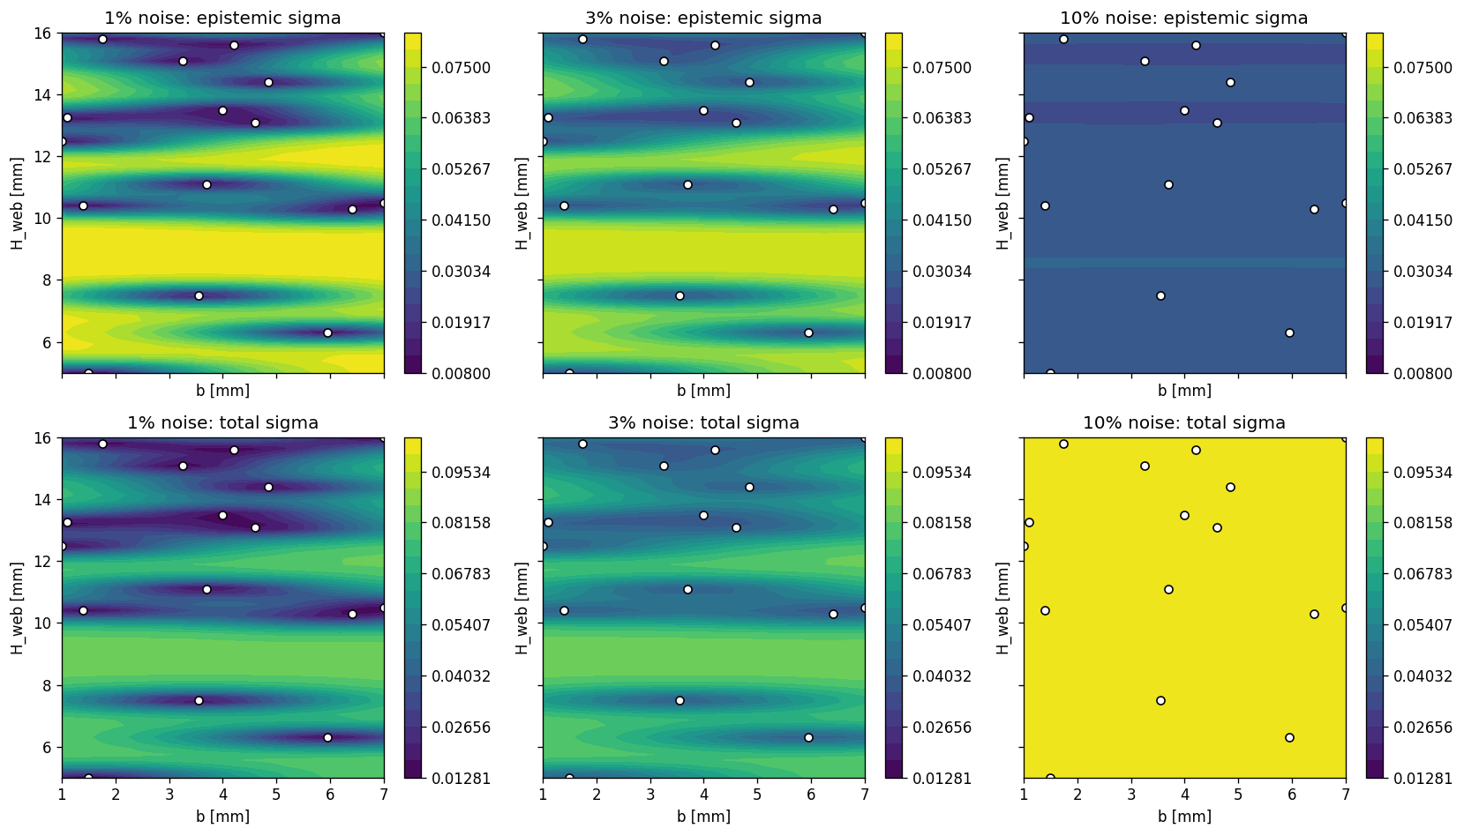
Noise changes both the fit and its uncertainty
Pre-lab 2 refits at 1%, 3%, and 10% using shared row-wise color scales.
The 1% fit recommends (1.58, 14.88); the 3% and 10% fits recommend (1.00, 13.39).

Slide 13
Epistemic and aleatory uncertainty do different jobs
• Epistemic: uncertainty about the underlying average trend because tests are sparse. An informative new beam can reduce it.
• Aleatory: print-to-print and test-to-test scatter at one nominal design. Testing another location does not remove it.
• For one future observation in log space: sigma_total = sqrt(sigma_epi^2 + r^2), with r = 0.03.
MUI and EI use epistemic sigma because they value learnable uncertainty. A reliability bound for one future printed beam uses total sigma.

Slide 14
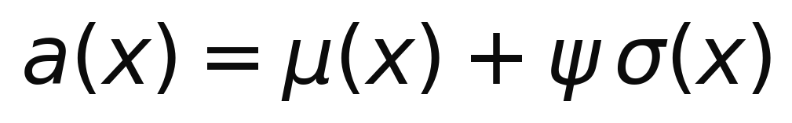
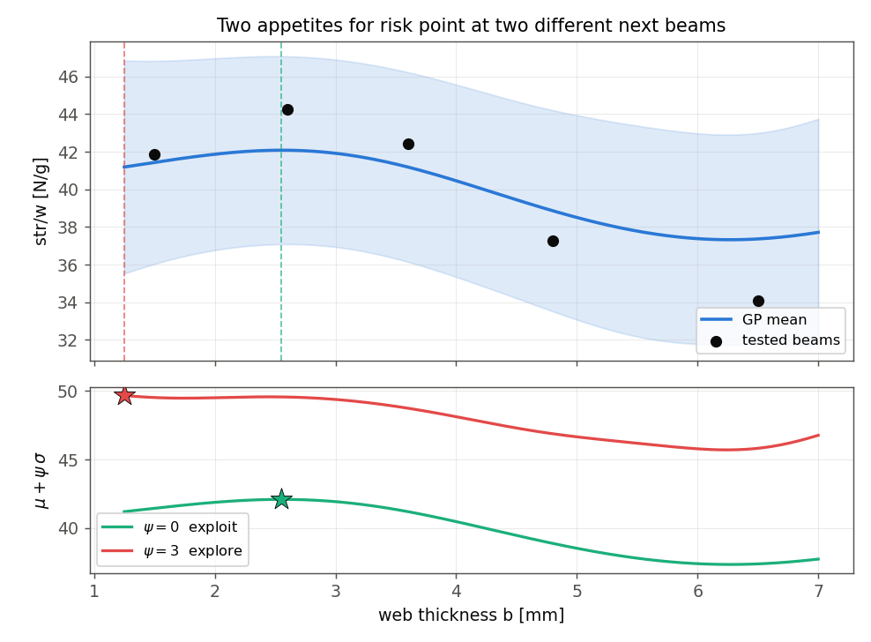
One dial balances performance and uncertainty
a(x): acquisition-function score; mu(x): predicted log(str/w); sigma(x): epistemic uncertainty; psi: how strongly uncertainty affects the choice.

Slide 15
The loop: Bayesian optimization
Fit, evaluate the acquisition function, choose the design with the highest score, test, and refit.
Seven tests, no gradient, no formula for the dip. (animated in slideshow)

Slide 16
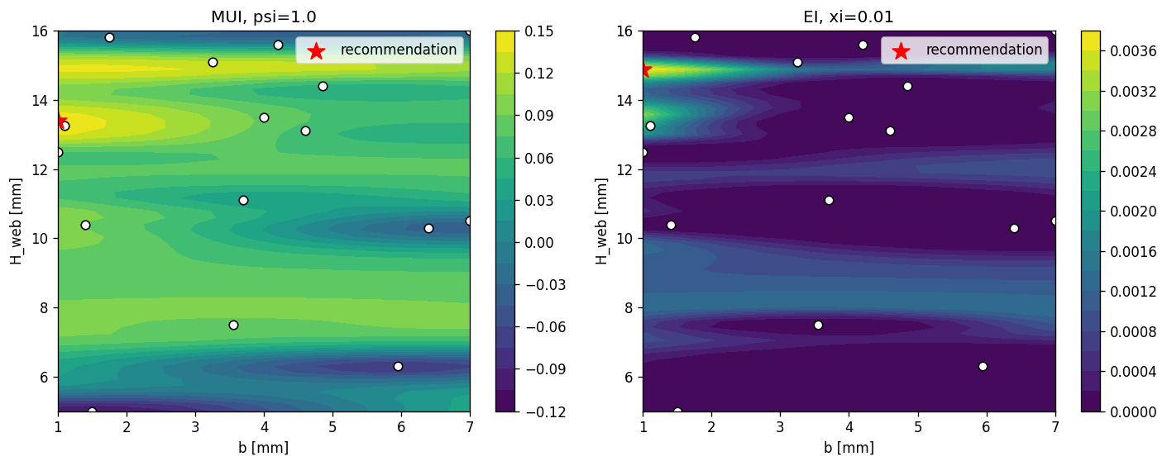
EI weighs the chance and size of a win
EI asks how much a new test would beat the best tested beam so far, on average.
Increasing xi often favors less-certain regions, but does not guarantee a more exploratory recommendation.

Slide 17
Zoom out: spending a test budget
Each print-and-test costs a machine slot, a test engineer hour, and days of queue. The class gets two pieces of ground-truth data from earlier tests through the frozen staff model, and each group gets one real print.
Optimal experimental design is the batch version of the acquisition question: given N tests, which set teaches the most or finds the best fastest?
Choosing the next test is the engineering decision.

Slide 18
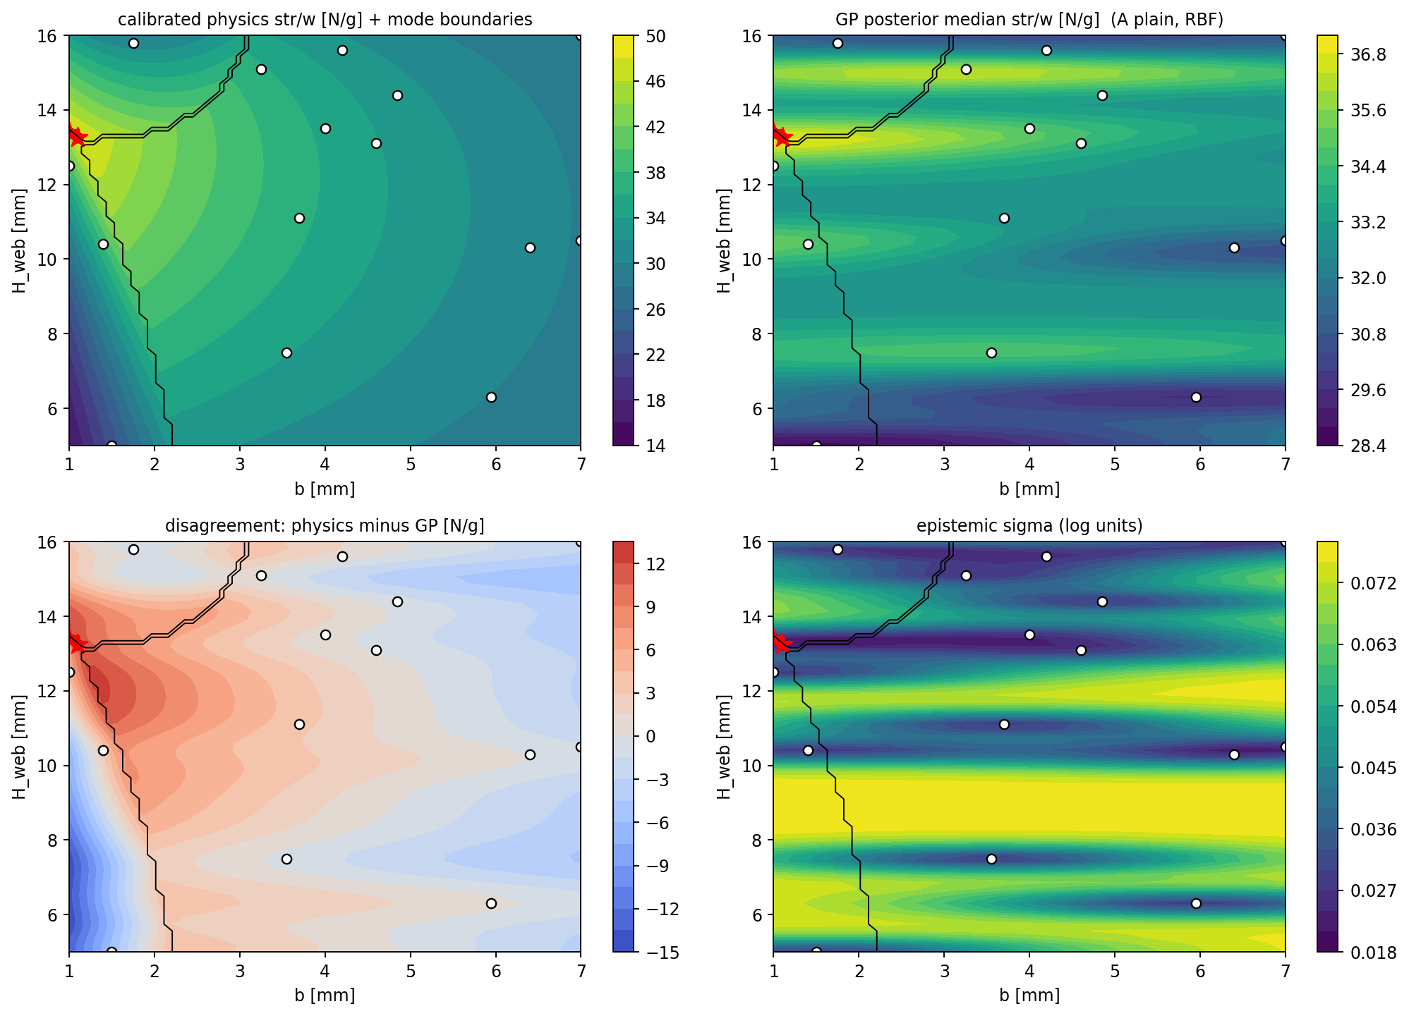
Physics-informed GP: the two tracks meet
A vanilla GP sees geometry only. A physics-informed GP can also receive signals from the calibrated capacity equations.
Submission 1 compares both approaches rather than assuming either one must win.

Slide 19
Decide first; run sensitivity checks afterward
You will meet six modeling "knobs" in Submission 1. Do not treat them as six equal choices.
• Students decide: how physics enters the model and the risk posture — how predicted performance and uncertainty affect the choice.
• Students check afterward: kernel, noise, and target-scale sensitivity.
If reasonable assumptions move the recommendation, report that instability. If they point to the same neighborhood, report local robustness. An unstable result can justify using a test to reduce uncertainty.

Slide 20
First compare what physics and the GP predict
The top row compares calibrated physics and the GP posterior median on the same design axes.

Slide 21
Then inspect disagreement and epistemic uncertainty
The bottom row shows where the models disagree and where epistemic uncertainty remains large.

Slide 22
The activity from here
• Pre-lab 2: fit the GP, write MUI (and EI), work the noise assumption, find the GP-recommended beam.
• Two class results: add ground-truth data from earlier tests for the equation design and the GP design — the same two beams for everyone.
• Submission 1: combine physics, GP, and the two new points; pick the beam you will print; defend it in the memo.
• Print, test, reflect, redesign: Submission 2 folds your own test result back into the model and asks what it changes.

Slide 23
Before next time: Pre-lab 2
In ME323_Module1_Prelab2_ML:
• warm up by rebuilding the GP from ME 239's Normal-fit in four small steps (fit one Normal, covariance, conditioning, many beams at once),
• compare vanilla GP setups and read posterior median, epistemic uncertainty, and total predictive uncertainty,
• write both MUI and EI,
• refit under 1% / 3% / 10% noise and note what moves,
• record the locked class design: b = 1.00 mm, H_web = 13.39 mm, posterior median 36.7 N/g.
That beam is the class's second ground-truth data point from earlier tests. Bring your rationale, not just the number.

