Slide 1



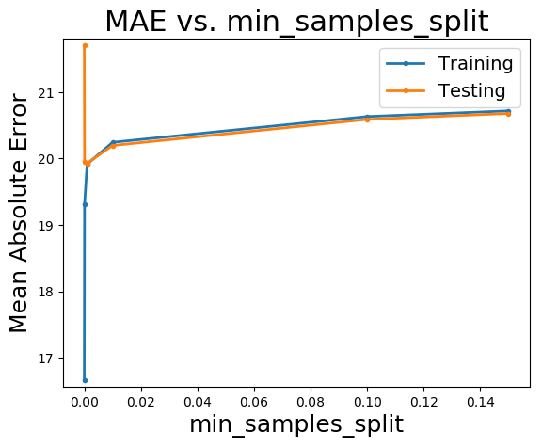
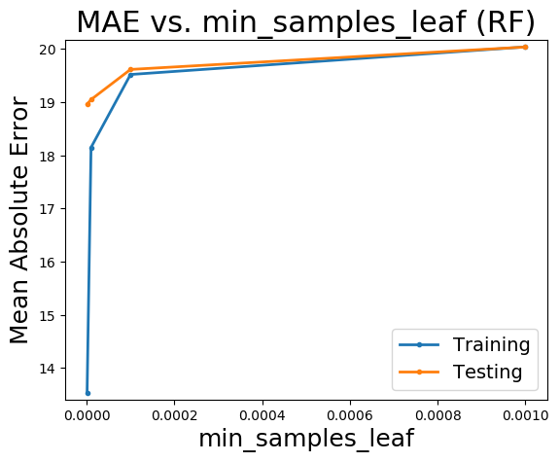


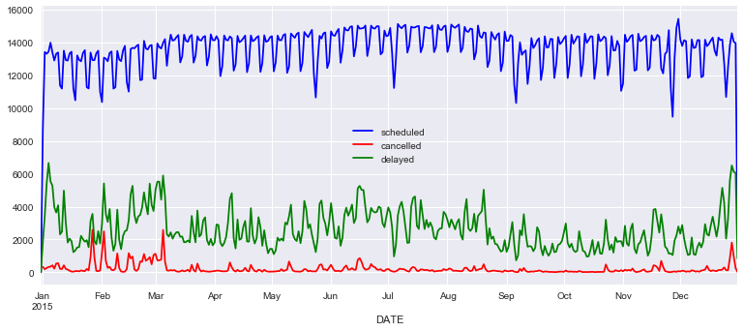

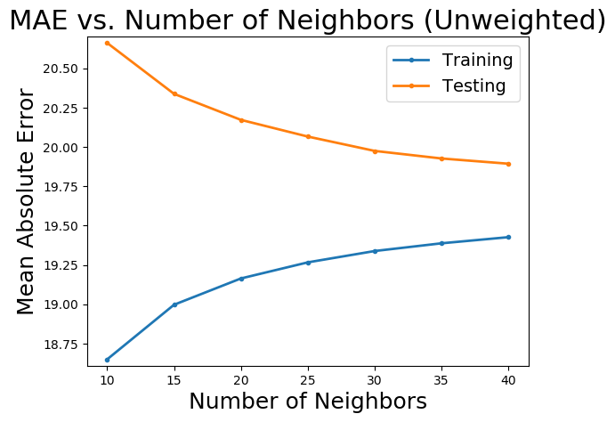
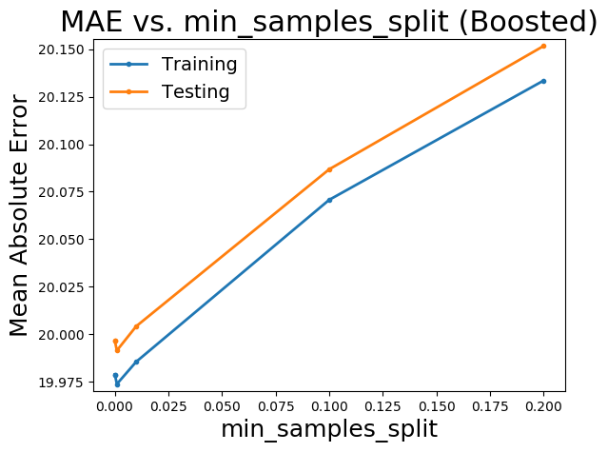
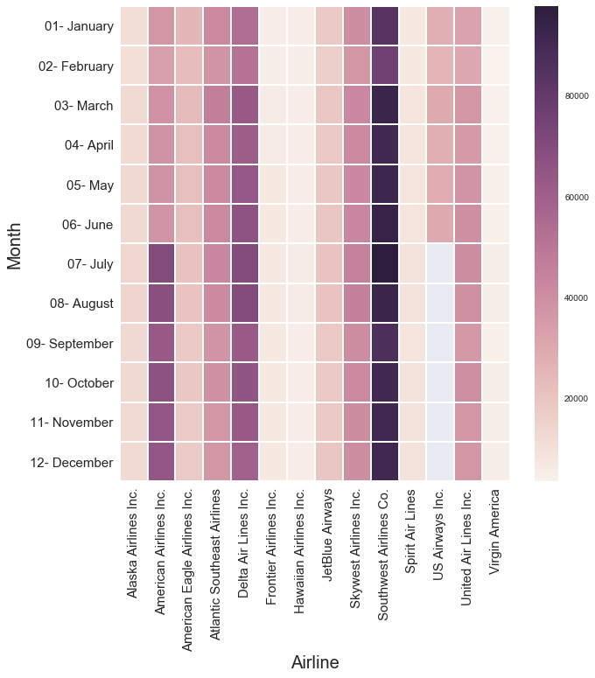
Predicting Flight Delays and Cancellations
with Machine Learning
Andrew Wang, David Kawashima, Steven Brotz
CS 141: Hack Society
Dataset Specifications
Cancellation Classification
Arrival +/- Delay Regression
5,819,079 domestic flights from 2015
Final set of features:
Time: month, day of week, day of year, departure/arrival hour
Flight specifics: airline, origin/destination airport, distance of flight(miles)
Weather: temperature, dew point, humidity, wind speed, precipitation, altitude, visibility, sky forecast
Airplane model: certificate date of airplane, model of airplane, manufacturer
Top 5 Most Cancelled By Airport, Airline
Origin Airports: SUN (8.88%), ASE (7.63%), MKG (6.83%), LAW, CMX
Destination Airports: CMX (6.85%), MKG (6.56%), LAW (6.54%), TXK, DBQ
Airlines: American Eagle/Envoy (5.11%), ExpressJet (2.66%), US Airways (2.07%), Spirit, SkyWest
Features used: Airline, departure temperature/ humidity/ altitude/ visibility, arrival humidity, day of year, departure/arrival hour
Top Features: Day of year, departure visibility/ wind speed/ air pressure/ temperature/ dew point, arrival temperature/ visibility/ air pressure, day of week
Initial Data Analysis
Model | Classification | Precision | Recall | Max Depth | Estimators | Balanced
Decision Tree | 97.6% | 24.23% | 30.22% | None | 1 | False
Random Forest | 98.55% | 89.12% | 5.2% | 10 | 10 | False
Random Forest | 85.7% | 7.03 % | 68.81% | 10 | 10 | True
Random Forest | 98.55% | 90.36% | 4.96% | 10 | 50 | False
Random Forest | 85.83% | 7.21% | 70.15% | 10 | 50 | True
Figure 5: Varying parameters of single tree regressor and random forests (100 estimators). min_samples_split refers to the minimum number of samples required to split an internal node. min_samples_leaf refers to the minimum number of samples to be at a leaf node.
Figure 1: Scheduled, cancelled, and delayed flights throughout 2015. Interesting to note the spike in cancellations and delays during the winter months.
Figure 3: Models used to predict flight cancellations. Balanced: Weights inversely proportional to class frequencies. Other models, such as Naive Bayes, had suboptimal results.
General statistics
Mean arrival time: +4.36 min.
For delays: 58.8 mins.
18% flights delayed
1.6% cancelled
Delay Classification
Top 5 Most Delayed by Airport, Airline
Origin Airports: ASE (34%), PBG (33%), OTH (35%), BPT, LGA
Destination Airports: ASE (36%), OTH (35%), BPT (32%), PBG, GUC
Airlines: Spirit (29%), JetBlue (25%), American (22%), Alaska, Delta
Figure 6: Results for using KNN and AdaBoost regressor (50 estimators).
Summary of Results
For cancellation classification: the minimum classification error achieved was 1.45%. Max. precision: 90.36%, recall: 70.15%
For delay classification, the minimum classification error achieved was 16.6%, slightly less than the naive 17.8%. Max precision: 67.52%, recall: 19.46%.
For regression, the least mean absolute error achieved was 19.05 minutes.
Top Features: Distance, departure dew-point / temp / altitude / humidity / hour, arrival temp / altitude / humidity / hour
Model | Classification | Precision | Recall | Max Depth | Estimators | Balanced
Decision Tree | 82.18% | n/a | 0 | None | 10 | False
Random Forest | 83.43% | 67.52% | 13.64% | 20 | 10 | False
Random Forest | 83.07% | 58.56% | 19.46% | 30 | 10 | False
Random Forest | 83.13% | 58.82% | 18.66% | 40 | 10 | False
Naive Bayes | 82.11% | 40.97% | 00.38% | n/a | 10 | False
Current Work
Further optimization of models
Integrate international flight data into dataset
Website and mobile application
Acknowledgements
Claire Ralph, TAs, and fellow students of CS141 for guidance
Data courtesy of:
Kaggle, U.S. Department of Transportation
Iowa Environmental Mesonet
Federal Aviation Administration
Figure 4: Models used to predict whether or not a flight is delayed. Max Depth is a method of early stopping for decision trees, therefore n/a for Naive Bayes models. Precision and Recall ill-defined for Decision Tree model because it predicts all negative.
Figure 2: Heat map of scheduled flights per airline.

