Slide 1
One-dimensional Staged
Self-Assembly
Andrew Winslow
Department of Computer Science
Tufts Graduate Research Symposium, April 7, 2011

Slide 2
Computing in a Petri Dish
Particles
Computation
Petri dish

Slide 3


Mix x 4
Mix x 6
Mix x 15
…
Metal
Computer
DNA
Computer

Slide 4

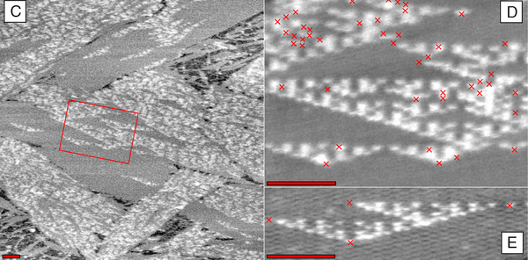
In 1997, Erik Winfree proved:
1. Such a computer is buildable.
2. This computer can compute anything a normal computer can!
Output is nanoscale crystalline structures.
P. W. K. Rothemund, N. Papadakis, E. Winfree, Algorithmic self-assembly of DNA Sierpinski triangles. PLoS Biology (12), 2004.

Slide 5
Staged Tile Assembly Model
Tiles are labeled squares with glues on their edges.
A
B
Tiles are mixed in bins and bond at common glues.
B
A
C
Mixing events are done in sequential stages.
C
B
A
The composite objects created are assemblies.
C
B
A

Slide 6
Specifying a Self-Assembly System
An acyclic directed graph of mixing steps.
A set of starting tiles.
A
F
B
C
E
D

Slide 7
Context-Free Grammars
S₁
S₁ S₂D
S₂ S₃S₅
S₃ S₄B
S₄ FA
S₅ CE
S₂
S₃
S₅
S₄
A
F
B
C
E
D
Grammar deriving string FABCED
Parse tree for FABCED
Notes:
afbced

Slide 8
Converting Between Self-Assembly and Grammars
FABCED
FABCE
FAB
FA
CE
A
F
B
C
E
D
A
F
B
C
E
D
Notes:
afbced

Slide 9
Implication of Conversion
Results for grammars also apply to self-assembly:
1. Fast algorithms for finding efficient self-assembly systems.
2. Non-existence of significantly faster algorithms.
3. Practical systems for solving self-assembly problems.
Notes:
afbced

Slide 10

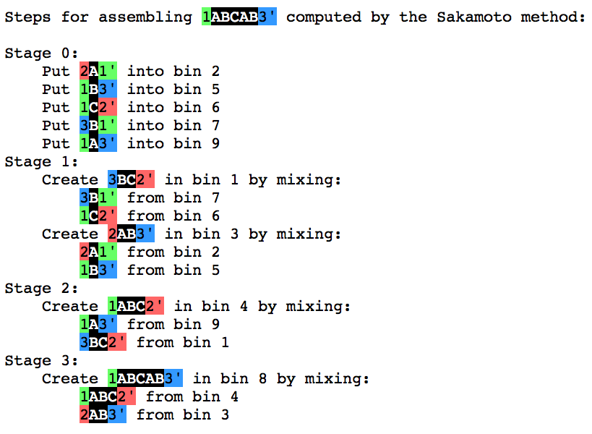
Web Application: Self-Disassembler
Software is using a grammar algorithm inside.
Computation of < 1s for
sequences of 10,000 labels
Notes:
afbced

Slide 11
Problem Solved?
Last result assumed mixings with one product.
Mixings may have many products.
A
B
C
A
B
C
A
A
B
B
A
Mixings with many products yields parallelism.
Notes:
afbced

Slide 12
Parallelism in DNA Computing
As with normal computers, parallelism increases efficiency.
We have proved that for some problems, this parallelism gives a quadratic speedup.
100 mixings
100² = 10,000 mixings
(Parallel model)
(Non-parallel model)
Notes:
afbced

Slide 13
Collaborators
This work was done in collaboration with many great researchers whom I am grateful to work with:
Tufts CS:
Michelle Ichinco
Mashhood Ishaque
Tony Lin
Diane Souvaine
MIT CSAIL:
Erik Demaine
Martin Demaine
Sarah Eisenstat
Andre Schulz
Tufts ChemBioE:
Hyunmin Yi
Jihae Sohn
Jennifer Rego
Funding was provided in part by NSF grant CBET-0941538.

