Slide 1
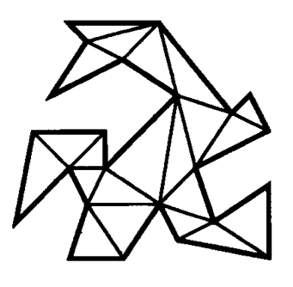
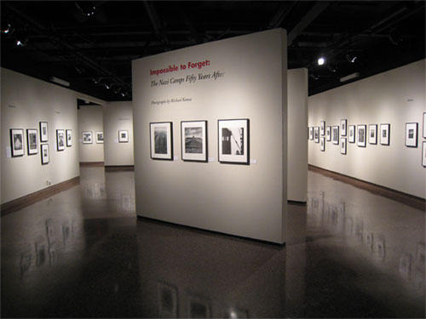
Triangulations and Art Galleries
2
1
COMP260 Guest Lecture 3/31/11
Andrew Winslow

Slide 2
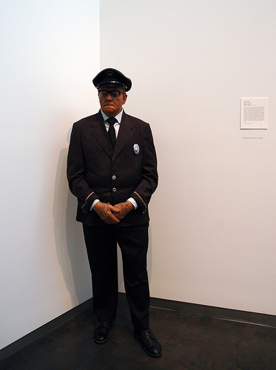
First Polygons, Then Picasso
We’ll talk about triangulations, an awesome and classic idea in computational geometry.
Gerald
Then we’ll show how triangulations can be used for helping Gerald.
3

Slide 3
Triangulations
A triangulation of a polygon P is a partition of P into triangles.

Slide 4
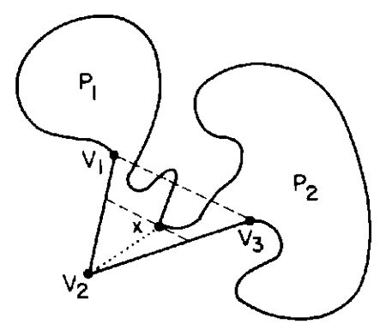
Does every polygon have a triangulation?
Yes
1. Find a diagonal of P.
2. Split P into P₁ and P₂.
3. Induct on P₁ and P₂.
1
Constructive proof!
Gives n-2 triangles for n-gon.
Free O(n²) algorithm.

Slide 5
More free stuff!
π
2π
(n-2)π
Claim: The sum of the interior angles is (n-2)π.
Proof: π interior angle per triangle,
triangulation has n-2 triangles.

Slide 6

How fast can triangulation be done?
Recall the free O(n²) algorithm.
Free lower bound of Ω(n) from input size.
A result that is not for free.

Slide 7
Duals
The edge dual of a triangulation is a tree
with a node for each triangle and an edge
for each pair of triangles sharing an edge.

Slide 8
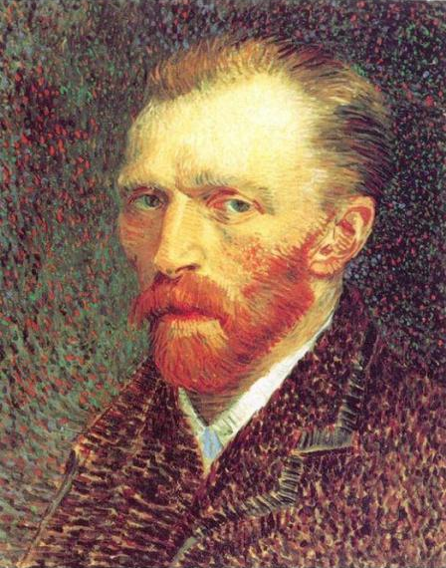
Two-Ear Theorem (Meister 1975)
An ear is a triangle that shares only 1 edge
with other triangles.
Claim: Every triangulation has two ears.
Proof: The edge dual has two leaves.
5
two ears
one ear

Slide 9
Coloring a triangulation
Consider 3-color vertex coloring a triangulation:
Claim: Any triangulation of a simple polygon can be 3-colored.
Proof: Induction. Remove an ear, color, add ear back.

Slide 10
Example coloring
Start by removing ears recursively.
Then add them back, coloring as you go…

Slide 11
Example coloring

Slide 12
Geometric machinery
Triangulations
Duals
Two-ear Theorem
Colorings

Slide 13
Triangulations
Art Gallery Theorems

Slide 14
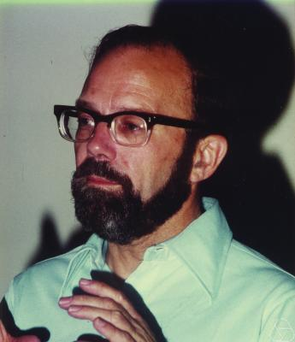
Art Gallery Theorems
Consider the floor plan of an art gallery, and guards
that stand stationary and look in all directions.
Victor Klee (1973): How many guards
are needed to see the entire floor plan?
6

Slide 15
Original Art Gallery Problem
Consider only polygons without holes and point
guards that see infinitely far in all directions.
2 guards sufficient here.
2 guards necessary?

Slide 16
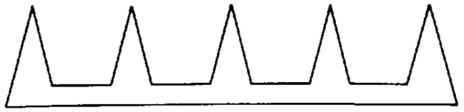
Original Art Gallery Theorem
Chvatal’s Art Gallery Theorem (Chvatal, 1975):
n/3 guards are sometimes necessary and
always sufficient for a simple n-gon.
Necessity proof: Consider the comb.
1
One guard needed per `tooth’.

Slide 17
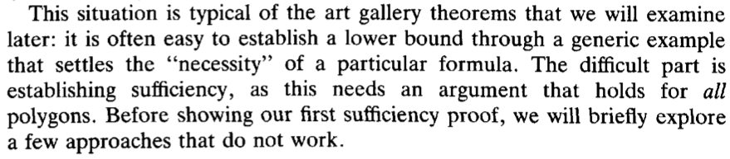
Original Art Gallery Theorem cont.
Sufficiency proof: Eh…O’Rourke (1987) says:
1
We will give the simpler proof by Fisk (not Chvatal).

Slide 18
Sufficiency proof: By construction.
1. Start with polygon P
2. Triangulate P.
4. Place guard at vertices with least frequent color.
3. 3-color the triangulation.
Each triangle has guard at vertex, so each triangle is guarded.

Slide 19
Other Art Gallery Theorems
Guarding orthogonal polygons.
Guarding using mobile guards.
Guarding with redundancy (e.g. got your back).
Guarding polygons with holes (difficult).
Minimizing number of guards (mostly NP-hard).
Guarding in polyhedra (3D).

Slide 20
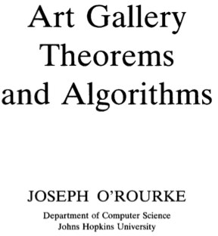

Joseph O’Rourke: Art Gallery Expert
7
1
282 pages of free well-guarded delight.

Slide 21
Triangulations
Art Gallery Theorems
Art Gallery Problems

Slide 22
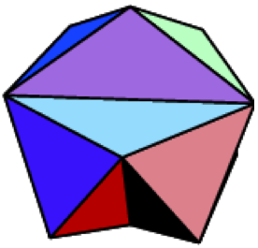
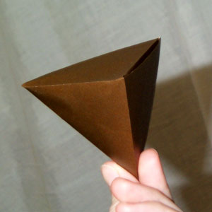
Guarding in polyhedra
A polyhedron is the 3D
equivalent of a polygon.
8
A tetrahedron is the
simplest polyhedron.
9
Urrutia (2000):

Slide 23
Generalizing the 2D approach
1. Start with a polygon polyhedron P.
2. Triangulate Tetrahedralize P.
3. 3-color 4-color the triangulation tetrahedralization.
4. Place guards at vertices with least frequent color.
Unfortunately, Steps 2 and 3 might not be possible…

Slide 24
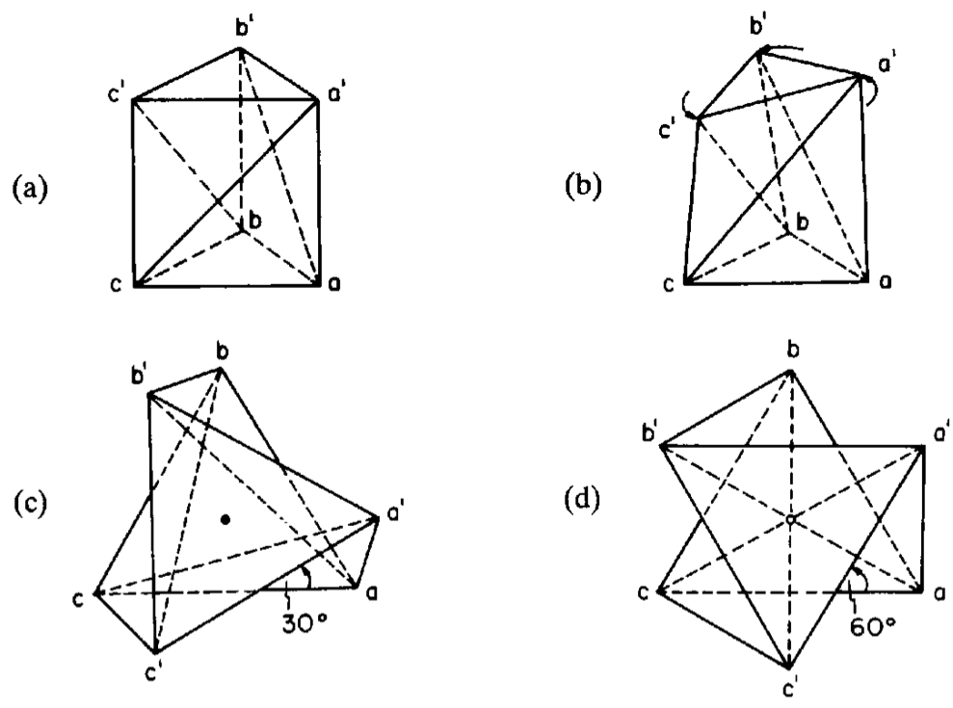

Schonhardt polyhedron breaks Step 2
O’Rourke (1987):
1
1
This polyhedron cannot be tetrahedralized!

Slide 25
Many examples break Step 3
4-coloring is impossible if the tetrahedralization
has a clique of 5 vertices.
This happens often.

Slide 26
A note on coloring
It is tempting to relax the
coloring to some number k > 4.
The problem is, 4 is the only number
for which the coloring argument works.
Coloring is a packing problem, while guarding is
a covering problem. k > 4 makes packing easier,
but destroys the guarding sufficiency.

Slide 27
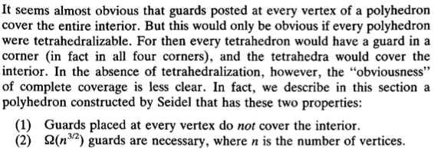
Throw more guards at it!
Maybe more vertex guards are needed?
Surely a guard at every vertex is sufficient?
or not…
1

Slide 28
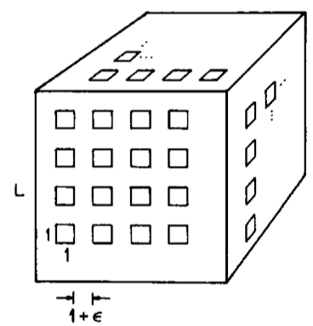
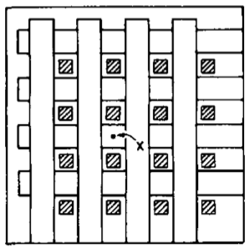

Seidel’s example
1
1
Seidel/Thurston example
4

Slide 29
An Opportunity?
The state of 3D art gallery theorems is limited.
I have just shown some of the reasons why.
However, these reasons can be summarized as:
It’s not like 2D.

Slide 30
Image Acknowledgements
1. Art Gallery Theorems and Algorithms, Joseph O’Rourke
2. http://www.lavc.edu/arts/pastevents.html
3. http://www.flickr.com/photos/lifeontheedge/711028659/in/photostream/
4. Giovanni Viglietta
5. http://theonlywordsallowed.wordpress.com/2008/12/01/tribute-to-an-artist/vincent-van-gogh-t7514/
6. http://en.wikipedia.org/wiki/Victor_Klee
7. http://maven.smith.edu/~orourke/
8. http://mathworld.wolfram.com/JessensOrthogonalIcosahedron.html
9. http://tetrahedral.blogspot.com/2011/01/amazing-tetrahedron.html

