Slide 1
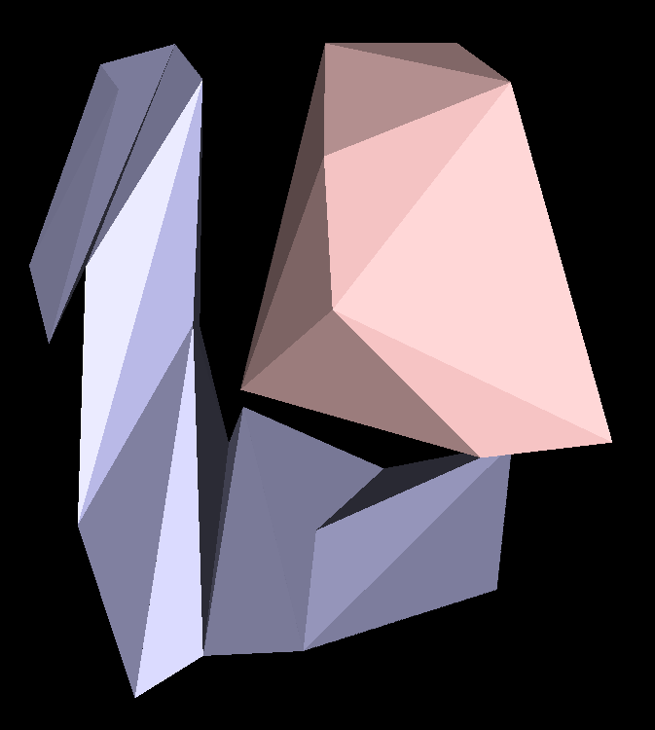


Bounded-Degree Polyhedronization of Point Sets
Andrew Winslow with Gill Barequet, Nadia Benbernou, David Charlton, Erik Demaine, Martin Demaine, Mashhood Ishaque, Anna Lubiw, Andre Schulz, Diane Souvaine, and Godfried Toussaint

Slide 2
The Problem
Let S be a set of points in R³ with no four points coplanar.

Slide 3
The Problem
Let S be a set of points in R³ with no four points coplanar.
Find a polyhedron P such that P:

Slide 4
The Problem
Let S be a set of points in R³ with no four points coplanar.
Find a polyhedron P such that P:
Has exactly S as vertices.

Slide 5
The Problem
Let S be a set of points in R³ with no four points coplanar.
Find a polyhedron P such that P:
Has exactly S as vertices.
Is simple (sphere-like).

Slide 6
The Problem
Let S be a set of points in R³ with no four points coplanar.
Find a polyhedron P such that P:
Has exactly S as vertices.
Is simple (sphere-like).
Has every vertex incident to O(1) edges (degree = O(1)).

Slide 7
The Problem
Let S be a set of points in R³ with no four points coplanar.
Find a polyhedron P such that P:
Has exactly S as vertices.
Is simple (sphere-like).
Has every vertex incident to O(1) edges (degree = O(1)).
Has a tetrahedralization and a chain dual (serpentine).

Slide 8
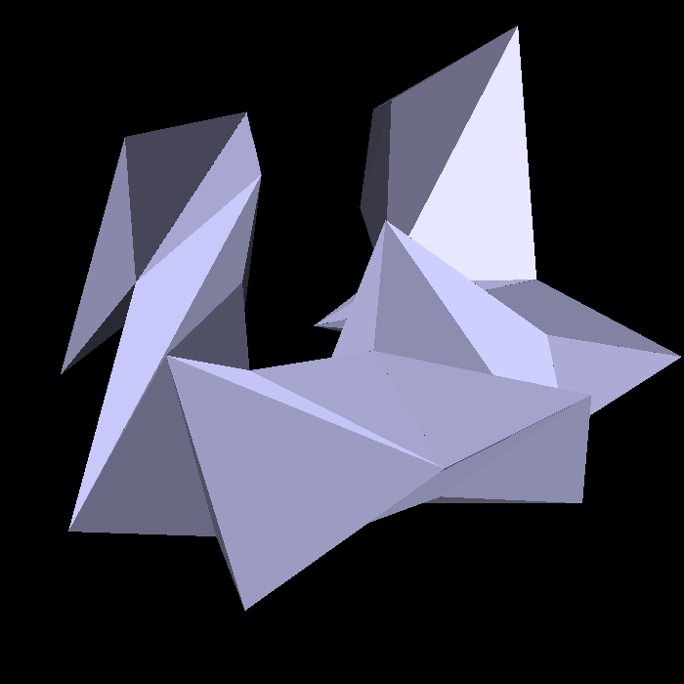
The Problem
Let S be a set of points in R³ with no four points coplanar.
Find a polyhedron P such that P:
Has exactly S as vertices.
Is simple (sphere-like).
Has every vertex incident to O(1) edges (degree = O(1)).
Has a tetrahedralization and a chain dual (serpentine).

Slide 9
History
In 1700s, Euler’s formula gave a lower bound of degree 6 for n > 12.
In 1994, Grünbaum showed that a polyhedronization is always possible.
In 2008, Agarwal, Hurtado, Toussaint, and Trias gave several algorithms for serpentine polyhedronizations with non-constant degree.

Slide 10
In This Work
We give an algorithm for computing a degree-7 serpentine polyhedronization of any point set.
We show that the algorithm runs in expected time .

Slide 11
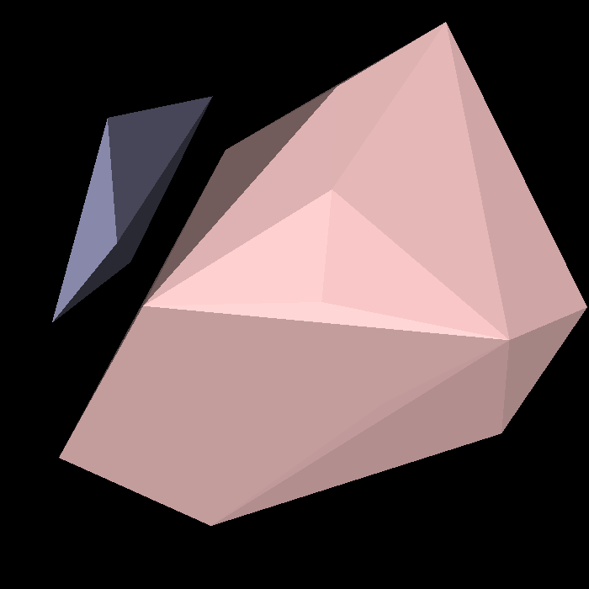
A High-Level Algorithm
Start with the convex hull of the points.
Shave off faces of the hull (triplets).
Connect each triplet to the previous one with a six-vertex polyhedron (tunnel).

Slide 12
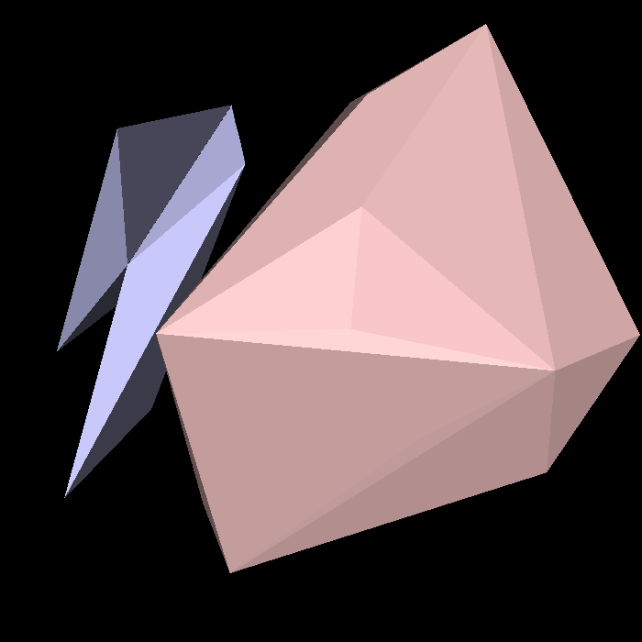
A High-Level Algorithm
Start with the convex hull of the points.
Shave off faces of the hull (triplets).
Connect each triplet to the previous one with a six-vertex polyhedron (tunnel).

Slide 13
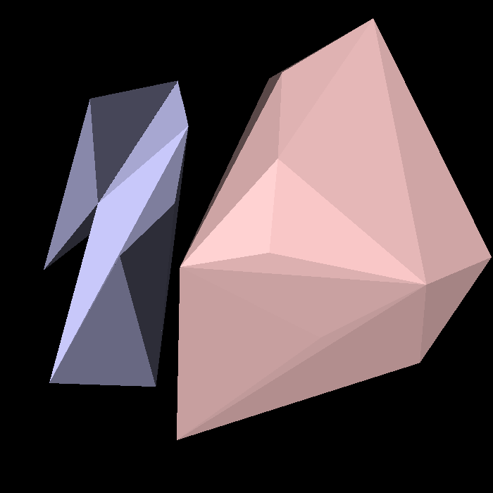
A High-Level Algorithm
Start with the convex hull of the points.
Shave off faces of the hull (triplets).
Connect each triplet to the previous one with a six-vertex polyhedron (tunnel).

Slide 14
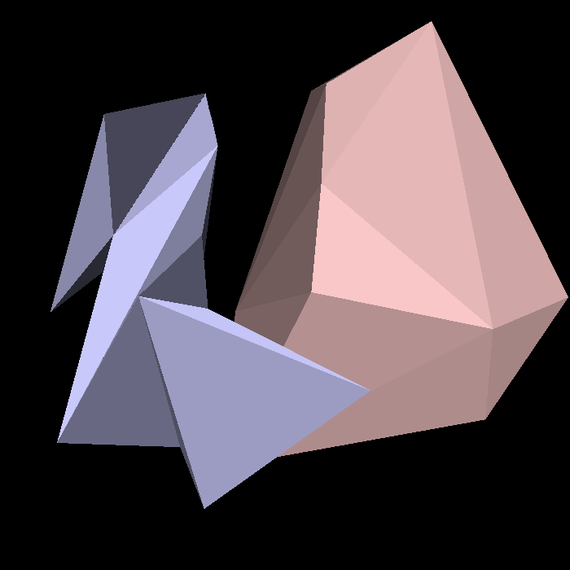
A High-Level Algorithm
Start with the convex hull of the points.
Shave off faces of the hull (triplets).
Connect each triplet to the previous one with a six-vertex polyhedron (tunnel).

Slide 15
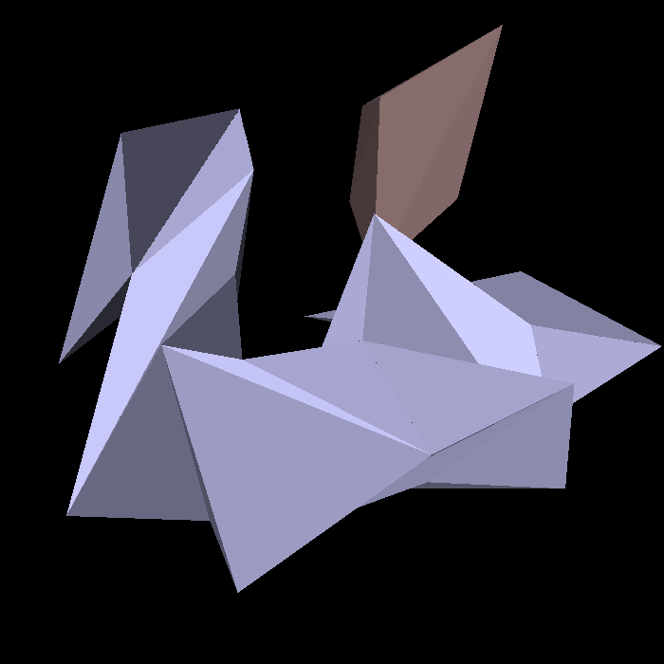
A High-Level Algorithm
Start with the convex hull of the points.
Shave off faces of the hull (triplets).
Connect each triplet to the previous one with a six-vertex polyhedron (tunnel).

Slide 16
A High-Level Algorithm
Start with the convex hull of the points.
Shave off faces of the hull (triplets).
Connect each triplet to the previous one with a six-vertex polyhedron (tunnel).

Slide 17


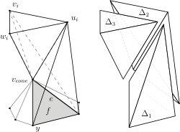
Tunnels
The degree of a vertex is the number of edges in both of its tunnels.
Each triplet contributes 1 + 2 + 3 edges.
Each tunnel is composed of three tetrahedra.

Slide 18
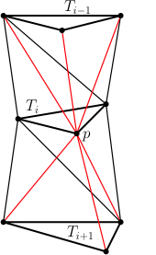
Degree-8 Bound
In the worst case, a vertex p of T_{i} may have three edges in both tunnels.
So degree(p) = 8 (= 2 + 3 + 3).
This can be avoided with more careful selection of T_{i+1}.

Slide 19
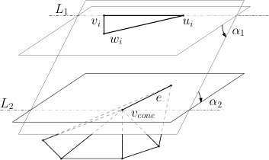
Selecting T_{i+1} Carefully
Label vertices of T_{i} according to number of edges in previous tunnel (w_{i} got 3).
Perform double rotation to find T_{i+1} requiring just one edge to w_{i}.
This gives a worst-case degree of 7.

Slide 20
Reaching Degree Optimality
Recall the lower bound of 6 for n > 12.
Open Problem #1: Is there a point set that admits only degree-7 polyhedronizations?
Open Problem #2: Is there an algorithm that produces a degree-6 polyhedronization?
Improving our algorithm to degree-6 would produce a long sequence of tunnels where every vertex has degree 6.

Slide 21
Serpentine
Recall that each tunnel consists of three tetrahedra.
Their dual is a short chain.
Adjacent tunnels connect at their ends.
So the polyhedronization is serpentine.

Slide 22
Running Time
The algorithm runs in expected time.
Uses dynamic convex hull (Chan 2010) to find the next T_{i} and update the convex hull in expected time .

Slide 23
Conclusion
We gave an expected-time algorithm that computes a degree-7 serpentine polyhedronization of any point set.
The algorithm uses iterative convex hulls to connect triplets of points with tunnels.

Slide 24
References
B. Grünbaum, Hamiltonian polygons and polyhedra. Geombinatorics, 3 (1994), 83–89.
P. Agarwal, F. Hurtado, G.T. Toussaint, and J. Trias, On polyhedra induced by point sets in space, Discrete Applied Mathematics, 156 (2008), 42–54.
T. Chan, A dynamic data structure for 3-d convex hulls and 2-d nearest neighbor queries, Journal of the ACM, 57 (2010), 1-16.

