Slide 1
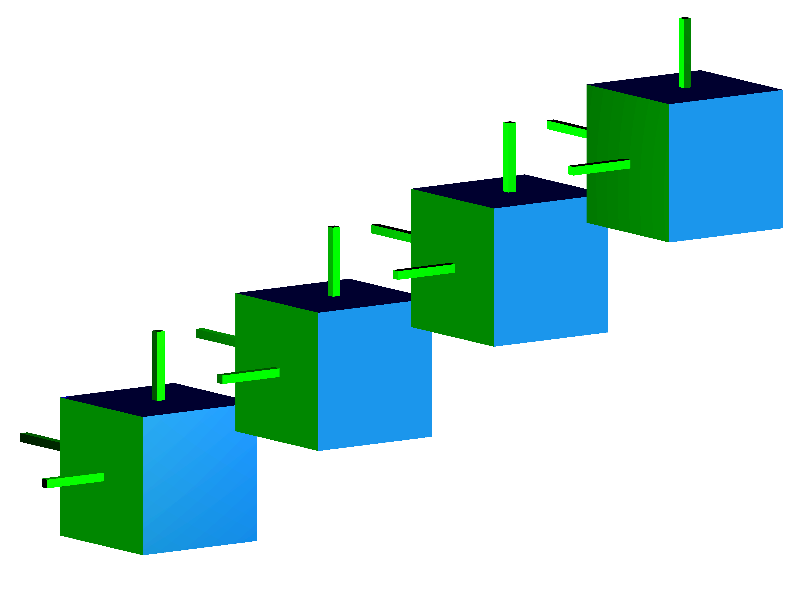

Face Guards for Art Galleries
Diane Souvaine, Raoul Veroy, and Andrew Winslow
Tufts University

Slide 2

Klee’s Art Gallery Problem
Consider the floor plan of an art gallery, and guards
that stand stationary and look in all directions.
Victor Klee (1973): How many guards
are needed to see the entire floor plan?

Slide 3
Chvátal’s Art Gallery Theorem
[Vašek Chvátal 1975]: n/3 vertex guards are sufficient.
Proof [Fisk 1978]: A 3-coloring argument.
Start with polygon

Slide 4
Chvátal’s Art Gallery Theorem
[Vašek Chvátal 1975]: n/3 vertex guards are sufficient.
Proof [Fisk 1978]: A 3-coloring argument.
Triangulate

Slide 5
Chvátal’s Art Gallery Theorem
[Vašek Chvátal 1975]: n/3 vertex guards are sufficient.
Proof [Fisk 1978]: A 3-coloring argument.
3-vertex-color triangulation

Slide 6
Chvátal’s Art Gallery Theorem
[Vašek Chvátal 1975]: n/3 vertex guards are sufficient.
Proof [Fisk 1978]: A 3-coloring argument.
Select one color

Slide 7
Chvátal’s Art Gallery Theorem
[Vašek Chvátal 1975]: n/3 vertex guards are necessary.
Proof: An explicit comb construction.
Three vertices per tooth, one guard per tooth.

Slide 8
Extending Klee’s Problem
Since the original problem was posed, many
variations have been posed.
We consider a new problem on guarding in three
dimensions using mobile guards.

Slide 9
Edge Guards
Edge guards are allowed to roam along an edge of the
polygon, guarding all points seen from somewhere
along the edge.
Edge guards have been studied since 1982:
-1981/1982: Toussaint proposes idea.
-1983: O’Rourke shows tight bound of n/4 edge or diagonal guards for
general simple n-gons.
-1992: Shermer gives bounds of n/4 and 3n/10 for edge guards in
general simple n-gons.
-1998: Bjorling-Sachs shows tight bound of (3n+4)/16 edge guards for
orthogonal simple n-gons.
-2008: Karavelas gives bounds of n/3 and (2n+1)/5 edge guards for
piecewise-convex curvilinear polygons.

Slide 10
Guarding in 3D
Guarding in 3D with vertex and edge guards has also
been studied for some time:
-1983: Grünbaum and O’Rourke show (2f-4)/3 vertex guards are
sufficient to guard the exterior of any convex polyhedron with f faces.
-1995: Czyzowicz et al. show that the exteriors of n congruent copies of
a constant convex polyhedron can be guarded with O(n) guards.
-1995: Everett and Rivera-Campo show n/3 and 2n/5 edge guards are
sufficient to guard triangulated and general polyhedral terrains with n
vertices, Bose et al. give a lower bound of (4n-4)/13.
-2000: Urrutia gives examples of orthogonal and general polyhedra
with e edges that require e/12-1 and e/6-1 edge guards, respectively.
He also proves e/6 edges are sufficient in the orthogonal case.
-2011: Benbernou et al. improve Urrutia’s upper bound on the number
of edge guards sufficient for orthogonal polyhedra to 11e/72.
Notes:
fix this slide

Slide 11
Face Guards
In this work, we consider guarding the interior of
simple polyhedra using face guards.
A face guard consists of an interior face of the
polyhedron, and guards all locations seen by some
point on the face.
Face guards for polyhedronizations are the 3D
generalization of edge guards in 2D.

Slide 12

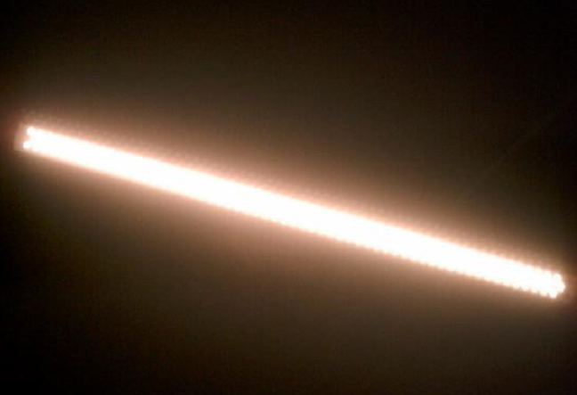

Illumination Analogy
Vertex guards are light bulbs
Edge guards are fluorescent tubes
And face guards are light boxes

Slide 13
Our Results
We give bounds for the number of face guards G necessary and sufficient to guard the interior of simple polyhedra with F faces.
F/7 <= G <= F/6 for orthogonal polyhedra
F/5 <= G <= F/2 for general polyhedra

Slide 14
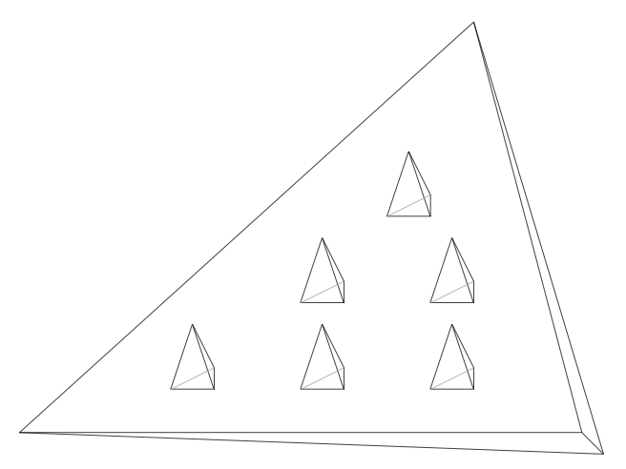
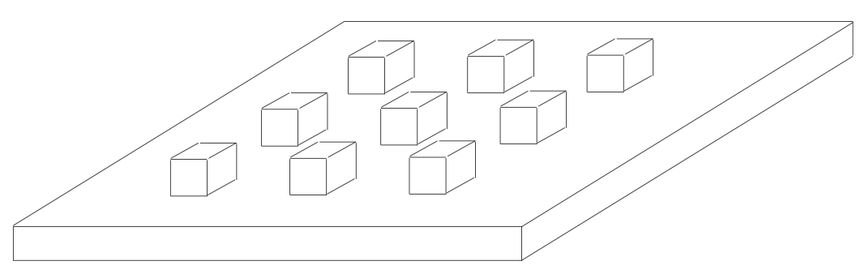
Notes on Definitions
We consider polyhedra that are simple, i.e. simply-connected/sphere-like/genus zero.
We do not require that faces are simple, i.e. disk-like. This definition is consistent with [Urrutia 2000].

Slide 15
Orthogonal Lower Bound
1 guard needed per chimney

Slide 16
Orthogonal Lower Bound
1 guard needed per chimney
21 faces per module

Slide 17
Orthogonal Lower Bound
3 guards needed per module

Slide 18
Orthogonal Lower Bound
1 guard per 7 faces

Slide 19
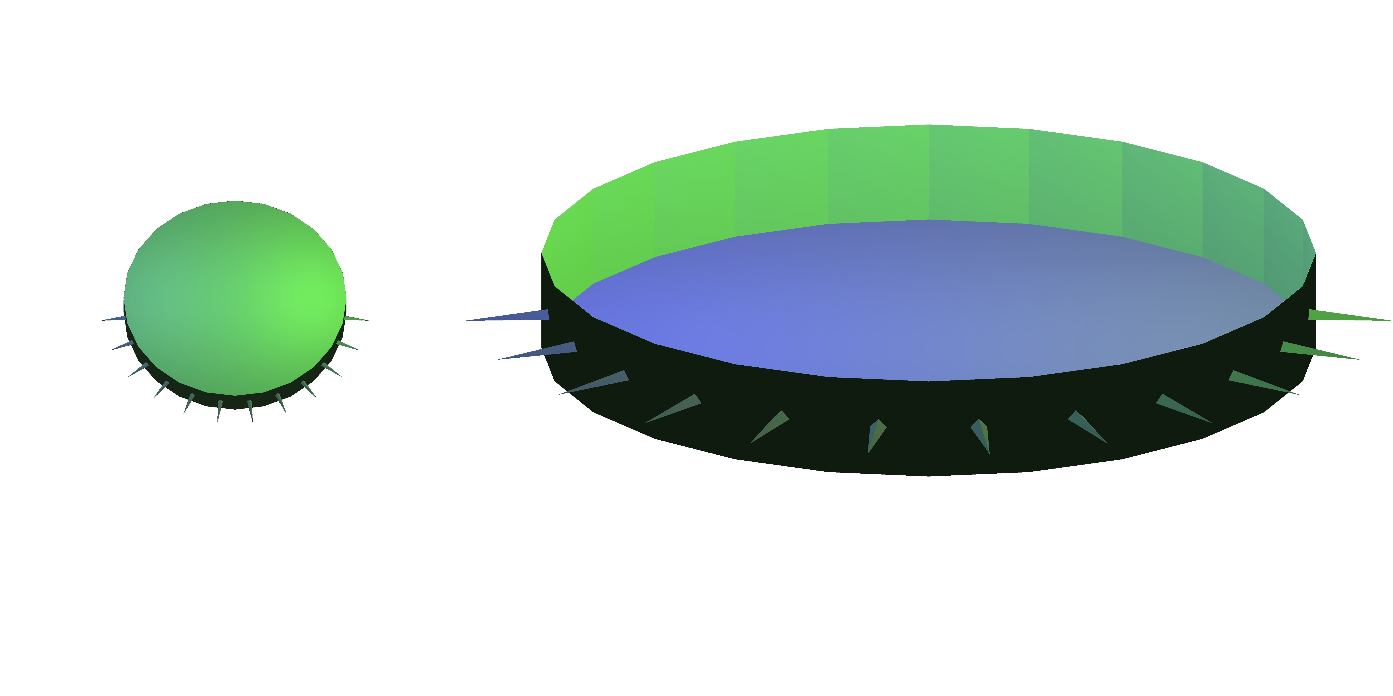
General Lower Bound
1 guard is needed per triangular spike

Slide 20
General Lower Bound
1 guard is needed per triangular spike
Each spike sits on a face and is visible to a second

Slide 21
General Lower Bound
5 faces per spike

Slide 22
General Lower Bound
5 faces per spike
1 guard per 5 faces

Slide 23
Upper Bounds
Recall the 3-vertex-coloring argument used by Fisk
to prove a bound of n/3 for vertex guards in polygons.
We also use coloring arguments for face guards in
polyhedra as well, but rather than color by graph
connectivity, we color by direction.

Slide 24
Upper Bounds
polyhedra
For orthogonal polygons, faces are oriented in one of
4 directions. Give each direction a different color.
For orthogonal polygons, faces are oriented in one of
4 directions. Give each direction a different color.
6
Every point is seen by a face of each color.

Slide 25
Upper Bounds
polyhedra
For general polygons the approach is similar, but only
2 directions are used.
For general polygons the approach is similar, but only
2 directions are used.

Slide 26
Simple Faces
Recall that we did not require that faces of the
polyhedron are simple/disk-like as in [Urrutia 2000].
If we consider only polyhedra with simple faces, then
we can show bounds of:
F/7 <= G <= F/6 for orthogonal polyhedra
F/6 <= G <= F/2 for general polyhedra
same
weaker
Idea: either move chimney/spike to edge of face or
split the face along the chimney/spike boundary.

Slide 27
Open Face Guards
We can omit the boundary of a face from the guard to
define open face guards, inspired by [Viglietta 2011]
and [Benbernou et al. 2011].
Under this definition, slight modifications of the
previous proofs gives the bounds:
F/6 <= G <= F/6 for orthogonal polyhedra
F/4 <= G <= F/2 for general polyhedra
stronger
stronger
Idea: many chimneys/spikes can be placed on single face.

Slide 28
Open Problems
Improving the bounds of the problem we presented,
as well as its variants (open guards, simple faces).
Bounds in terms of edges/vertices.
Other classes of polyhedra: positive-genus,
fixed-orientation, monotone, tetrahedralizable.

Slide 29
Difficulty of Improving Bounds
The 2D version of our problem is guarding simple
polygons with edge guards.
This problem was solved for orthogonal polygons by
Bjorling-Sachs (tight bound of (3n + 4)/16) in 1998.
The general case remains open, with the last progress
being in 1992 by Shermer (bounds of n/4 and 3n/10).
Is the 3D version easier?
A standard 2D tool, triangulations, do not exist.

