Slide 1



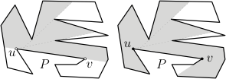
Open Guard Edges and Edge Guards in Simple Polygons
Csaba Tóth, Godfried Toussaint, and Andrew Winslow

Slide 2
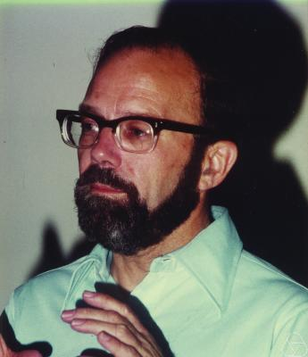
Klee’s Art Gallery Problem
Consider the floor plan of an art gallery, and point
guards that stand stationary and look in all directions.
Victor Klee (1973): How many guards
are needed to see the entire floor plan?

Slide 3
Edge Guards

Slide 4
Edge Definitions
Historically, edge guards have included the endpoints.
Recently, excluding the endpoints has been considered.
See: talk in 30 minutes.
CLOSED
OPEN

Slide 5
Bounds on Edge Guards
Bounds given are on the number of edge guards necessary
and sufficient to guard all simple polygons.
n/4 ≤ g ≤ 3n/10
[Toussaint 81]
[Shermer 92]
CLOSED
n/3 ≤ g ≤ n/2
OPEN
[Today]

Slide 6

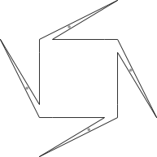

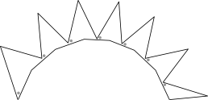
A Lower Bound
n/3 open edge guards needed.

Slide 7
An Upper Bound
Set of edges pointing up/down suffice.
Gives bound of n/2.
Conjecture: n/3 is sufficient.

Slide 8
Guard Edges
A guard edge is an edge guard that sees the
entire polygon.

Slide 9
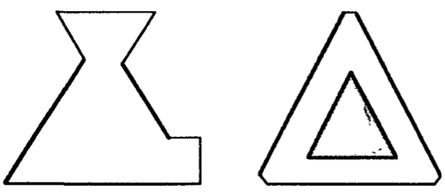
Maximizing Guard Edges
[Park 93] proves that for non-starshaped polygons:
At most 3 closed guard
edges in simple polygons.
At most 6 closed guard edges
in non-simple polygons.

Slide 10
Our Work on Maximizing Guard Edges
We prove non-starshaped simple polygons have
at most 1 open guard edge.
We give a short proof that non-starshaped
simple polygons have at most 3 closed guard
edges.

Slide 11


Maximizing Open Guard Edges
Lower bound: the comb.
Upper bound: 2 guard
edges implies starshaped.

Slide 12
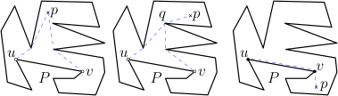
Open Guard Edge Upper Bound
1. Define edge-point visibility as disjoint pair of
geodesics from endpoints of edge to point.

Slide 13

Open Guard Edge Upper Bound
2. Assume two guard edges, and show
opposite vertex geodesics are single segments.

Slide 14
Open Guard Edge Upper Bound
3. Show that intersection is in the kernel of
polygon by empty quad formed.

Slide 15
At Most 3 Closed Guard Edges
Use a similar approach as for open guard edges:
if a polygon has 4 closed guard edges, then it
must be starshaped.
This gives a simple proof of the 3 closed edge
guard result in [Park 93].

Slide 16
Finding Guard Edges
[Sack, Suri 88] and [Shin, Woo 89] give O(n)
algorithms for finding all closed guard edges of
an arbitrary polygon.
We give an O(n) algorithm for finding all open
guard edges of an arbitrary simple polygon.

Slide 17
Finding All Open Guard Edges
Wrong intuition: find all edges in the kernel.
Guard edges can be outside the kernel.
We instead use a pair of weaker kernels.

Slide 18
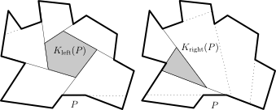
Left and Right Kernels
Kernel pair generated by half of each reflex vertex.
Guard edges intersect both kernels.

Slide 19
Left and Right Kernel Examples

Slide 20
Left and Right Kernel Examples

Slide 21
Finding Open Guard Edges in O(n) Time
[Lee, Preparata 81] give O(n) algorithm for
computing the kernel of a polygon.
This is modifiable to find each of the left and
right kernels in O(n) time.
Algorithm: compute left and right kernels,
report all edges that lie in both.

Slide 22
Summary
We give bounds on the number of open edge
guards for guarding simple polygons.
We show non-starshaped simple polygons
admit at most 1 open guard edge.
We reprove that non-starshaped simple
polygons admit at most 3 closed guard edges.
We give a O(n) algorithm to find all open guard
edges in a polygon.

