Slide 1

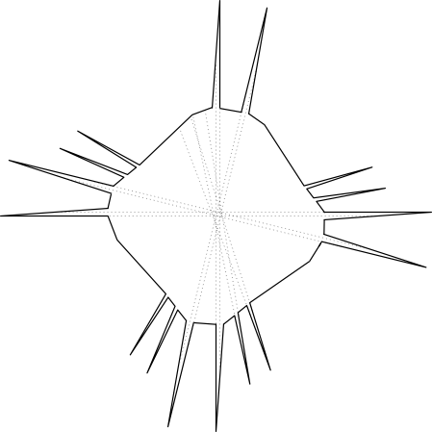
Hidden Mobile Guards in Simple Polygons
Sarah Cannon Diane Souvaine Andrew Winslow

Slide 2

Art gallery problems

Slide 3

Art gallery problems

Slide 4








Art gallery problems

Slide 5

Art gallery problems

Slide 6
Art gallery problems

Slide 7

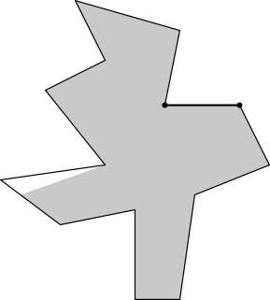
Art gallery problems

Slide 8
Art gallery problems

Slide 9
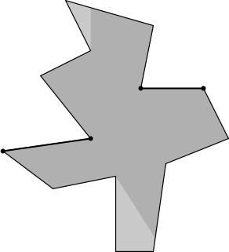
Art gallery problems

Slide 10
Art gallery problems
Goal: all locations seen by some guard.

Slide 11

Hidden guards

Slide 12

Hidden guards

Slide 13

Hidden guards

Slide 14

Hidden guards

Slide 15
Hidden guards
Claim: This polygon does not admit a hidden guard set.
Proof: Any single guard is insufficient, any two are not hidden.

Slide 16
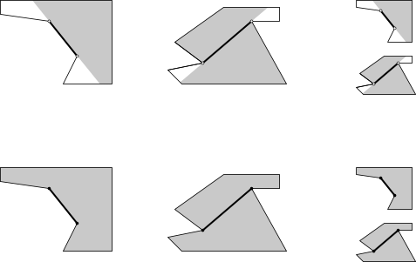
Guard varieties
Open
Edge
Diagonal
Mobile
Closed
Edge
Diagonal
Mobile

Slide 17
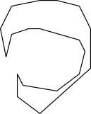


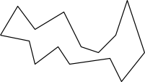
Polygon classes
Simple
Starshaped
Orthogonal
Monotone

Slide 18
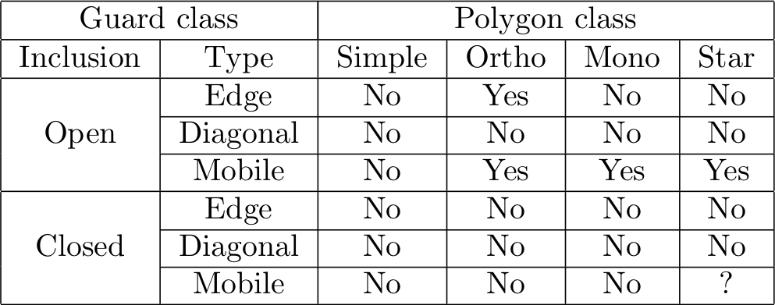
Results for hidden guards
Do all polygons in class admit a hidden guard set?

Slide 19
Results for hidden guards
Do all polygons in class admit a hidden guard set?

Slide 20
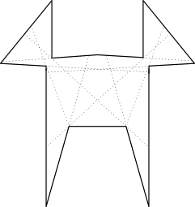
Claim: this monotone polygon does not
admit a hidden open edge guard set.

Slide 21
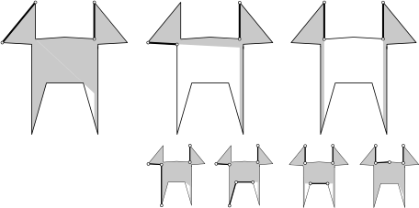
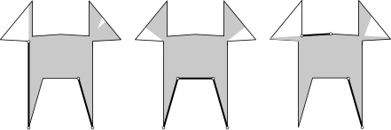
Proof:
Each ear needs an edge guard inside it.
Any ear edge guard pair can’t be augmented into a hidden guard set.

Slide 24
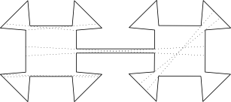
Claim: this simple polygon does not
admit a hidden open mobile guard set.

Slide 25
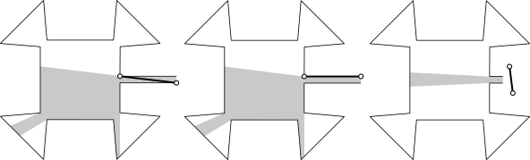
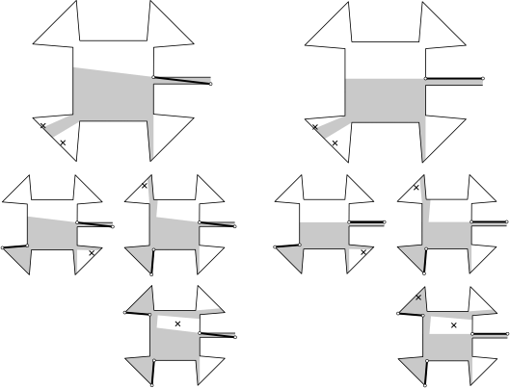
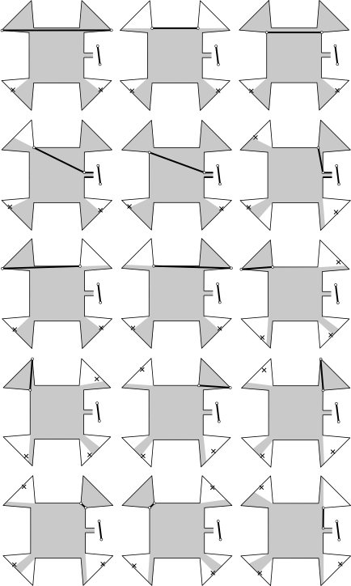
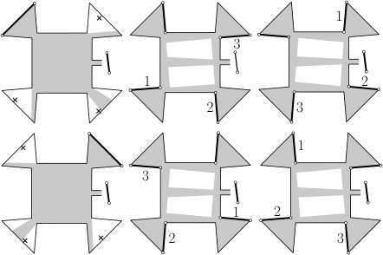
Proof by 27 subcases
Subcases 3a-o
Cases 1-3
Subcases 3p-u
Subcases 1a-c, 2a-c

Slide 27
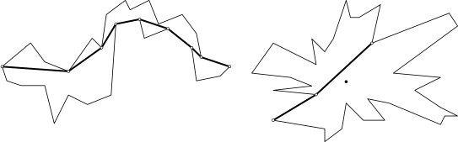
Claim: every monotone or starshaped polygon
admits a hidden open mobile guard set.
Approach: use the set of edges of a geodesic path.

Slide 28
Results for hidden guards
Open problem!

