Slide 1

Some Results on Hidden Edge Guards
Sarah Cannon Diane Souvaine Andrew Winslow

Slide 2
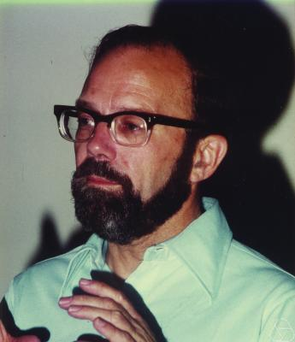
Klee’s Art Gallery Problem
Consider the floor plan of an art gallery, and point
guards that stand stationary and look in all directions.
Victor Klee (1973): How many guards
are needed to see the entire floor plan?

Slide 3
Hidden Guards
In 1989, Thomas Shermer considered the same problem with
the restriction that guards cannot see each other.
OK
BAD

Slide 4
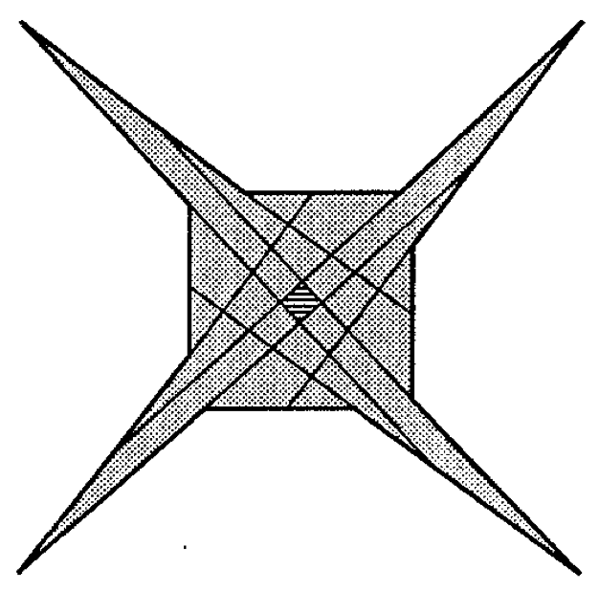
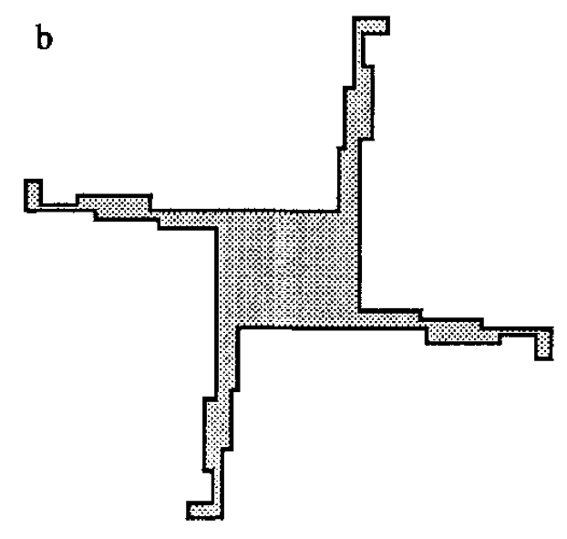
Hidden Guards
For hidden guards restricted to vertices, Shermer found that
some polygons do not admit guarding!
T. Shermer, Hiding people in polygons, Computing, 1989.

Slide 5
Are there other guard varieties for which
some polygons do not admit guarding?

Slide 6
Edge Guards

Slide 7
Edge Definitions
Historically, edge guards have included the endpoints.
Recently, excluding the endpoints has been considered.
CLOSED
OPEN

Slide 8
Hidden Closed Edge Guards
YES
NO
YES
NO

Slide 9
Hidden Open Edge Guards
YES
NO
YES
NO

Slide 10
Results for Hidden Edge Guards
Open Edges
Closed Edges
Not all simple polygons admit guarding.
Not all monotone polygons admit guarding.
Not all starshaped polygons admit guarding.
All orthogonal
polygons admit guards.
Not all orthogonal polygons
admit guarding.
Guardable polygons may
require n-22 edges.
Guardable polygons may
require (n-12)/3 guards.

Slide 11
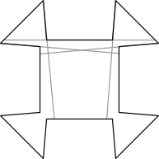
Admissibility
This polygon cannot be guarded by
open or closed hidden edge guards.

Slide 12
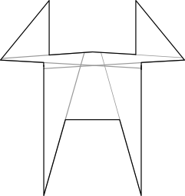
Admissibility
This polygon cannot be guarded by
open or closed hidden edge guards.

Slide 13
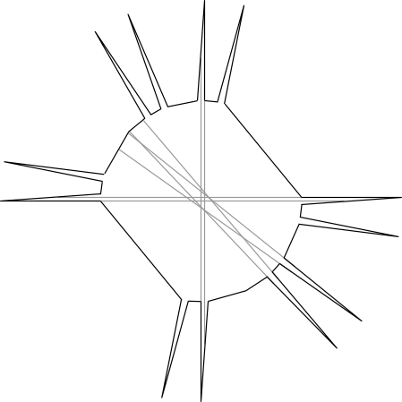
Admissibility
This polygon cannot be guarded by
open or closed hidden edge guards.

Slide 14
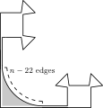
Combinatorics
Antiforcing gadget

Slide 15
Thank you

