Slide 1
Hidden Guards in Art Gallery Problems
Andrew Winslow, Tufts University

Slide 2

An art gallery example
Consider placing point guards in a simple polygon P
such that every location in P is seen by some guard.
[Klee 1973]: How many guards are needed in the
worst case to see the entire polygon?
Notes:
each point is a guard, the dark regions are guarded, light regions are not

Slide 3
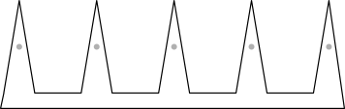
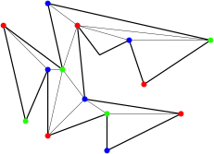
An art gallery example
[Chvátal 1975]: n/3 point guards are sometimes necessary
and always sufficient to guard a simple n-gon.
Necessity
Sufficiency

Slide 4

Guard varieties: points, vertices, edges
In addition to point and vertex guards, we also
consider polygon edges as guards:
Definition detail: are endpoints part of an edge?

Slide 5

Open and closed edge guards
Closed
Open
Closed edge guards include endpoints and see more.
Example: 3n/10 closed edge guards are always sufficient
for n-gons, n/3 open edge guards are sometimes necessary.

Slide 6
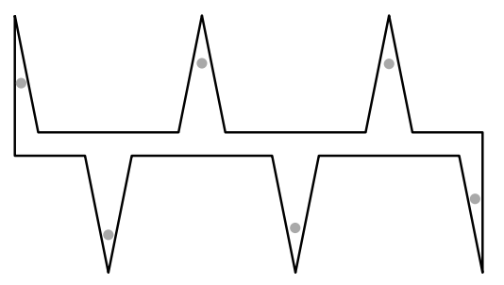
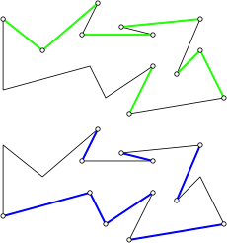
Open edges
n/3 necessity
n/2 sufficiency
Notes:
If you consider releasing a helium balloon from every point in the polygon, what subset of the edges are hit? (Green edges)
Similarly, release a stone from every point and see which edges are hit. (Blue edges)
NOTICE THE GAP, THIS IS OPEN. Conjecture: n/3 sufficient
Minimizing the number of open edge guards for a given polygon is NP-hard, by modifying Lee and Lin’s construction for vertices and closed edges.

Slide 7
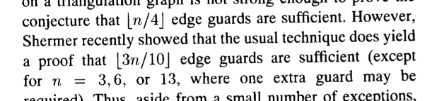

Closed edges
3n/10 sufficient(?)
=
n/4 necessary
n/3 sufficient

Slide 8
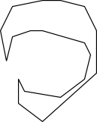
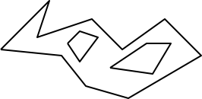
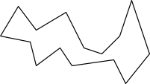


Polygon varieties
We usually think of simple polygons: polygons without holes.
General polygons allow holes:
A number of subclasses of simple polygons also exist:
monotone
starshaped
orthogonal
spiral
Notes:
Bounds on number of open or closed edges s.n. and a.s. for general polygons is weak: n/2 and n/3 for open, 4n/9 and n/4 for closed.
Number of closed edge guards a.s. for starshaped is unknown (conjectured to be n/5, n/5 is s.n.)

Slide 9
Hidden guarding
[Shermer 1989] introduced the idea of hidden guarding:
requiring that no guard may see another guard.
Unlike other guarding problems focused on minimization, a
primary question in hidden guarding is existence: can every
polygon be guarded?
Notes:
Guarding with point guards is easy: add incrementally in unguarded region until region is empty.
Uses at most n-2 polygons: one for each triangle (convex region) in a triangulation.
Eidenbenz showed later that O(n) is the best approximation possible in poly-time; the same given by this algorithm.
A saw polygon with teeth forming a convex arc requires about n/2 guards: one per tooth.

Slide 10

Hidden point guards
All polygons can be guarded with hidden point guards.
Notes:
Guarding with point guards is easy: add incrementally in unguarded region until region is empty.
Uses at most n-2 polygons: one for each triangle (convex region) in a triangulation.
Eidenbenz showed in 2006 that an approximation ratio better than n is the best approximation possible in poly-time, which is what this algorithm gives.

Slide 11

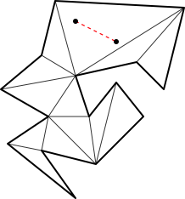
Hidden point guards
n/2-1 necessary
n-2 sufficient
Notes:
n/2-1 and n-2 are the best known bounds FOR SIMPLE POLYGONS.
A saw polygon with teeth forming a convex arc requires about n/2 guards: one per tooth.

Slide 12

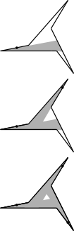
Hidden boundary point guards
Always possible?
Notes:
n/2-1 and n-2 are the best known bounds.
Eidenbenz showed later that O(n) is the best approximation possible in poly-time; the same given by this algorithm.
A saw polygon with teeth forming a convex arc requires about n/2 guards: one per tooth.

Slide 13
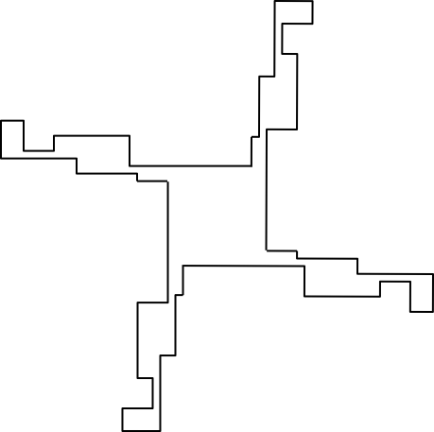
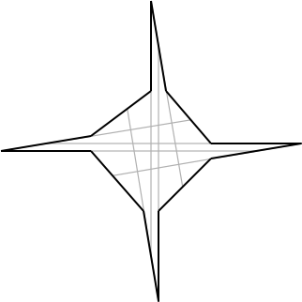
Hidden vertex guards
Not always possible, even for restricted classes.
Notes:
Notice the left polygon is both starshaped and monotone, right is orthogonal.
Also add: determining if it is possible for an input simple polygon is NP-complete, shown by Shermer.

Slide 14

Hidden vertex guards
For the set of simple polygons that can be guarded:
n/2-1 necessary
n/2 sufficient
Notes:
General polygons give same bounds: n/2 upper, n/2-1 lower

Slide 15
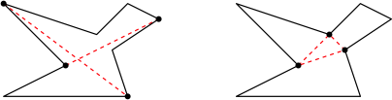
(Almost) hidden vertex guards
Bill Hall and John Iacono pose “max-hiddenness”:
fewest pairs
smallest clique
Notes:
Almost hidden guarding is not about existence, but about minimization.
``Are all simple polygons guardable with at most n/6 guard-guard visibilities’’
``Are all simple polygons guardable with a guard-guard visibility clique of size at most 4?’’

Slide 16
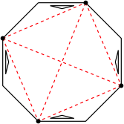
(Almost) hidden vertex guards
Conjecture: Every simple n-gon is guardable with at most n/6 pairs and no clique of size 3.
General n-gons may require
θ(n²) pairs or clique of size θ(n).
Notes:
General polygons give same bounds: n/2 upper, n/2-1 lower

Slide 17
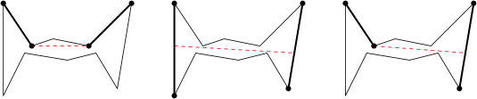
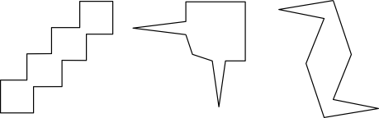
Hidden closed edge guards
Notes:
Edge-edge visibility can happen in a number of ways, but all involve a pair of points from the pair of edges which see each other.
There are many examples of polygons that can’t be guarded, even for restricted classes (monotone and orthogonal), starshaped.
How simple can they be?

Slide 18
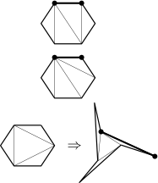

Minimal unguardable polygon
All hexagons guardable
Some septagons not
Notes:
It can be shown that any hexagon is guardable with a single closed edge guard using a case analysis of combinatorial `dominating’ arguments on the triangulation graph, and a geometric argument in one case.
There are septagons that are not. however. Example due to Chris Paige.

Slide 19
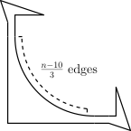

Hidden closed edge guards
For the set of simple polygons that can be guarded:
(n-10)/3 necessary
n/3 sufficient
Notes:
Also add: the problem of determining whether an input polygon can be guarded using hidden closed edge guards is NP-complete. We will talk about existence complexity later.

Slide 20
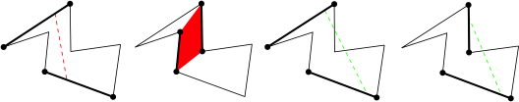
Weakly hidden guards
Richard Pollack and Joseph Malkevitch pose weakening hiddenness:
strong
weak
now permitted
Are all simple polygons guardable using (weakly) hidden closed edge guards? Conjecture: yes.
Notes:
Strong visibility is ``there exists, there exists’’.
Weak is ``for all, for all’’
There are two other intermediate versions:
``for all, there exists’’: dog-walking
``there exists, for all’’

Slide 21

Hidden open edge guards
Are all simple polygons guardable?

Slide 22
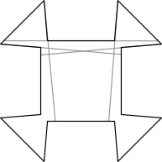

Hidden open edge guards

Slide 23
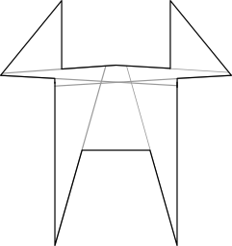
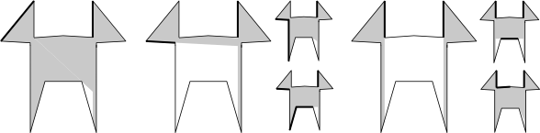
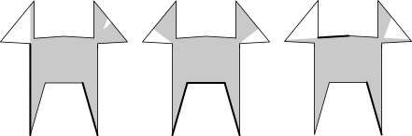
Hidden open edge guards
Notes:
The lower left figure:
First we consider guarding as much of the polygon as possible using hidden guards not in the two `ears’.
We see that any such set of guards leaves a portion of each ear unguarded, and that this portion is not visible from any edge in the opposite ear.
This implies that we need at least one edge per ear to guard each ear completely.
The lower right figure:
Here we consider each possible pair of guards, one in each ear.
We find that any such pair results in some portion of the polygon being unguardable, regardless of the remaining guards choices.

Slide 24
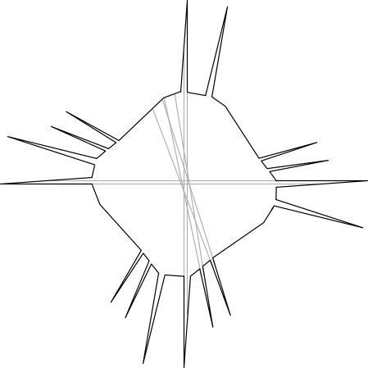
Hidden open edge guards
Inspired by Shermer:
Notes:
Starshaped polygons that can’t be guarded use gadgets that force multiple guards to lie on the large center convex region. This idea is inspired by an example of Shermer that can’t be guarded using hidden vertex guards.

Slide 25
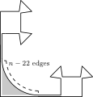

Hidden open edge guards
For the set of simple polygons that can be guarded:
n-16 necessary
n-2 sufficient
Notes:
Is there a septagon that cannot be guarded?

Slide 26
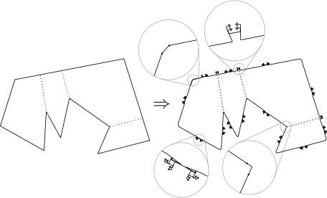
Hidden open edge guards
Every hidden vertex problem is a hidden open edge problem.
Notes:
It is NP-hard to answer the decision problem: can the polygon be guarded using hidden open edge guards.
The reduction is from deciding whether an input polygon can be guarded using hidden vertex guards,
and the idea is to replace vertices with tiny edges that may be selected as guards, and use gadgets to
exclude the other (long) edges from being guards.
This also shows that hidden vertex problems have a correspondence to a subset of hidden edge guard problems. Is is a proper subset? OPEN

Slide 27
This is joint work with the following:
Sarah Cannon, Diane Souvaine,
Csaba Tóth, Godfried Toussaint

