Slide 1
Some New and Old Problems In Polygon Visibility
Andrew Winslow
Department of Computer Science, Tufts University

Slide 2
Polygon visibility
points

Slide 3
Polygon visibility
vertices

Slide 4
Edge Guards
edges

Slide 5


Klee’s Art Gallery Problem
Consider the floor plan of an art gallery, and point
guards that stand stationary and look in all directions.
Victor Klee (1973): How many guards
are needed to see the entire floor plan?
Vasek Chvatal (1975): For simple n-gons,
n/3 vertex guards are always sufficient.

Slide 6
Triangulations
A triangulation of a polygon P is a partition of P into triangles.

Slide 7
Coloring a triangulation
Consider 3-color vertex coloring a triangulation:

Slide 8
Coloring algorithm
Start by removing ears recursively.
Then add them back, coloring as you go…

Slide 9
Example coloring

Slide 10
Chvatal’s Art Gallery Theorem
Vasek Chvatal (1975): n/3 vertex guards always
enough to guard a simple n-gon.
Proof (Fisk, 1978): 3-color the polygon, select all
vertices with the color that occurs least frequently.

Slide 11
n/3 guards also sometimes needed:
One guard needed per tooth.
Theorem: n/3 point or vertex guards sometimes
necessary and always sufficient to guard simple n-gon.

Slide 12
Recall edge guards:

Slide 13
Edge Definitions
Edges are open or closed depending on endpoint inclusion.
CLOSED
OPEN

Slide 14
n/4 closed edge guards sometimes needed.
Toussaint (1981): conjecture that n/4 closed edge
guards are always sufficient.

Slide 15
Bounds on Edge Guards
Bounds given are on the number of edge guards necessary
and sufficient to guard any simple n-gon.
n/4 ≤ g ≤ 3n/10
[Toussaint 81]
[Shermer 92]
CLOSED
n/3 ≤ g ≤ n/2
OPEN
[Toth, Toussaint, W 11]

Slide 16

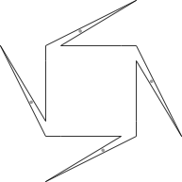

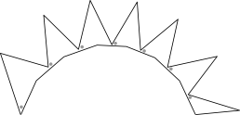
A Lower Bound
n/3 open edge guards needed.

Slide 17
An Upper Bound
Set of n/2 edges pointing up/down suffice.
We conjecture n/3 is sufficient.

Slide 18
Let g be the number of guards sometimes necessary and always sufficient to guard any simple n-gon.
For point or vertex guards, g = n/3. OLD
For closed edge guards, n/4 ≤ g ≤ 3n/10. OLD
For open edge guards, n/3 ≤ g ≤ n/2. NEW

Slide 19
Hidden Guards
Thomas Shermer (1989) considered guarding with the
restriction that guards cannot see each other.
OK
BAD

Slide 20
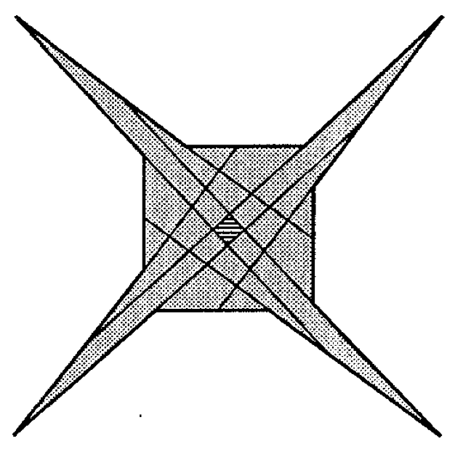
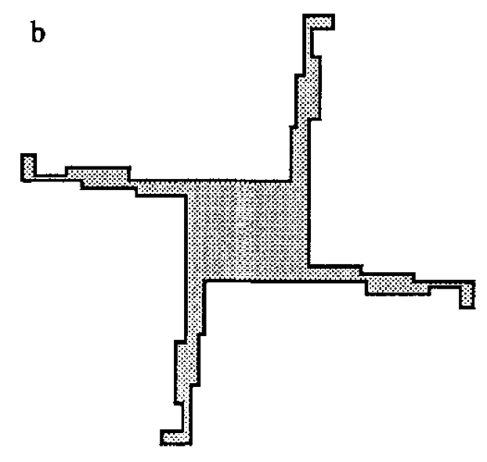
Hidden Guards
For hidden guards restricted to vertices, Shermer found that
some polygons do not admit guarding.
T. Shermer, Hiding people in polygons, Computing, 1989.

Slide 21
Hidden Edge Guards
Closed edges:
Open edges:

Slide 22
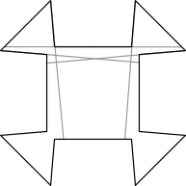
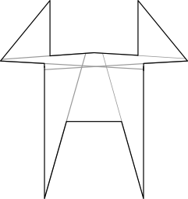
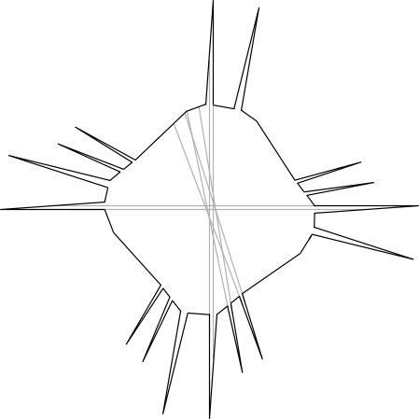
Hidden Edge Guard Results
Cannon, Souvaine, W (2011): For open and closed
hidden edge guards, there exist simple, monotone,
and starshaped polygons that do not admit guarding.

Slide 23
Admissibility
This polygon cannot be guarded by
open or closed hidden edge guards.

Slide 24
Monotone admissibility
This polygon cannot be guarded by
open or closed hidden edge guards.

Slide 25
Starshaped admissibility
This polygon cannot be guarded by
open or closed hidden edge guards.

Slide 26
In attempting to guard any polygon with
hidden guards that may not see each other.
For vertex guards, not always possible for
simple, monotone, or starshaped polygons.
OLD
For edge guards, not always possible for
simple, monotone, or starshaped polygons.
NEW

Slide 27
Conclusions
Today we considered problems and results from before 1990 (the old) and after 2010 (the new).
Interesting new problems can be found by making small changes to old problems.

Slide 28
Thank you

